Slide 2
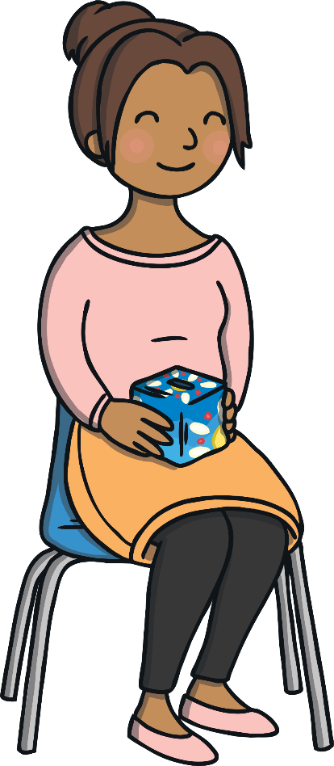
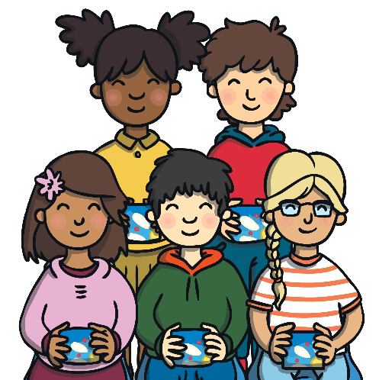
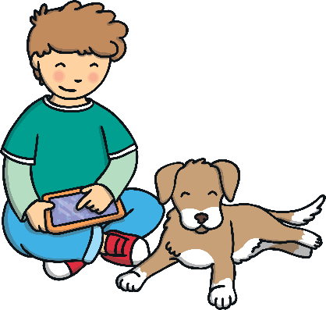
Frankie had always been a happy boy. He had a great family, a lovely teacher and brilliant friends at school. Best of all, he had his dog, Bella.

Slide 3
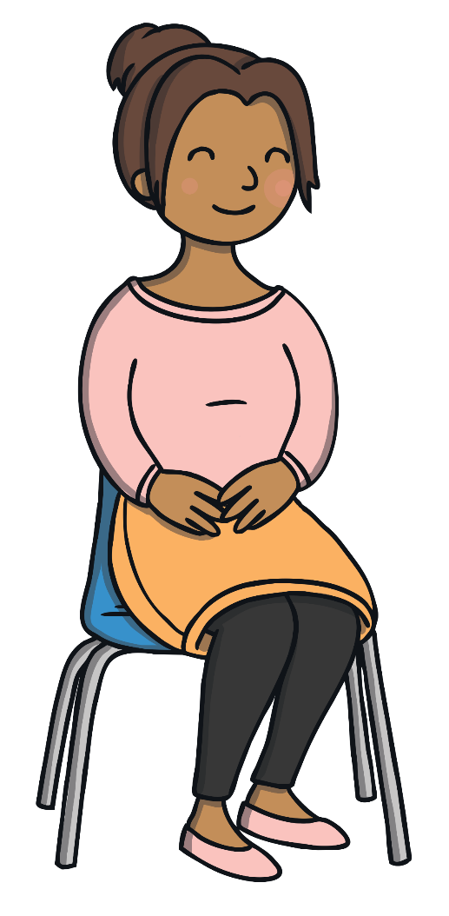
But one day at school, Frankie’s teacher told the class that things would soon be changing. She said that after the summer holidays, they would be moving to a different class. Their new class would be in a different part of the school and they would have a different teacher.

Slide 4
Frankie started to feel worried. It started with little worries about where he would sit and what the new classroom would look like. But the worries started to get bigger and bigger. Soon, Frankie had huge worries, about what his new teacher would be like, whether playtime would be the same and how hard the work would be.

Slide 5
Then, all of a sudden, a colourful box appeared next to Frankie! He knew that it was full of his worries. The more worries Frankie had, the bigger the box became. Frankie’s worry box followed him everywhere and it kept getting bigger and bigger.

Slide 6
He tried to talk to his mum about the worry box but she just said, “Don’t be silly Frankie, you don’t have anything to worry about!” This just made Frankie feel worse because he had a whole box of worries that only he could see.

Slide 7
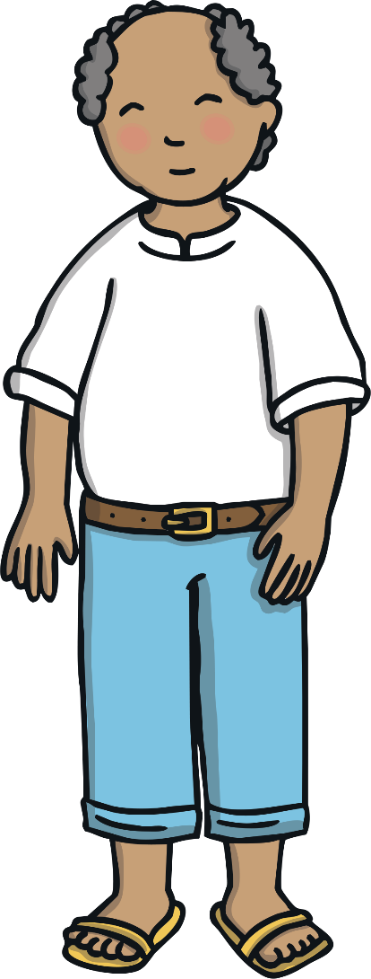
He tried to talk to his grandad about the worry box but he just said, “Try to do something to take your mind off it, and you’ll soon forget.” This didn’t help because, no matter what Frankie did, the worry box was still there and it was growing bigger and bigger.

Slide 8
Finally, when he had tried everything else, Frankie told Bella about the worry box. He didn’t think she could help but he thought it was worth a try. Bella gave Frankie a friendly lick and wagged her tail. And then, before Frankie could stop her...

Slide 9
....Bella jumped up and barked at the worry box! Worries went flying everywhere! Frankie felt more worried than ever because he didn’t want his worries to get out of the box.

Slide 10
Then, something strange happened. Once Frankie could see his worries, he realised that they weren’t as big as he thought. When they were out of the box, some of them seemed quite silly and small.

Slide 11
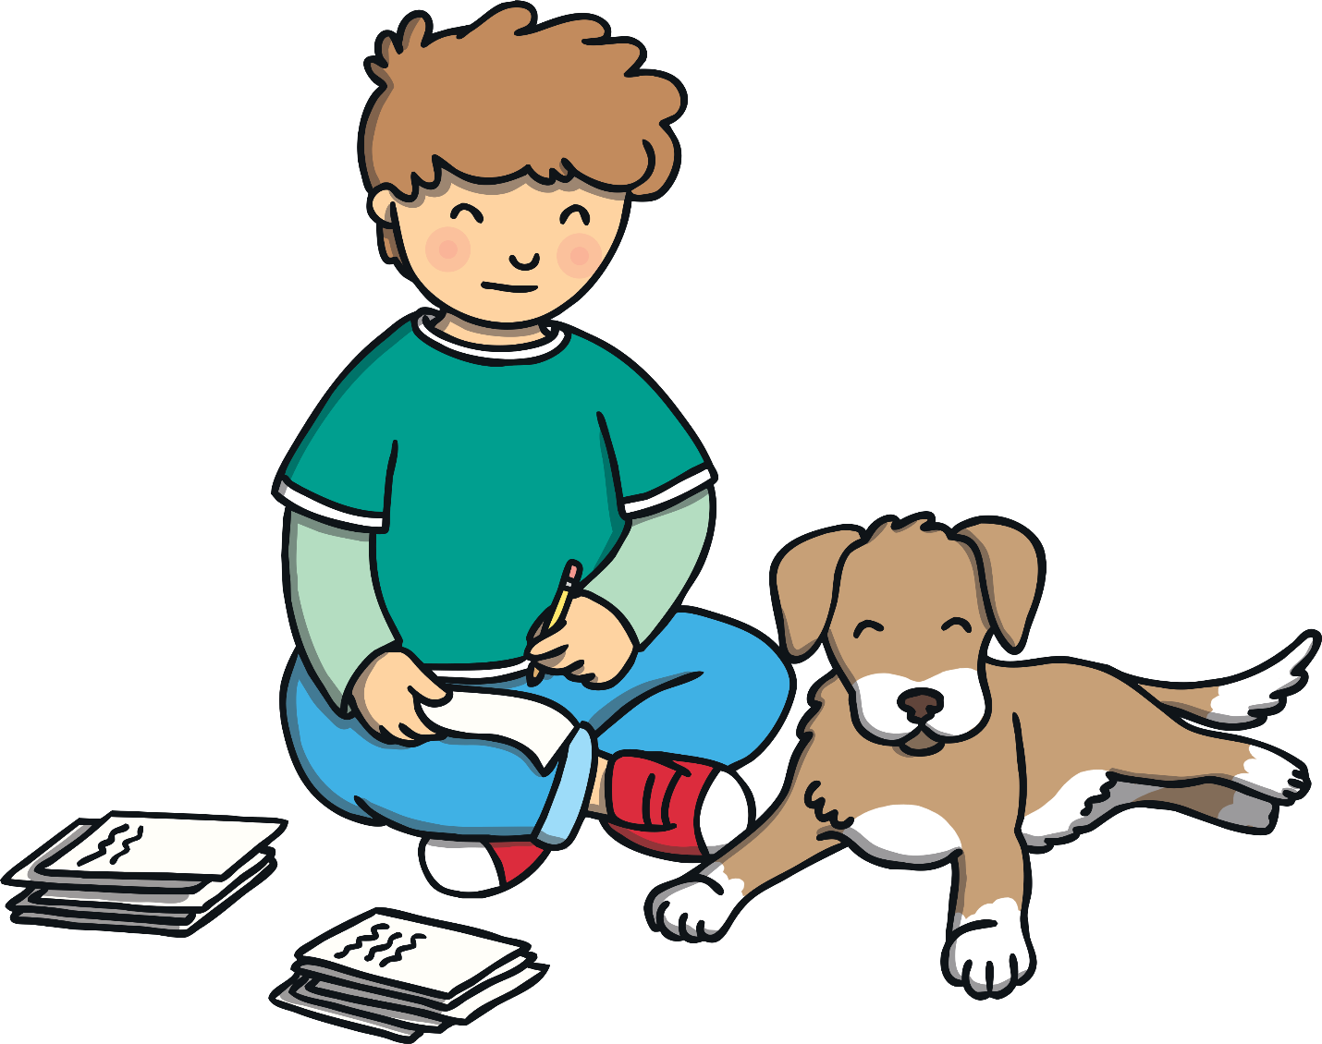
Bella helped Frankie to sort the worries into different piles so they could decide what to do about them. It was much easier now they were out of the box and Frankie started feeling less worried straight away.

Slide 12
The next day, Frankie told his teacher about the worry box and what had happened when Bella barked at it. He even showed her some of his worries and she helped him to sort them out. She told him what the new class would really be like.

Slide 13
“Everyone has worries, Frankie,” said his teacher, kindly. “Some of them are big and some of them are small,” she told him, “but if we keep them shut in a box they will only get bigger. Worries hate being out in the open so, the best thing you can do is say them out loud to someone who can help.” Frankie knew she was right.

Slide 14
Then, Frankie’s teacher had an idea. “Let’s all make a worry box today and put all our worries about going to a new class inside! We can empty our worry boxes together and share the things we’re worrying about.” Frankie thought it was a wonderful idea, although he was sure he would have many more worries than his friends.

Slide 15
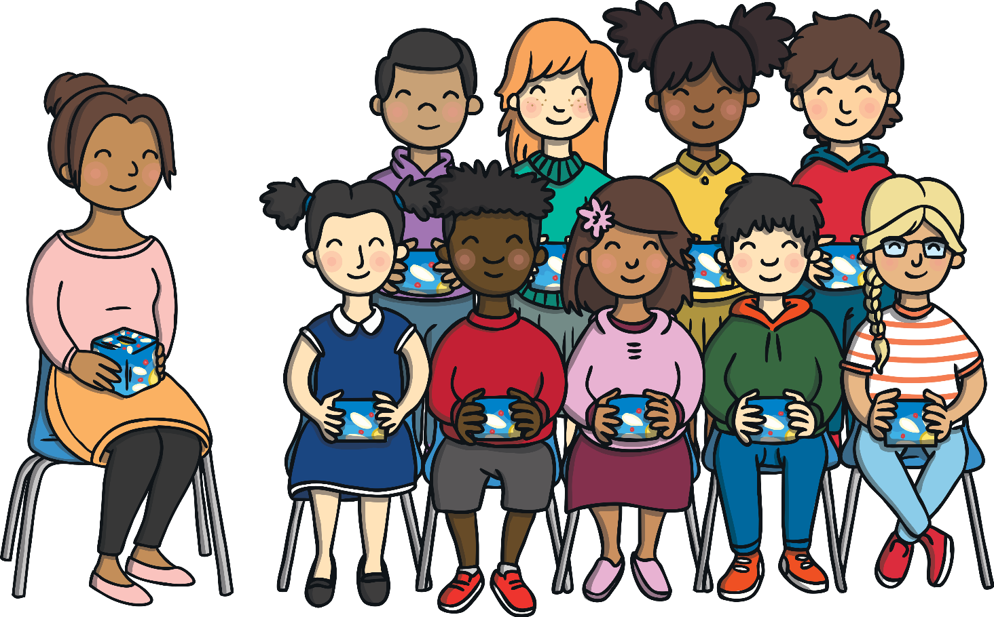
Frankie was surprised to find out that all of his friends had worries about the new class and many of their worries were the same as his. He was shocked to find out that even his teacher had worries about her old class leaving and a new one starting. Sharing and talking about the worries made Frankie feel much better.

Slide 16
Now that Frankie had the tiny worry box that he had made at school, he realised that his big worry box had disappeared. From then on, whenever Frankie felt worried, he wrote his worry down and popped it in the box. To stop the worry box getting too big, he made sure to empty it often and talk about what was inside. This way, Frankie never had to worry about his worries getting too big ever again.

Slide 17
Today, you will be making a worry box, just like Frankie.
You can decorate your worry box however you wish.
Write down (or draw) your worries or any questions you have about moving to a new class.
Put your worries or questions into your worry box.
As a class, go through the worries and questions.
Your teacher can answer your questions, reassure you about your worries and tell you what it will be like in the new class.

