Slide 1
I like that

Slide 2
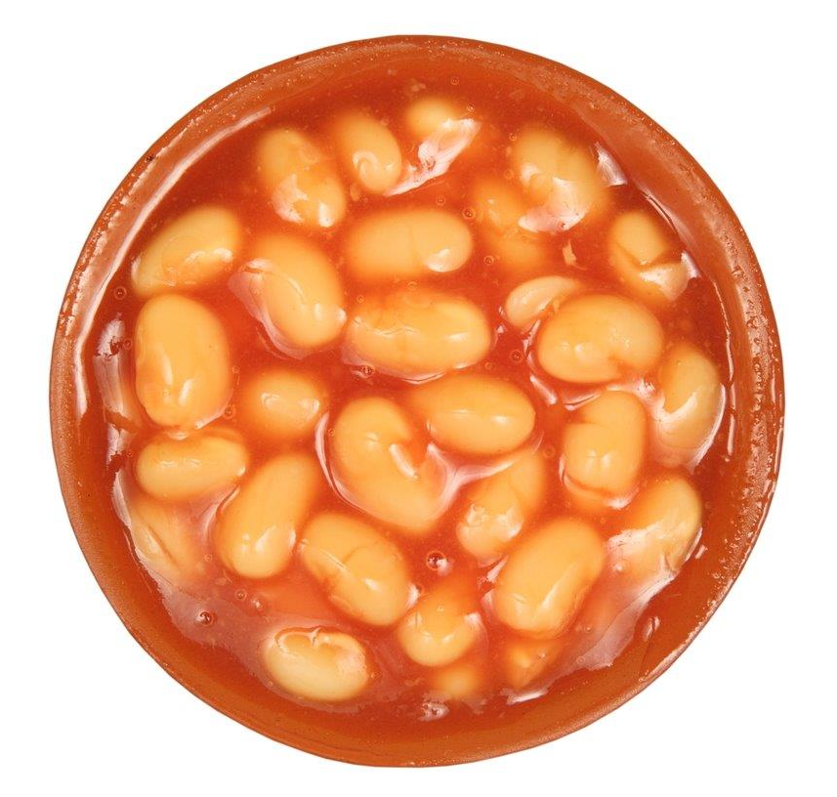
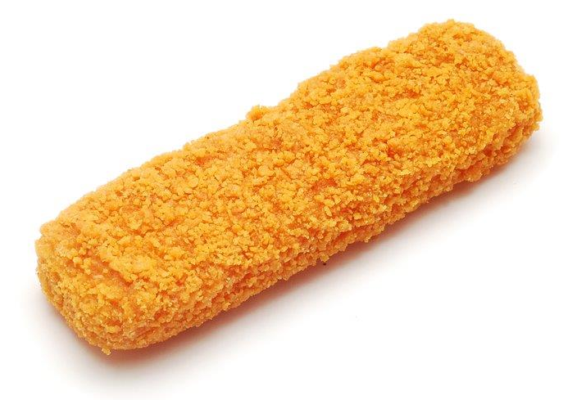
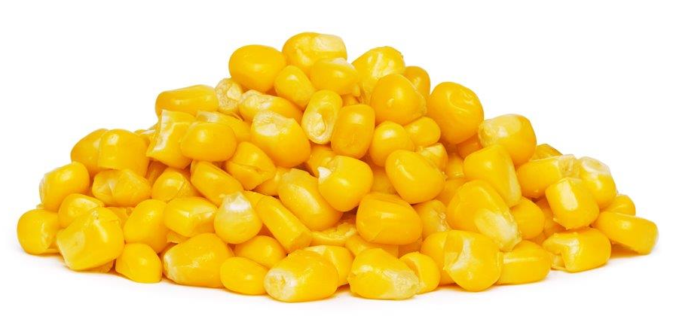
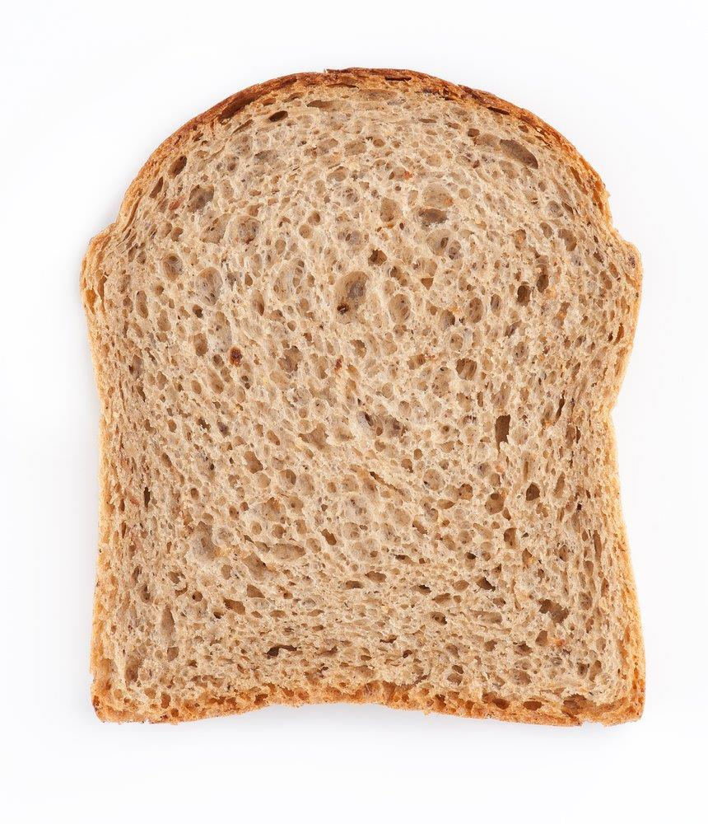
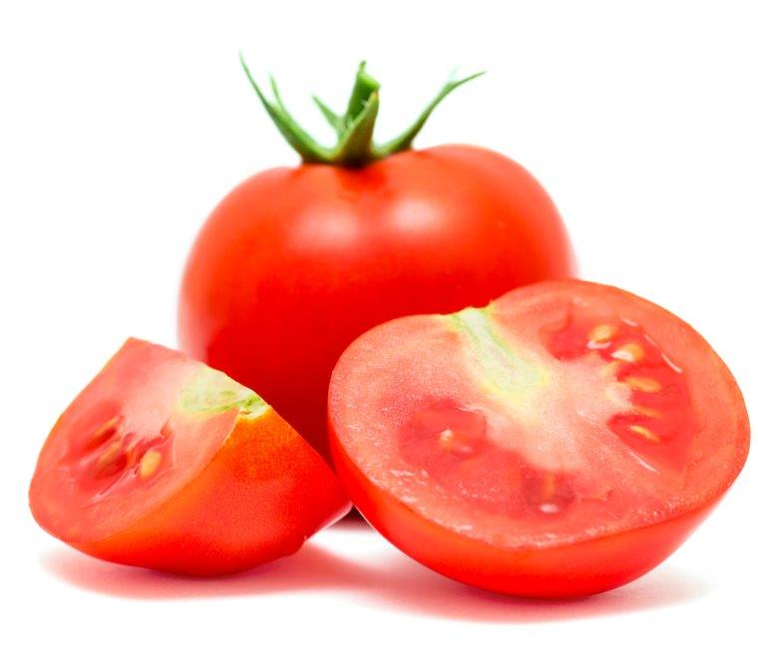
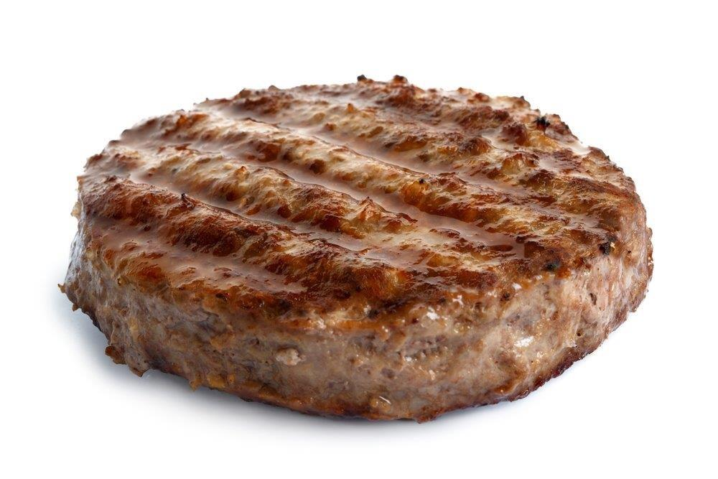
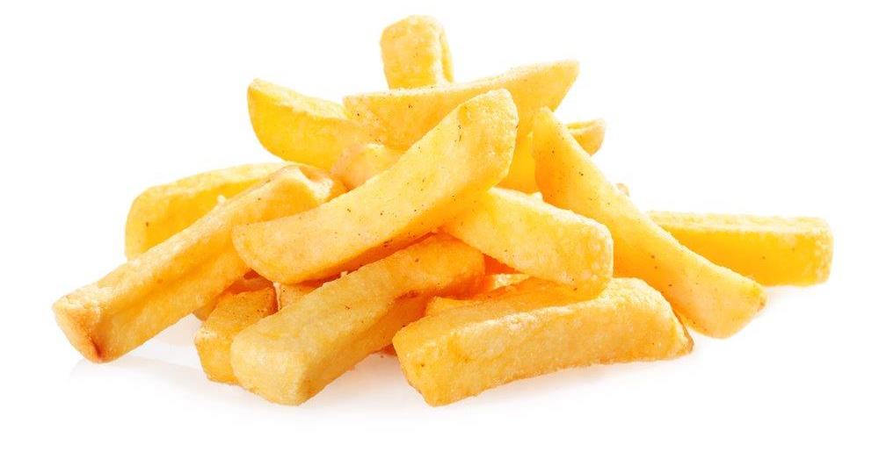
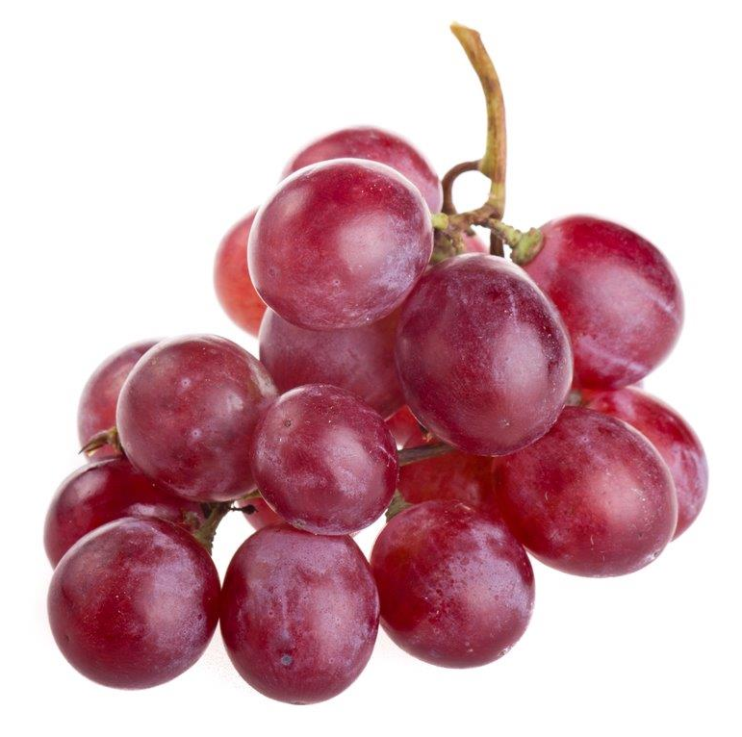
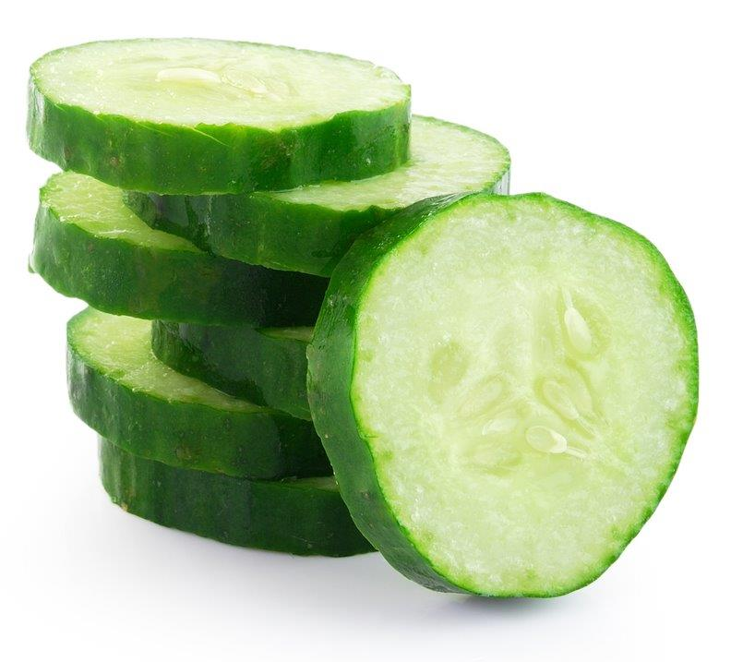
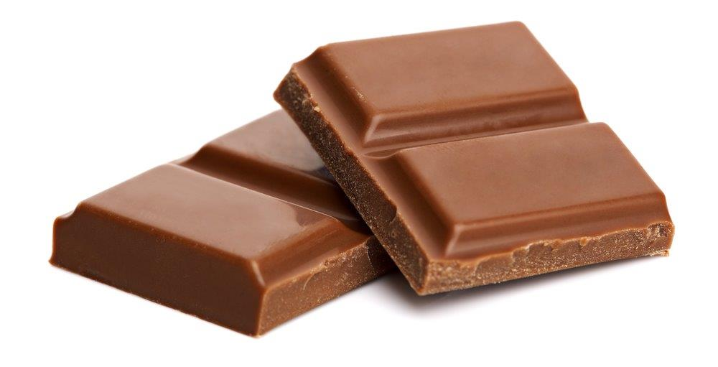
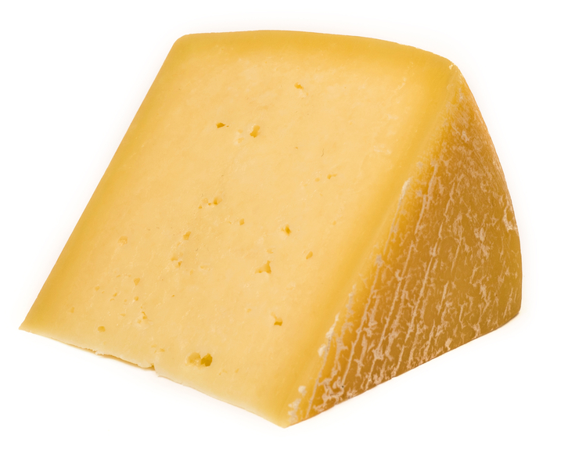
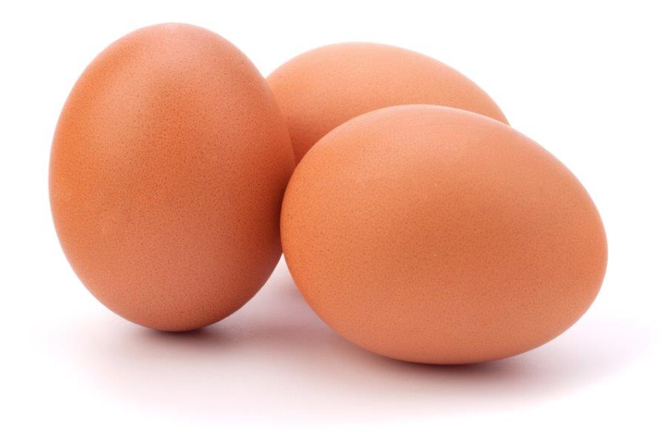
There are lots of different types of food.
What food can you see here?
What is your favourite food?
What food do you not like?

Slide 3
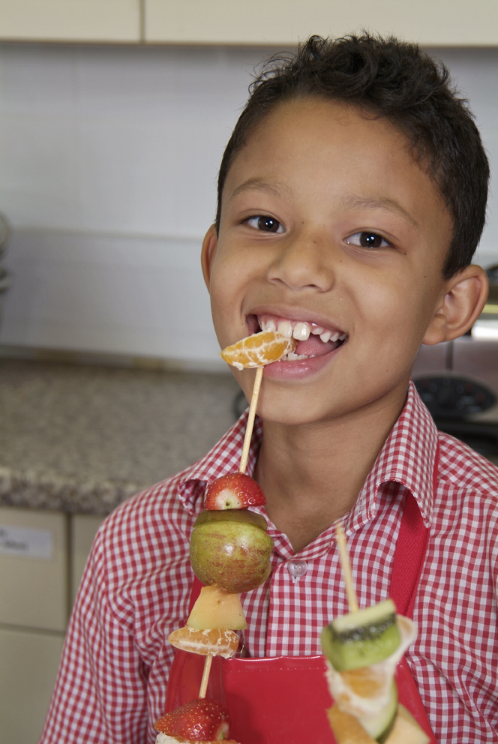
What might make us like or dislike a food?
It might be the…
sound
feel
smell
look
taste

Slide 4
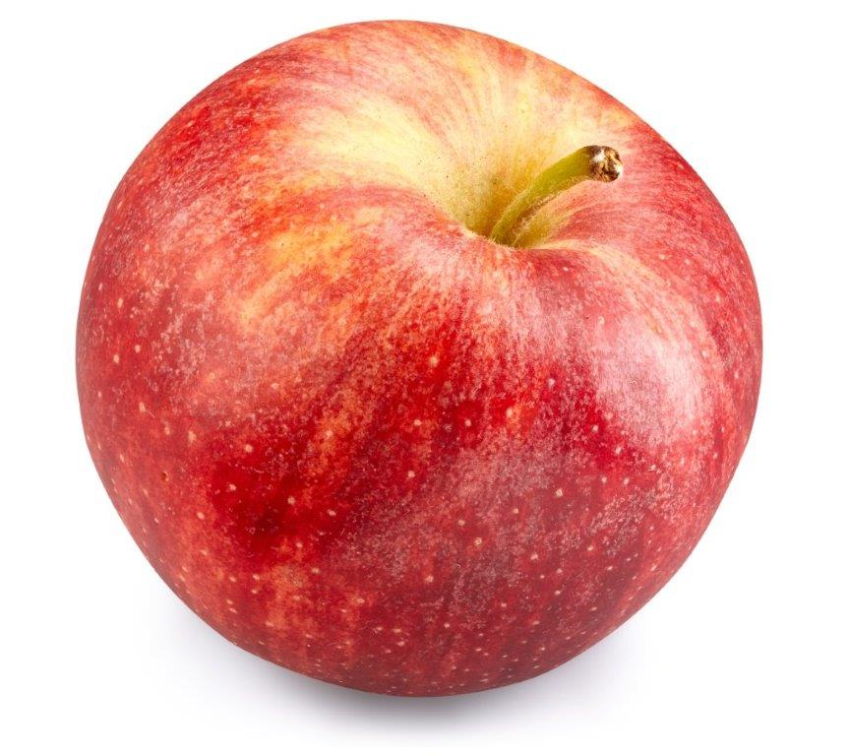
How could we describe an apple?
crunchy
juicy
crispy
Now describe the food on the next few slides.

Slide 5
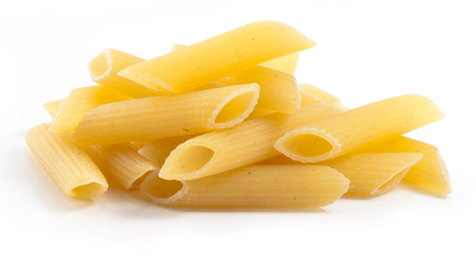
What words can you use to describe this food?
Do you like this food? Why?

Slide 6
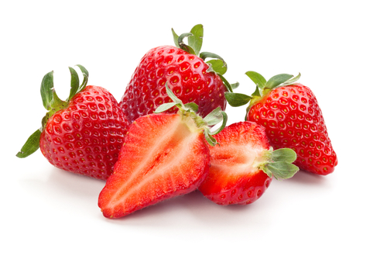
What words can you use to describe this food?
Do you like this food? Why?

Slide 7
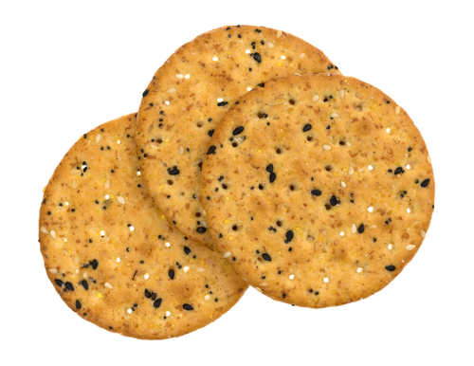
What words can you use to describe this food?
Do you like this food? Why?

Slide 8
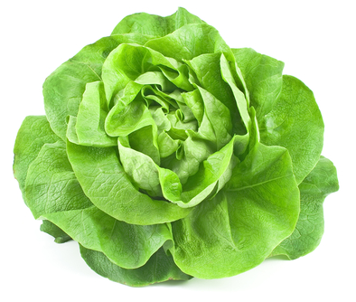
What words can you use to describe this food?
Do you like this food? Why?

Slide 9
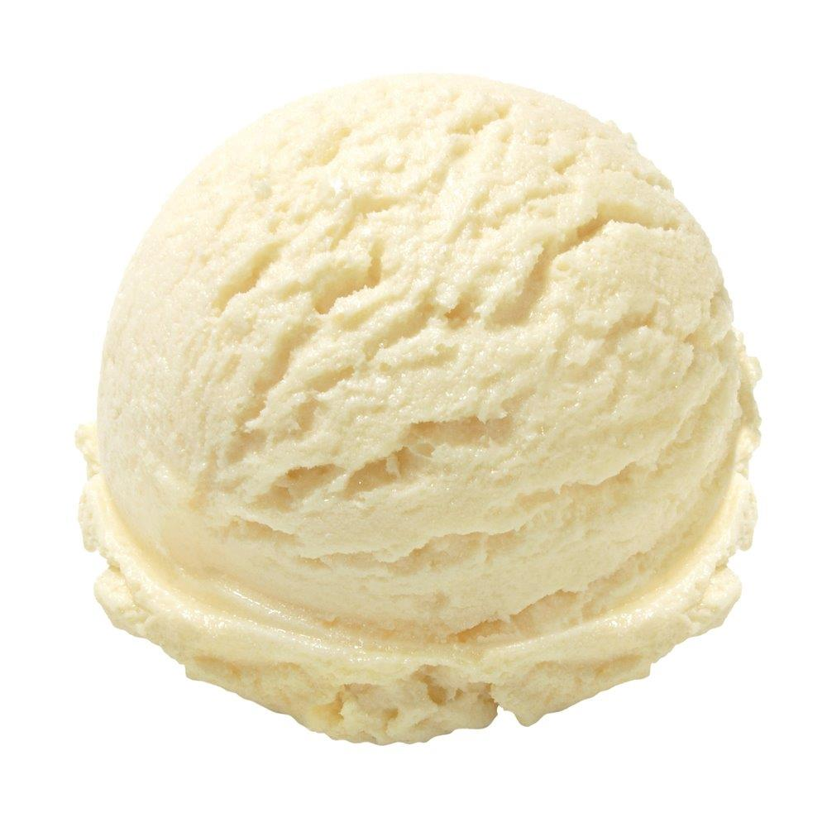
What words can you use to describe this food?
Do you like this food? Why?

Slide 10
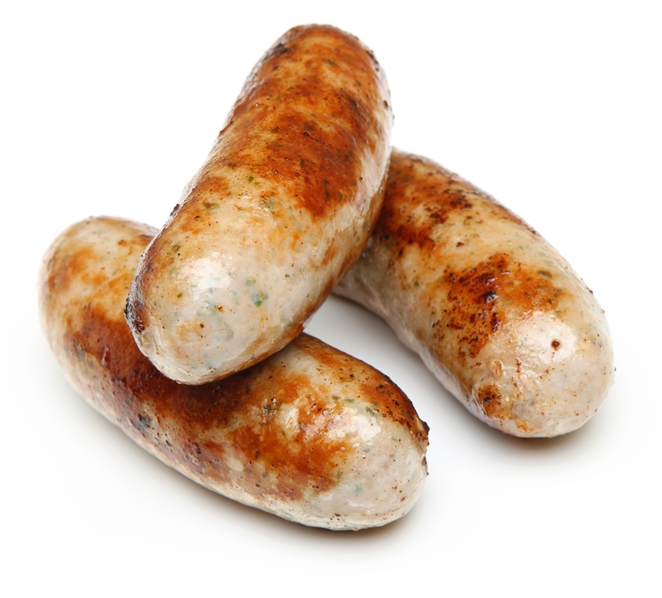
What words can you use to describe this food?
Do you like this food? Why?

Slide 11
Think of a food for each of these words.
bobbly
sticky
spongy

Slide 12
I like that
For further information, go to:
www.foodafactoflife.org.uk

