Slide 1
Welcome to our distance Eggs-cellent Easter Assembly!

Slide 2
Why shouldn’t you tell an Easter egg a joke?

Slide 3
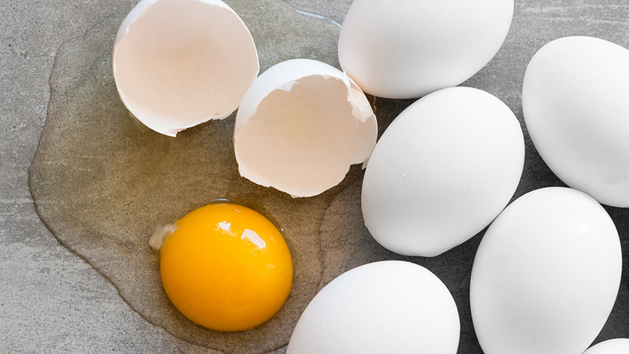
It might crack up!

Slide 4
What do you call a rabbit with fleas?

Slide 5
Bugs Bunny!

Slide 6
What do you get when you pour hot water into a rabbit hole?

Slide 7
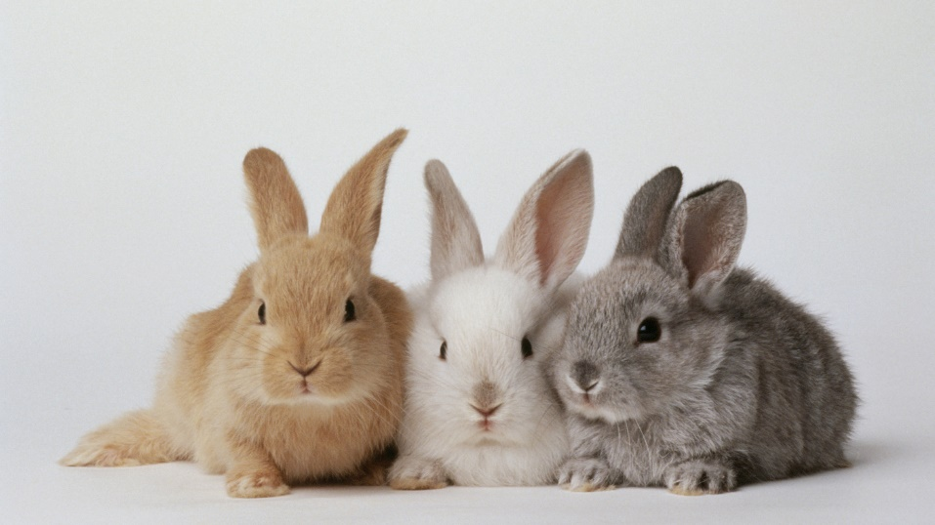
Hot cross bunnies!

Slide 8
What did the Easter Bunny say to the carrot?

Slide 9
Nice gnawing you!

Slide 10
What is the Easter Bunny’s favourite kind of music?

Slide 11
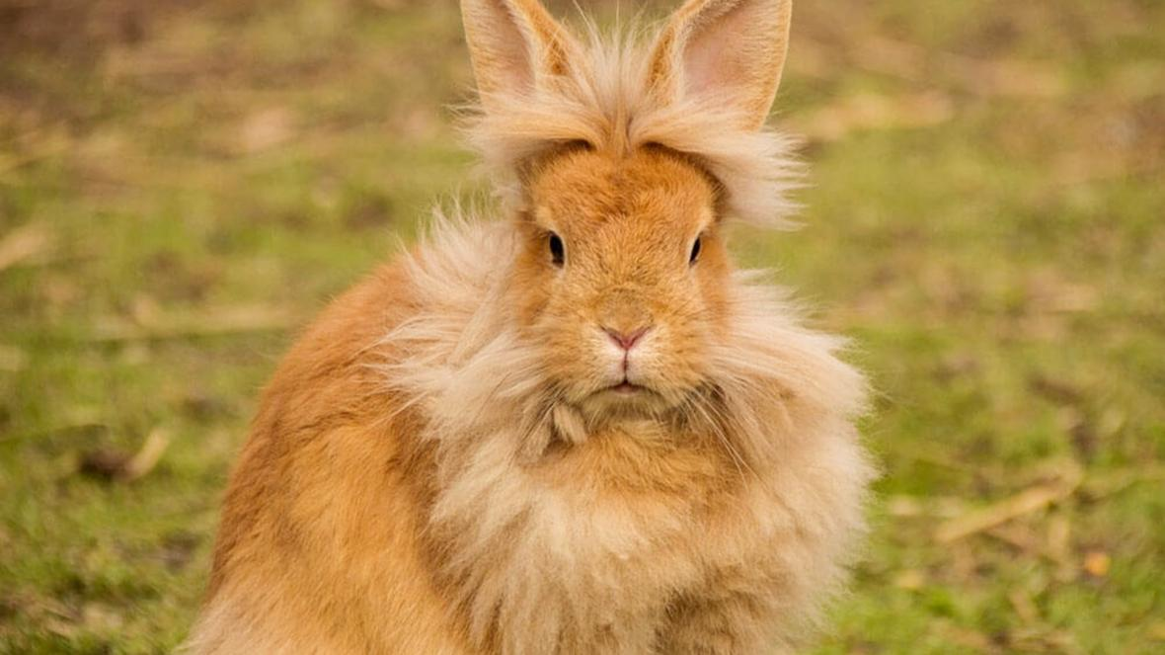
Hip-hop!

Slide 12
Let`s have a bit of a sing-song and a fidget!
https://www.youtube.com/watch?v=gPaaDjhVKqk
Easter Bunny Song!

Slide 13
Like many Easter traditions, the Easter bunny evolved out of ancient spring celebrations. Rabbits give birth in the spring. So, in places where the fields became overrun with baby bunnies, it was natural to incorporate the rabbit as a symbol for spring and, eventually, Easter.
According to an old German story a poor woman who loved children would hide brightly coloured eggs in her garden as Easter treats. One year, while the children searched for them, they noticed a hare hopping past and believed that the hare had left the eggs.

Slide 14
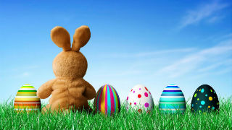

Slide 15
There's a reason why Easter Sunday is often celebrated with church service at the crack of dawn. In the Easter story it was at early at dawn on Easter morning that Mary opened Jesus's tomb to find it empty — which is why so many churches now hold services at sunrise to mark this occasion.

Slide 17
Next week is known as Holy week as a way of preparing for Easter
https://www.youtube.com/watch?v=wSIs1MHdFQY
A clip from a musical film Godspell

Slide 18
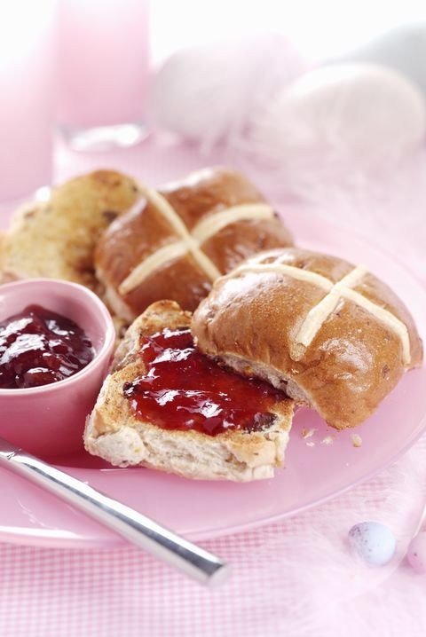
Easter Traditions: Hot Cross Buns
These round breads embellished with crosses have been traced back to ancient Egypt, Rome, and Greece, where such foods served as symbols of honour towards their goddesses. Later, these sweet breads filled with currants and spices became popular Easter traditions, especially in England where bakers were forbidden to sell spice breads except on special holidays, like the Friday before Easter.

Slide 19
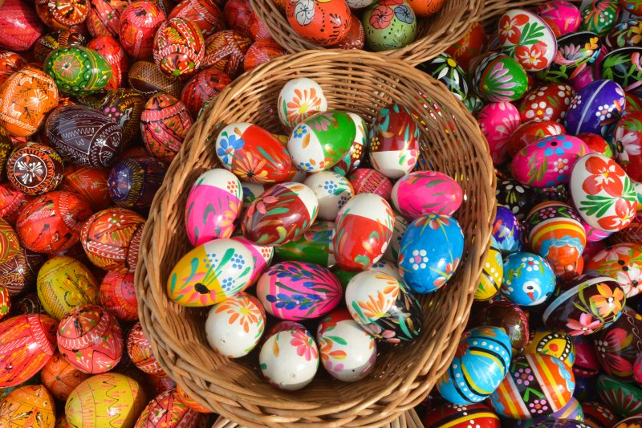
Easter Traditions: Easter Eggs

Slide 20
Easter Traditions: Easter Eggs
A lot of us may “chomp” on chocolate eggs at Easter, but originally eating eggs was not allowed by church leaders during the week leading up to Easter (known as Holy Week).
So any eggs laid that week were saved and decorated to make them Holy Week eggs, that were then given to children as gifts.
Victorians adapted the tradition with satin-covered cardboard eggs filled with Easter gifts.
This has now developed into the tradition that many people enjoy today.

Slide 21
Easter Traditions: Easter Eggs
The first chocolate eggs appeared in France and Germany in the 19th Century, but they were bitter and hard.
As chocolate-making techniques improved, hollow eggs like the ones we have today were developed.
They very quickly became popular and remain a favourite tradition with chocolate-lovers today. (Especially Mrs. Thurlow!)

Slide 22
Narrated Story of Easter
https://www.youtube.com/watch?v=zQeU6gZzHT4

Slide 23
Happy Easter
So have a lovely, lovely Easter Mid Calder children and we will check in with you all in two weeks time!
Be safe
Have fun
Enjoy your chocolate eggs!

