Slide 1

Mid Calder Primary School
P1 & P1/2 Meet the Teacher
September 2019

Slide 2
Structure of the School Day
Monday to Thursday
8.00 Breakfast Club (Optional)
8.30 Playground supervision
8.45 School Day starts
9:00 Morning Session 1
10.30 Interval
10.47 Morning Session 2
12.20 Lunch
1.00 Afternoon Session
15.05 End of School Day

Slide 3
Structure of the School Day
Friday
8.00 Breakfast Club
8.30 Playground Supervision
8.45 School Day Starts
9:00 Whole School Assembly
9:30 Morning Session 1
10.30 Interval
10.47 Morning Session 2
11.45 Free Time Friday
12.30 End of School Day

Slide 4
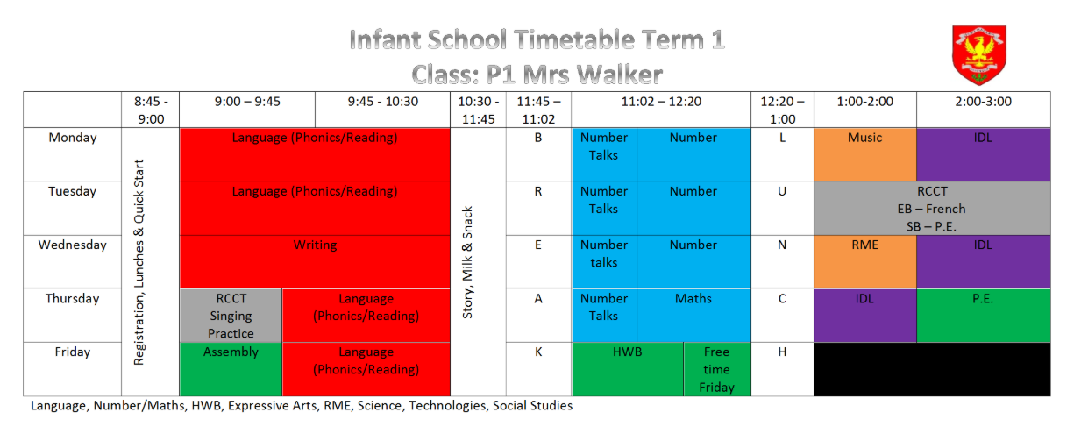
Weekly Timetable

Slide 5
School Uniform
Grey trousers/skirt/ shorts and white shirt/blouse and red & grey striped school tie (grey/red cardigan optional)
Grey trousers/skirt / shorts and red school polo shirt with school badge and grey school sweatshirt with school badge
Grey school cardigan
Summer: Red and white gingham dress with red or grey cardigan
P.E. Kit: White t-shirt (school logo optional)
Shorts
Gym shoes
Old clothes for art/Outdoor learning clothes
PLEASE NAME EVERYTHING!

Slide 6
Lunchtime Reminder
School lunches are ordered daily through iPay impact – All P1-3 children are entitled to free school dinner
You can look at the lunches at home with your child and pre order your child’s lunch.

Slide 7
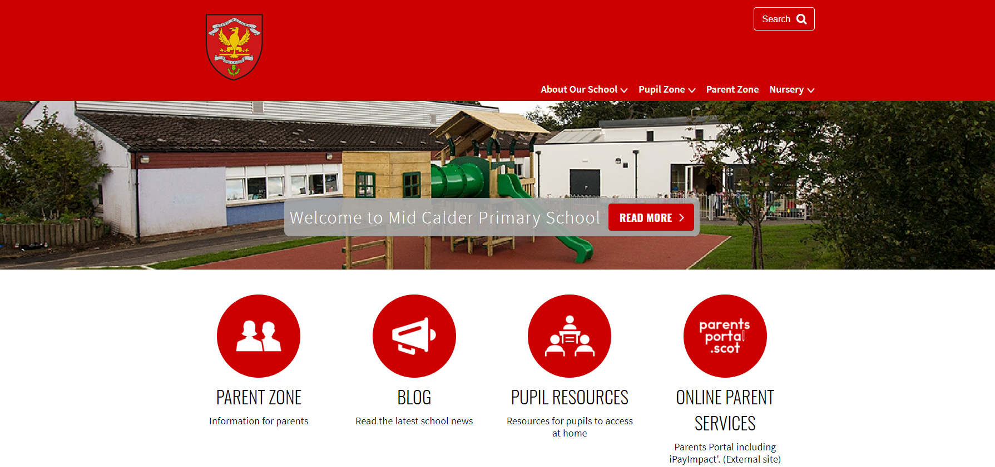
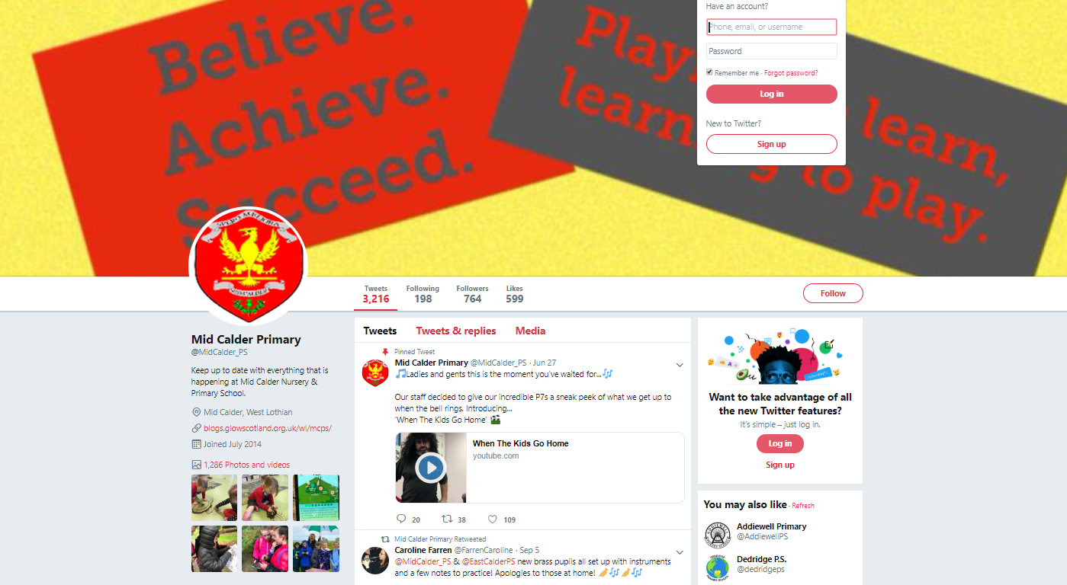
Blog: https://midcalderprimary.westlothian.org.uk/
Twitter: @MidCalder_PS

Slide 8
Important Documents
Please return the photo permission forms and EE2 forms as soon as possible if you haven’t already done so. We cannot share any photos to twitter or the school blog until these are returned.
Please ensure that all medical forms are filled in fully and handed back promptly with any appropriate medication.

Slide 9
In P1 and P2…
We will be using consultative planning methods (such as floorbooks, talking tubs etc.) and the learning will come from the children.
So therefore, because it is personalised to each class’s interests, the focus and content will be varied in each class.
This term, our learning context will begin with “Dinosaurs”.

Slide 10
Literacy – Jolly Phonics
Children will participate in various activities which will develop their:
  Letter recognition skills
  Letter formation skills
  Blending skills
  Identifying sounds in words
  Tricky words

Slide 11
Literacy – Reading
In P1, children may initially be sent home with wordless books and/or picture books for you to read with them.
Jolly Phonics/Oxford Reading Tree readers will be our main reading schemes which will be sent home.
Each comes with a set of key words to practice at home.

Slide 12
Literacy – Reading
Other resources that may be used include:
Dandelion readers - fiction
Snapdragon books - fiction
Fireflies – non-fiction
Rhyme books

Slide 13
Literacy – Writing
Personal writing
Black pen drawings
Writing from experience
Teacher modelling
Teacher scribes story, children begin to write familiar words
Descriptive writing
Imaginative writing
Up-levelling

Slide 14
Numeracy and Maths
Number will be taught through active tasks. This will develop skills in:
  Numerals and number structure from 0 to 10 and then beyond – dots, fingers, ten frames, rekenrek
  Forward and backward number word sequences
  Counting in steps of one, two, five & ten
  Formation of numbers
  Addition and subtraction within 10 and beyond
  Sharing

Slide 15
Numeracy and Maths
Beyond Number:
  Sorting and matching
  Pattern
  2D shapes and 3D objects
  Recognising and using coins
  Information handling
  Time -days of week, months of year, seasons, key dates, o’clock

Slide 16
Traffic Lights
If the child continues to display their chosen behaviour they will move to red, which will result in loss of 5 minutes free time Friday and SMT involvement when appropriate.
If the child continues to display their chosen behaviour they will move to an orange warning and have a calm down time to reflect. They cannot return to green.
Thinking cloud allows the child to reflect on their chosen behaviour and provides the opportunity to return to green.
All children start the day on green.
**There may be circumstances where the child is moved straight to red.**

Slide 17
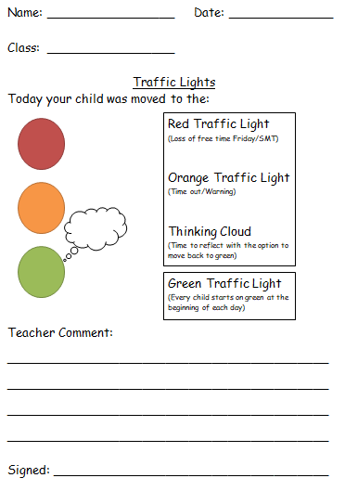
Traffic Lights
In the event that a staff member is unable to speak directly to a parent/guardian, about a child’s chosen behaviour at the end of the school day, a letter will be sent home to inform you, so that you can discuss your child’s behaviour with them.

Slide 18
Homework Folders
P1/P2 homework folders for majority of children should include:
Reading record
Reading book
Magic reading wand
Word list keyring (phonetic words)
Tricky word list keyring
Homework jotter
SUMDOG & Teach your monster to read password card
**Please note that reading records will not be read everyday. Ensure important notes/messages are passed to a member of staff.**

Slide 19
Homework
Homework will be given out on a Monday and should be returned on a Friday.
The late return of reading books will impact on another child receiving their reading book on a Monday for homework.
Homework folders should be brought in every day to school with their reading book inside.
Missing reading books will incur a cost for the book to be replaced.

Slide 20
Homework - Reading
Look at and discuss the front cover, back cover, spine, blurb, author and illustrator.
Look at the pictures and talk about them together.
Stop at different parts and predict what will happen next. Also discuss the sequence of the story (Beginning, Middle, End or First, Next, Then, Last).
Look at sentence structure (capital letters, full stops, finger spaces etc.)
Look for known tricky words and sounds (Your child may begin to attempt to blend sounds together to read simple words).
Try to relate the themes in the book to your child’s own experiences.
Also allow time for your child to explore the book independently after reading it together.

Slide 21
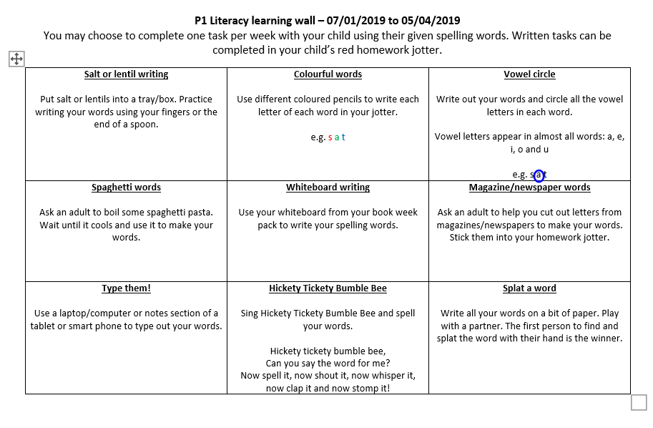
Homework – Word List Keyring
Each week your child will receive a list of words that will use sounds they have covered in class.
You may want to discuss these words verbally with your child or complete one of the active learning tasks on their literacy grid in their homework jotter.

Slide 22
Homework – Tricky Word Keyring
Your child’s tricky work keyring will build up a list of tricky words that they will gradually cover over the term in class.
Please practise the tricky words provided on a regular basis with your child to increase their word recognition and fluency when reading.
When we start a new set of tricky words, the next set will be added to their tricky word keyring.
It is important to revise all tricky words on a regular basis.

Slide 23
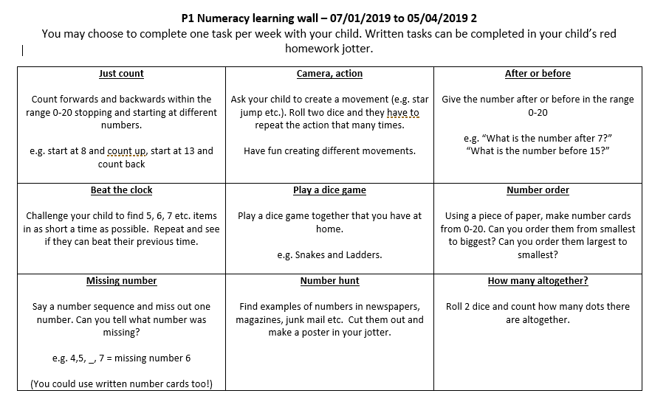
Homework – Numeracy
For number, you may want to complete one of the active learning tasks on their numeracy grid in their homework jotter.

Slide 24
Homework – Other
Your child can also use Sumdog and Teach Your Monster to Read at home.
Occasionally, they may also have additional tasks related to their class topic.
Other than daily reading, homework is not compulsory and if you feel you do not want your children to receive these additional homework tasks please let the class teacher know in writing.

Slide 25
Thank you
Thank you for coming along.
We would greatly appreciate it if you could go to the hall for refreshments and fill in questionnaires on the Ipads with our P7 helpers.

