Slide 1

Mid Calder Primary School
P1 Meet the Teacher
September 2018

Slide 2
Structure of the School Day
Monday to Thursday
8.05 Breakfast Club (Optional)
8.30 Playground supervision
8.45 School Day starts
9:00 Morning Session 1
10.45 Interval
11.02 Morning Session 2
12.20 Lunch
1.00 Afternoon Session
15.05 End of School Day

Slide 3
Structure of the School Day
Friday
8.05 Breakfast Club
8.30 Playground Supervision
8.45 School Day Starts
9:00 Morning Session 1
10.45 Interval
11.02 Morning Session 2
11.05 Whole School Assembly
11.45 Free Time Friday
12.30 End of School Day

Slide 4
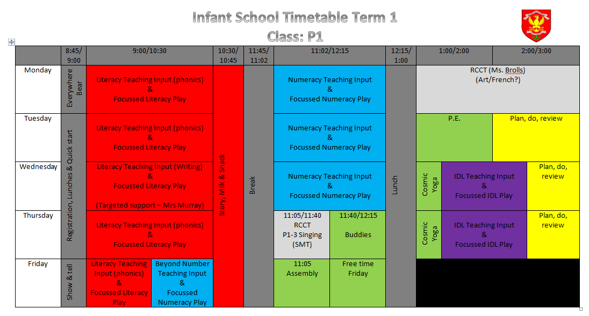
Weekly Timetable

Slide 5
School Uniform
Grey trousers/skirt/ shorts and white shirt/blouse and red & grey striped school tie (grey/red cardigan optional)
Grey trousers/skirt / shorts and red school polo shirt with school badge and grey school sweatshirt with school badge
Grey school cardigan
Summer: Red and white gingham dress with red or grey cardigan
P.E. Kit: White t-shirt (school logo optional)
Shorts
Gym shoes
Old clothes for art with Ms.Brolls (optional)
PLEASE NAME EVERYTHING!

Slide 6
Lunchtime Reminder
School lunches are ordered daily through iPay impact – All P1-3 children are entitled to free school dinner
You can look at the lunches at home with your child and pre order your child’s lunch.

Slide 7
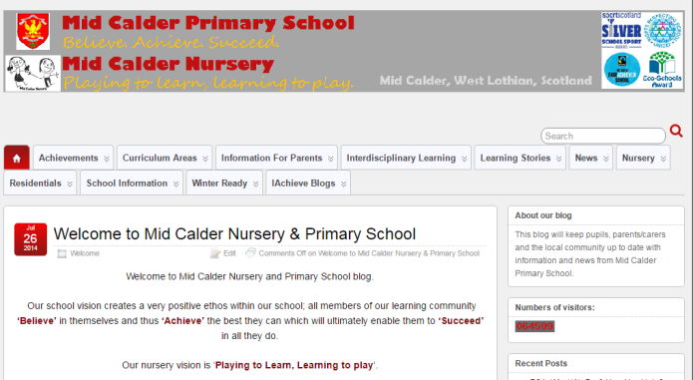
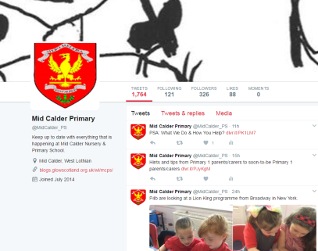

Blog: https://blogs.glowscotland.org.uk/wl/mcps
Twitter: @MidCalder_PS

Slide 8
In P1 and P2…
We will be using consultative planning methods, such as floorbooks, and the learning will come from the children.
So therefore, because it is personalised to each class’s interests, the focus and content will be varied in each class.
This term, our learning context will be “The Sea”.

Slide 9
Literacy – Jolly Phonics
Children will participate in various activities which will develop their:
  Letter recognition skills
  Letter formation skills
  Blending skills
  Identifying sounds in words
  Tricky words

Slide 10
Literacy – Reading
In P1, children will initially be sent home with picture books for you to read with them.
Jolly phonics readers will be our main reading scheme which will sent home when your child is able to confidently recognise and blend the first 42 Jolly Phonics sounds.
Each comes with a set of key words at the front of the book to practice at home before reading.

Slide 11
Literacy – Reading
Other resources that may be used include:
Dandelion readers - fiction
Snapdragon books - fiction
Fireflies – Non-fiction
Rhyme books

Slide 12
Literacy – Writing
Personal writing
Black pen drawings
Writing from experience
Teacher modelling
Teacher scribes story, children begin to write familiar words
Functional writing – lists, letters, instructions etc
Imaginative writing
VCOP - vocabulary, connectives, openers and punctuation
Up-levelling

Slide 13
Numeracy and Maths
Number will be taught through active tasks in rotations. This will develop skills in:
  Numerals and number structure from 0 to 10 and then beyond – dots, fingers, ten frames, rekenrek
  Forward and backward number word sequences
  Counting in steps of one, two, five & ten
  Formation of numbers
  Addition and subtraction within 10 and beyond
  Sharing

Slide 14
Numeracy and Maths
Beyond Number:
  Sorting and matching
  Pattern
  2D shapes and 3D objects
  Recognising and using coins
  Information handling
  Time -days of week, months of year, seasons, key dates, o’clock

Slide 15
Homework
This session we will be consulting children, parents and staff about their thoughts on homework and create a homework policy.
Please look out for more information and we would appreciate your support in completing homework questionnaires.
In the meantime, you can support your child by encouraging them to read a variety of texts. Your child will receive a reading book to read at home.
Your child will also receive their SUMDOG password in due course in order to support numeracy learning.

Slide 16
Thank you
Thank you for coming along.
We would greatly appreciate it if you could fill in and return the two questionnaires on the table.

