Slide 1
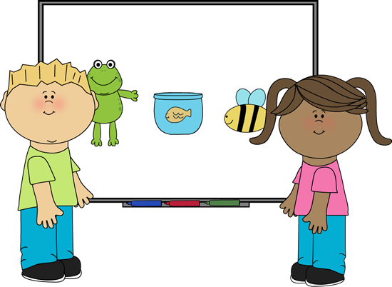
French First Level
Classroom Talk!

Slide 2
First Level Significant Aspects of Learning
Use language in a range of contexts and across learning
Continue to develop confidence and enthusiasm to communicate using the language being learnt
Develop an awareness and understanding of patterns and sounds of language
Begin to develop an understanding of, interest in and respect for other countries, cultures and languages
Appreciate and understand the value of language learning
Recognise familiar written words when listening
Explore how gesture, expression and emphasis are used to help understanding.
Listen, recognise and respond to familiar voices in short, predictable conversations
Understand and respond to familiar spoken vocabulary
Actively take part in daily routines
Listen and join in with stories, song or poem
Enjoy engaging with simple and familiar texts on my own and with others using resources to support learning
Participate in familiar games, paired speaking and short role plays
Take part in simple, paired conversations about themselves giving simple opinions and asking simple questions

Slide 3
Classroom Talk! Vocabulary
Ecoutez Listen
Regardez Look
S’il vous plaît Please (for use when pupil is talking to the teacher, or the teacher is talking to the whole class)
Mettez-vous en ligne Line up
Oui Yes
Non No
Merci Thank you
Asseyez-vous Sit down
Levez-vous Stand up
Levez la main Put your hands up
Répétez Repeat
Voilà! Here you go!
S’il te plaît Please (for use when pupils are talking to
each other or when the teacher is talking one pupil)
J’ai fini I’m finished
De rien You’re welcome
Pas de problème No problem
Je peux aller aux toilettes? Can I go to the toilet?
Notes:
Everything in bold is additional at First Level

Slide 4
Teachers’ note
For commands in French, we use a different variation for single and plural commands. Examples of these are below. Start with one or the other if you feel more comfortable and work your way up to both.
Whole class command | When speaking to one person | Meaning
Écoutez | Écoute! | Listen
Répétez | Répète! | Repeat
Regardez | Regarde! | Look/watch
Mettez-vous en ligne | Mets-toi en ligne | Line up
Asseyez-vous | Assieds-toi | Sit down
Levez-vous | Lève-toi | Stand up
Levez la main | Lève la main | Put your hand(s) up

Slide 5
Ecoutez
s’il vous plaît!

Slide 6
Répétez
Répétez
Répétez
Répétez
Répétez
Répétez
s’il vous plaît!

Slide 7
Regardez
s’il vous plaît!

Slide 8
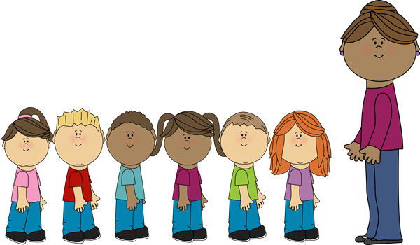
Mettez-vous en ligne!

Slide 9
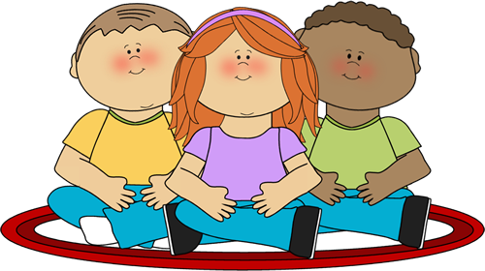
Asseyez-vous

Slide 10
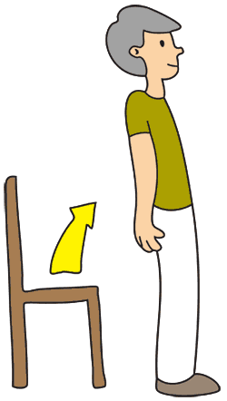
Levez-vous

Slide 11
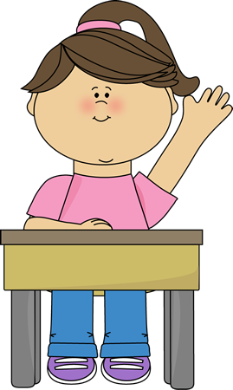
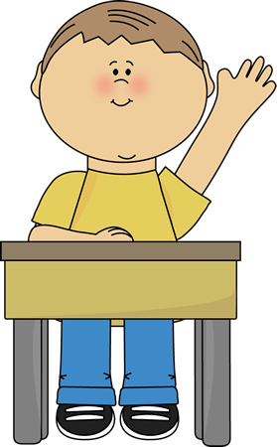
Levez la main

Slide 12
Écoute
s’il te plaît!
Notes:
Listen – to one person

Slide 13
Répète
Répétez
Répétez
Répétez
Répétez
Répétez
s’il te plaît!
Notes:
Repeat – to one person

Slide 14
Regarde
s’il te plaît!
Notes:
Look– to one person

Slide 15
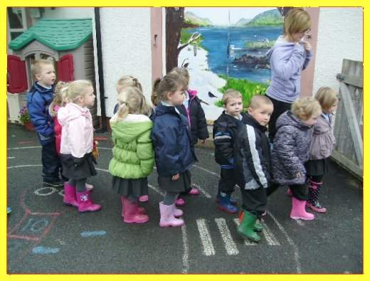
Mets-toi en ligne!
Notes:
Line up – to one person

Slide 16
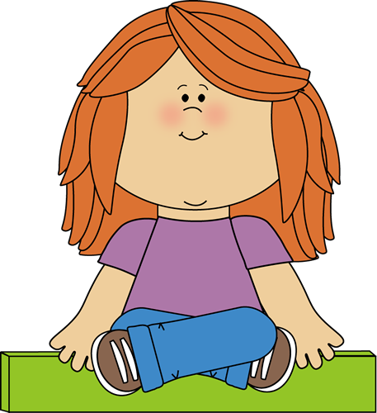
Assieds-toi
Notes:
Sit down – to one person

Slide 17
Lève-toi
Notes:
Stand up – to one person

Slide 18
Lève la main
Notes:
Put your hand up – to one person

Slide 19
Oui

Slide 20
Non

Slide 21
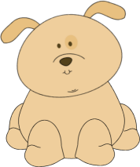
S’il te plaît

Slide 22
S’il vous plaît
Notes:
Please when speaking to more than 1 person or in formal situations (e.g. in France, pupils would use the vous form when speaking to the teacher.

Slide 23
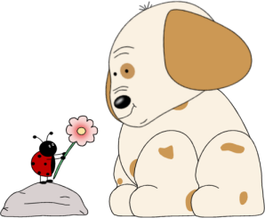
Voilà!

Slide 24
Merci!

Slide 25
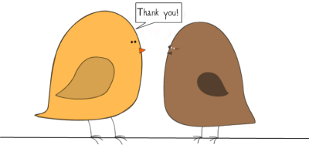
De rien!
merci
de rien

Slide 26
Pas de problème!

Slide 27
J’ai fini!

Slide 28
Je peux aller aux toilettes?

Slide 29
Embedding the language
All this language is designed to be used as part of everyday classroom practice.
You could do the register with oui and non on some days (on fait l’appel for the register is in the Greetings PPT).
There are example activities however to help teachers reinforce the language being used.

Slide 30
Mot de la semaine Mot du mois
Mot de la semaine means word of the week. Mot du mois means word of the month.
As a way of building up classroom vocabulary gently, you could have a word of the week/month which everyone will use in class (or out of class too if they like!)
Once you move onto your next word, keep the previous words going! This way the pupils will build up their language gradually!

Slide 31
The Big Bonjour Challenge!
Set pupils the challenge of saying Bonjour, merci, s’il vous plaît and de rien (or whichever vocab you like) to everyone they speak to.
You could get them to tally mark how many they do in a week and have an inter-class competition.

Slide 32
Sample activities
You will find a bank of sample activities which you can use to practise the vocabulary in the classroom.
This is not a prescriptive list of activities and you can use or adapt them to suit the needs of your class.

Slide 33
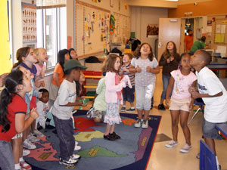
Activité 1
Jacques a dit

Slide 34
Jacques a dit
Jacques a dit is French for Simon says.
It works exactly the same way whereby if you say Jacques a dit (Jack said) at the start of a command then everyone has to do it. If you just say the command then pupils should stand still. If they do the action, they then sit down. Sample commands are below:
Jacques a dit écoutez! (pupils can cup hand to ear)
Jacques a dit regardez! (mime searching)
Jacques a dit mettez-vous en ligne! (pupils get into a line)
Ecoutez!
Regardez!
Mettez-vous en ligne!
Asseyez-vous
Levez-vous

Slide 35
Jacques a dit….
Choisissez une action…
…pour chaque instruction.
1. Écoutez!
2. Regardez!
3. Levez-vous!
4. Asseyez-vous!
5. Levez la main!
Notes:
Choose an action for each command.

Slide 36
Some extra commands!
French | English
Dansez! | Dance
Bougez! | Move!
Touchez la tête! | Touch your head!
Touchez le nez! | Touch your nose!
Tournez! | Turn
Touchez les pieds! | Touch your feet!
Notes:
Let’s go!

Slide 37
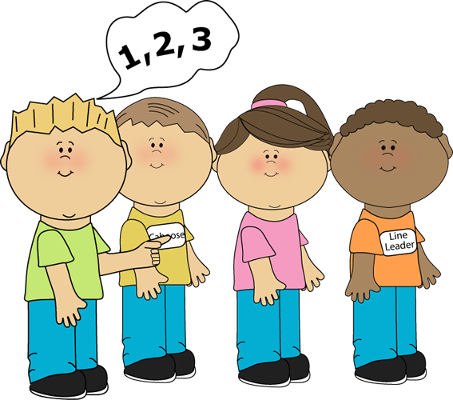
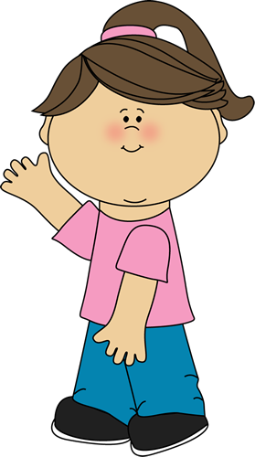
Activité 2
Vous ou toi?
Notes:
You or you?

Slide 38
Teacher notes
You can start this activity by going through the photos and asking pupils to decide if each one would be either Levez-vous, lève-toi, asseyez-vous or asseid-toi.
You can then play a game where pupils have to either stand up or sit down together depending on what the phrase says.
Divide the class into two teams. Ask one team to nominate 3 pupils to come out to the front and the other team to nominate 1 person only. Have a seat for each of them at the front.
Give the commands either Lève toi, Levez-vous, Asseid-toi or Asseyez-vous to the pupils.
The group should perform the plural “vous” commands and the individual pupil should perform the “toi” commands.
You can give points, swap pupils in and out and ask other pupils to come out to the front to give them commands.

Slide 39
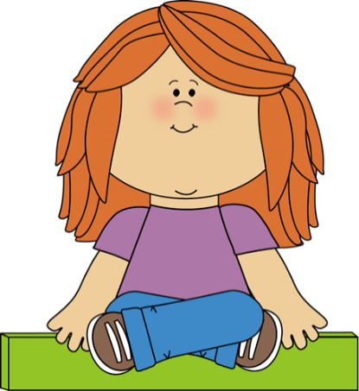
C’est quelle phrase?
Regardez
les photos
décidez si
et
ou
Assieds-toi
Asseyez-vous
Notes:
Which phrase is it? Look at the following pictures and decide if it’s sit down (talking to one person) or sit down (talking to more than one person)

Slide 40
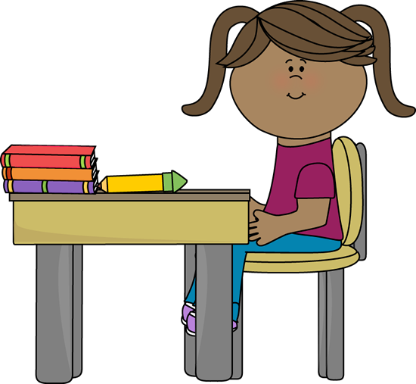
Assieds-toi ou asseyez-vous?

Slide 41
Oui! Assieds-toi!

Slide 42
Assieds-toi ou asseyez-vous?

Slide 43
Oui! Asseyez-vous!

Slide 44
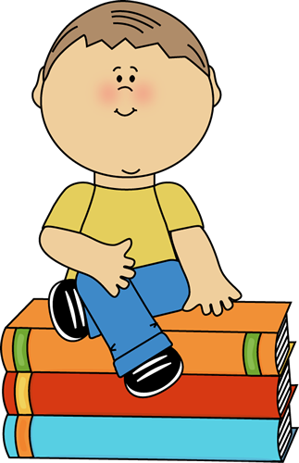
Assieds-toi ou asseyez-vous?

Slide 45
Assieds-toi! Bien sûr! ☺
Notes:
Sit down – of course! ☺

Slide 46
Assieds-toi ou asseyez-vous?

Slide 47
Oui! Super! Assieds-toi!

Slide 48
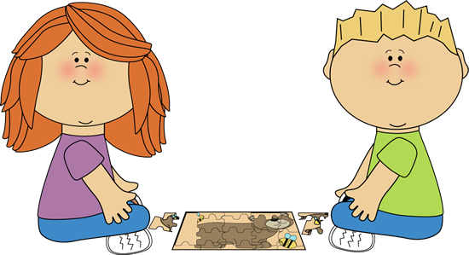
Assieds-toi ou asseyez-vous?

Slide 49
Bravo! Asseyez-vous!

Slide 50
C’est quelle phrase?
Regardez
les photos
décidez si
et
ou
Lève-toi
Levez-vous
Notes:
Which phrase is it? Look at the following pictures and decide if it’s stand up (talking to one person) or stand up (more than one person).

Slide 51
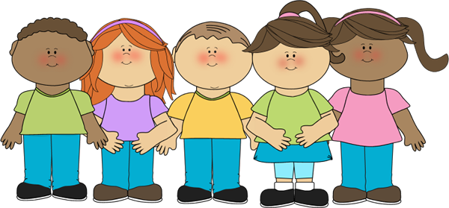
Lève-toi ou levez-vous?

Slide 52
Oui! Levez-vous!

Slide 53
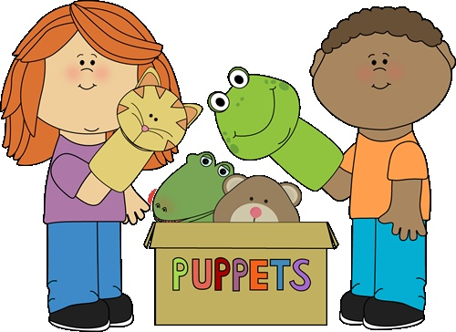
Lève-toi ou levez-vous?

Slide 54
Levez-vous!

Slide 55
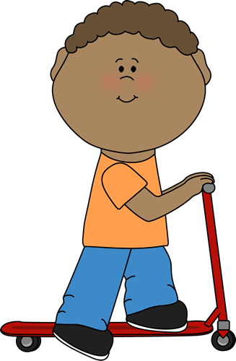
Lève-toi ou levez-vous?

Slide 56
Oui! Lève-toi!

Slide 57
Lève-toi ou levez-vous?

Slide 58
Lève-toi! Bien sûr!
Notes:
Bien sur – of course

Slide 59
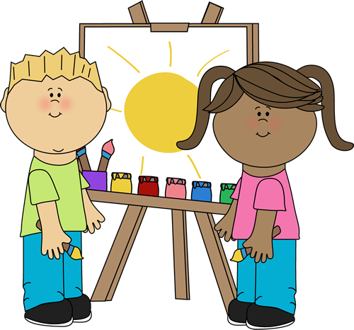
Lève-toi ou levez-vous?

Slide 60
Levez-vous!

Slide 61
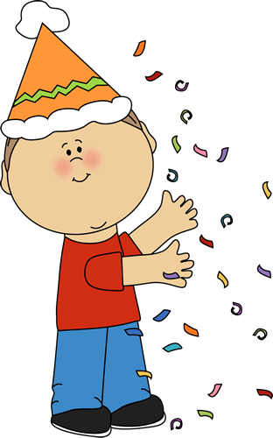
Lève-toi ou levez-vous?

Slide 62
Lève-toi!

Slide 63
Activité 3
C’est moi le prof!
Notes:
I’m the teacher!

Slide 64
Teacher notes
In this activity, pupils take turns to come out to the front and act as the teacher for the class.
They select a piece of paper from a hat and have to say what’s written in French and give the class an instruction.
The first person to either act it out (e.g. cupping their ear to show their listening) or say what it is in English, wins, and gets to go next.
You can the add an extra stage where the pupils have to act out the phrase and the others have to say what it is in French.

Slide 65
Bonjour tout le monde! C’est moi le prof aujourd’hui!

Slide 66
Songs and videos!
You will find a bank of sample songs and videos which you can use to practise the vocabulary in the classroom.
This is not a prescriptive list of songs and you can use or adapt them to suit the needs of your class.

Slide 67
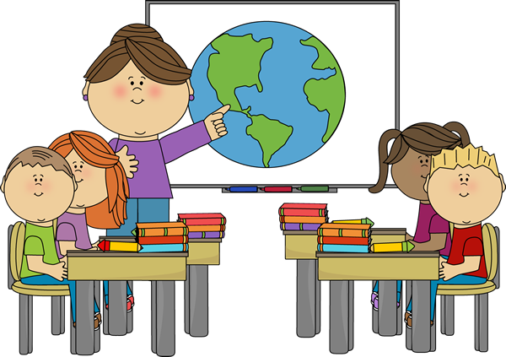
Ecoutez, écoutez moi!
Regardez, regardez moi!
Levez la main!
Touchez la tête!
C’est la salle de classe!
Asseyez-vous, touchez le nez,
Levez-vous et répétez!
Levez la main!
Touchez la tête!
C’est la salle de classe!
Est-ce que je peux aller aux toilettes?
Levez la main, et touchez la tête!
Mettez-vous en ligne,
Et dansez!
C’est la salle de classe!
C’est la salle de classe!
Notes:
The classroom instructions song! You can ask the pupils to make up actions to go along with each part of the song!

Slide 68
Mettez-vous en ligne (to the tune of farmers in his den)
Mettez-vous en ligne!
Mettez-vous en ligne!
Tous les enfants de la classe,
Mettez-vous en ligne!
Notes:
Tous les enfants de la class means all the children in the class.

Slide 69
J’ai fini!
J’ai fini mon travail
Pas de problème!
J’ai fini mon travail
Pas de problème!
J’ai fini mon travail
Pas de problème!
J’ai fini mon travail,
Il n’y a pas de problème!
Notes:
Il n’y a pas de problème is the full version of pas de problème and means There is no problem. J’ai fini mon travail means I have finished my work.

Slide 70
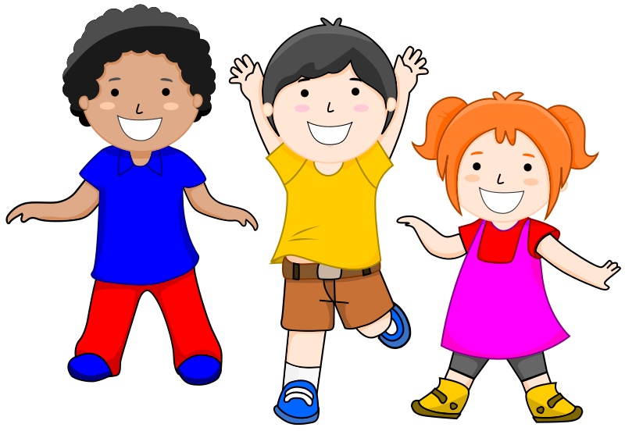
Asseyez-vous, levez-vous song!
Asseyez-vous, levez-vous, levez la main!
Asseyez-vous, levez-vous, levez la main!
Asseyez-vous, levez-vous, levez la main!
Asseyez-vous, levez-vous, levez la main!
X 3
Plus rapide! (faster)
Notes:
You can add in actions with this song and get the pupils to stand up, sit down and put their hand up.

Slide 71
Au revoir!

