Slide 1
P7 Transition Challenge

Slide 2
Expectations
Be a role model
Be respectful and responsible
Be a buddy
Do your responsible role

Slide 3
House Captain/ vice captains
You make your own presentation to show your house how you will be great house or vice captain.
You get to plan/run your house meeting and organize your house parties if you win the term points.
you also run the house lines with a hula-hoop

Slide 4
P7 Jobs
BY CAMERON AND MATT

Slide 5
WHAT JOBS DO YOU GET
In P7 you will have your responsible roles as you know you will also your chosen JLT. You will also get your house captain election where 8 from your class will be elected 4 house captains and 4 vice captains. As P7s you will also get to use the benches at assembly.

Slide 6
I.D.L
By Louise and Lauren

Slide 7
Introduction
In P7 we have done loads of topics such as…
World war two
Mid Calder election
Science experiments / investigations
Religions

Slide 8
WW2
P7 and P6 have learned about ww2…
We did loads of posters we made real life paintings of the leaders and we watched videos.
We learned about evacuees and rationing and about each leader.
We also wrote a poem about us being evacuees.

Slide 9
MCPS Election
We had to do a presentation about our parties and persuading the class to vote for us.
We also did a voting election to whoever we wanted to vote for to be president of the class, we had a ballot box to place our votes.

Slide 10
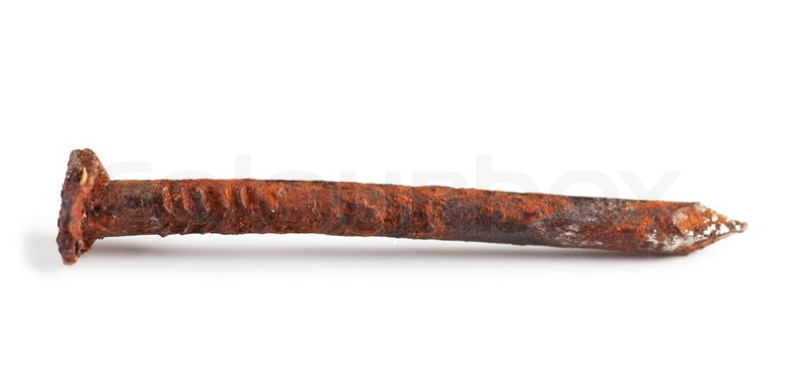
Science Experiments
We had a lot of fun doing science experiments….
Rusty nail investigation
Melting butter and chocolate
Clay
And the most fun making slime!!!!!

Slide 11
Language

Slide 12
Language
In language you need to write and read.
You will get texts and you will need to answer them with the answers from the texts.
We done a huge topic on harry potter and you needed to write a lot and read.
We done blooms questions.
We done inferences and deductions on different questions.

Slide 13
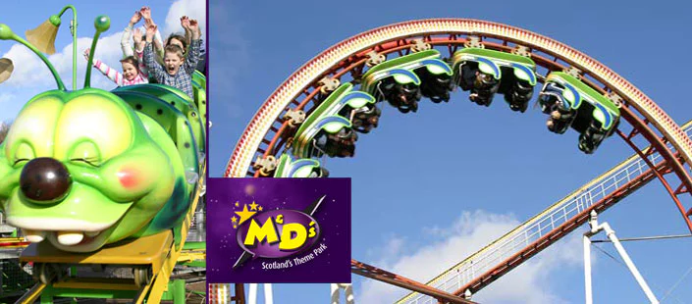
P7 Trips
By EUAN & Keira

Slide 14
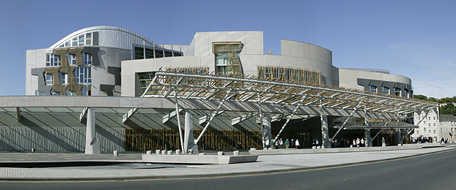
What P7 trips have we done in 2017
We went to the pantomime to watch Alice in wonderland because that was our topic and we done a show about it.
We went to the parliament for our debating topic.
We also went to the botanic gardens for our garden topic.
We also went to M&Ds.

Slide 15
Expectation on a P7 trip ?
Make sure you behave and represent the school.
Learn and have fun at the same time.
Wear school uniform unless told not to but in June you get to wear your P7 leavers hoodie.
Remember to bring your EE2 forms on time and bring the money if needed so you get to go on the trip.

Slide 16
REMEMBER!
Trips are privileges you need to behave to get to go.

Slide 17
Health and Wellbeing
By Matthew

Slide 18
During p7 you will do more : sex education in a more detailed way. You will do drug and tobacco education. You will also do enjoy-a-ball and futsal. In P7 you may also do basketball and handball but it depends on which teacher you get.

Slide 19
P7 Maths
In Maths Your going to learn harder skills and more knowledge

Slide 20
What You Will Learn
You will learn Equations and Algebra
You will learn different ways to answer your sums
You will learn different ESMD strategies
You will learn more about Angles
You will also learn more about coordinates

Slide 21
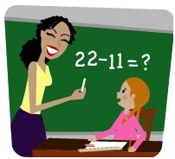
Number Talks
In number talks we do different games work sheets and much more

Slide 22
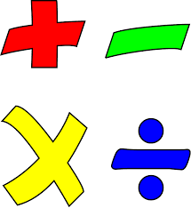
Thanks for Watching

