Slide 1
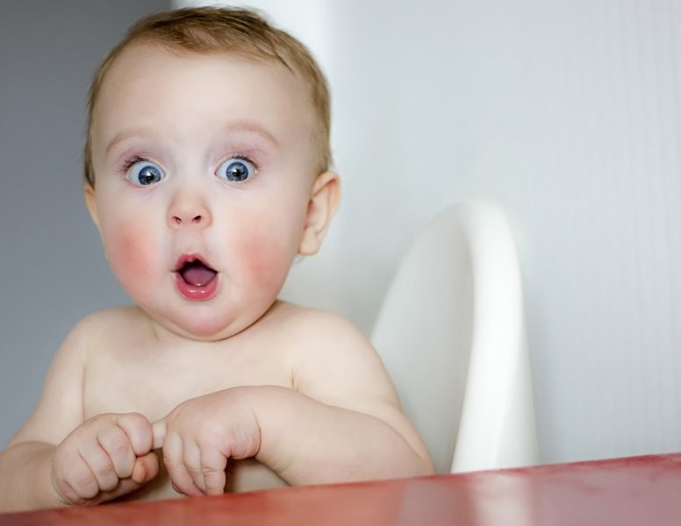
The Baby Gym Challenge
Welcome to our
Primary 3 Assembly!

Slide 2
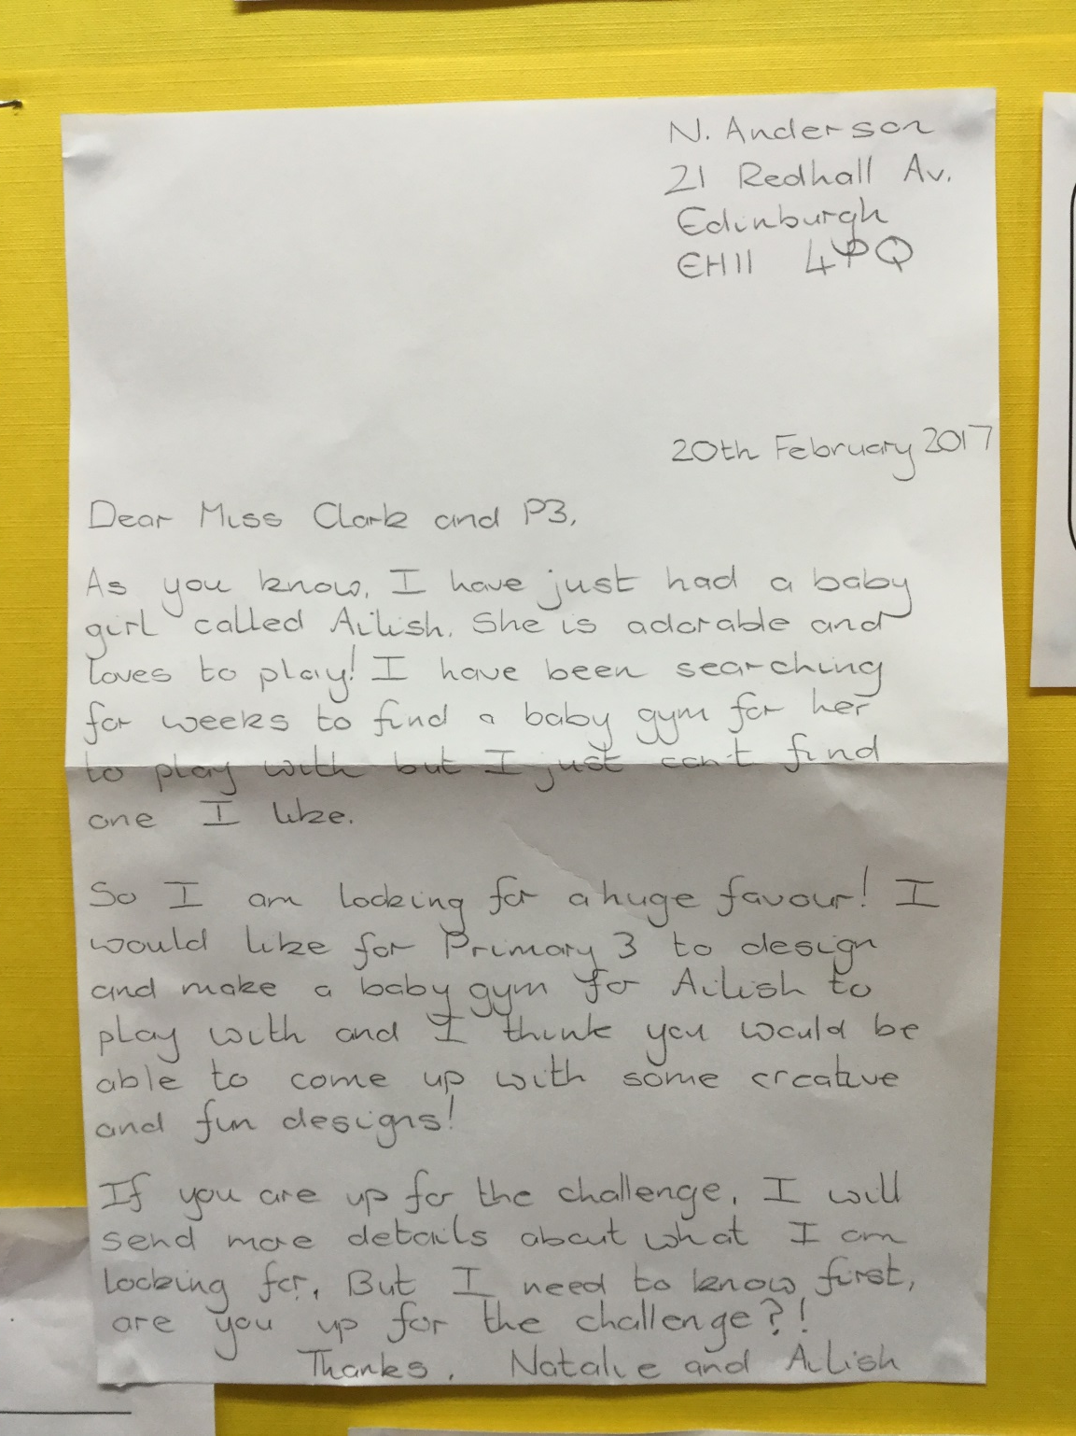
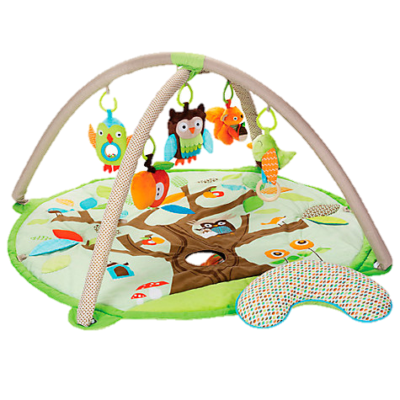
Primary 3 received an exciting letter…

Slide 4
The Boss Babies Rap
This is the Boss Babies rap
I’m looking for a toy so I can learn and play,
Something to stop me crying night and day,
What about a baby gym? I’ve heard they’re cool,
But it has to be the best, because I’m no fool!
Baby gym, my my my baby gym!
Baby gym, my my my baby gym!
I’d like a toy that’s really colourful and comfy,
So that I can roll around in my onesie!
With toys that I can touch, see, hear and smell,
If you can manage that then you’re doing well!
Baby gym, my my my baby gym!
Baby gym, my my my baby gym!

Slide 5
The DESIGN Stage

Slide 6
The BUILDING Stage

Slide 7
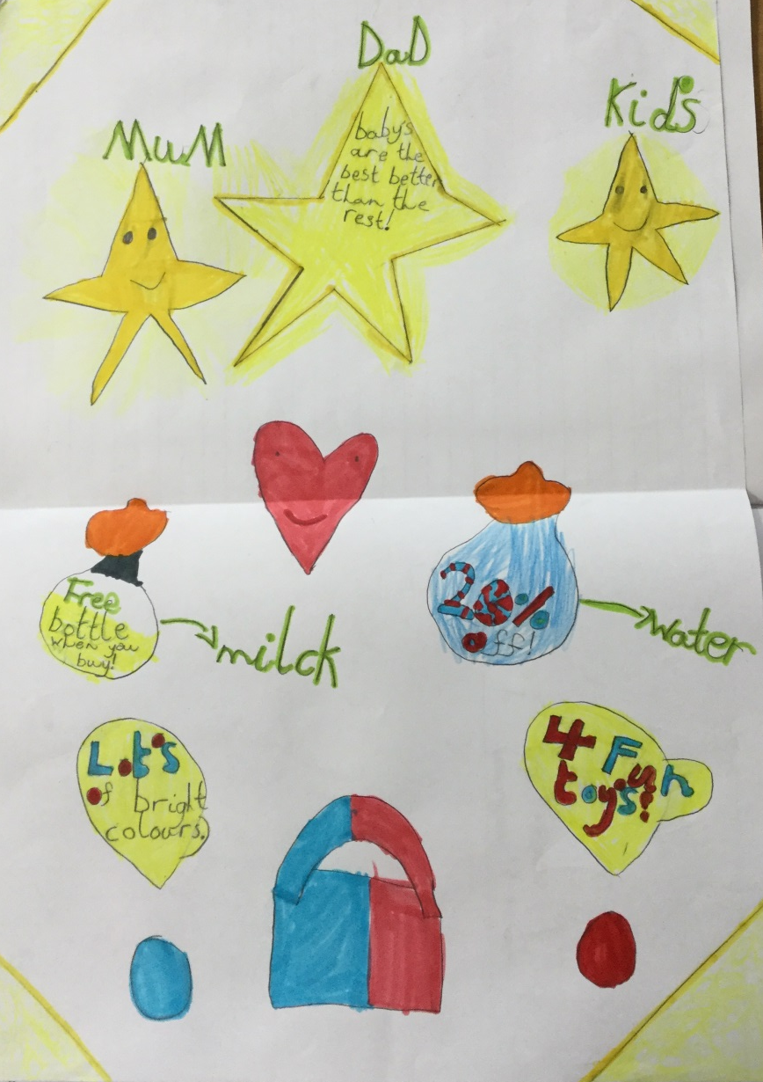
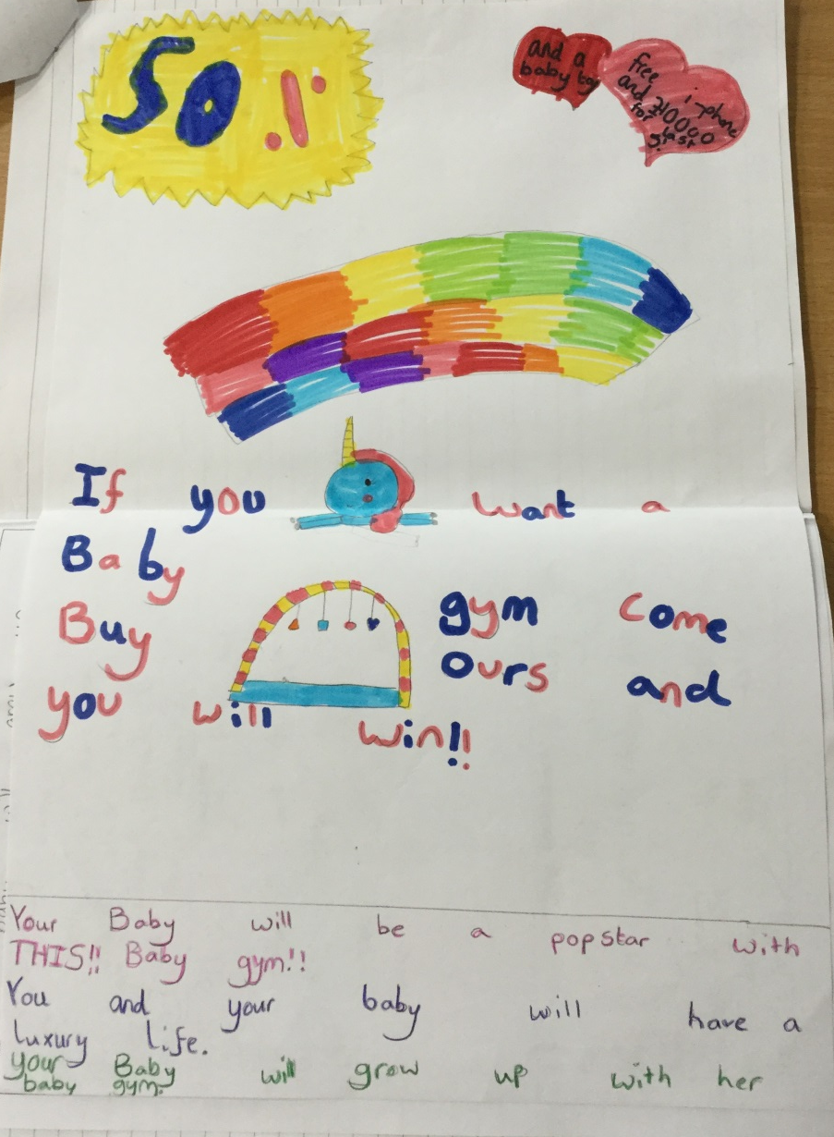
The SELLING Stage
We are learning to create an advert using persuasive language.
I can create a catchy slogan.
I can include the main selling points.
I can include special offers or discounts.
I can make my advert eye-catching and colourful.

Slide 8
Baby TV
Baby
TV

Slide 9
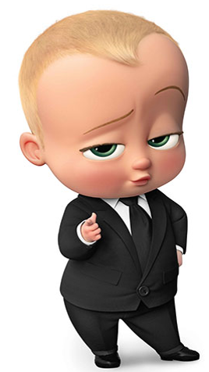
Thanks for listening!

