Slide 1
Welcome
to P3
Mrs Stewart
and
Mrs Redmond
2015

Slide 2
Our Expectations
In Primary 3, we have been creating a class contract that we created from all the things we thought were important to ensure a happy, friendly learning environment.
We expect good behaviour and good manners, demonstrating our school values at all times.
Our Golden Rule is to –
Always try our best and never give up!

Slide 3
How you can help?
Please support your children in preparing for school each day, your child should bring:
a sharp pencil and a ruler – if possible some highlighters
a rubber
reading and library books
homework diary
a healthy snack
a P.E kit (as per school uniform list)
a water bottle

Slide 4
Homework
Your child will have a minimum of two pieces of
homework each week. We would appreciate if all
homework could be signed.
Other Curricular Areas
Work will be set in other areas if/when relevant.
Spelling – will usually be set on a Monday and should be handed in by Friday. Pupils are tested on Friday. There will be a variety of spelling activities used. On occasions when task cards are used, the title of the spelling activity should be noted in homework jotters.

Slide 5
Reading
This term, your child will take part in twice weekly reading. The pages to be read at home will be recorded in the reading record, with any additional comments regarding how to support and should be signed each time.
We will be focussing on expression and fluency of reading this term, so please encourage your child with this, as they read to you.
It would be appreciated if the children could bring their books every day, as their reading will be heard throughout the week and reading activities may be based on their current book.
In addition to their reading books children will visit the library once a week to pick a library book of their own choice.

Slide 6
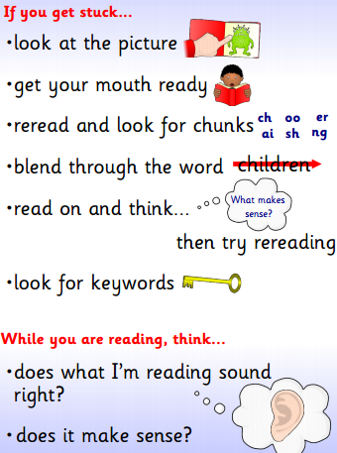
How you can help with their reading?

Slide 7
Maths
Homework will be set as required and should be returned by the date set in their jotter.
How you can help with Maths and Numeracy?
Ask your child the time, use both analogue and digital displays.
Give your child coins to practice counting money
Count in steps as you walk, count in 2’s, 5’s or 10’s.
Ask simple problems. I have 12 sweets I eat 6 how many left?

Slide 8
Free time Friday
Children who have respected the class community charter all week will be rewarded with Free time Friday on a Friday morning.
Children who have chosen not to respect the rights in our Class Charter will lose some of their Free time Friday.
Parents will be made aware of this with a letter home which we ask to be signed.
A certificate will be issued at the end of each term to children who have not lost any of their Free time Friday time.
This, along with the Class Dojo system, Star Pupil certificates and Living the Values, rewards good behaviour.

Slide 9
Specialist Teachers
We will also have lessons throughout the year from:
Mrs Mitchell – P.E. Term 1
Mr Buchan - Enjoy-a-ball
Additional Support
Mrs Kellner and Mrs Robertson (PSW) will provide extra support as required.

Slide 10
Our first couple of weeks…
Community building
Team work
Established grouping
Class community charter – class rules
Dojo system
IDL Traditional Tales

Slide 11
Term 1 Overview
Traditional Tales focus on Writing, Social Studies and Drama
Maths- new groupings- Number to 100, addition and subtraction within 10/20/30, mental maths and time.
Literacy- Writing for a variety of genres linked to Traditional Tales, spelling, handwriting and grammar. Reading own group books and whole class novel.
P.E- ‘Mini-fit’ and Ball Skills.
Expressive Arts- Drama linked to IDL, Art and singing
Technologies – Internet Safety
H&WB - Friendships and Building Community, Roots of Empathy programme
Science – Sound
RME – Celebrations/Harvest
Extras – WL Money Week

Slide 12
Thank you for coming
along this evening!

