Slide 1
ORT Characters

Slide 2
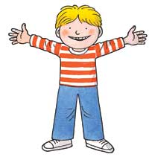
Kipper

Slide 3
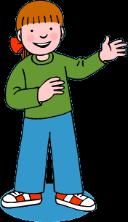
Biff

Slide 4
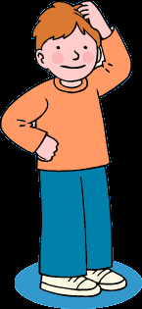
Chip

Slide 5
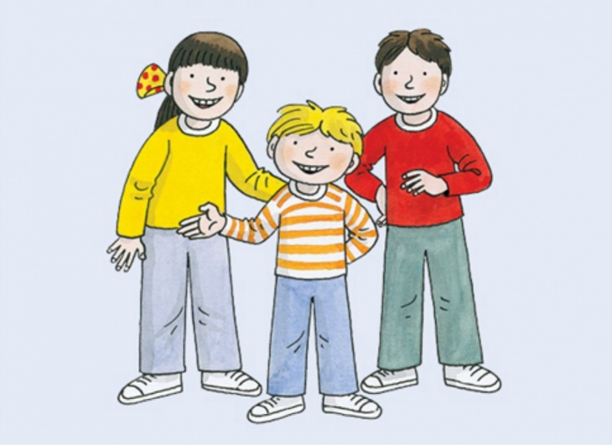
Biff and Kipper and Chip

Slide 6

Mum

Slide 7
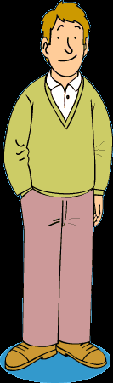
Dad

Slide 8

Mum and Dad

Slide 9
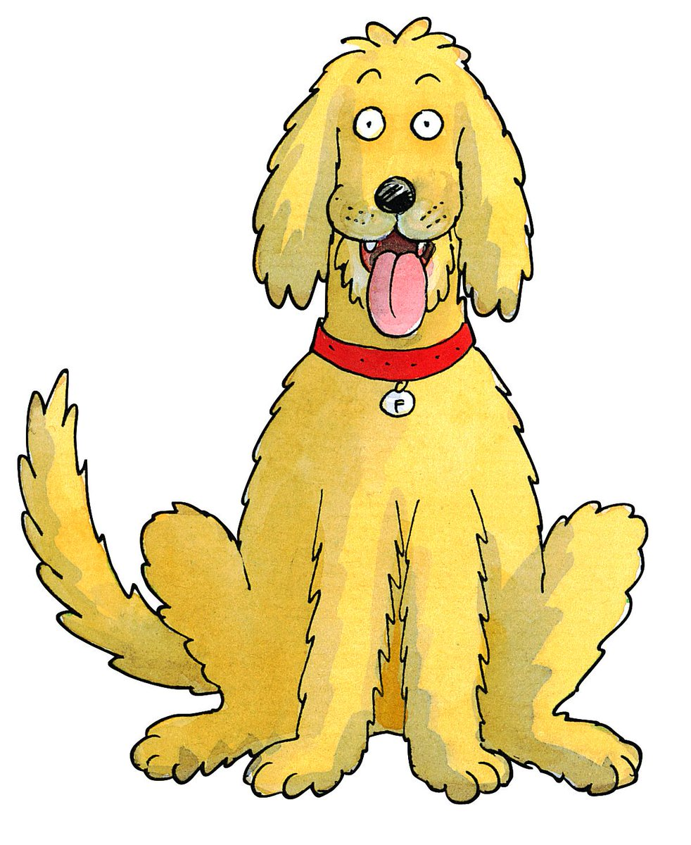
Floppy

