Slide 2
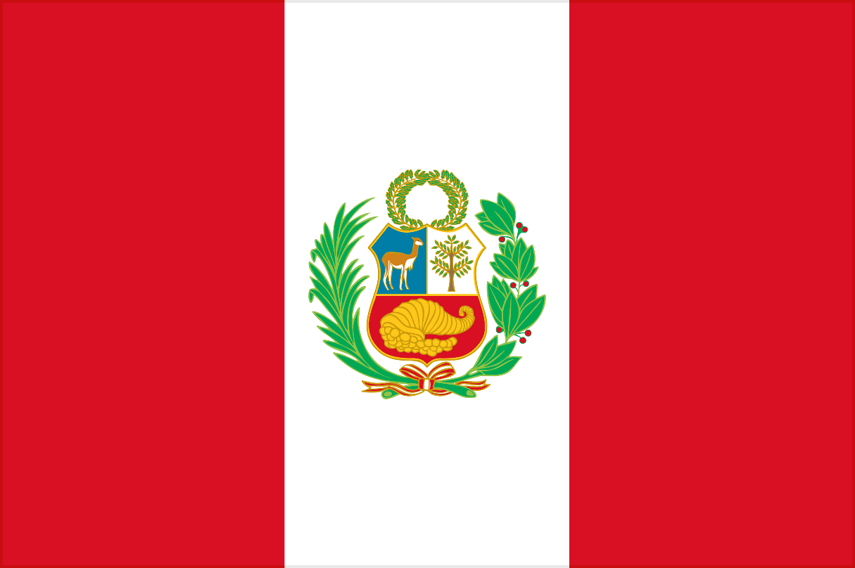
All About Peru
Peru’s official name is Republic of Peru (República del Perú).

Slide 3
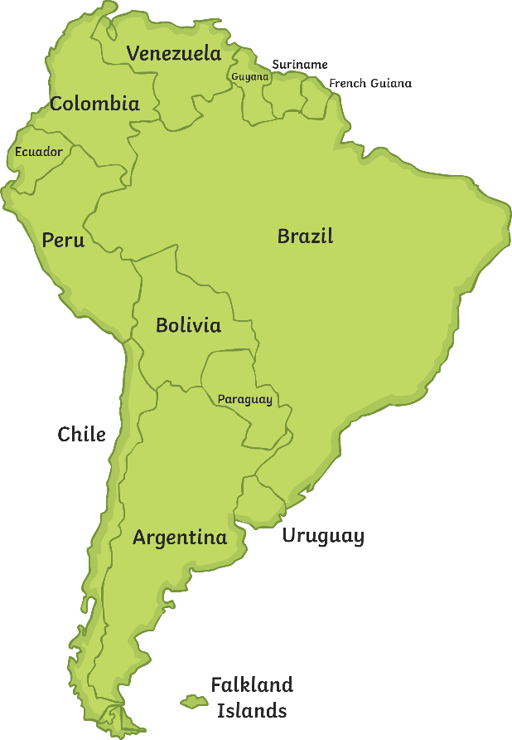
All About Peru
Peru is located in South America. It is the third largest country in South America and the 20th largest nation in the world.

Slide 4
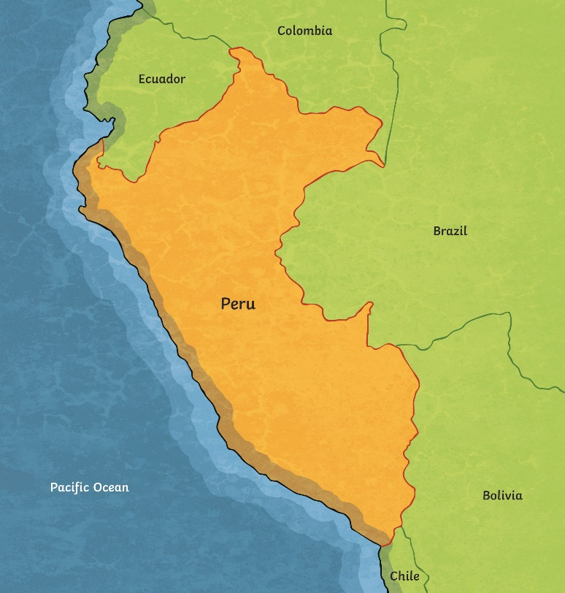
All About Peru
Peru shares land borders with Ecuador, Colombia, Brazil, Bolivia and Chile. Its longest land border is shared with Brazil. It has a coastline along the Pacific Ocean.

Slide 5
All About Peru
Capital City: Lima
Most populated city in Peru.
Located in the valleys of the Chillón, Rímac and Lurín rivers.
Has a population of more than 9 million.
Founded by the Spanish conquistador Francisco Pizzaro in 1535.

Slide 6
All About Peru
Peru’s flag is red and white with the national coat of arms in the centre of the white stripe.

Slide 7
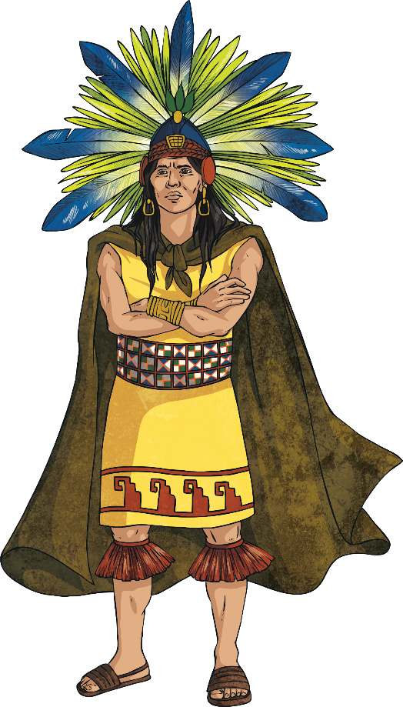
All About Peru
Many great ancient civilizations inhabited Peru, including the Chíma, Nasca and Incas. These civilisations contributed to Peru’s landscape greatly with beautiful temples and ancient ruins that continue to exist today!

Slide 8
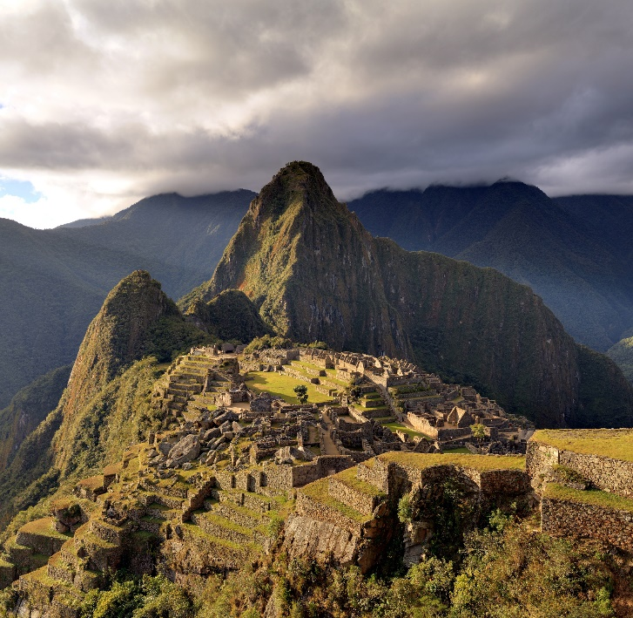
All About Peru
Machu Picchu
Mysterious ancient ruins located in the Andes. Once this was a large Inca city and now it is one of the most visited archaeological locations in Peru.
By Martin St-Amant (S23678) - Own work, CC BY-SA 3.0, https://commons.wikimedia. org/w/index.php?curid=8450312

Slide 9
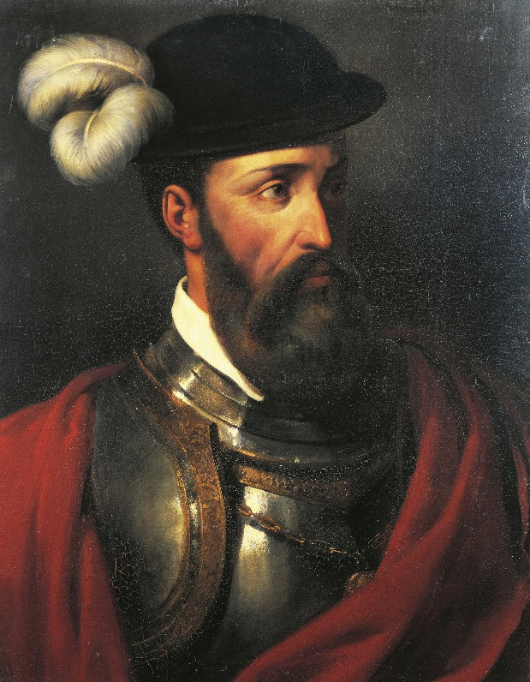
All About Peru
Spanish Conquest AD 1532
The Inca Empire thrived for centuries before being conquered by Francisco Pizzaro and his army in 1532.

Slide 10
All About Peru
José San Martín Simon Bolivar and their armies helped to free Peru from Spanish rule and it gained independence in 1821.

Slide 11
All About Peru
The world’s largest rainforest, the Amazon, covers nearly half of Peru. It is called the ‘selva’ in Spanish and covers half of Brazil too. In this huge jungle you can find plants and animals that do not exist anywhere else on Earth. Scientists believe that there may be tribes of people who live in the Amazon who have never seen the outside world.

Slide 12
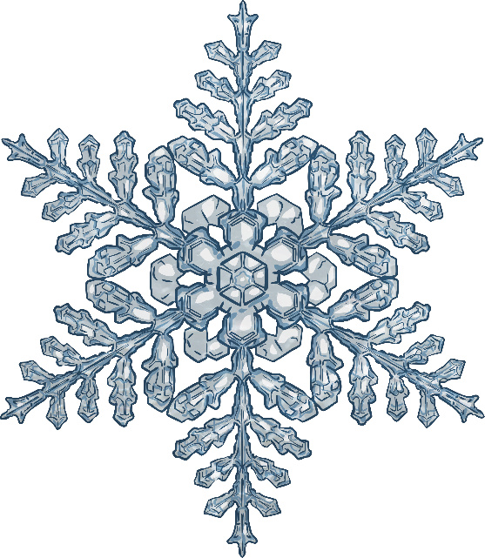
All About Peru
Climate
The climate in Peru varies from tropical in the east to dry desert in the west and can be mild to freezing in the Andes.

Slide 13
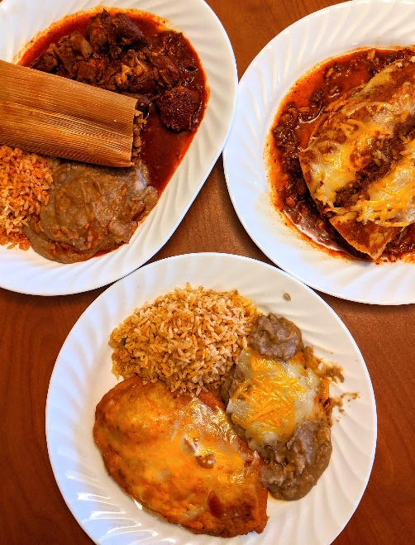
All About Peru
Food
Chupe de camarones: Soup made from shrimp, potatoes, milk and chilli pepper.
Cuy: Roasted or grilled guinea pig is a delicacy.
Anticuchos: Beef heart soaked in spices and grilled.
Tamales: Boiled corn with meat or cheese wrapped in a banana leaf.

Slide 14
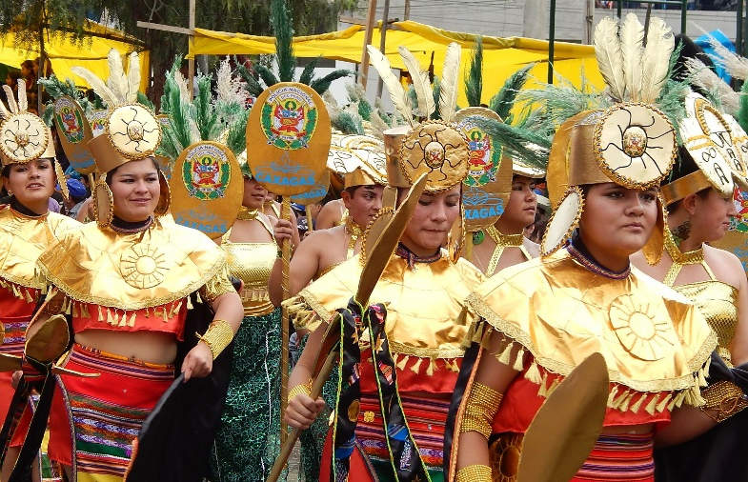
All About Peru
Festivals:
Fiesta de la Cruz: Festival of the Cross with parades, dancing and music in towns such as Lima, Ica and Cusco.
El Señor de los Milagros: A religious festival in Lima. ‘The Lord of Miracles’ is the festival celebrating Jesus Christ. Thousands of people celebrate it and wear bright purple on the day.
Inti Raymi: Festival of the Sun. The festival celebrates the winter solstice and worships the Inca sun god.

Slide 15
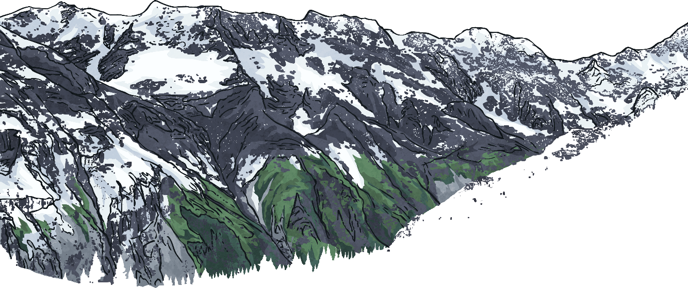
All About Peru
Peru has a famous mountain range called the Andes. These mountains are so tall and impressive that the Peruvian people often thought they were gods. Mammals such as llamas, alpacas and vicunas eat the grasses and special types of plants that grow in the Andes.

Slide 16
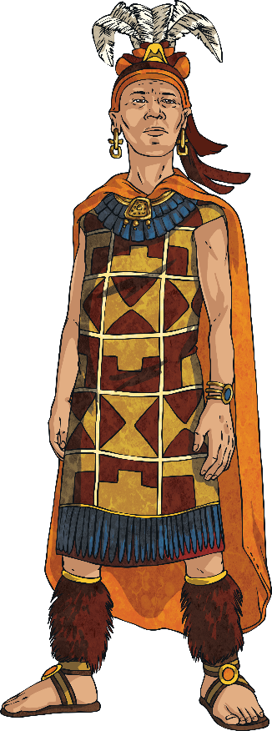
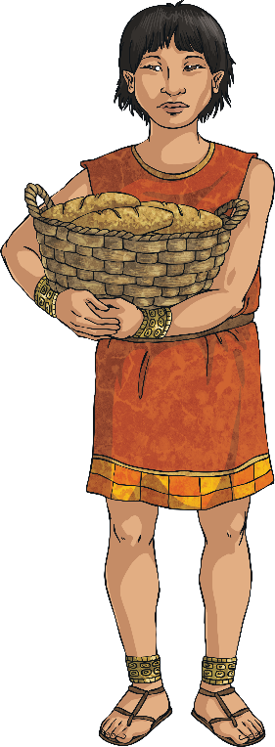
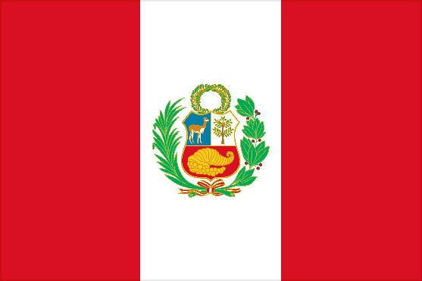
All About Peru
Official Languages: Spanish, Quechua
Money: Nuevo Sol
Area: 1,285,216 square kilometers
Major Mountain Ranges: Andes
Major Rivers: Amazon, Ucayali, Madre de Dios

