Slide 1
Plastic Pollution in
the Deepest Ocean

Slide 2
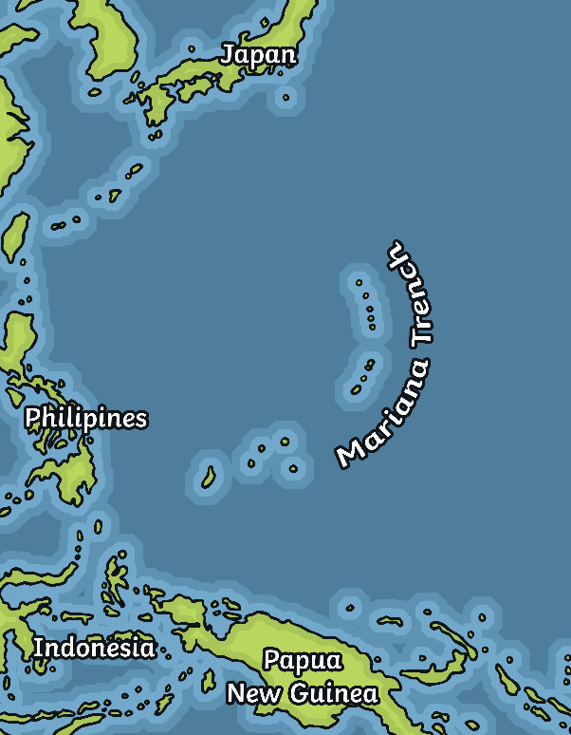
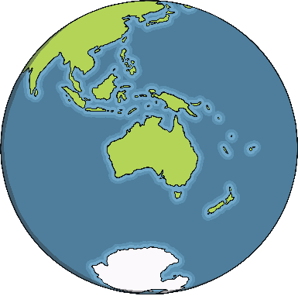
The Deepest Ocean
The Mariana Trench is the deepest point on our planet.
The Mariana Trench is found in a remote part of the Pacific Ocean.
It stretches down to almost 11,000 metres below sea level.

Slide 3
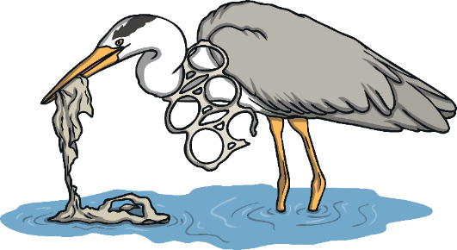

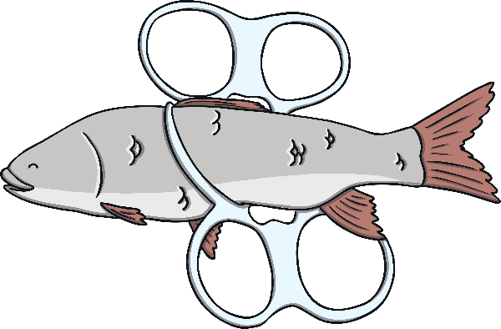
Plastic in the Ocean
Many millions of tonnes of plastic enter the oceans every year.
You may have seen videos of plastic floating on top of the sea and of sea animals trapped in plastic.
Researchers have been studying the deepest part of the ocean to find out if it has been polluted by plastic.
Where all the plastic in our oceans finally ends up is not well known.

Slide 4
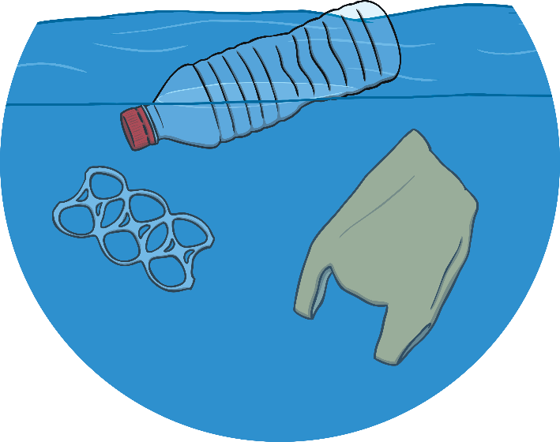
The Mariana Trench
Researchers collected bottom water and sediment samples from 2500m down
to almost 11,000m below sea level.
They found that the concentration of microplastics got bigger as they got deeper into the ocean trench.
The plastics they found were fibres a few millimetres long, probably from clothing, bottles, packaging and fishing equipment.
They also found a plastic bag, like the kind you get at a supermarket, in the deepest part of the ocean.

Slide 5
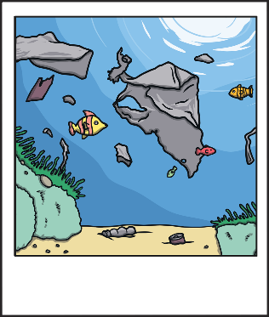

Exploring Our Oceans
Scientists study the oceans through underwater dives.
Scientists send submersible underwater vehicles or submarines down to take photos and videos.
Lots of rubbish was recorded in the database.
These photos and videos are stored in a database that is a collection taken from 5010 dives over the last 30 years.
Some of the rubbish found included rubber, metal, wood, and cloth but plastic was the most common.

Slide 6
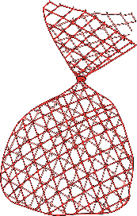
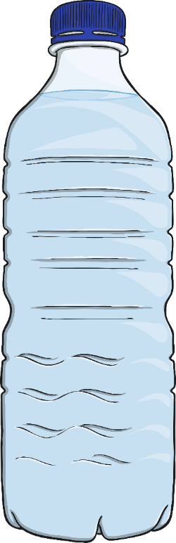
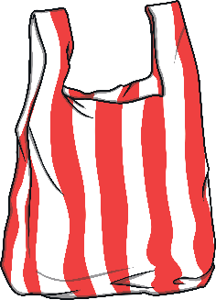

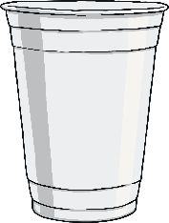


Plastic in the Mariana Trench
Most of the plastic (89%) was single use.
Single-use plastic is something that is used once and then put thrown away.
Things like plastic water bottles
or plastic cutlery are single use.

Slide 7
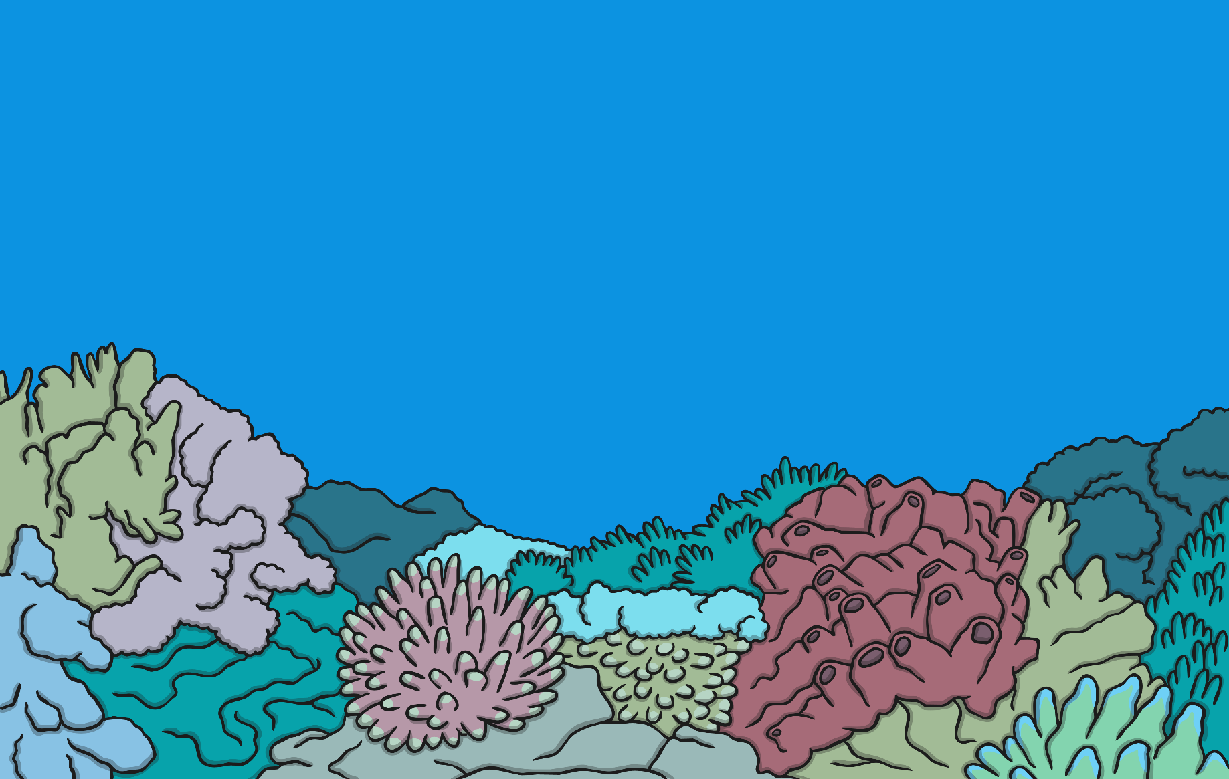
The Mariana Trench
Even though it is very deep, things like coral, jelly fish and octopus live in the Mariana Trench.
The study of the Mariana Trench showed that 17% of the plastic had an impact on the things living there.
This study shows us how serious plastic pollution is to our planet.

Slide 8
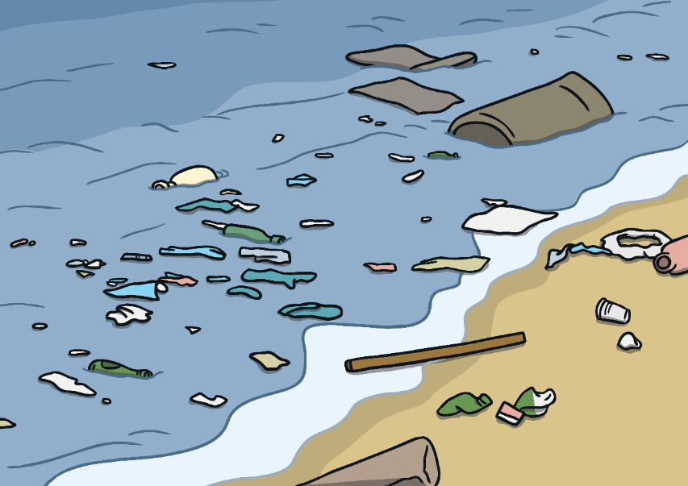

How Did the Plastic Get There?
Some parts of the Mariana Trench have higher levels of pollution than some of the most polluted rivers in China.
Plastic can get into the ocean directly if rubbish is blown from the beach or thrown from ships on the sea.
A different study found that most plastic in our oceans comes from 10 very polluted rivers.
These rivers run through areas where lots of people live; people who use lots of plastic.

Slide 9
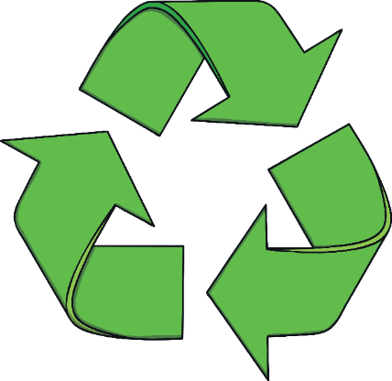
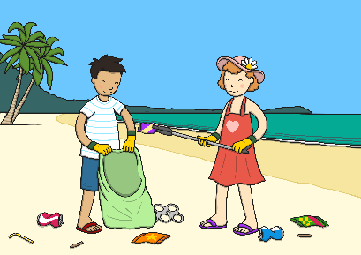




What Can We Do?
Join a river clean-up.
Reduce and recycle
Support bans on single-use plastics.
Ask shops and restaurants if
they have
plastic-free alternatives.

