Slide 1
Kid’s quiz!

Slide 2
How to play…
You could choose to play this quiz in your house in teams – choose somebody to read the questions and decide how long each team gets to write or say their answer. Choose how many points each question is worth and add up your scores.
If you are able to video chat with other family members or maybe some friends from school, you could play against them, each household could be a team. You will still need to choose someone to read out the questions. Don’t look at the answers until you are all ready to check them!
You will need to be able to see the PowerPoint for the Picture Round, so make sure you can either share your screen or email it to each team before you start. Set a time limit for the picture round and see how many of the films you can name.

Slide 3
Round One: General Knowledge
How many sides does a pentagon have?
Which fairy-tale character had VERY long hair?
What sort of animal is the videogame character, Sonic?
Which three colours make up the French flag?
What colour are sapphires?
How many months start with the sound J?
Which word can go before ache, brush and paste to make three new words?
What do tadpoles turn into?
What magical item does Aladdin fly on?
What is the name of the fiery liquid which flows from a volcano?

Slide 4
Round One: Answers
How many sides does a pentagon have? Five
Which fairy-tale character had VERY long hair? Rapunzel
What sort of animal is the videogame character, Sonic? Hedgehog
Which three colours make up the French flag? Blue, white and red
What colour are sapphires? Blue
How many months start with the sound J? Three: January, June, July
Which word can go before ache, brush and paste to make three new words? Tooth: toothache, toothbrush, toothpaste
What do tadpoles turn into? Frogs
What magical item does Aladdin fly on? Magic Carpet
What is the name of the fiery liquid which flows from a volcano? Lava

Slide 5
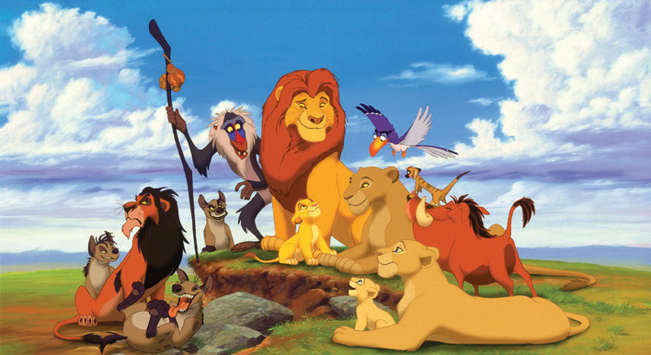
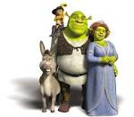
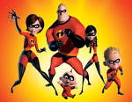
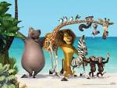
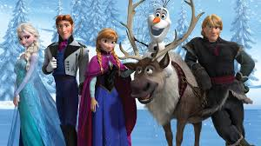
Round Two: Name the Film
5
1
3
4
2
10
6
8
7
9

Slide 6
Round Two: Answers
5. Gnomeo and Juliet
1. The Lion King
3. The Little Mermaid
4. Shrek
2. The Incredibles
10. Madagascar
6. Despicable Me
8. Monsters, Inc.
7. Ratatouille
9. Frozen

Slide 7
Round Three: Scavenger Hunt Can you find the following things around your house – if you find it in 30 seconds (or a minute?!), you get a point!
Something red.
Something soft.
Something with buttons.
Something you can eat.
Something made of metal.
Something you can bend.
Something with a pattern.
Something shiny.
Something from outside.
Something smaller than your hand.

Slide 8
Optional Round 4: Music
If you fancy doing a music round, it is very easy if you have a mobile phone or laptop with youtube, itunes, spotify or the likes!
Just make a wee playlist of songs you think teams might know and play the first 10 seconds or so of each song.
Let each team have time to write or say the song and/or who sings it, or choose songs from famous films and guess which film each song is from.
I will not attempt a music round because you will just end up with back-to-back Abba and Fleetwood Mac and, although I’m sure I’m not the only one who would enjoy that, there might be some eye rolls!
I hope you have enjoyed doing some quizzing together. Have a very happy weekend everyone!
Take care, love from Mrs Jamieson!

