Slide 1
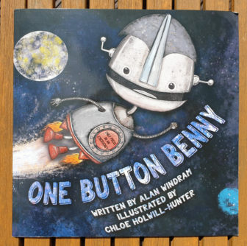
One Button Benny
Pick at least 2 tasks to complete for your Literacy work this week

Slide 2
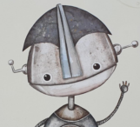
One Button Benny Reading Comprehension
1. What was written on Benny’s button?
2. Why was Benny sad?
3. Where did Benny hide after hearing stories about the collectors?
4. Who are the collectors?
5. How many times did Benny press his button?
6. Do you think Benny will have to press his button again?

Slide 3
Book Review
Print out the book review and complete (or create your own version)
Wonderful Writer
During the book, Benny discovers that his button can help people. Write your own imaginative story about a robot with a special button that helps people or the environment.
Dynamic Designer
Design a special robot, draw it and label its features. You may even want to build one?
Word Wizard
Find out the dictionary definition of the following words and write them in your own sentence: emergency, wondered, gigantic, flash

Slide 4
Artistic Ace
Draw a picture to represent part of the story and write at least 2 sentences to describe your drawing.
Question Master
Design your own One Button Benny quiz. (remember to use question marks)
Rocking Researcher
In the book Benny flies off to space. Find out the names of the planets in our Solar System. Pick one and write a few facts about it.

