Slide 1
Welcome to our Family Learning Event for Multiplication & Division

Slide 2
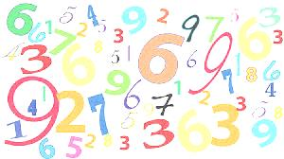
Family Learning
‘Parents are a child’s first and most enduring educators, and their influence cannot be overestimated. Parents should be at the centre of any plan to improve children’s outcomes, starting with the early years and continuing right through schooling.‘
Williams P. Independent Review of Mathematics Teaching in Early Years Settings and Primary Schools: final report DCSF, 2008
Welcome!
Notes:
Importance of involving families

Slide 3
This is how maths feels for some people
Notes:
How maths can make some people feel.

Slide 4
Aims of the Event
To provide parents with an overview of multiplication and division strategies.
To raise parent confidence in supporting pupils with multiplication and division.
Notes:
Aims of the event

Slide 5
“Why do they do it differently these days?”
‘When children reach a certain age many parents get a shock. They find their children bringing home vocabulary and methods that they just don’t recognise.’
‘Parents keen to help realise that…they don’t understand what their child is doing and… when they try to demonstrate how to do something differently, all they manage to do is confuse the child.’
‘Adapted from: ‘Maths for Mums and Dads’

Slide 6
Curriculum for Excellence – expectations for Numeracy and Maths
From the early stages onwards, children and young people should experience success in mathematics and develop the confidence to take risks, ask questions and explore alternative solutions without fear of being wrong. They will enjoy exploring and applying mathematical concepts to understand and solve problems, explaining their thinking and presenting their solutions to others in a variety of ways.
Mathematics: Principles and Practice

Slide 7
Notes:
This is why secure understanding and confidence with numbers is essential

Slide 8
Resource available on Parentzone
Notes:
New resource for families – clearly demonstrating the importance of being numerate within wide range of work/real life situations.

Slide 9
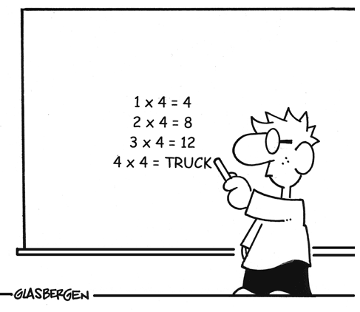
Key Concepts for Learning
Growth Mindset
Sense of number –
SEAL and Numbertalks
Concrete, Pictorial and Abstract
(CPA) Approach
Notes:
Concepts underpinning learning in West Lothian

Slide 10
“ … aptitude is the length of time it takes a person to learn, not how ‘bright’ a person is, that is, everyone can learn given the right circumstances.”
Notes from Benjamin Bloom’s Lecture, ACSA, April 1987

Slide 11
I can’t do it…yet – Growth Mindset
Perhaps most important of all, encourage a growth mindset, i.e. the idea that ability and smartness change as you work more and learn more.
The opposite to this is a fixed mindset, where the idea is that ability is fixed and you can either do maths or you can’t. When children have a growth mindset, they do well with challenges and do better in school overall (Dweck, 2006)
Jo Boaler - Growth Mindset

Slide 12
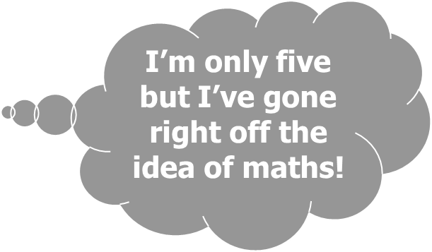
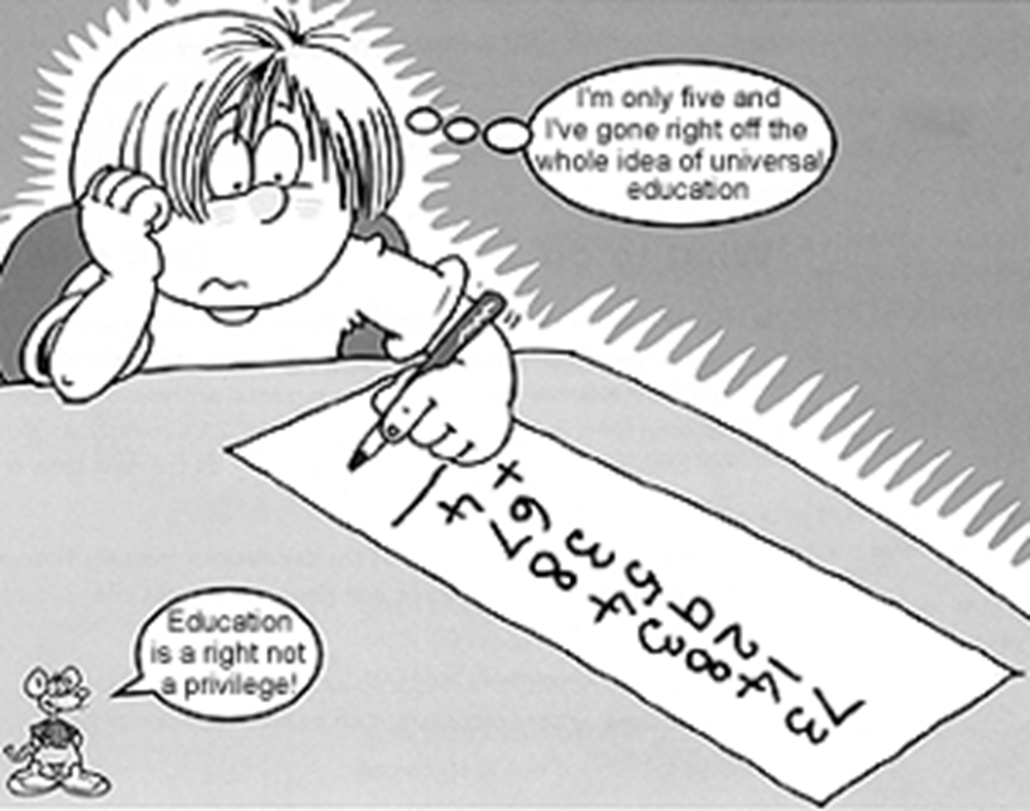
Jo Boaler
Notes:
Video clip of Jo Boaler introducing Numbertalks and relevance for children.

Slide 13
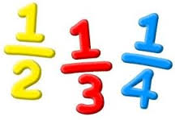
CPA Approach
CONCRETE ➢ PICTORIAL ➢ ABSTRACT

Slide 14
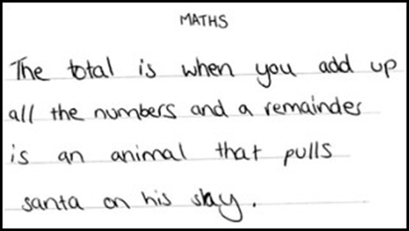
Multiplication
&
Division

Slide 15
Family Learning Booklet including: 1. Worked examples of strategies used to teach multiplication and division. 2. National Numeracy Progression of multiplication and division. 3. Key Skills in multiplication and division progression.
Resources Shared

Slide 16
Like to know more?
Ask your child’s teacher or a member of the leadership team.
Maths for Mums and Dads – Rob Eastaway & Mike Askew
Family maths toolkit http://www.familymathstoolkit.org.uk
Khan Academy www.khanacademy.org
Education Scotland’s Parent Support Website
http://www.educationscotland.gov.uk/parentzone
Multiplication support
Multiplication Support Booklet
Using Equipment for Multiplication

