Slide 2
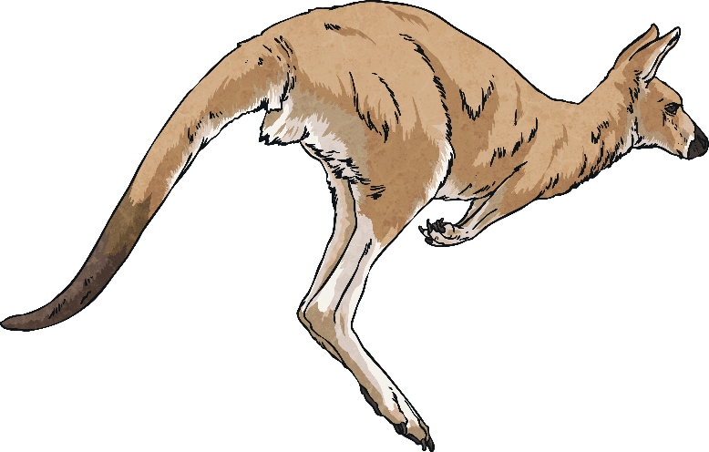
Have you ever heard of an animal being called a marsupial?
What do you think the word ‘marsupial’ means?
Your answer might include:
An animal that has a pouch.
An animal that raises its young in a pouch.
This is correct!
Let’s find out together.

Slide 3
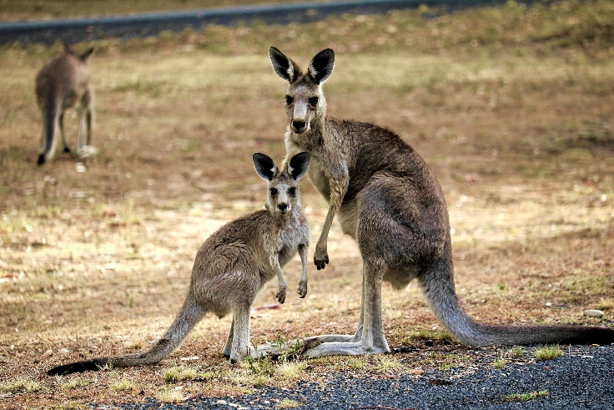
Kangaroo
Kangaroos are mammals and belong to a group called marsupials. This means that the mother carries her young in a pouch.
Kangaroos have large, strong legs with big feet. This makes them great jumpers!
They also have a long tail (to keep them balanced) and a small head.
Kangaroos live in groups called mobs.
They are herbivores. This means that they eat plants, leaves and different grasses.

Slide 4
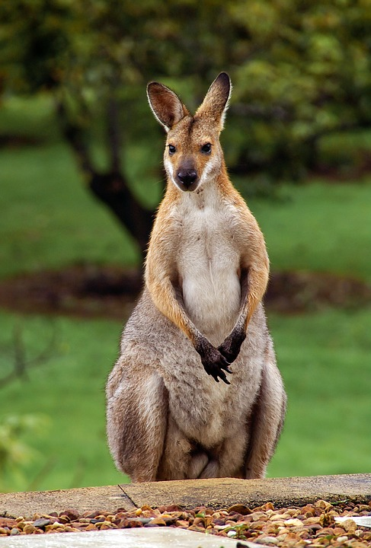
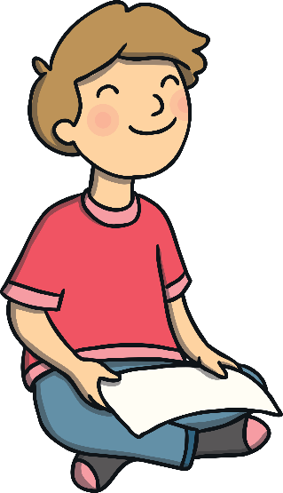
Kangaroo
A baby kangaroo is known as a joey.
The red kangaroo is the largest marsupial ^{in the world.}
^{Did You Know?}
Kangaroos cannot move backwards.

Slide 5
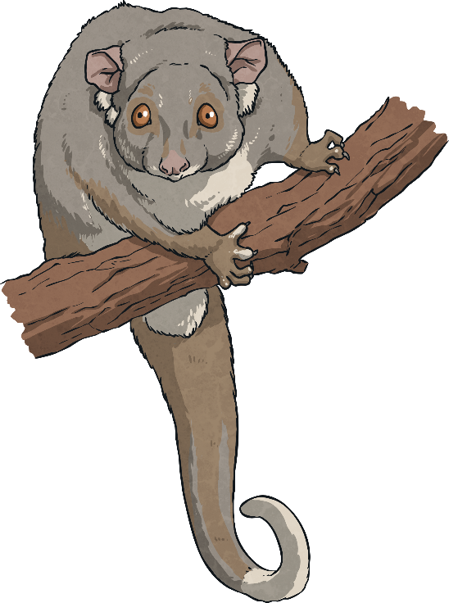
Majority of Marsupials
There is thought to be more than 330 species of marsupials.
Most of these animals call Australia home, while the rest live in South America.
The Opossum is a marsupial that is not found in Australia.

Slide 6
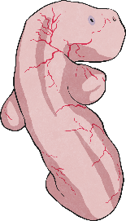
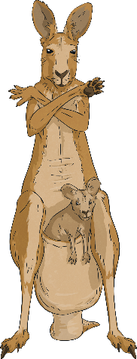
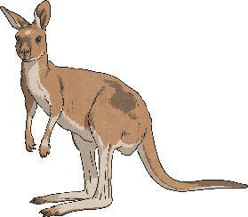
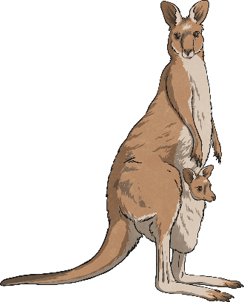
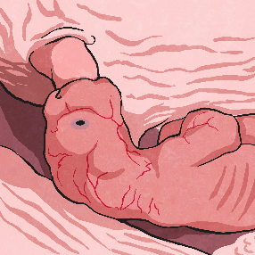
Kangaroo Life Cycle
After two years it can’t fit in its mother’s pouch anymore and is now an adult.
A female kangaroo gives birth to a baby kangaroo, called a joey.
1
5
2
The joey starts to come out of the pouch at eight months.
The joey climbs up its mother’s stomach and into her pouch.
4
3
The joey grabs onto a teat to feed from until it gets bigger and stronger.

Slide 7
Questions
What did you discover about marsupials?
Can you describe each stage of the kangaroo
life cycle?
Can you find out about other
marsupials?

