Slide 1
Year 3 | Week 8 | Day 3

Slide 2
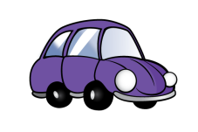
Year 3 | Week 8 | Day 4

Slide 3
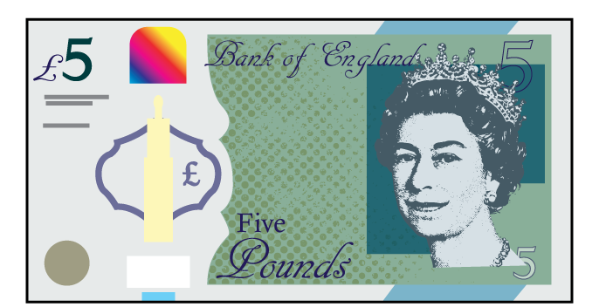
Year 3 | Week 8 | Day 5

Slide 4
Year 3 | Week 9 | Day 1

Slide 5
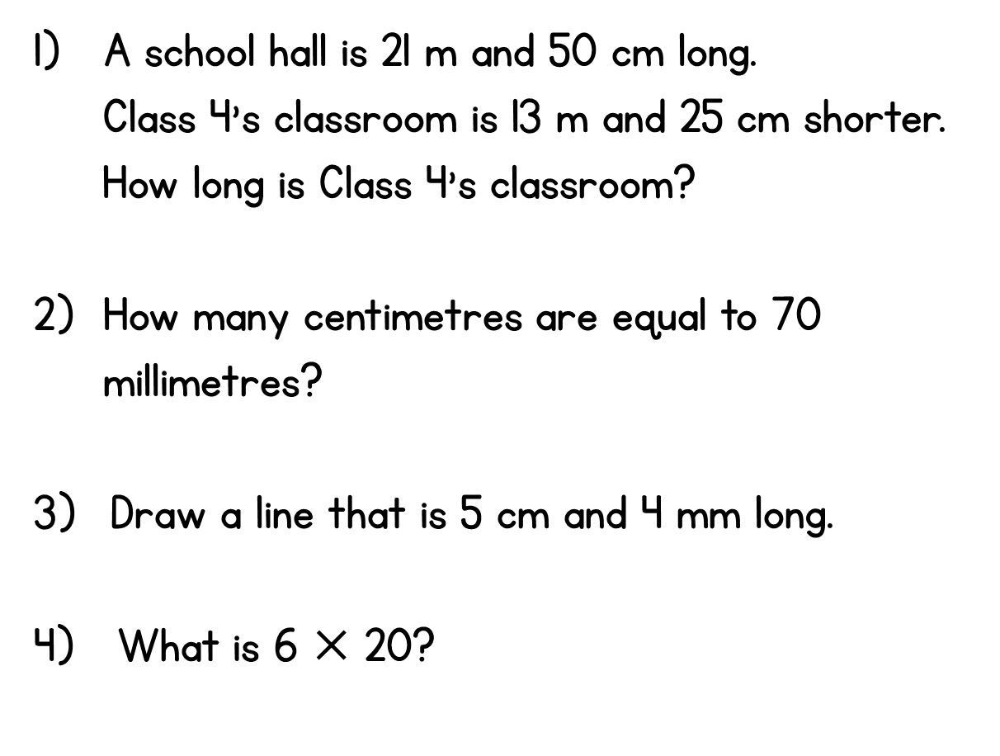
Year 3 | Week 9 | Day 2

