Slide 1
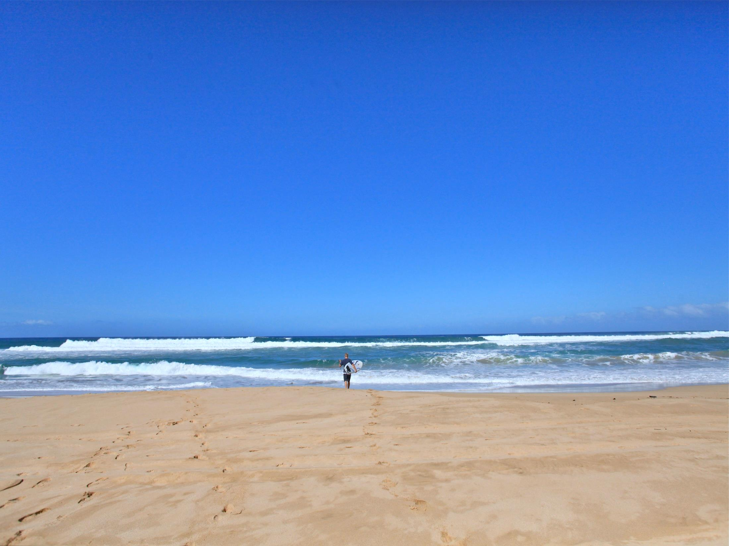
Kim’s Game
Look at the first picture for a few minutes and discuss.
Click on next slide, which shell is missing. When you think you know, click on the next slide to get the answer.
We will play the game 6 times.
Hint – spend time talking about each shell, describe it, give each a name e.g. star shell, twins. It will then be easier to say which one has gone missing. Enjoy.

Slide 2
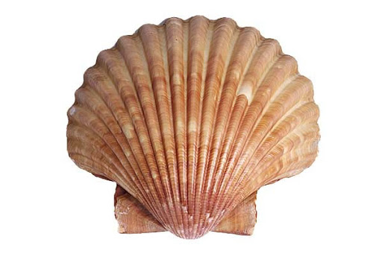
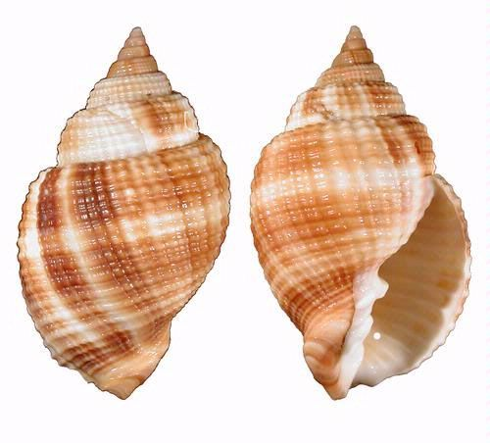
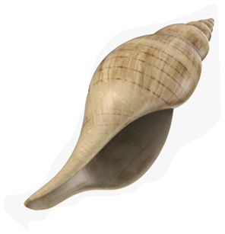
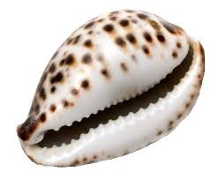
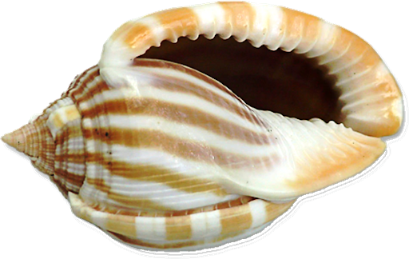
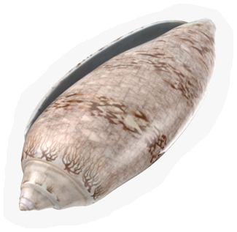
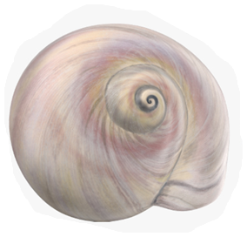
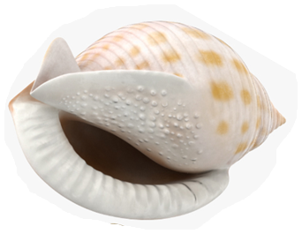
1

Slide 3
1

Slide 4
That was easy
It was this one
Let’s see if I can make it more difficult?

Slide 5
2

Slide 6
This one
2

Slide 7
3

Slide 8
This one
3

Slide 9
4

Slide 10
This one
4

Slide 11
5

Slide 12
These two
5

Slide 13
6

Slide 14
This one
6

Slide 15
How many did you get right?
Can you find out the real names of the shells?

