Slide 2
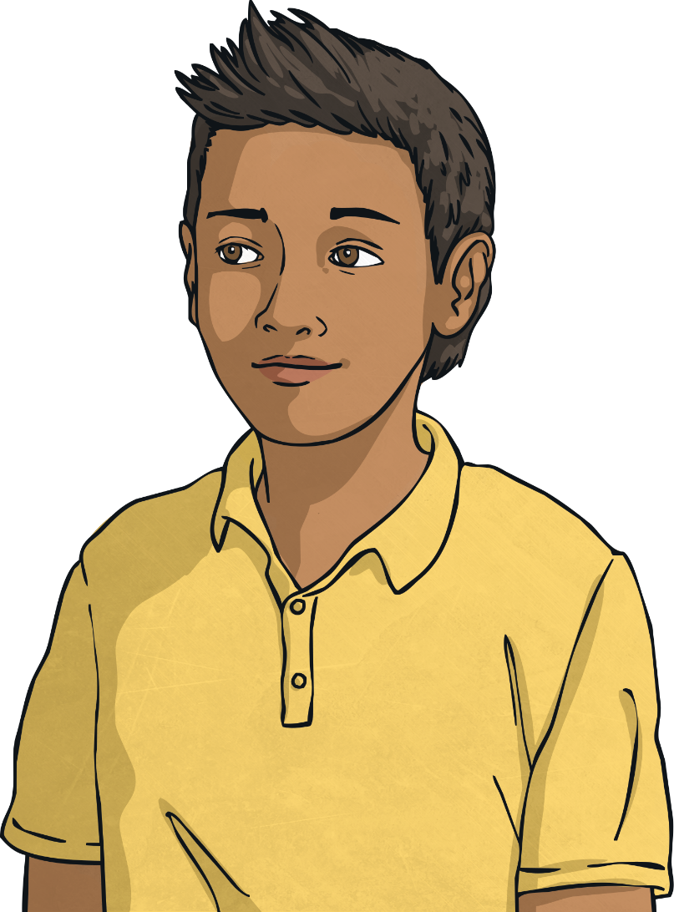
How Are You Feeling?
Sometimes we feel low, anxious or unhappy and we can’t think why.
Feeling like this is ok. But sometimes
we feel like this for so long that we
don’t want to do anything at all.
Sometimes we can’t always explain how we are feeling. That’s usually the time someone we know asks us if we’re ok.

Slide 3
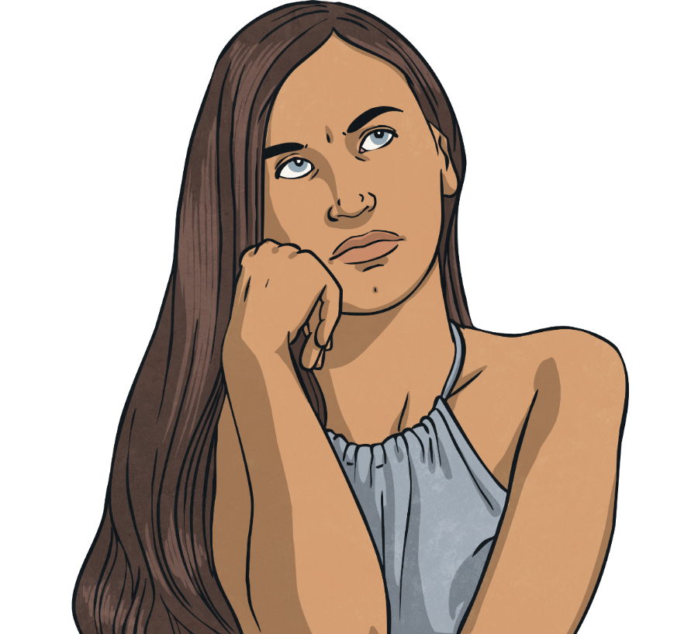
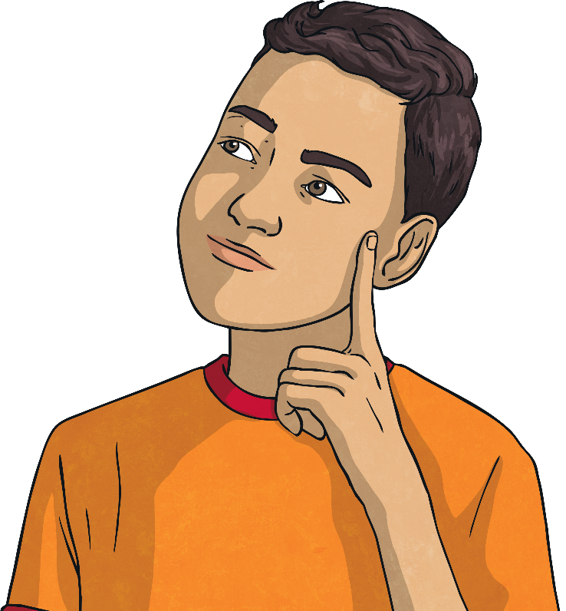
What happens
If we feel unhappy and we can’t explain why, sometimes things can get out of control.
Think about a time when you felt out of control.
Did you lose your temper?
Did you throw something?
Did you shout at someone?

Slide 4
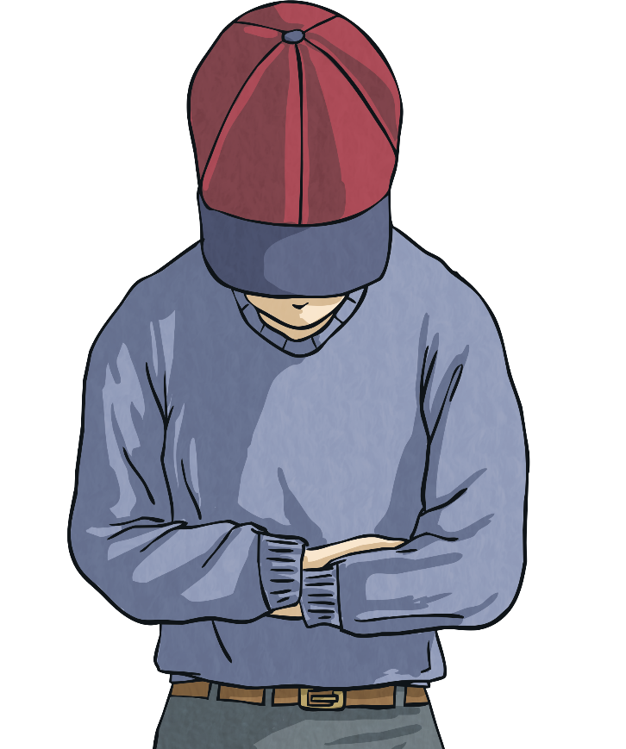
What Might Happen?
If we don’t deal with these feelings, things can get very messy. We might fall out with our friends. We might get into trouble at school. Our parents might get angry with us.

Slide 5
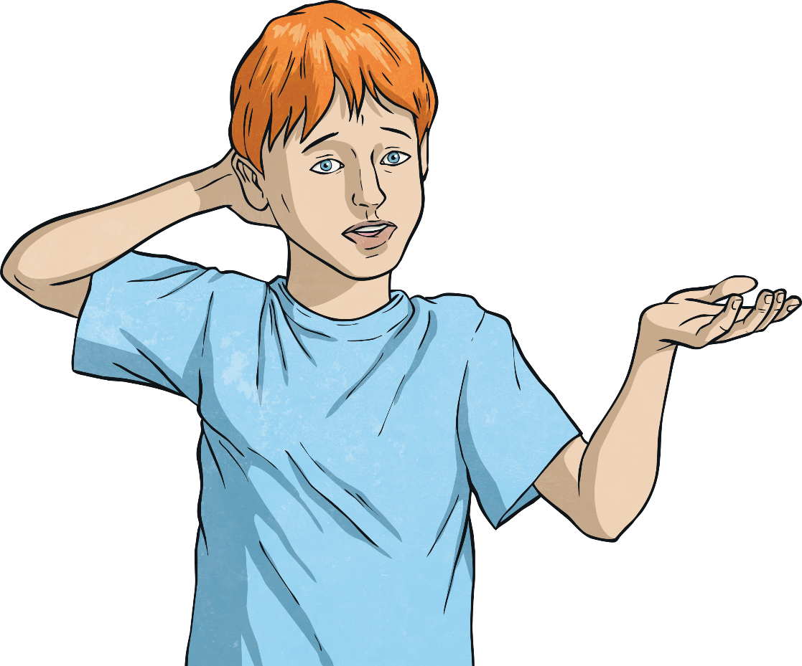

What Can We Do?
We often feel out of control of things that happen in our lives. We get told where we need to be, what time we have to leave, who’s picking us up, even where we might be sleeping that night.
?
?
?
?
?
We might have so many thoughts in our head that they start to get muddled up.
?
?
?
?
?

Slide 6
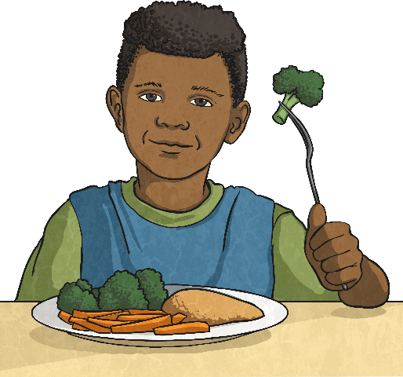
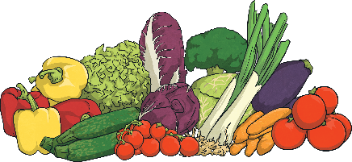

Eat Well, Feel Well
We have all been told about healthy eating, and usually it’s to
keep our bodies fit and healthy. However, a good diet helps our
mental health too.
Don’t skip meals. We are designed to have three meals
a day with some healthy snacks in between. If we don’t
eat regularly or healthily, we can feel grumpy, tired,
lose concentration and lack motivation to do anything.
Eat breakfast every day. Our bodies and minds have run out of fuel during the night and we need to give ourselves
a good start.
Avoid takeaways and ready meals. They are often full of things which
don’t help our minds to work efficiently.
Drink at least 6 glasses of water a day. It’s vital for our brain’s wellbeing.

Slide 7
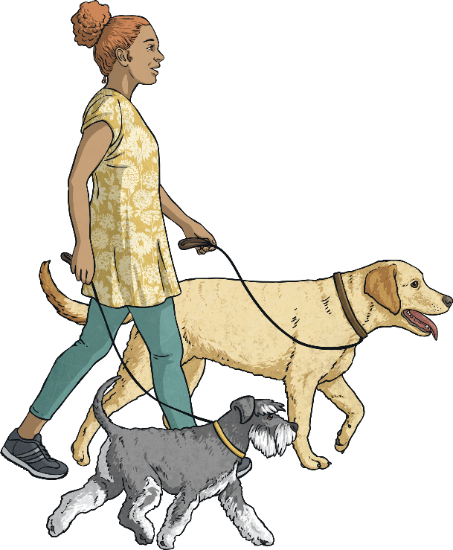
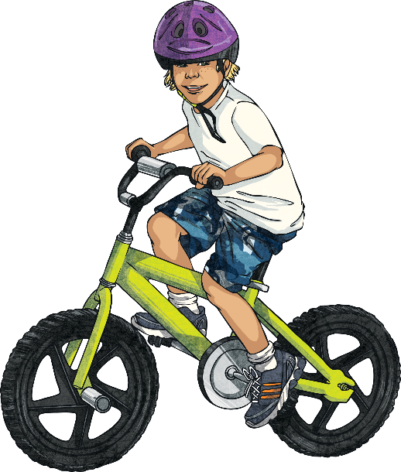
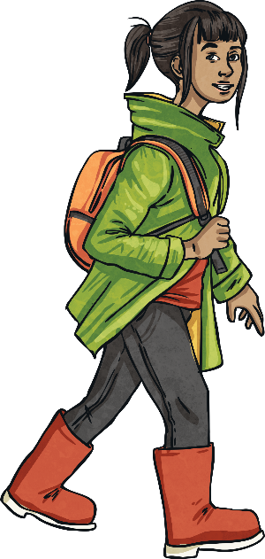
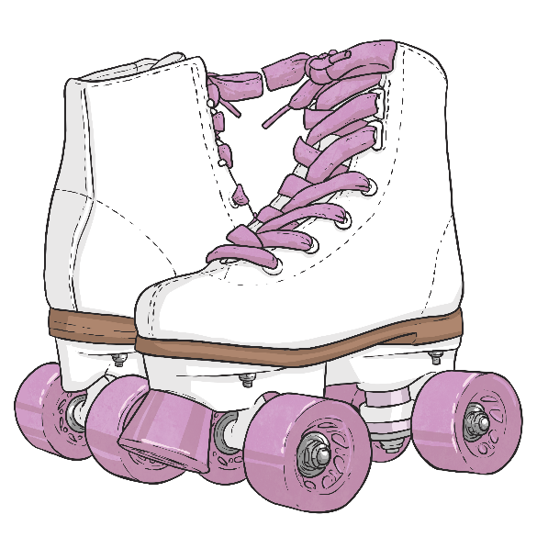
Get Out there!
Exercise is very important for your mental health. Moderate exercise is recommended for up to 30 minutes a day. Have a go! You could:
Rollerskate
Walk to school
Ride your Bike
Walk the dog

Slide 8
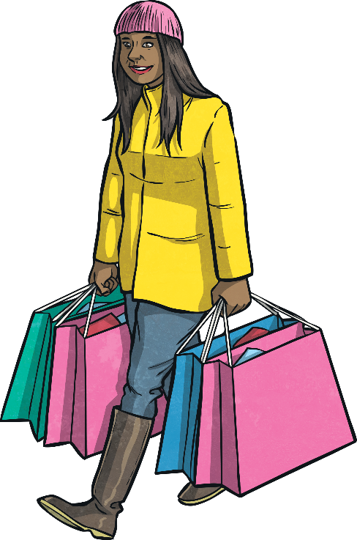
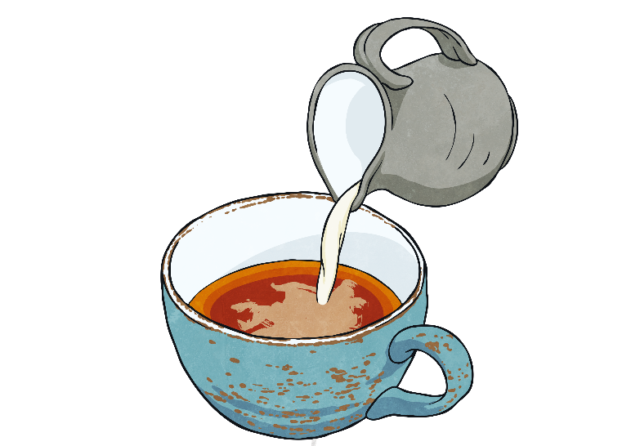
Help Other People
There’s nothing like the feeling you get when you are appreciated by other people. Helping them is a great way to do something useful but also feel good about yourself.
Is there a neighbour you can
pop to the shop for?
Have you got family at home who
would appreciate a cup of tea?
Do you have a younger
brother or sister who you
could read to at bedtime?

Slide 9

Think Good Things About Your Self
Thinking positively is tricky when you feel low, but following a few of these tips could help that downward spiral of negativity.
Consider your achievements – all those swimming certificates and dance exams mean you are doing really well!
Control your temper and walk away. Breathe deeply and concentrate on that until you feel calmer.
Avoid people who are unkind to you. Don’t try to make them be friendly.
Think about things you enjoy doing and that you’re good at.

Slide 10



Take Time Out
Things are really strange these days because of school closures. We may feel that everything is not ‘normal’ and we miss our friends, family and routine. When we feel like this we need to take time out…
Recharge your batteries – even if you just lie on
your bed for 10 minutes in peace and quiet.
Write down how you’re feeling. It’s a good way to get
things off your mind without upsetting anyone else.
Think of your favourite place. Remember what you
might hear, see and feel like when you’re there.

Slide 11
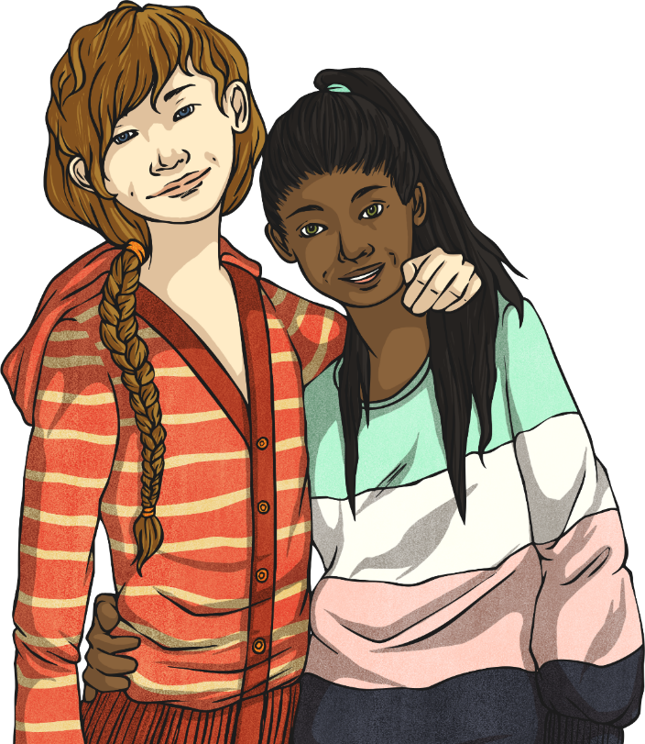
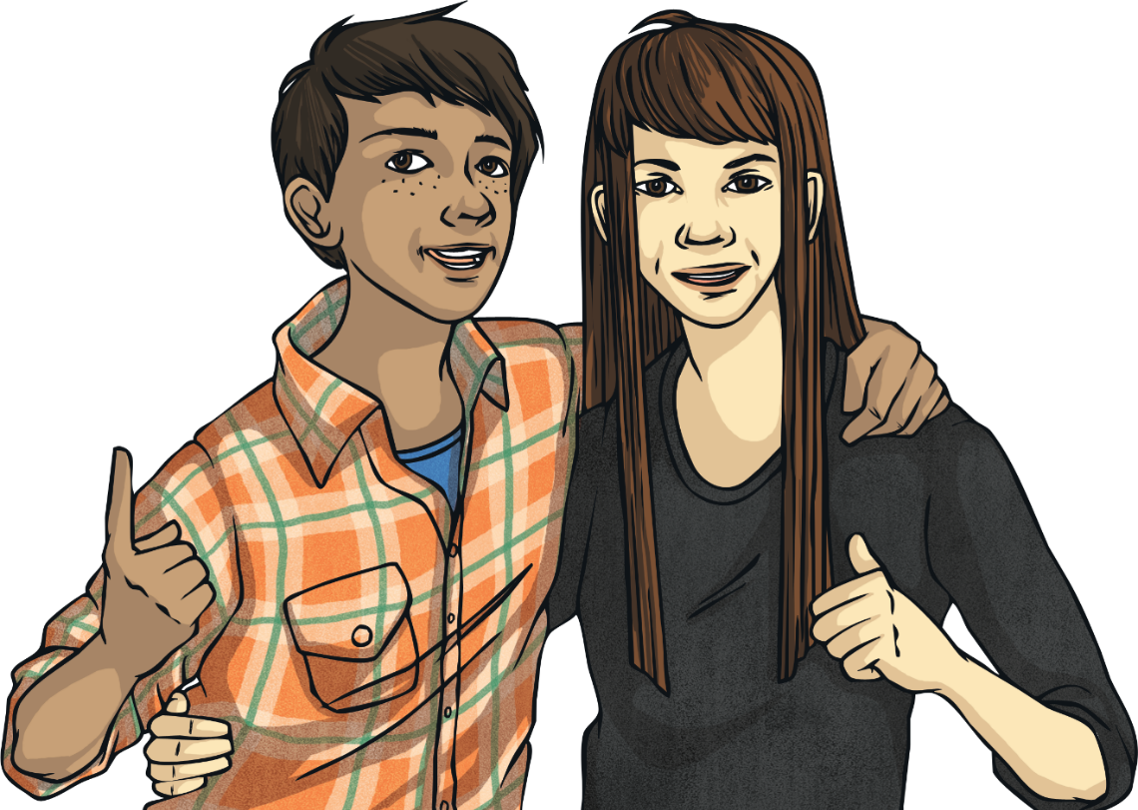
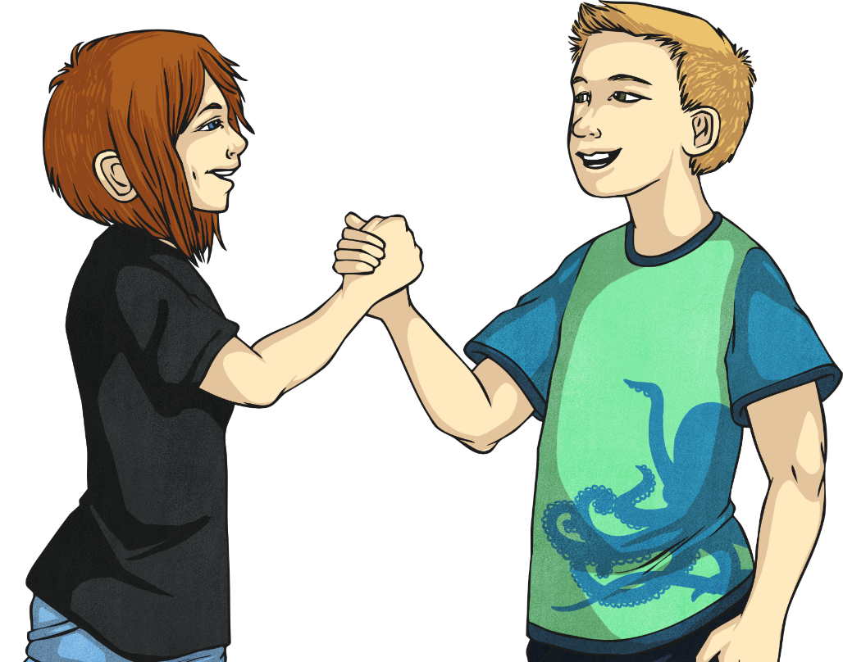
Spend Time With Friends
Our friends are called friends for a reason!
I understand we can’t meet with friends but we can still phone or FaceTime them. Confide in someone you trust. Tell them how you’re feeling. You never know, they have probably felt like that too, and might have some good advice.
Arrange to see a friend so that you have something to look forward to – maybe a trip to the cinema or shops.
If you have been spending a lot of time on your own recently, actively go and find a friend to spend time with.

Slide 12
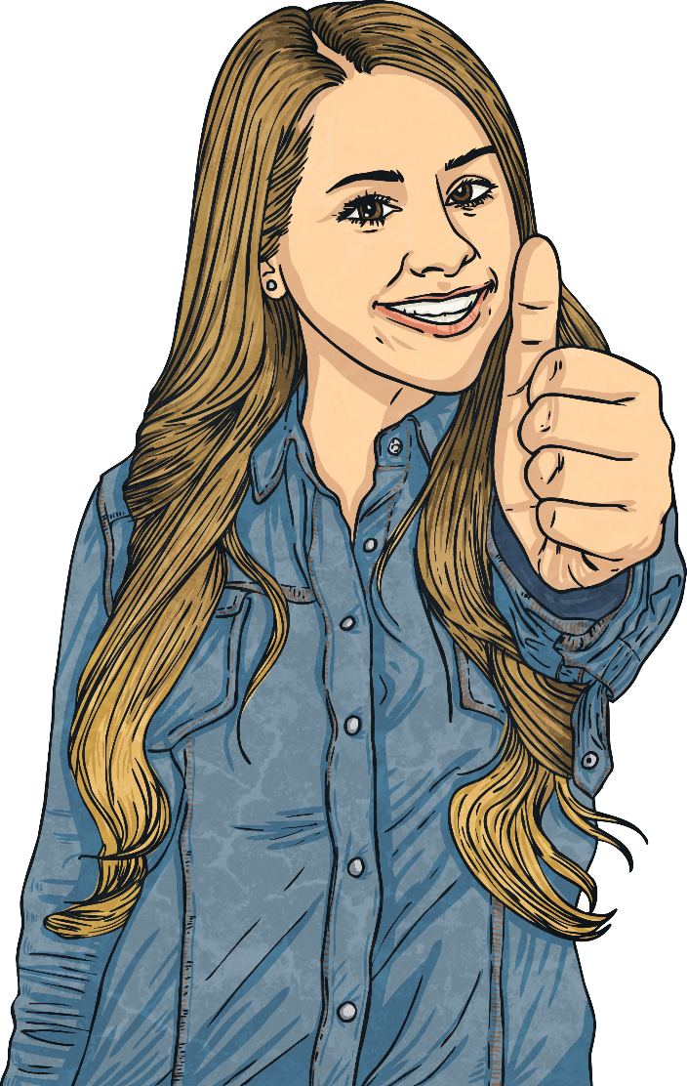
Ask For Help
There are people out there to help you.
Ask for help.

