Slide 1
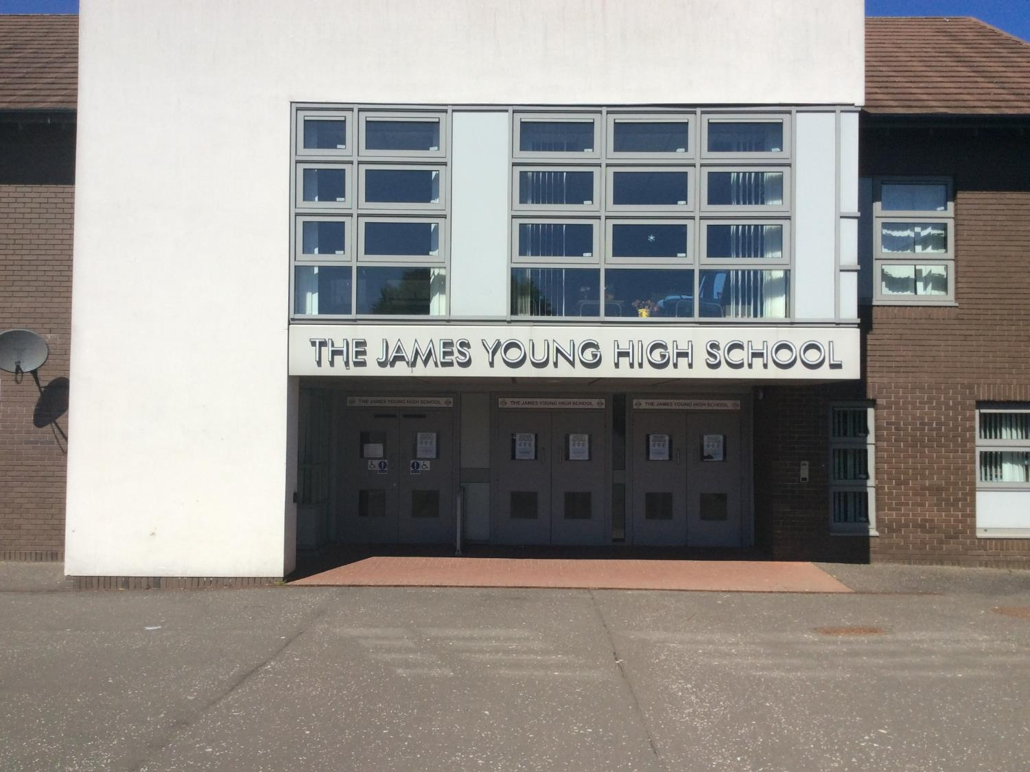
JYHS Virtual Tour

Slide 2
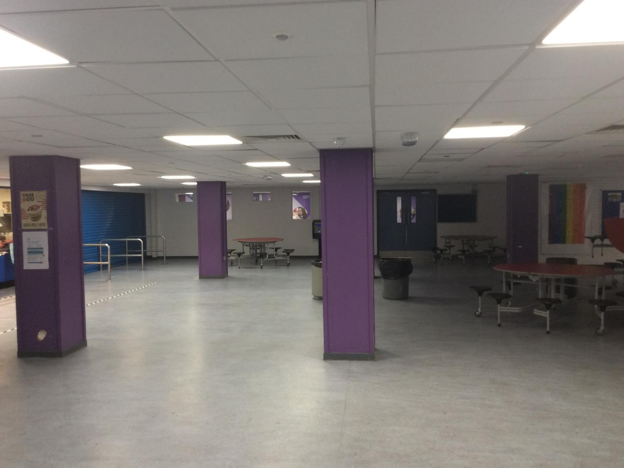
Canteen
Canteen

Slide 3
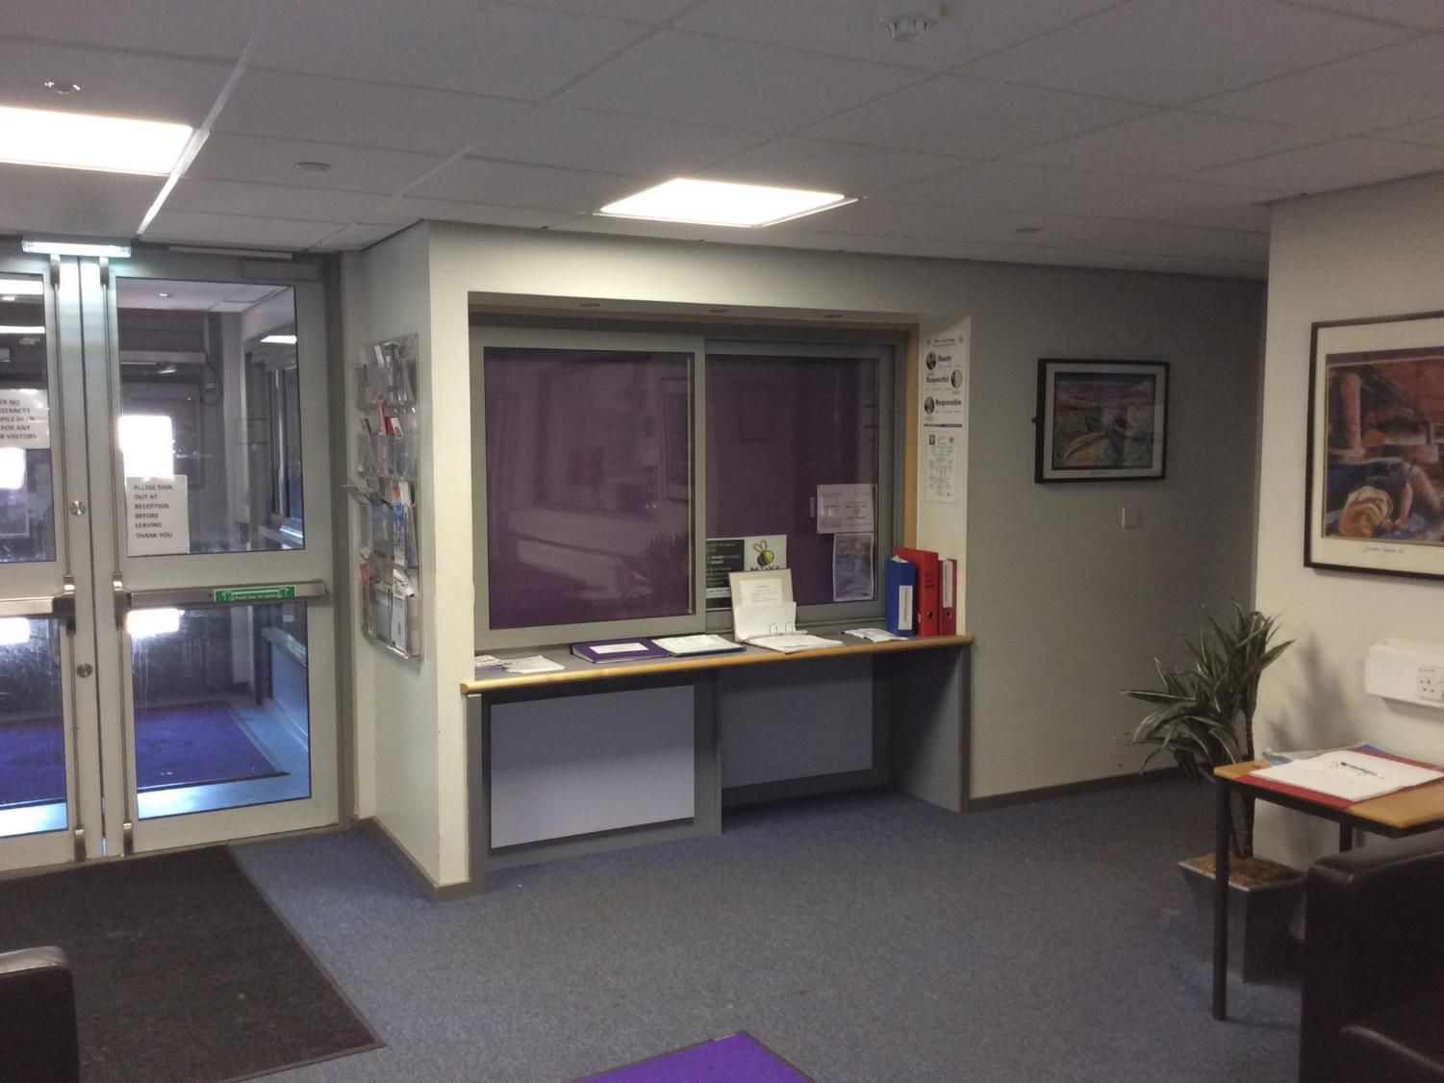
Office
Main school office

Slide 4
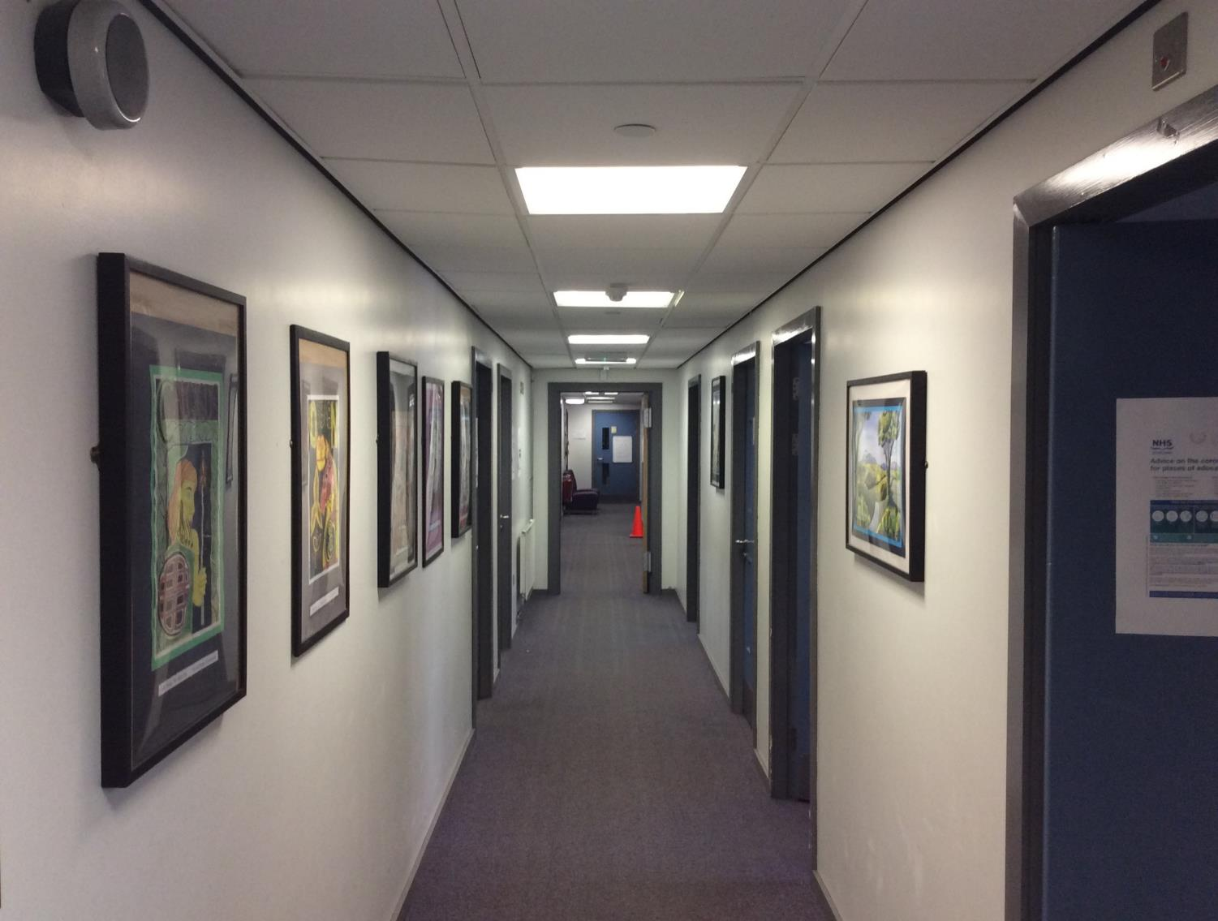
Management Corridor
Headteacher’s office
Janitor’s office

Slide 5
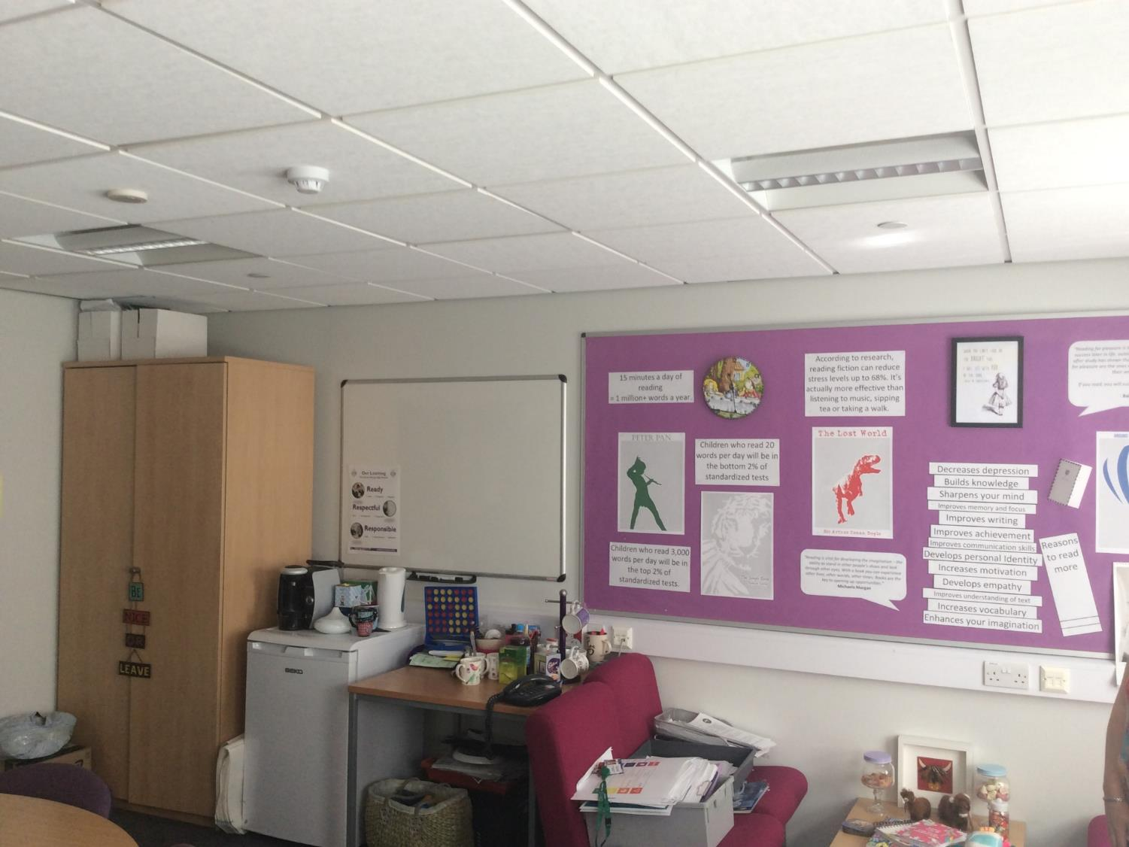
Evelyn’s Office
Mrs Russell’s Office

Slide 6
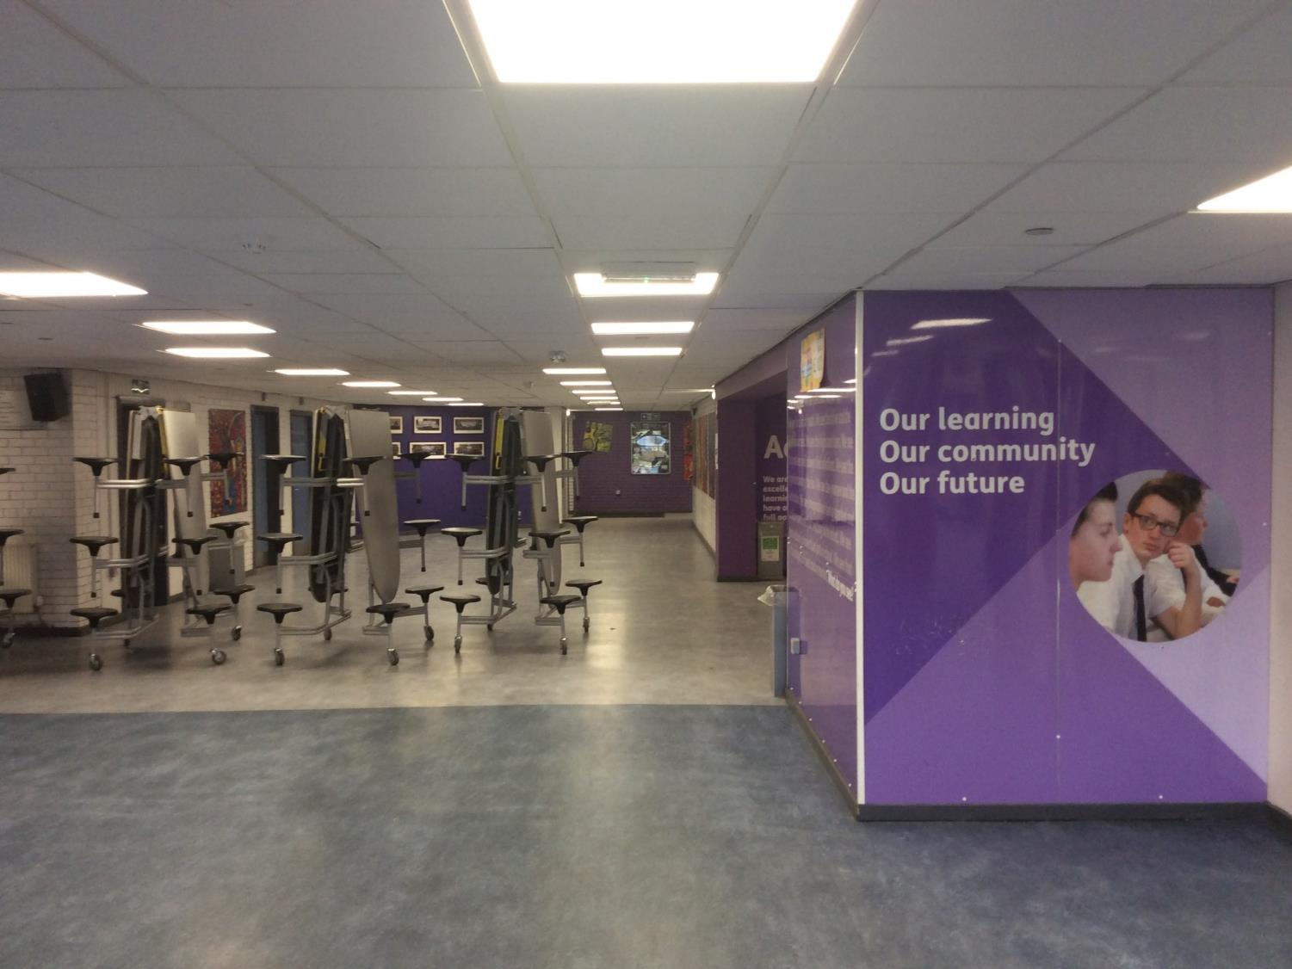
Canteen towards English

Slide 7
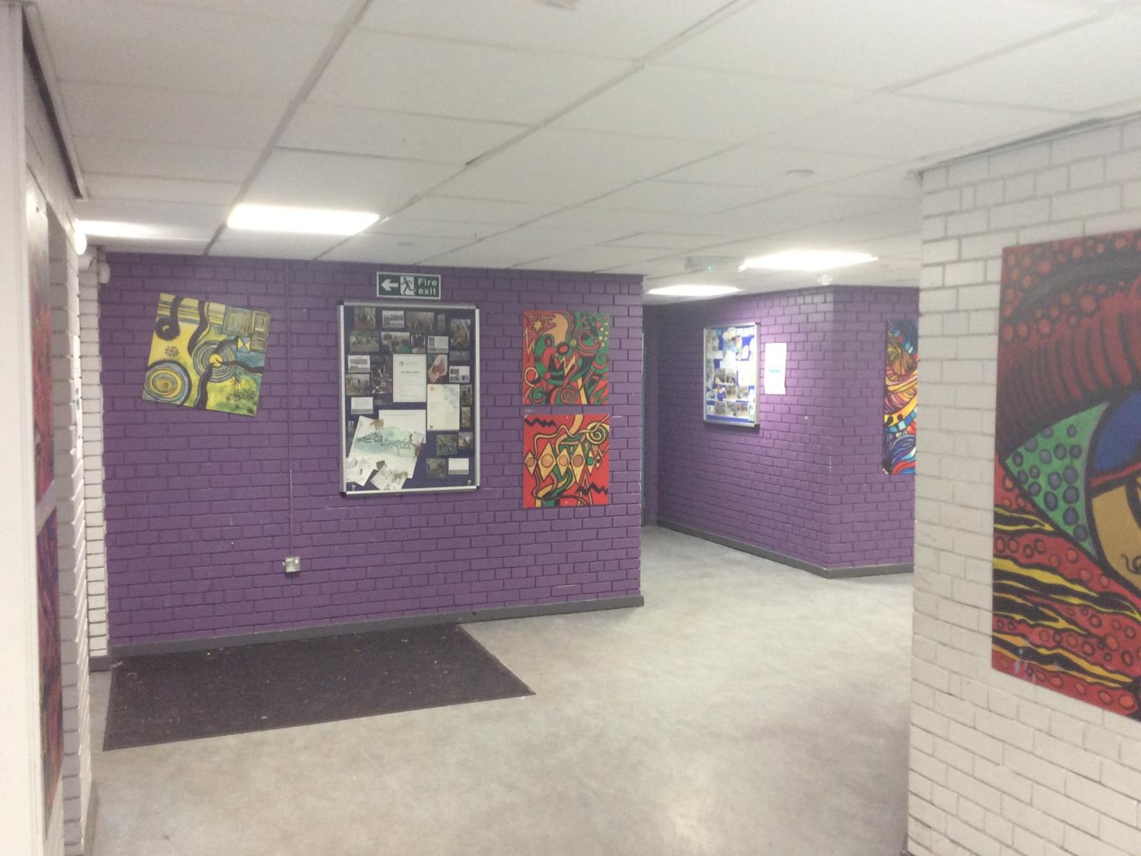
Back gate door
Door to back gate

Slide 8
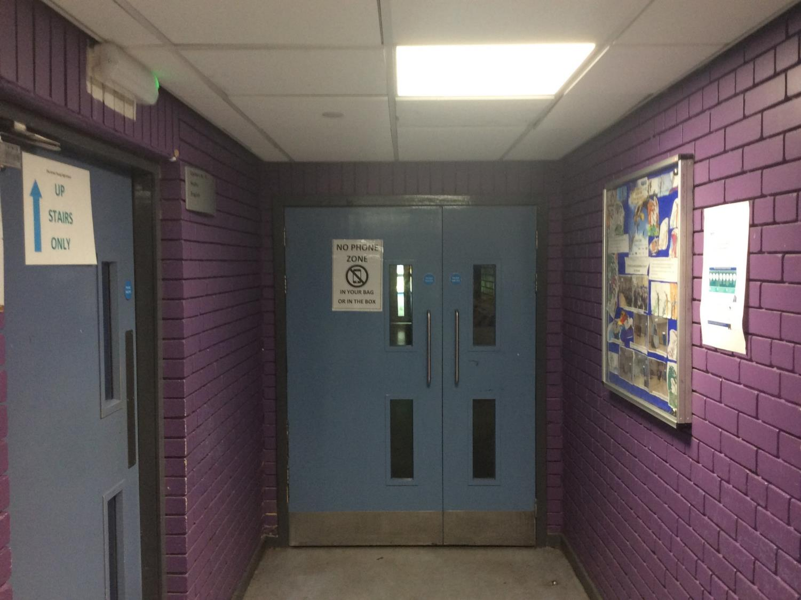
English corridor 1

Slide 9
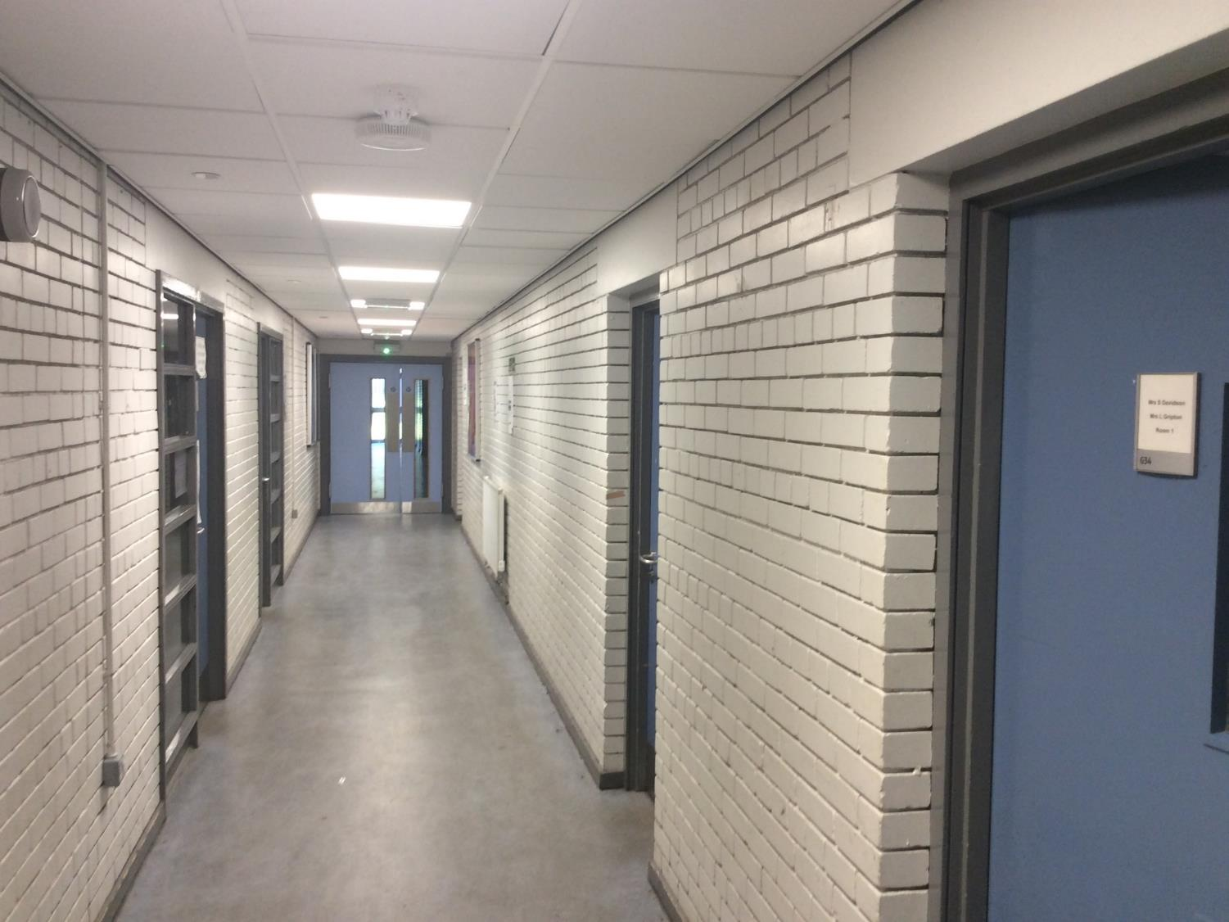
English corridor 2
See inside!
English classrooms
English classrooms
English classrooms

Slide 10
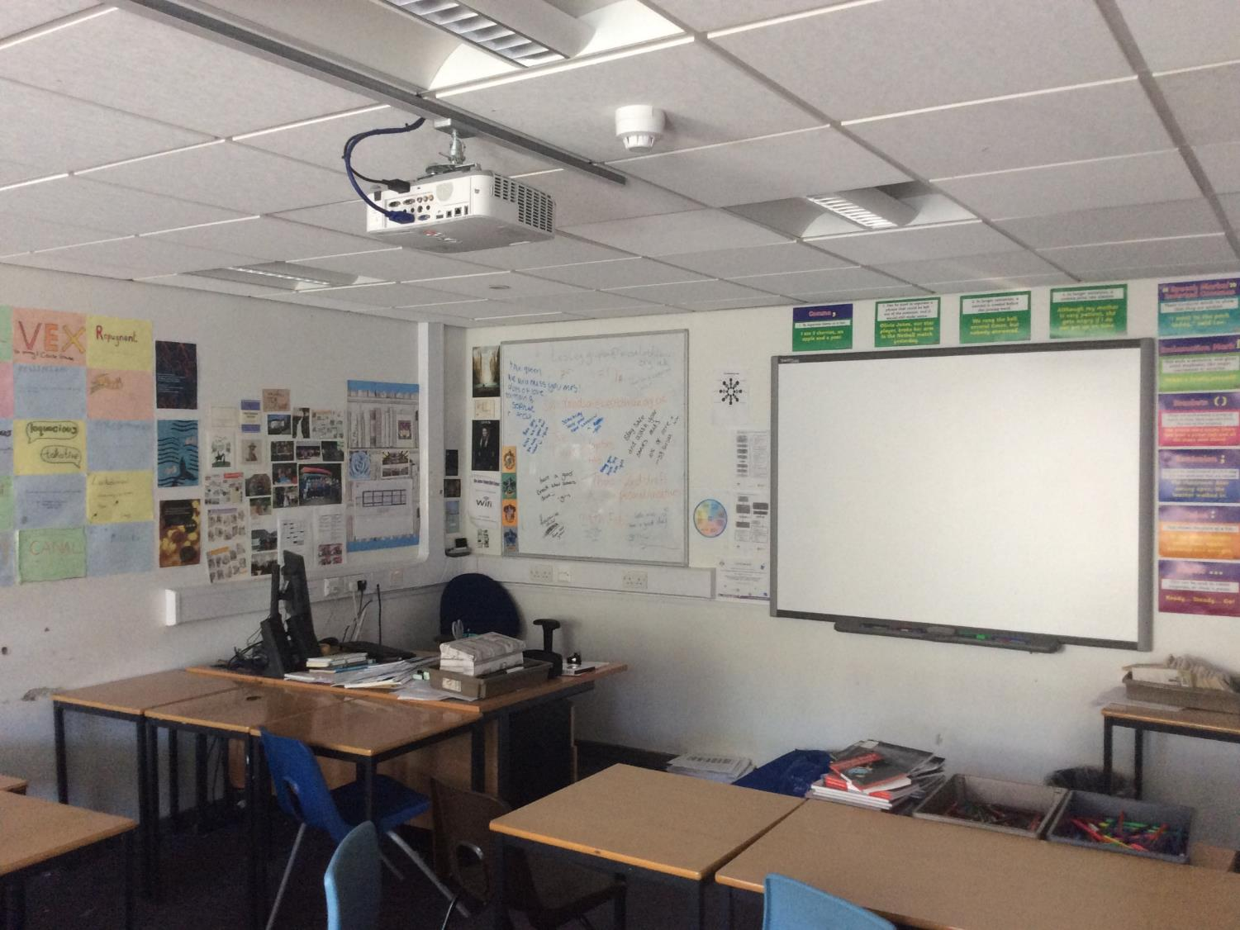
Susi/Lesley’s room

Slide 11
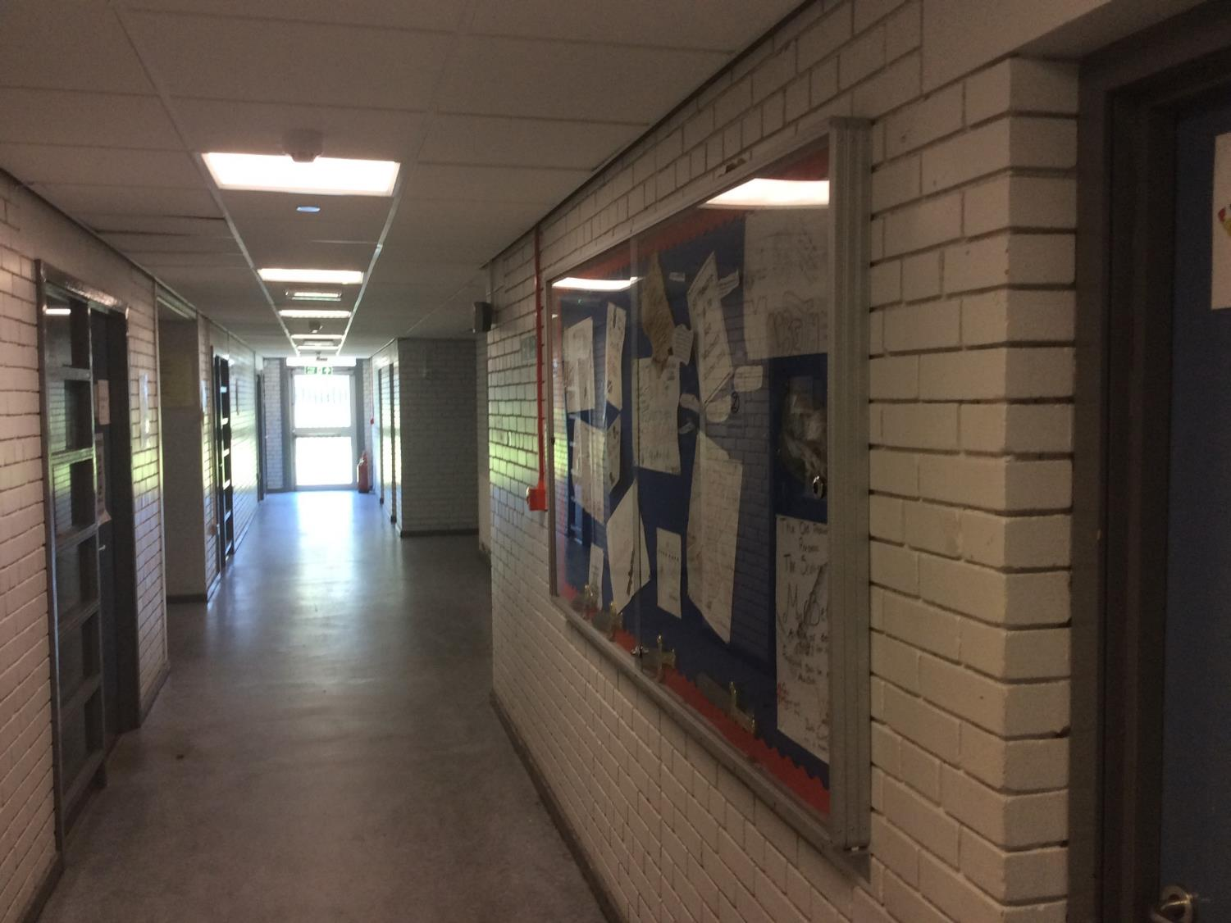
English corridor 3

Slide 12
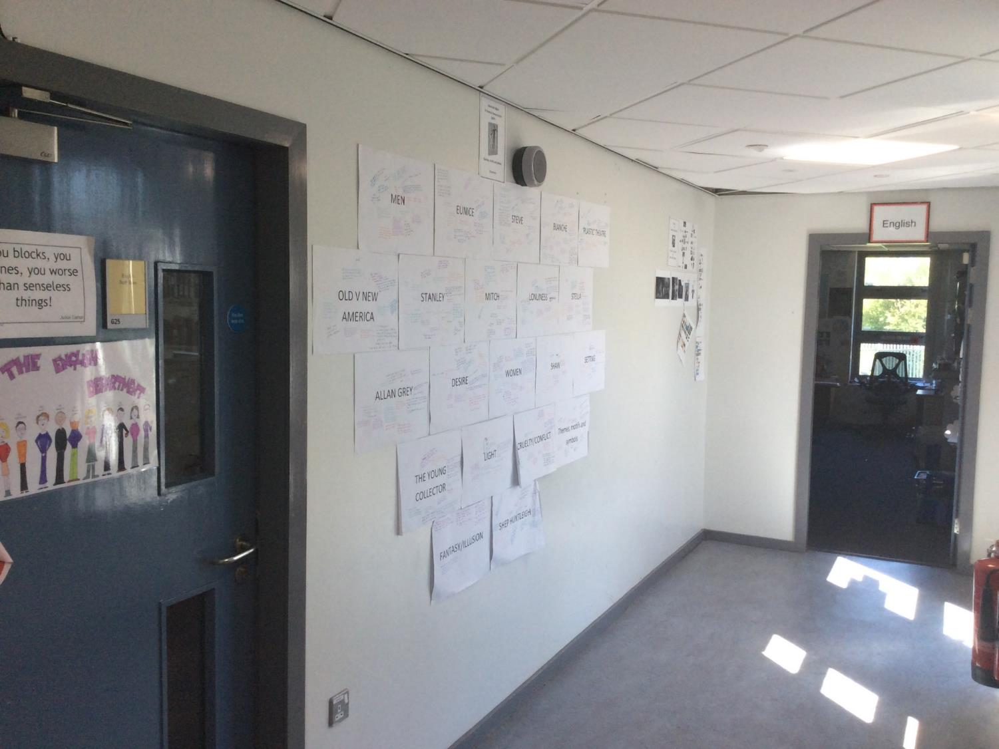
English corridor annexe
English classroom
English staffroom

Slide 13
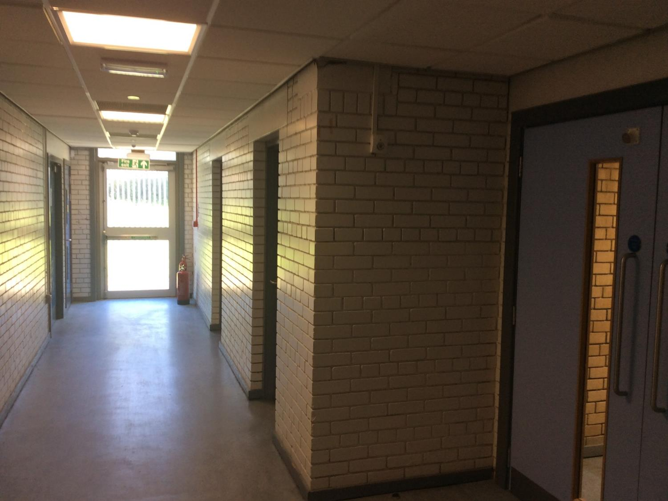
English/Unit corner

Slide 14
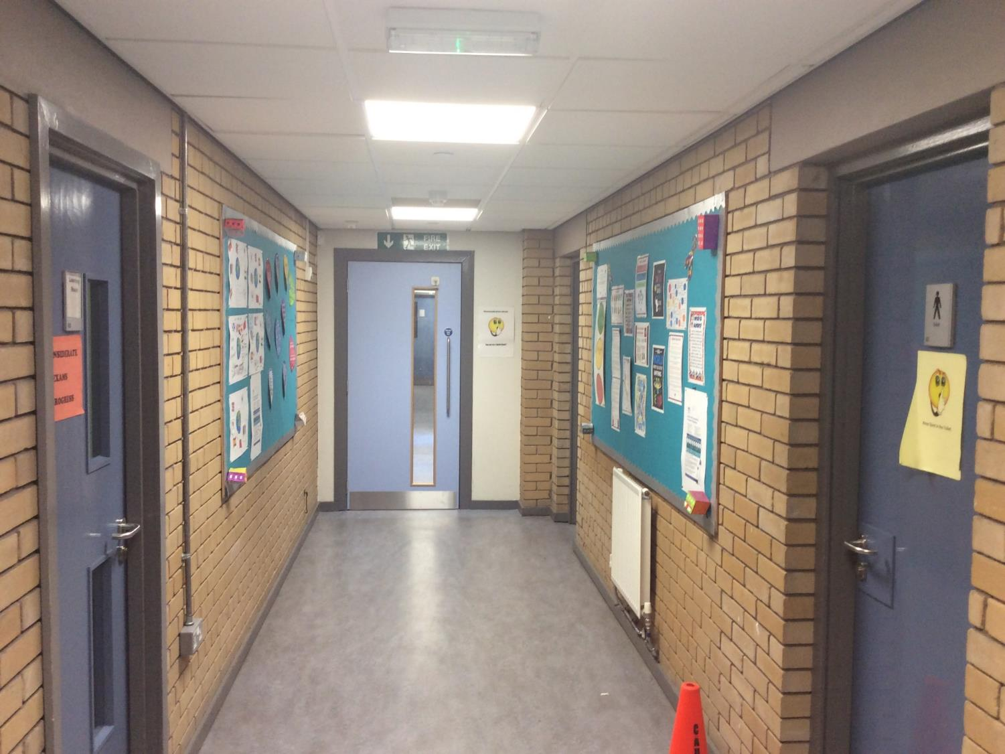
Unit 1
Autism Support Unit

Slide 15
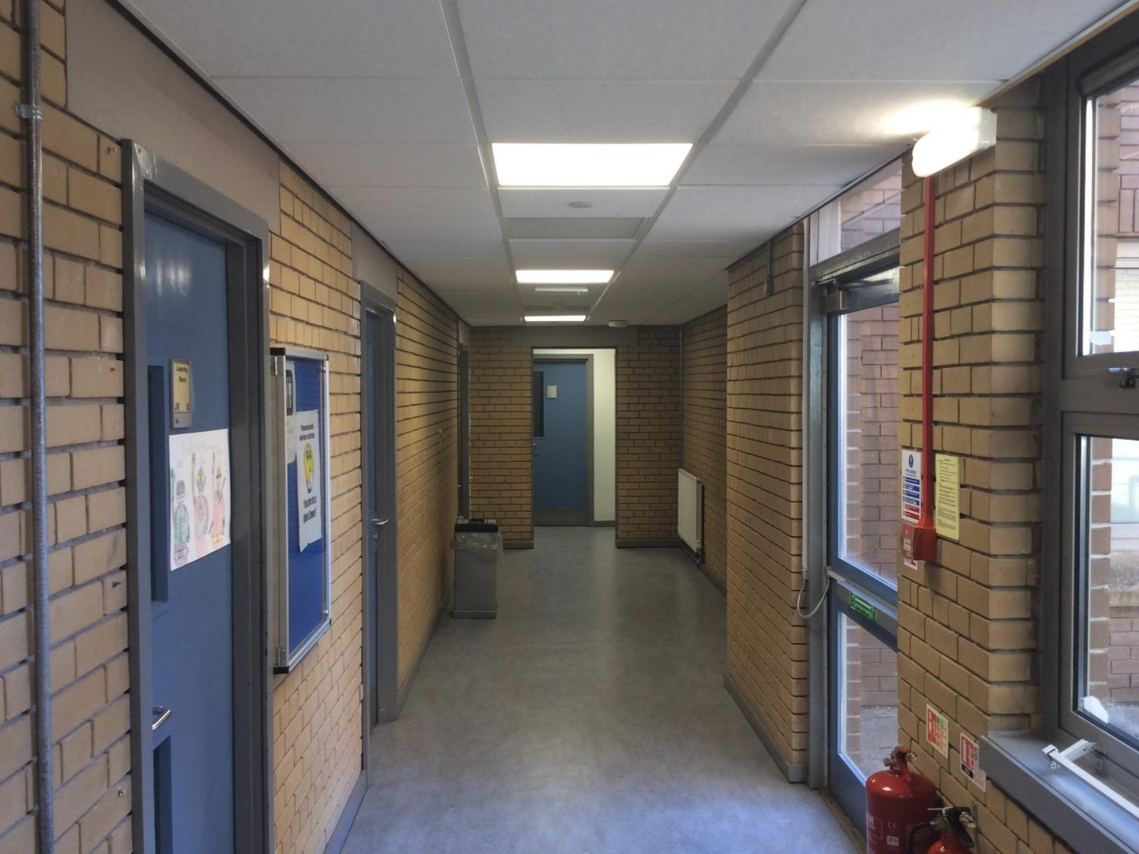
Unit 2
Autism Support Unit

Slide 16
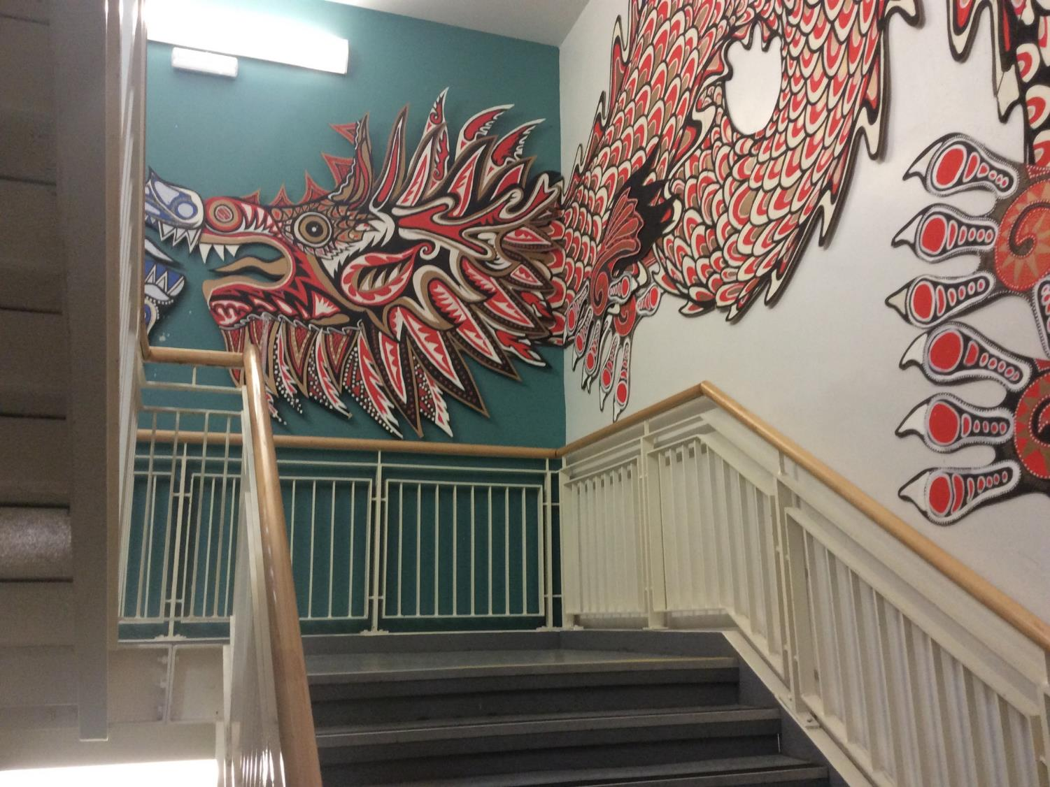
Main stairs

Slide 17
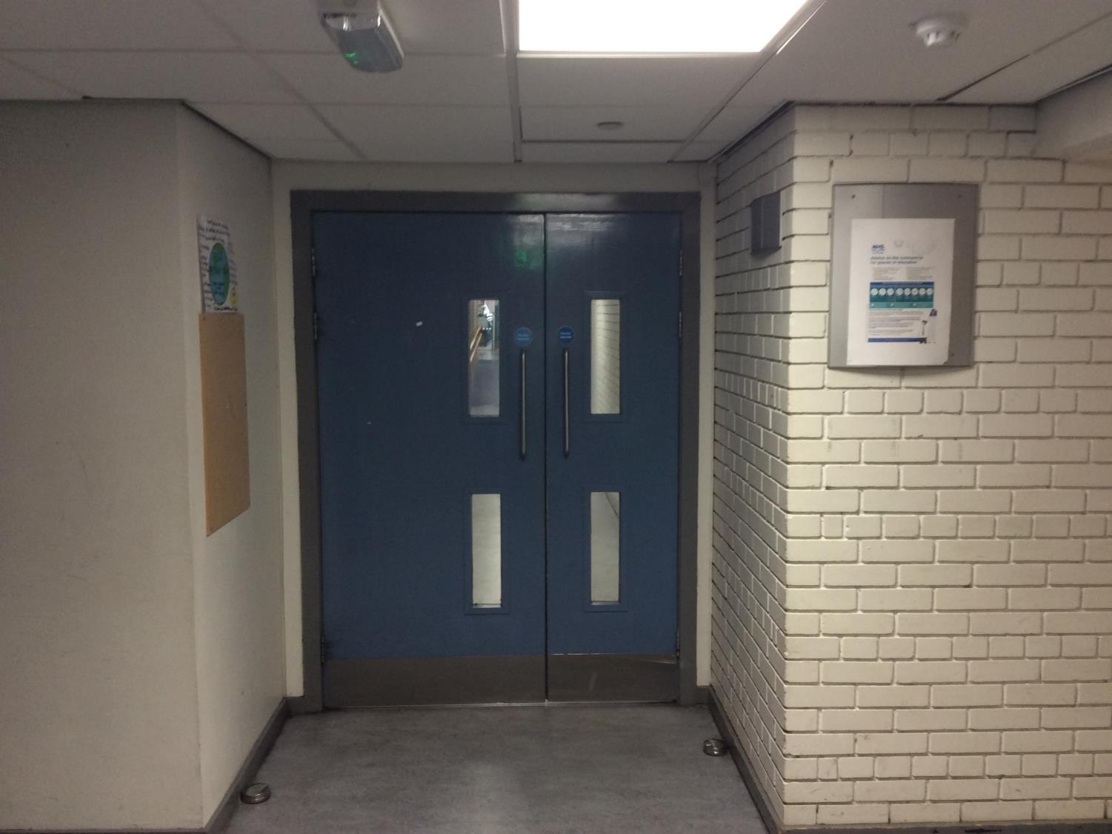
Maths/PSE/Comp Crossroads

Slide 18
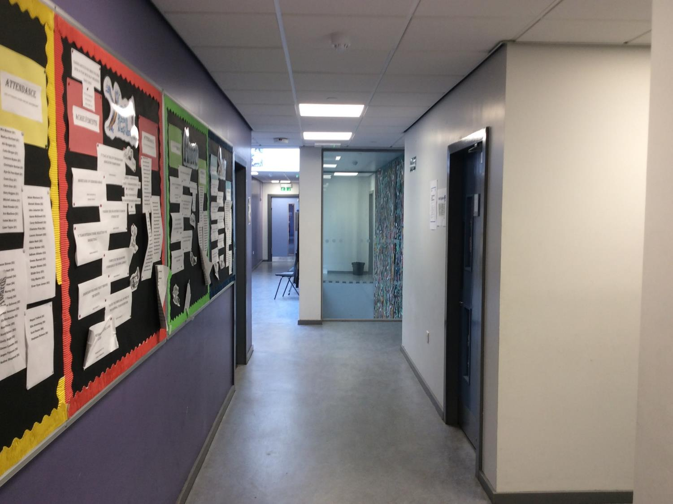
House Heads office area
House heads’ office

Slide 19
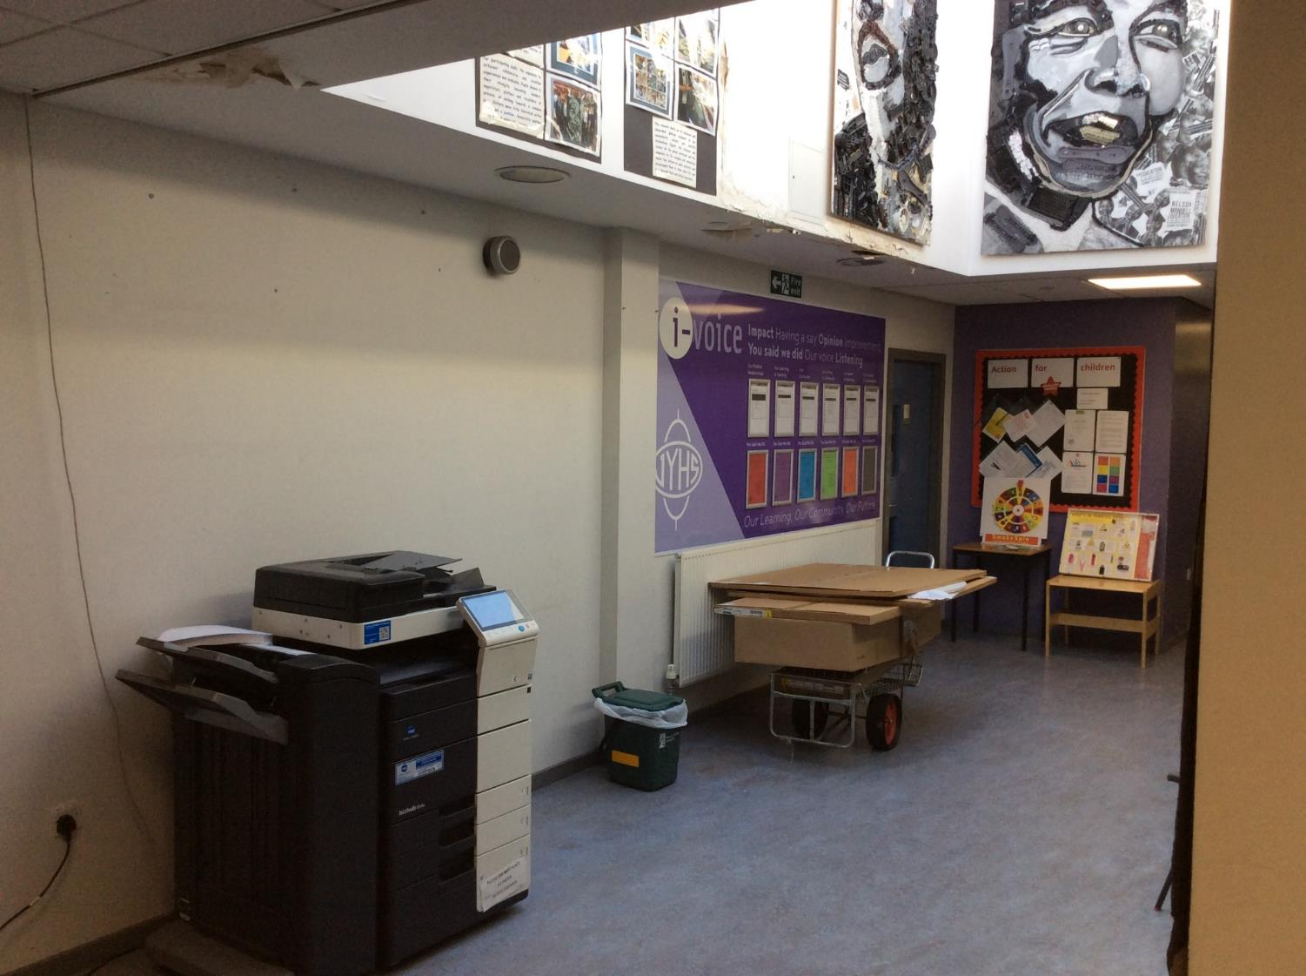
Old iaspire area
Pupil support office

Slide 20
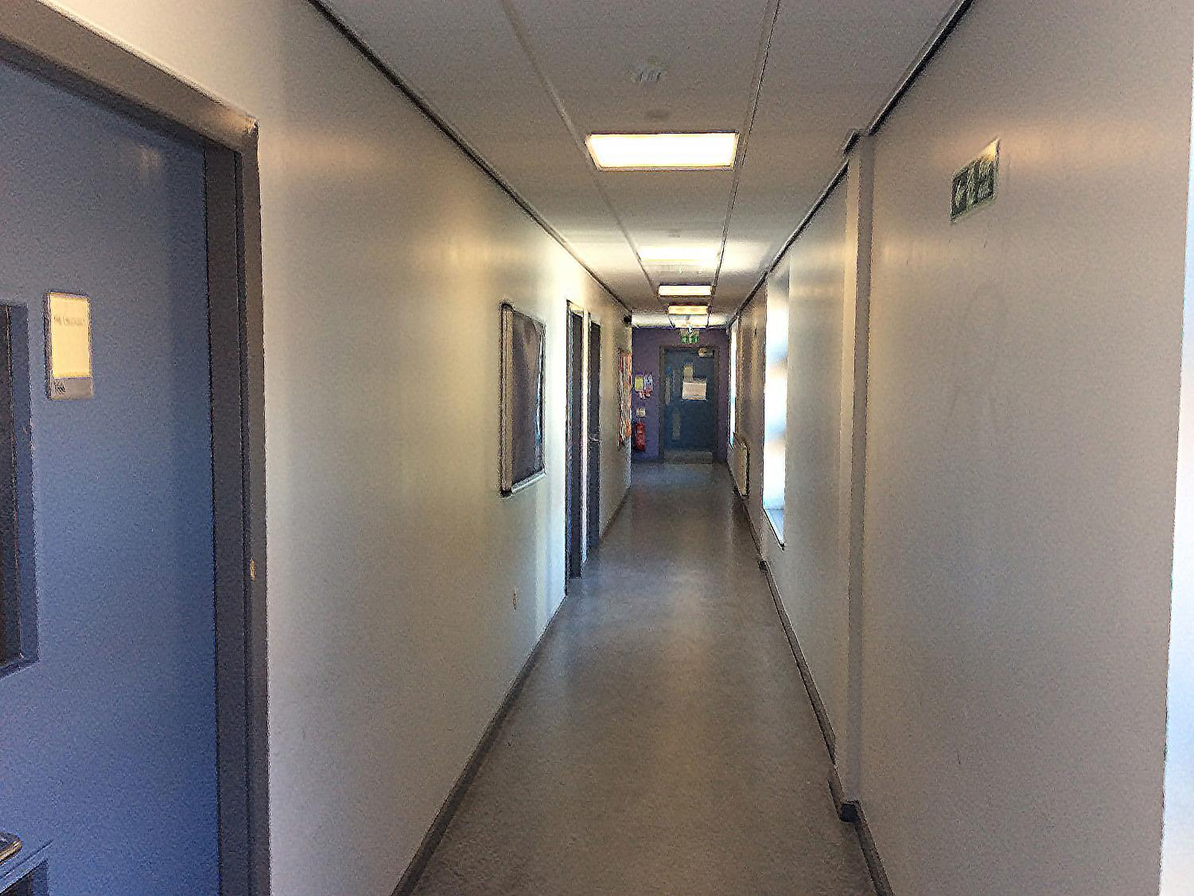
PSE rooms
PSE classrooms
PSE classroom

Slide 21
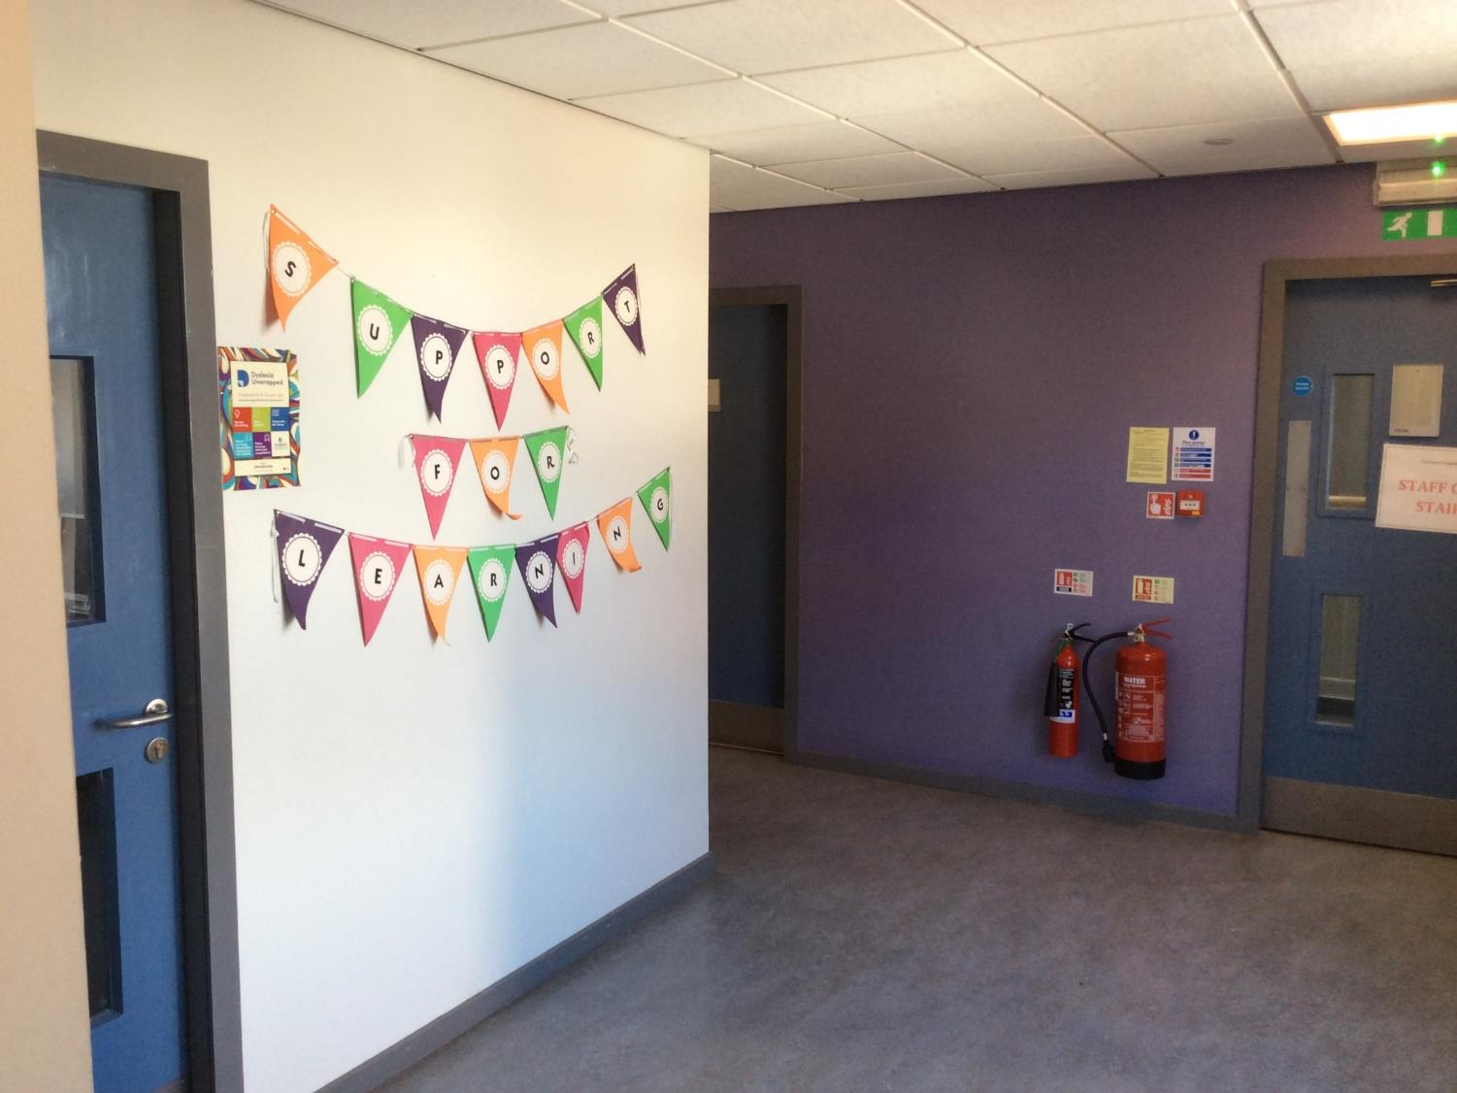
SfL rooms
Support for Learning room 2
Support for Learning room 1

Slide 22
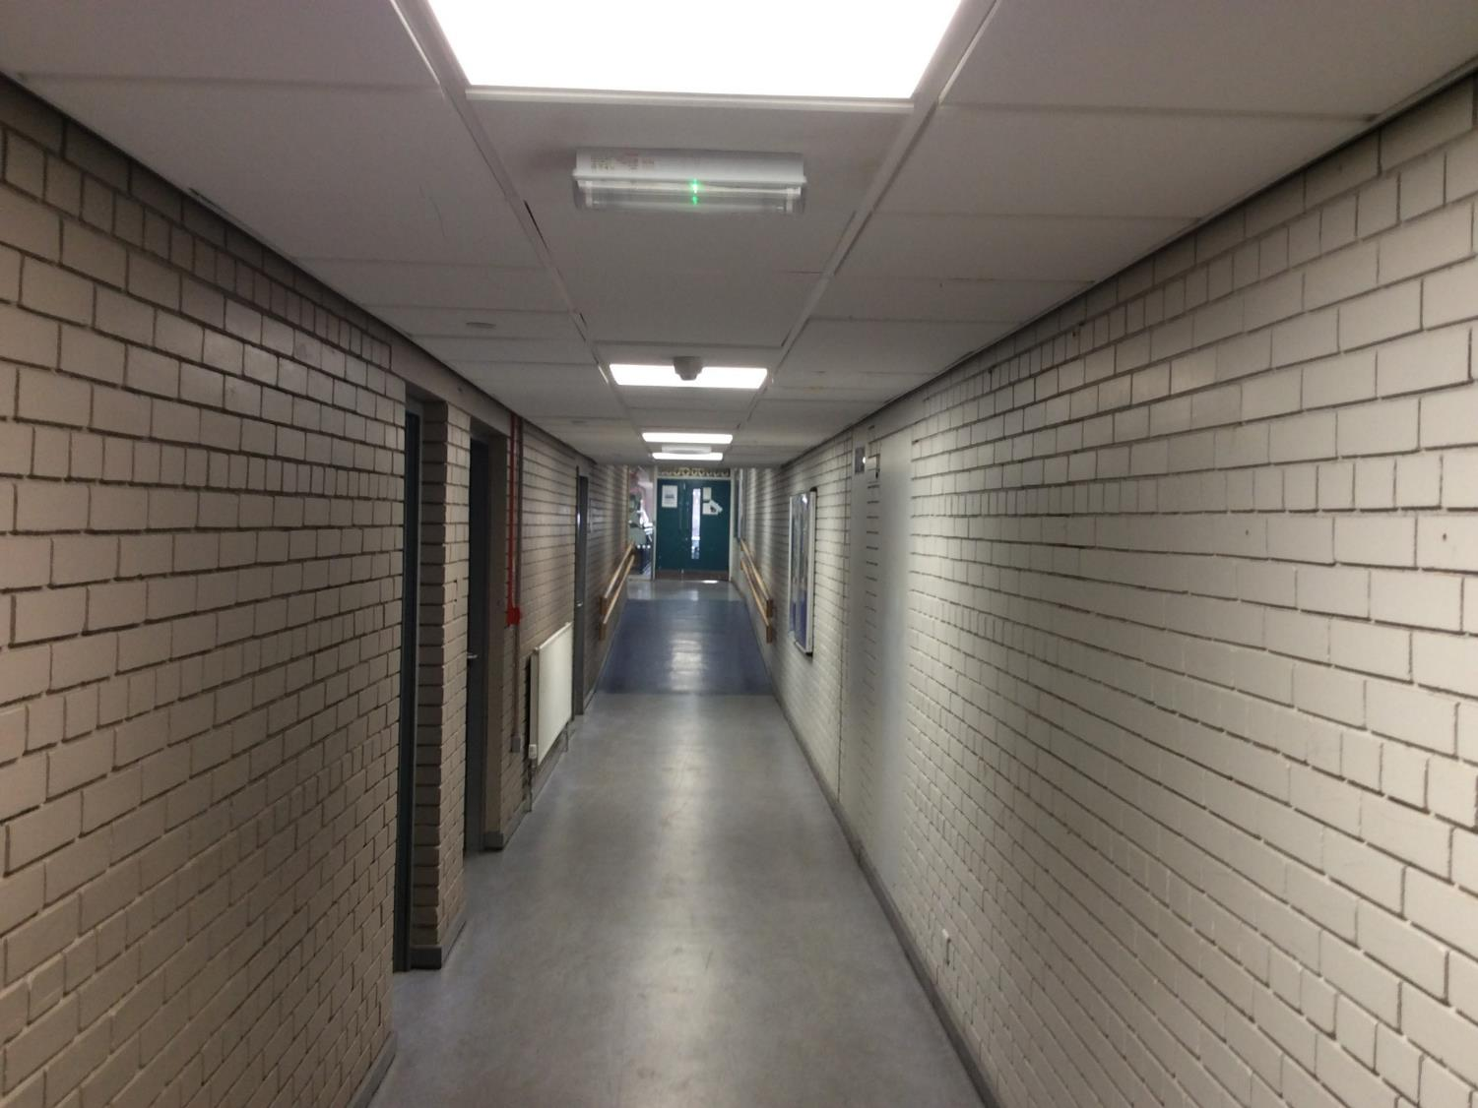
Road to library
Careers office

Slide 23
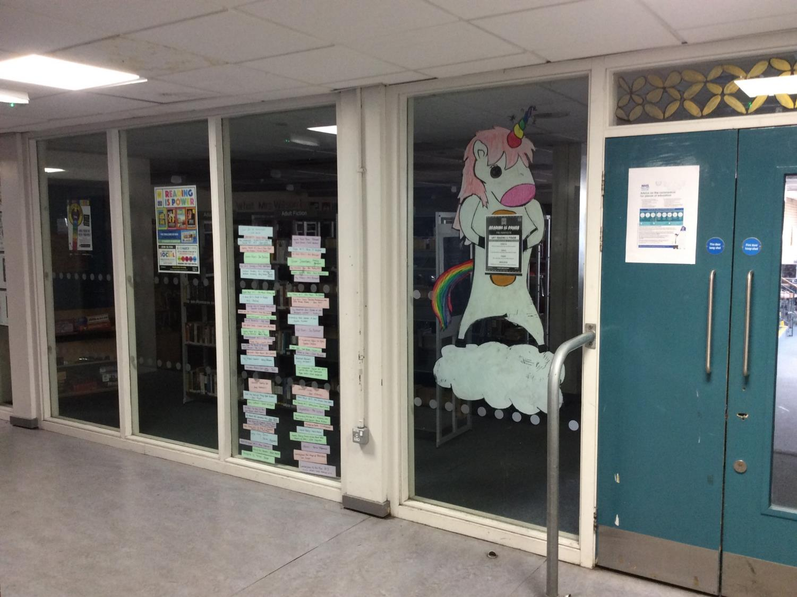
Library corner
Visit the library!

Slide 24
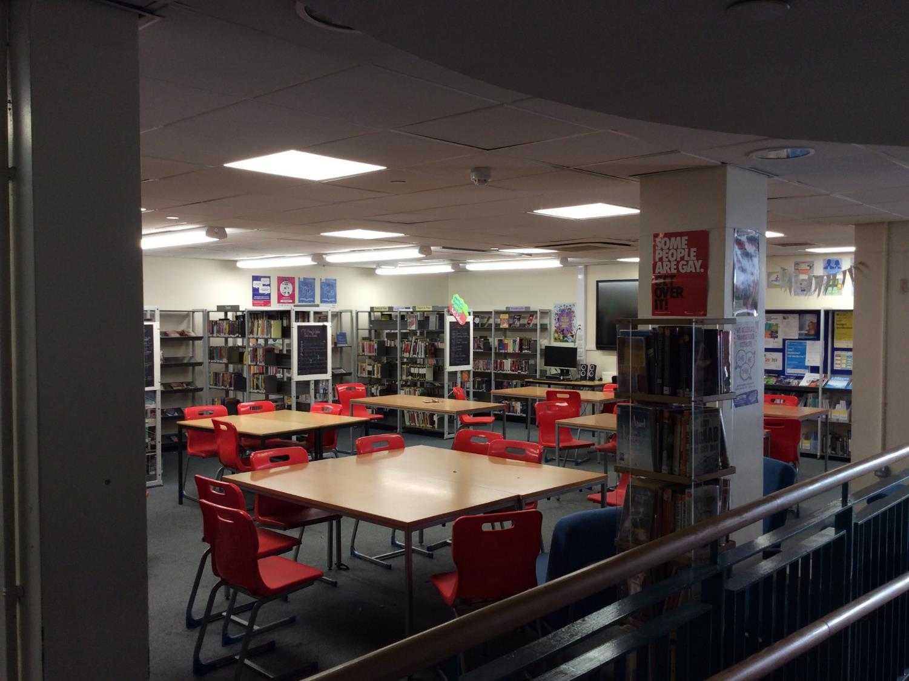
Library Upper

Slide 25
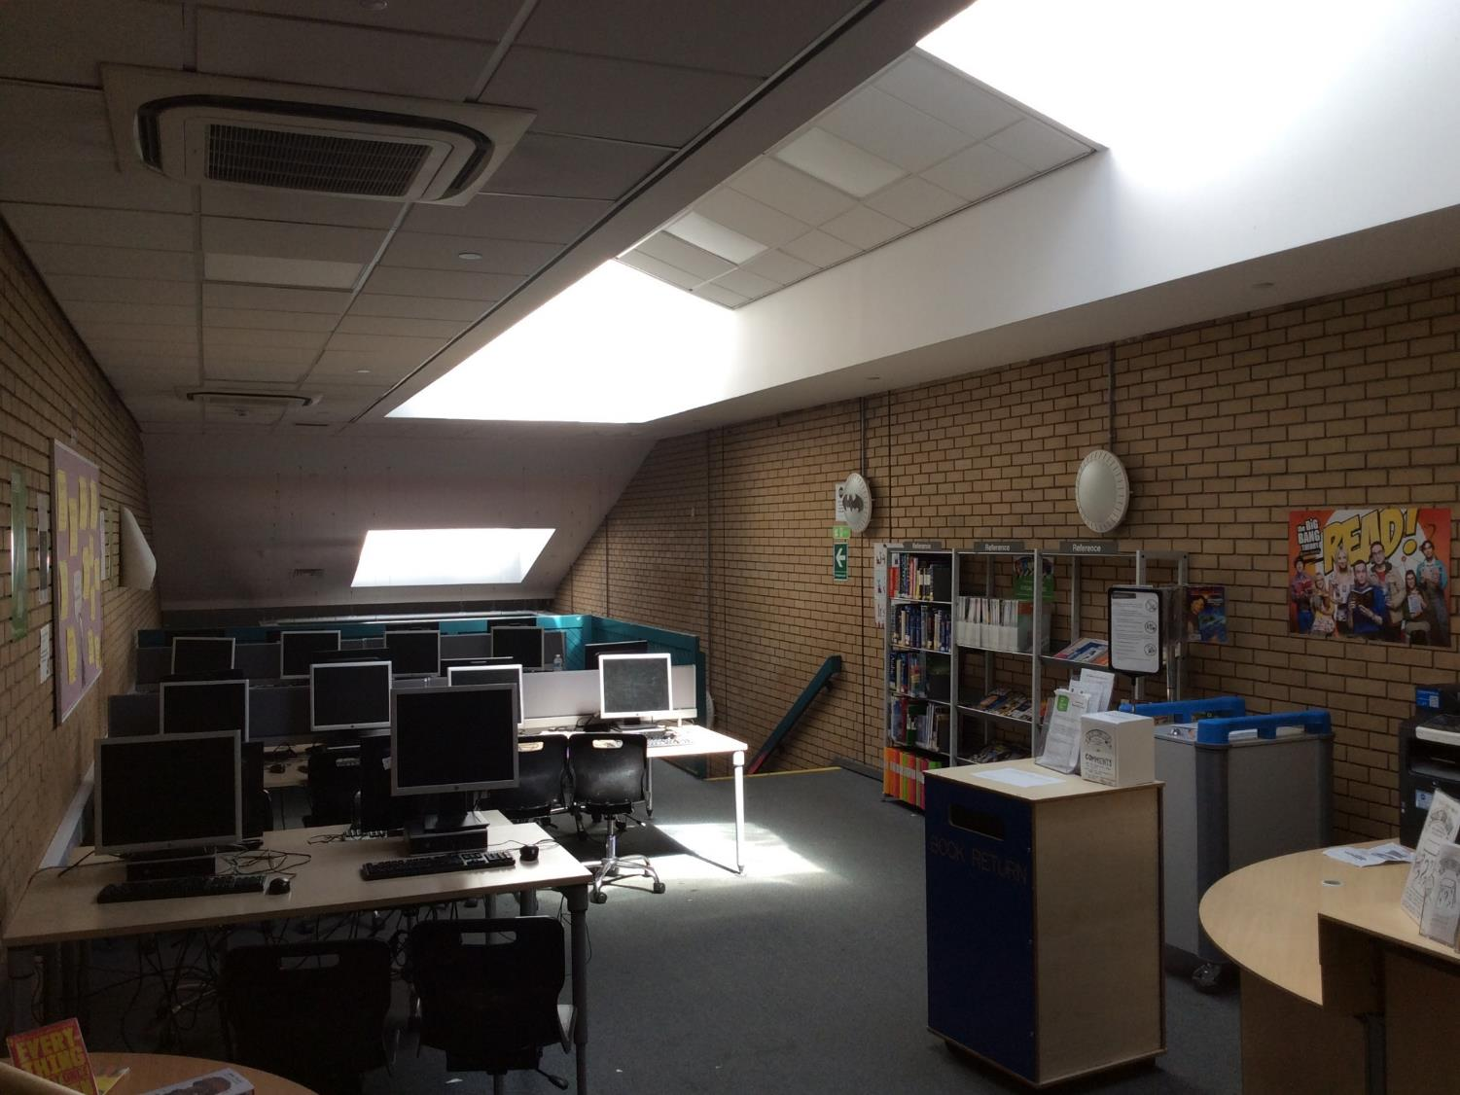
Library Mid

Slide 26
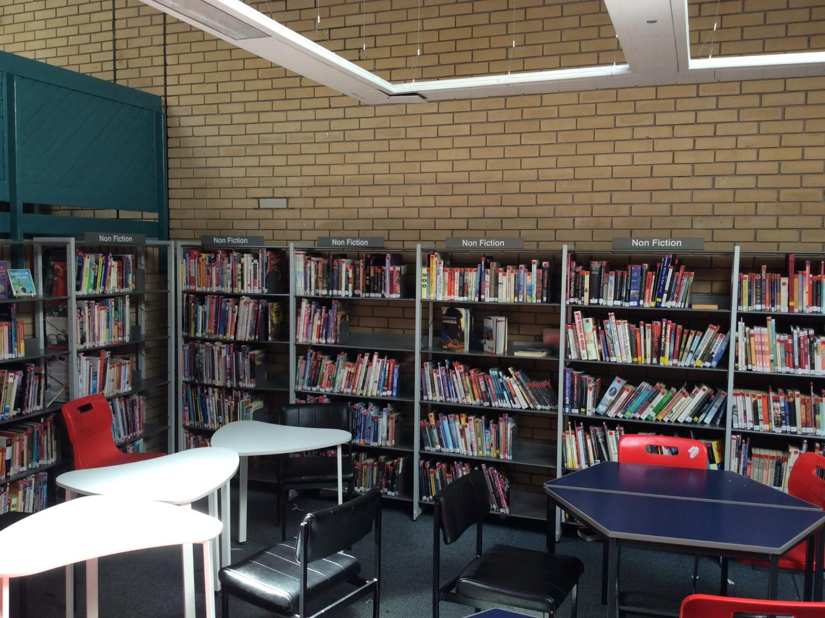
Library Lower

Slide 27
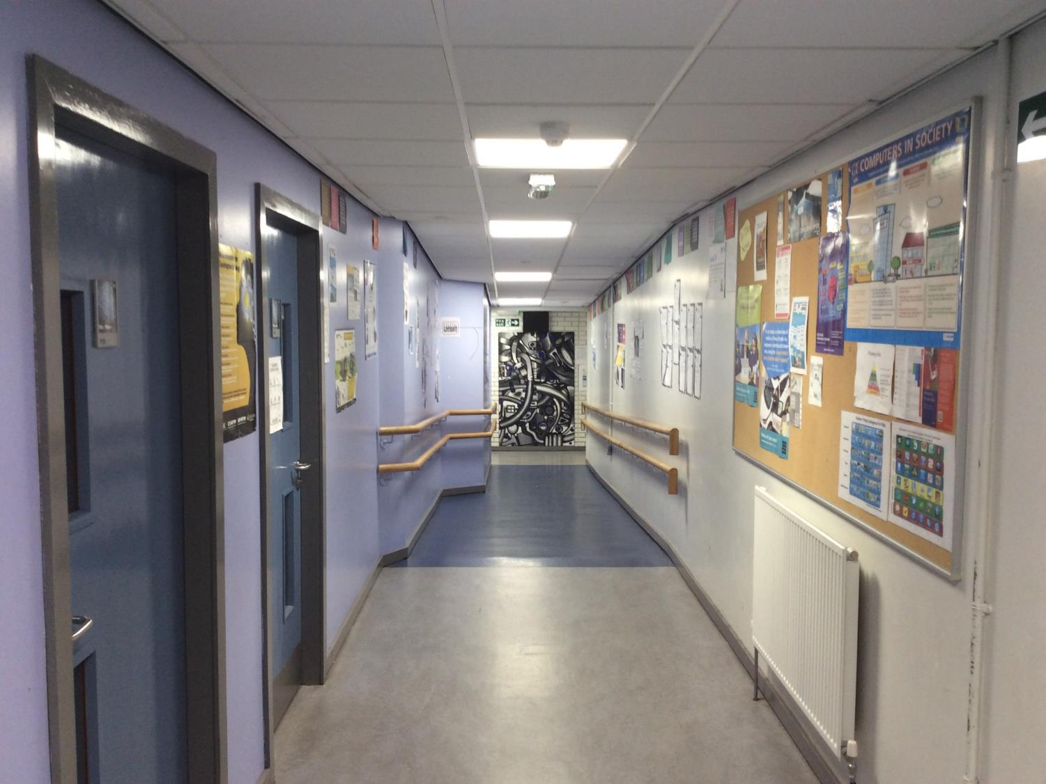
Computing Upper
See inside!
Computing classrooms

Slide 28
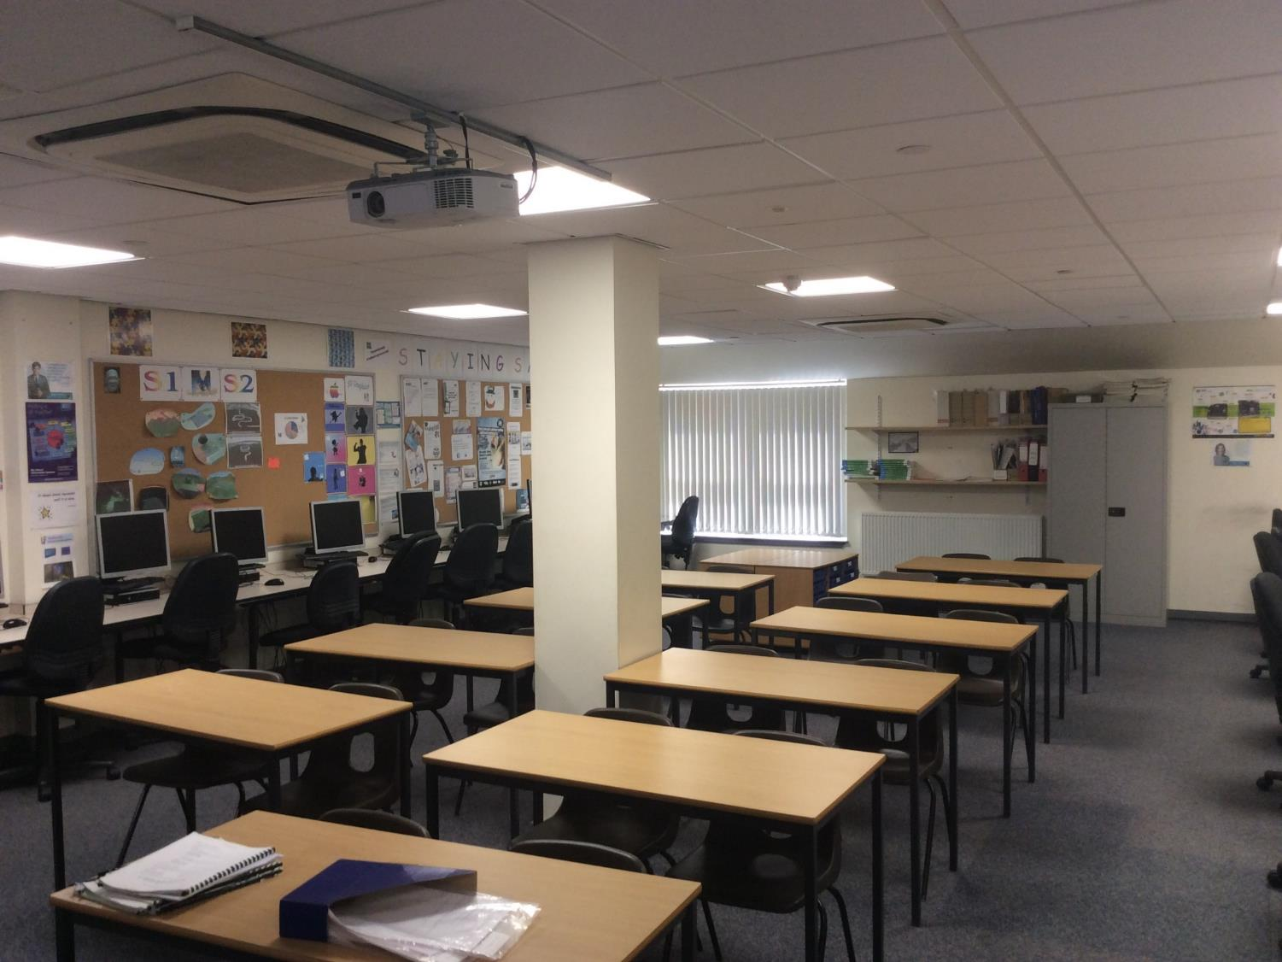
Comp Classroom

Slide 29
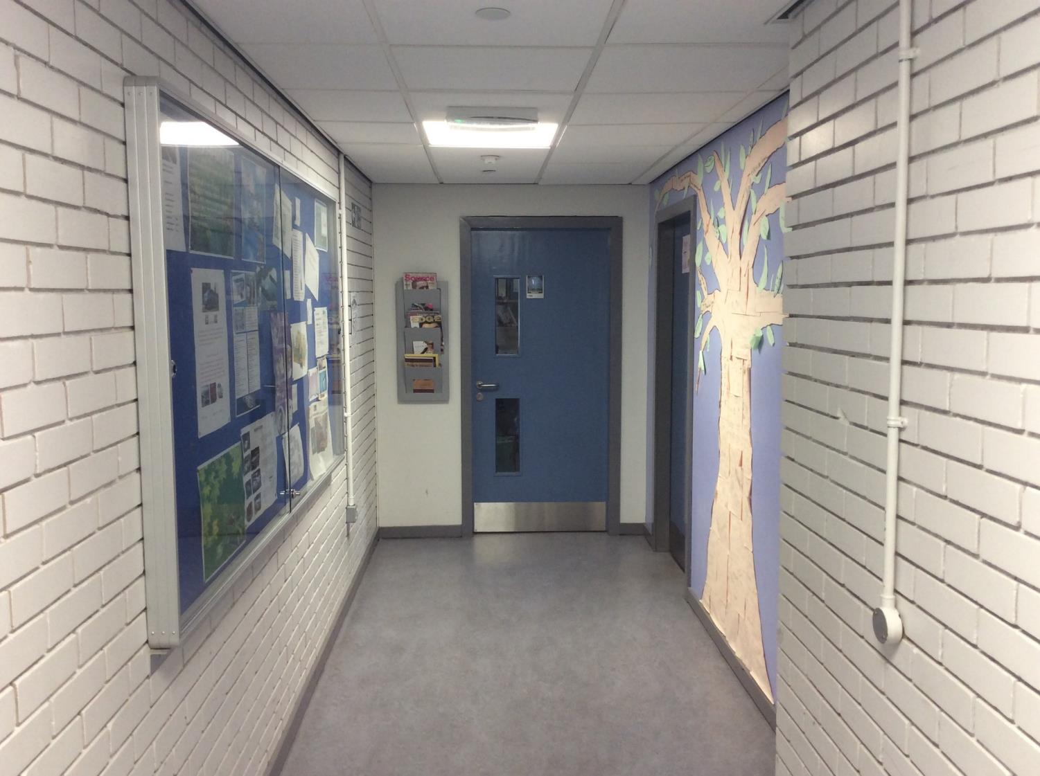
Comp McNeice
Computing staffroom
Computing classroom

Slide 30
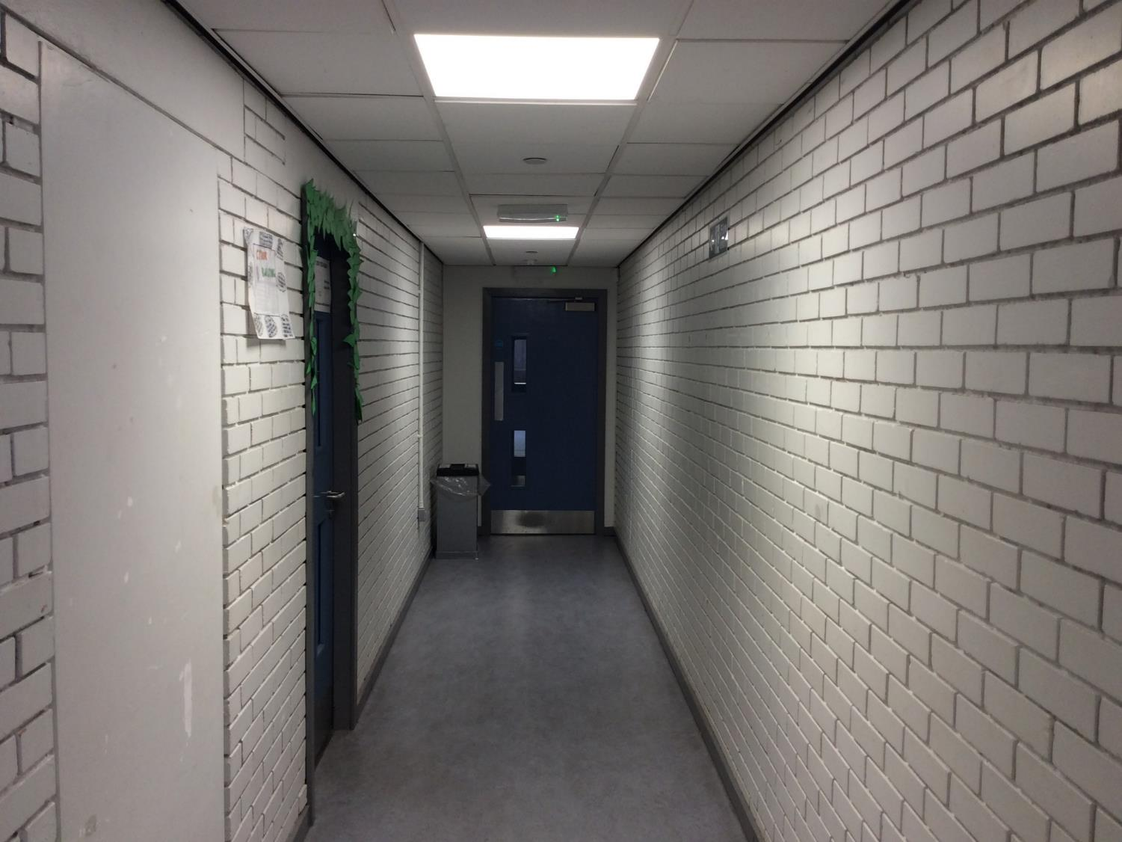
Comp Other
Main staffroom
Computing classroom

Slide 31
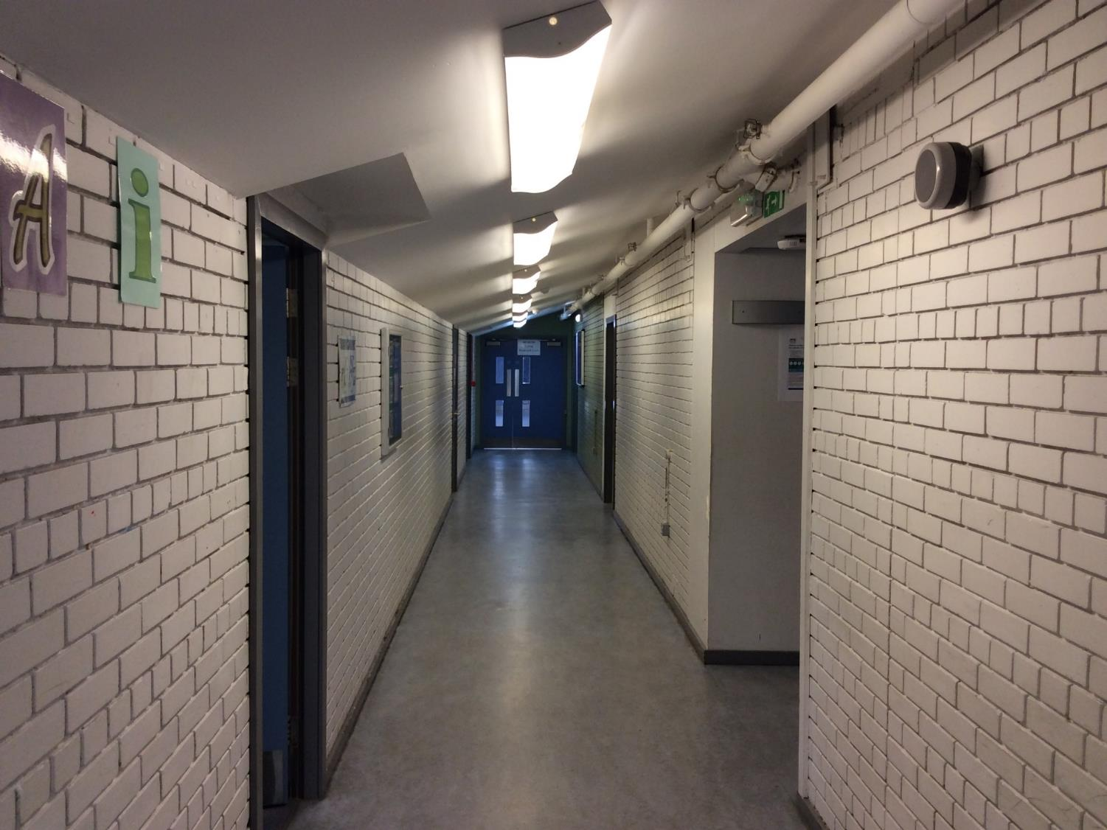
Maths/HE junction
Maths classroom

Slide 32
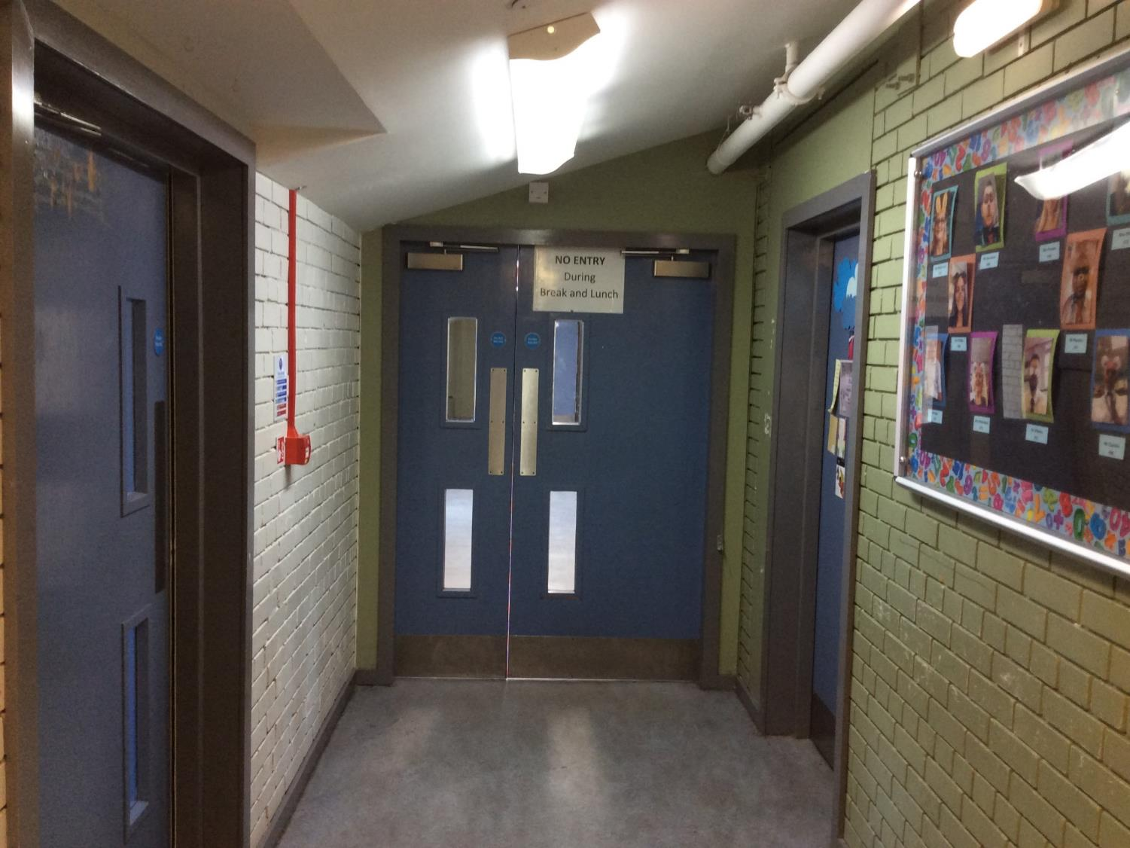
Maths 1
Maths classroom

Slide 33
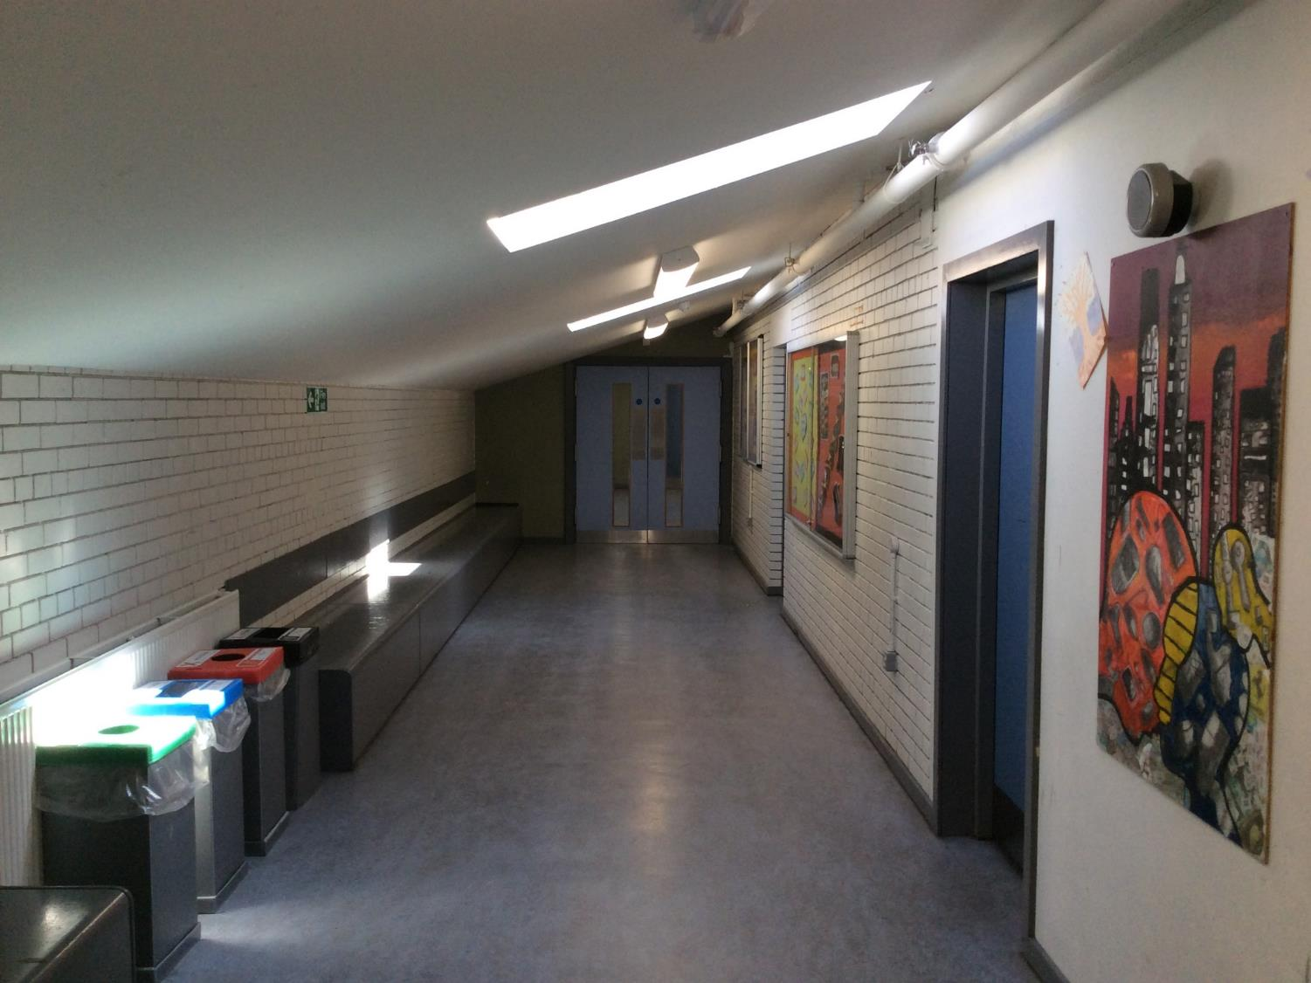
Maths 2
See inside!

Slide 34
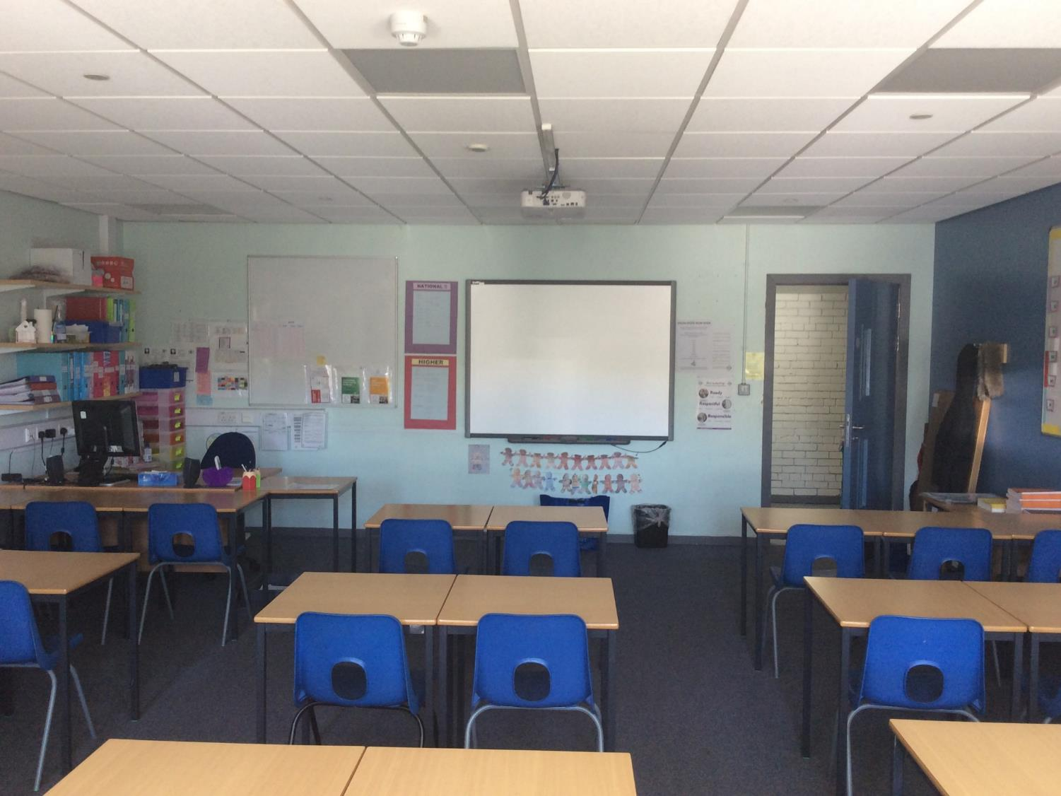
Nicole’s room

Slide 35
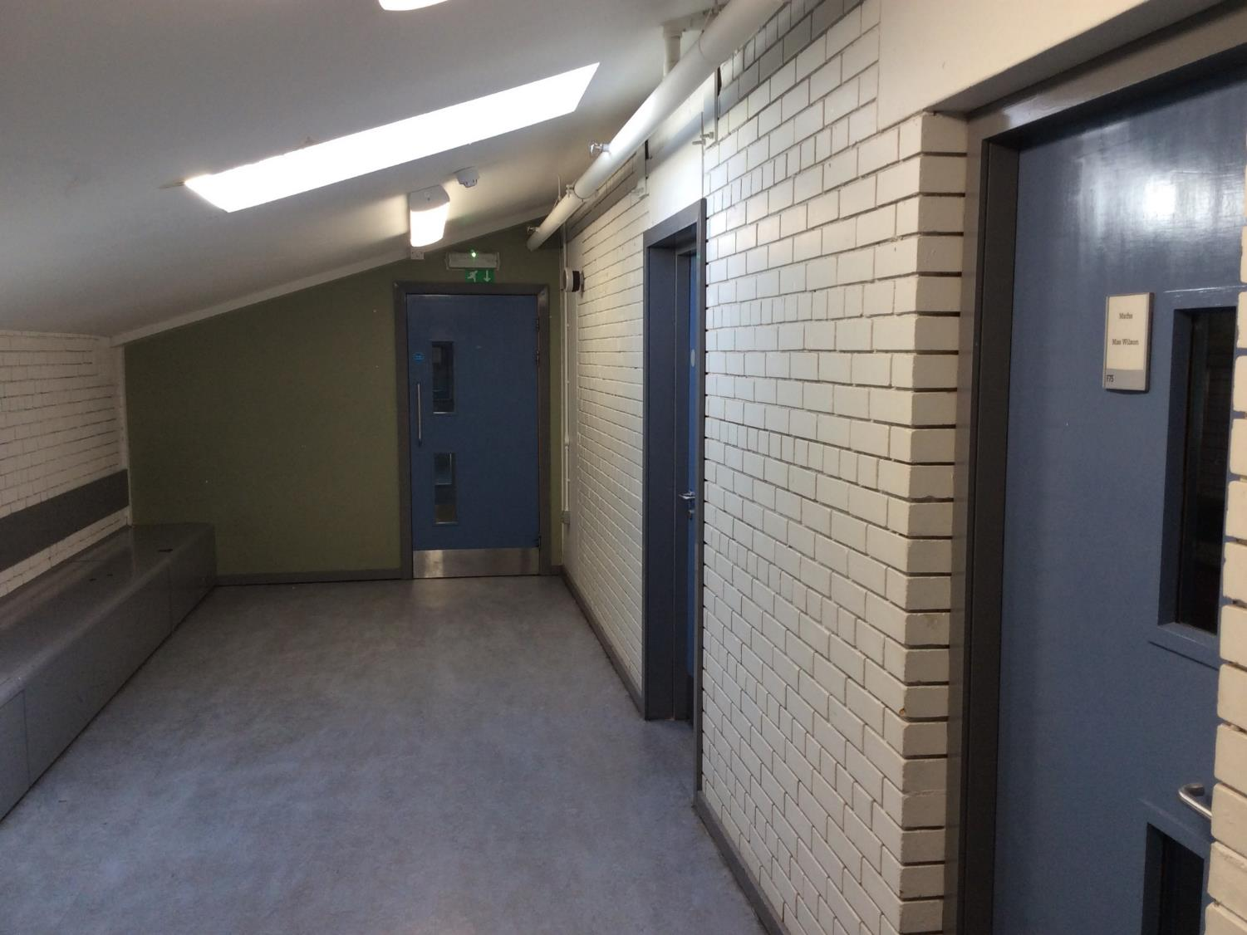
Maths 3
More Maths classrooms!
More Maths classrooms!

Slide 36
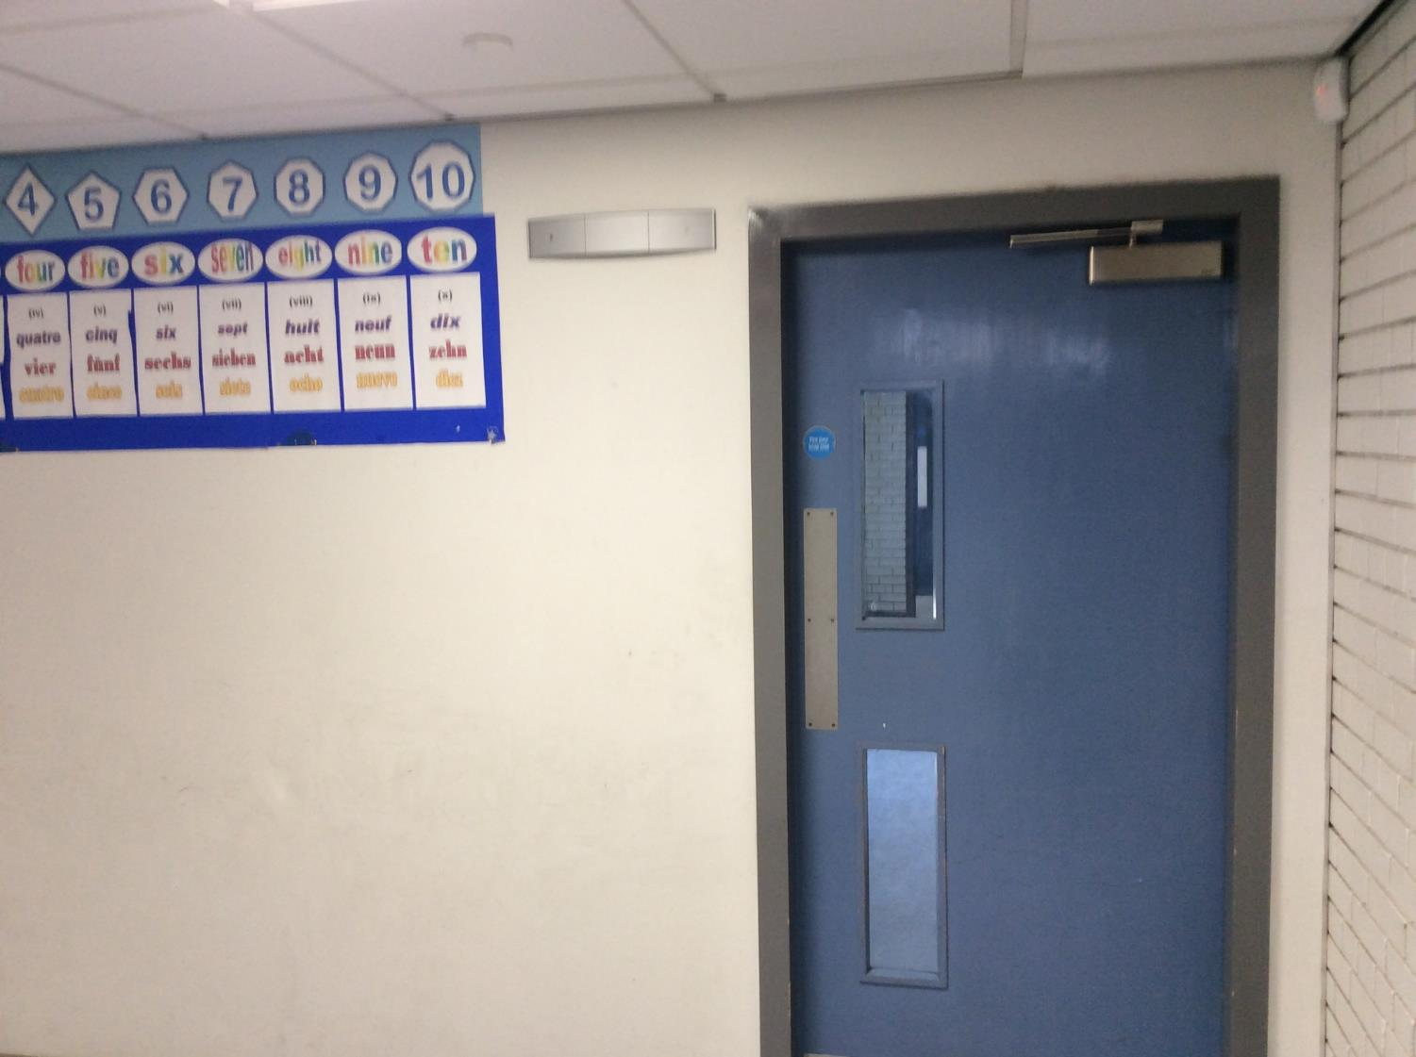
Maths corner

Slide 37
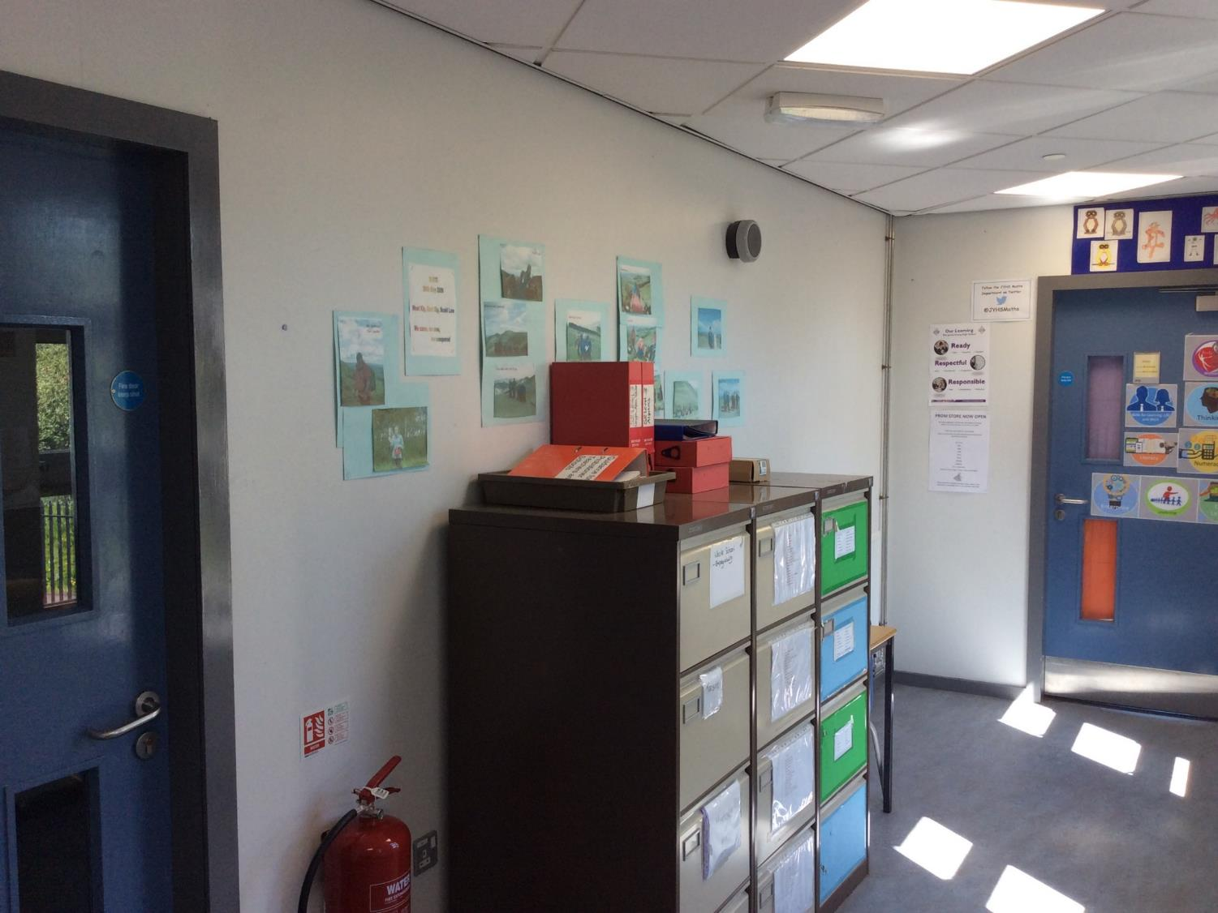
Maths annexe
Maths staffroom
Maths classroom

Slide 38
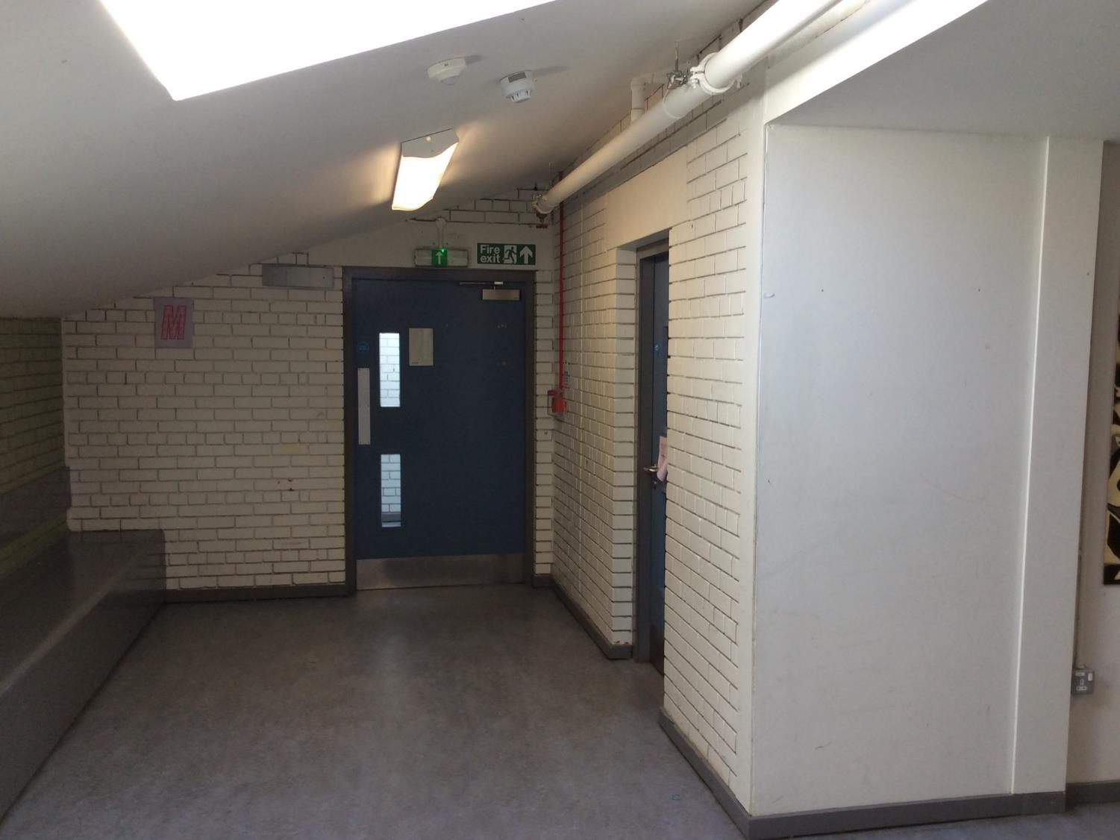
Maths end
Maths classroom

Slide 39
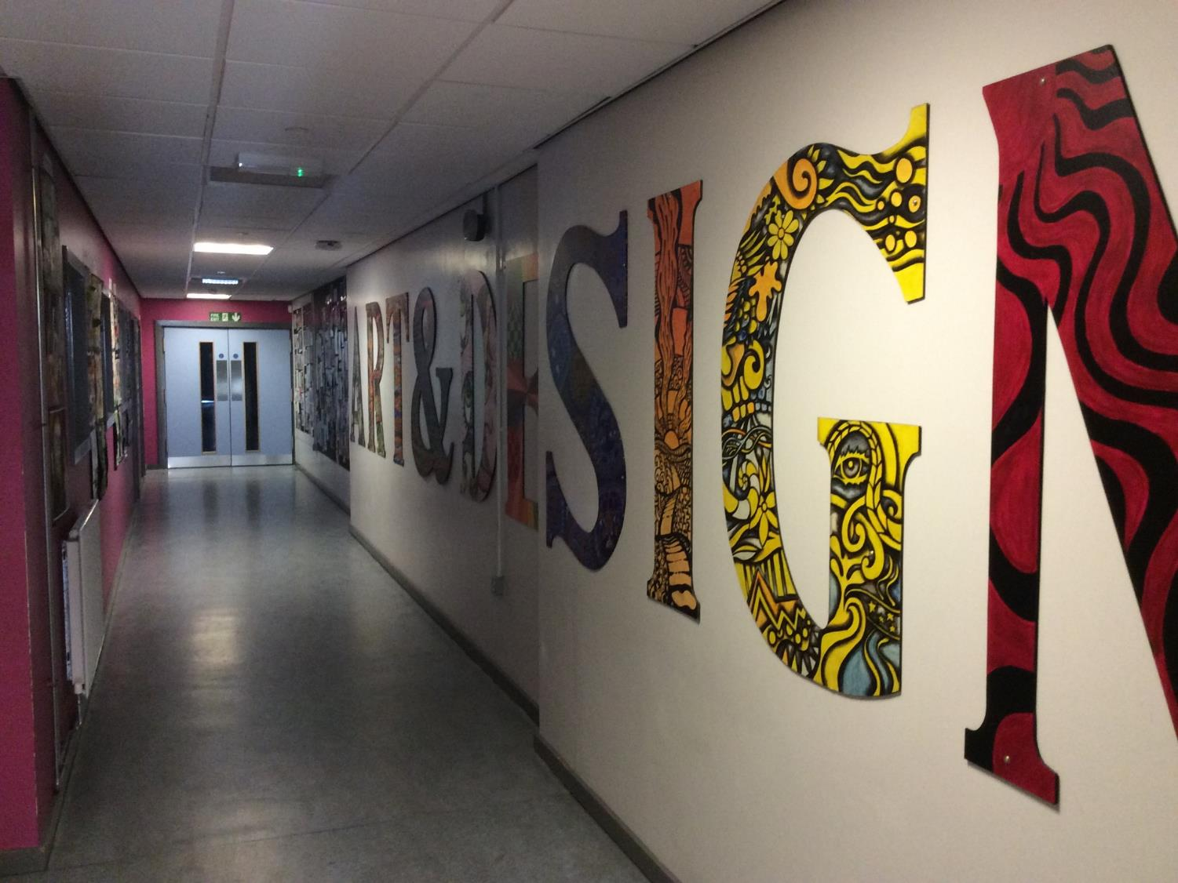
Art entrance

Slide 40
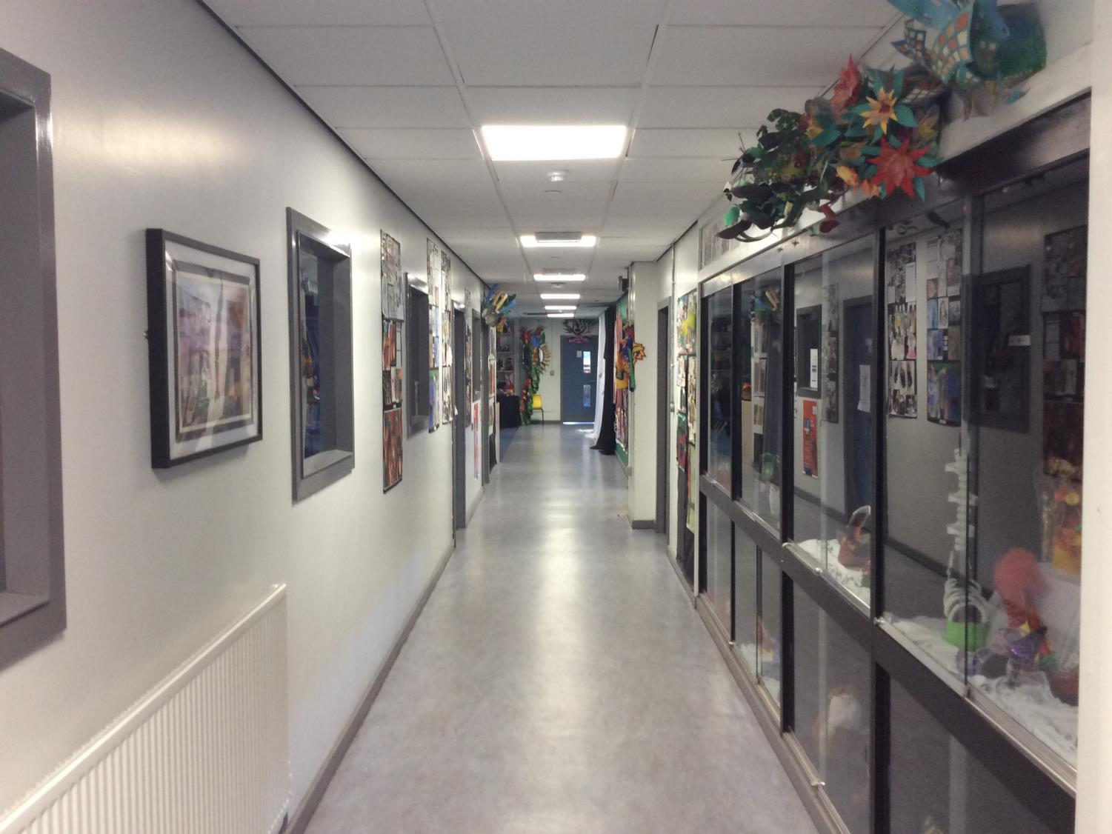
Art 1
Art classroom

Slide 41
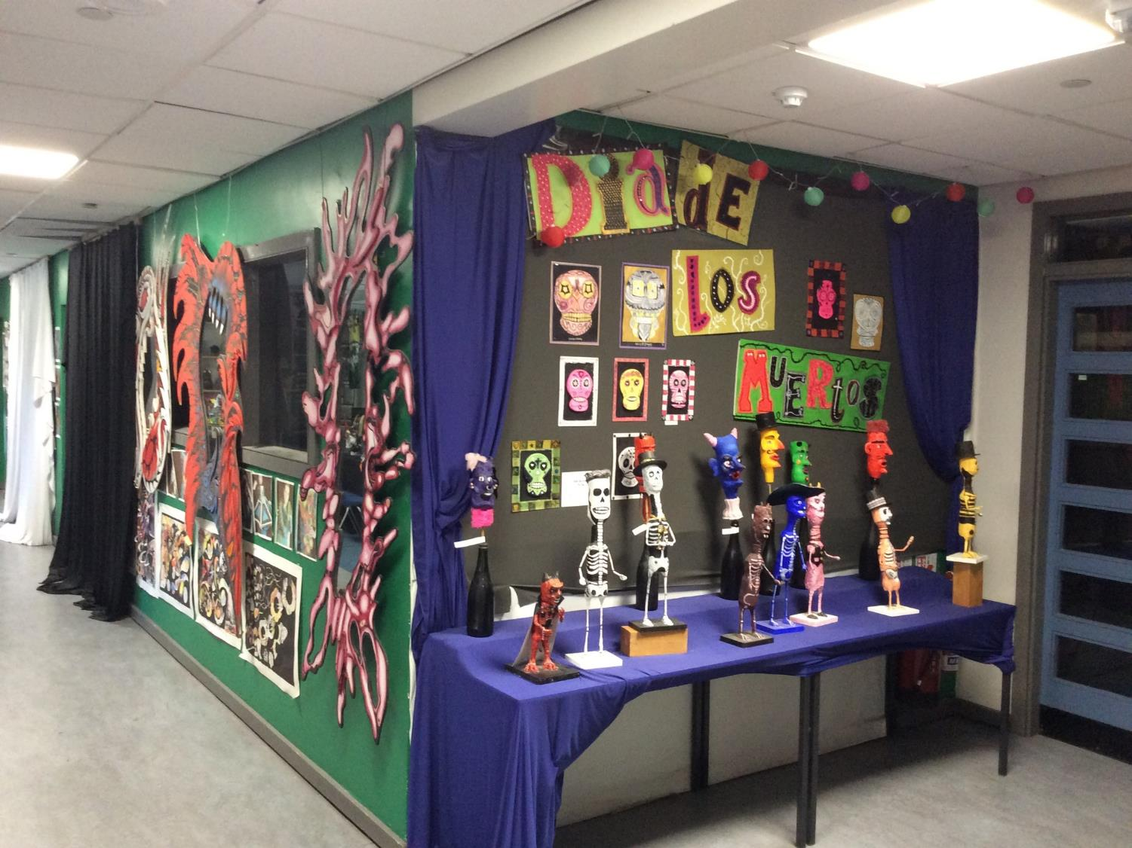
Art corner

Slide 42
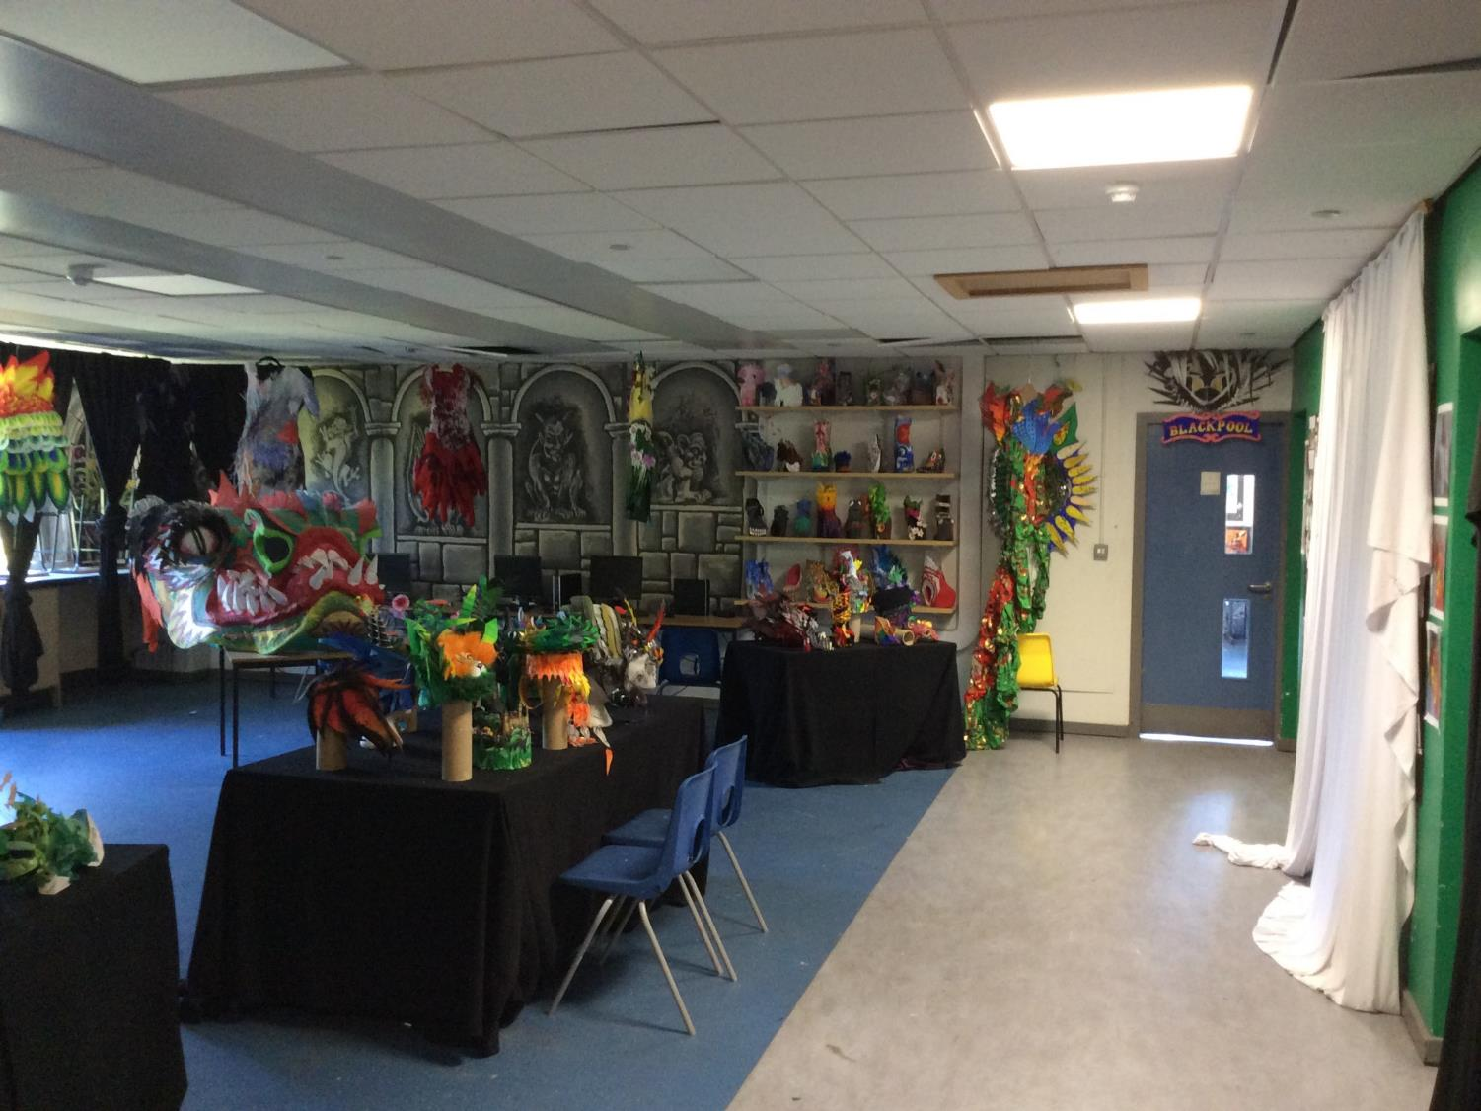
Art end
Art classroom

Slide 43
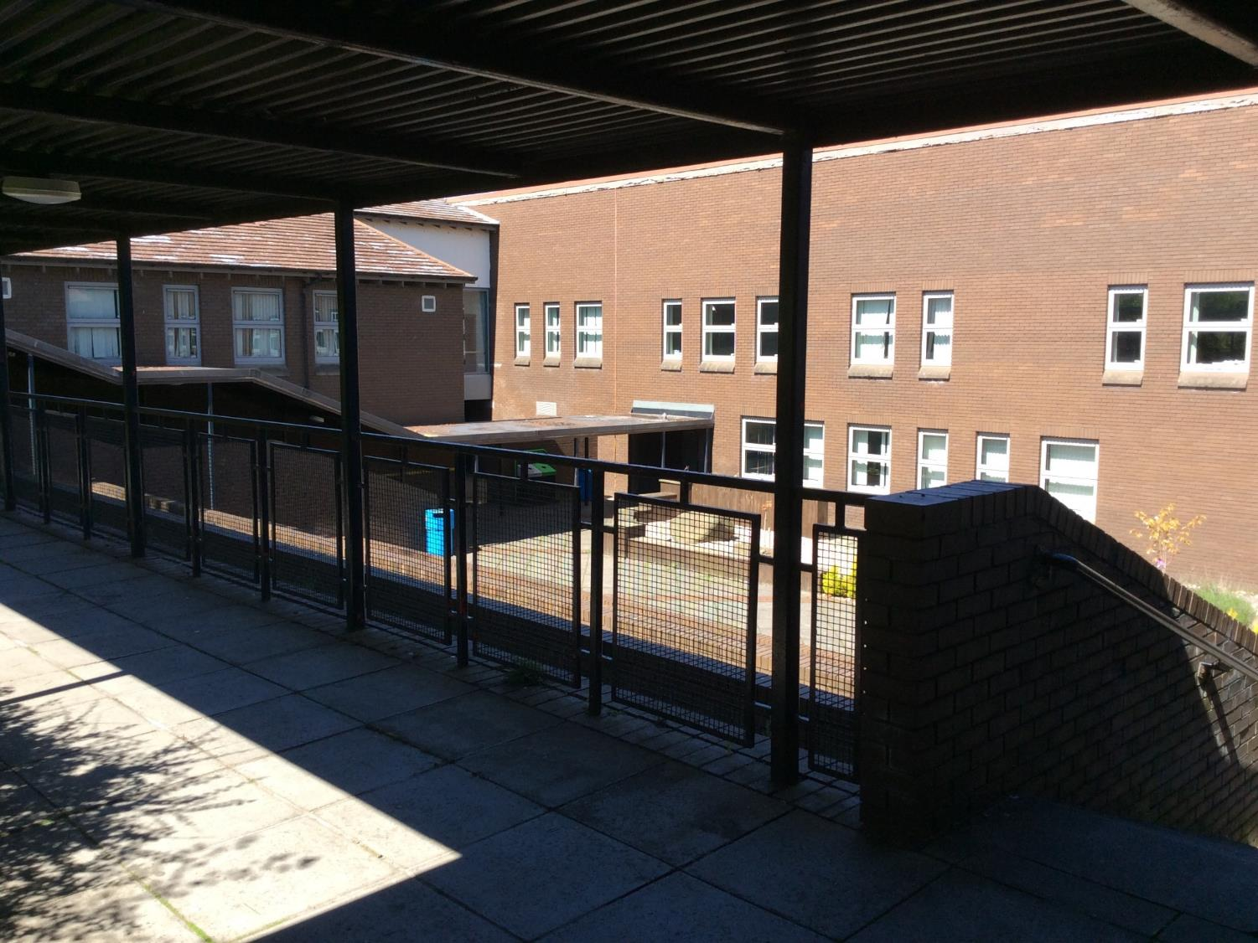
Walkway Upper

Slide 44
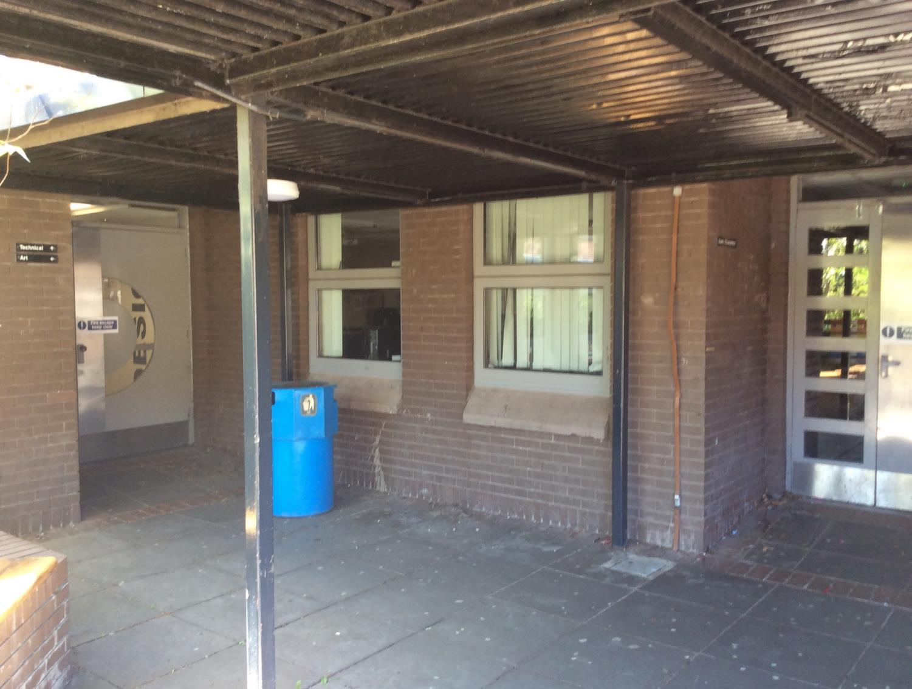
Walkway Upper CDT

Slide 45
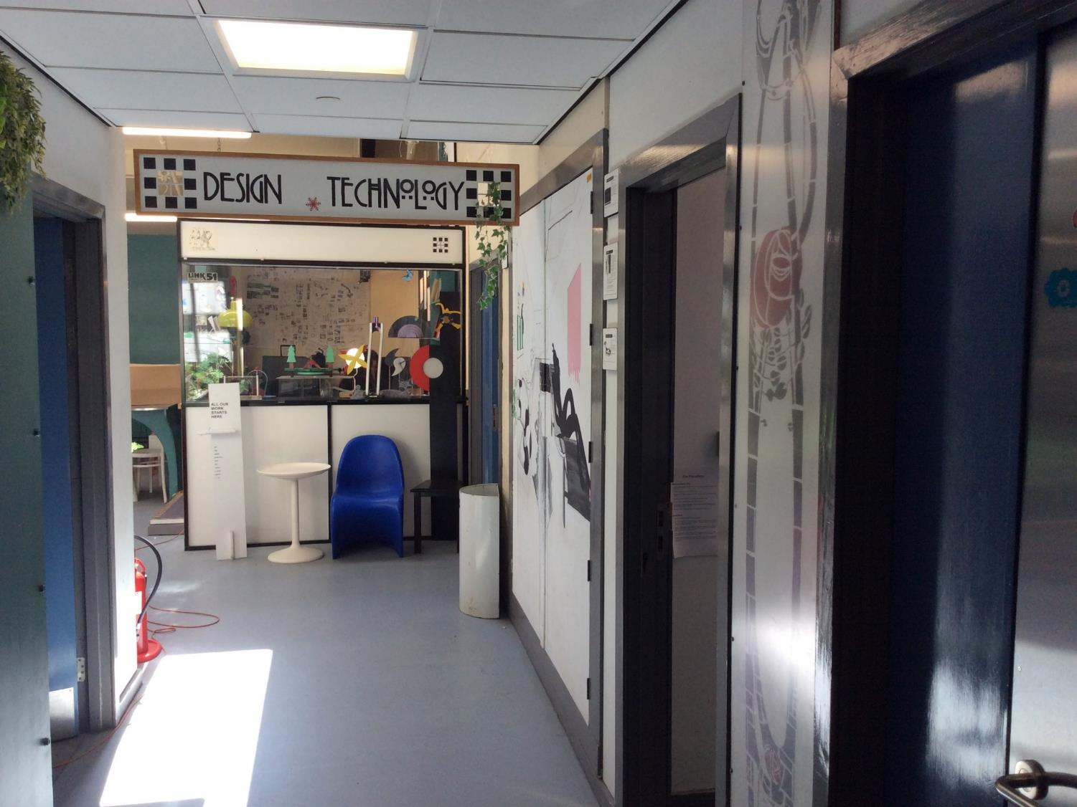
CDT 1
CDT staffroom
CDT classroom

Slide 46
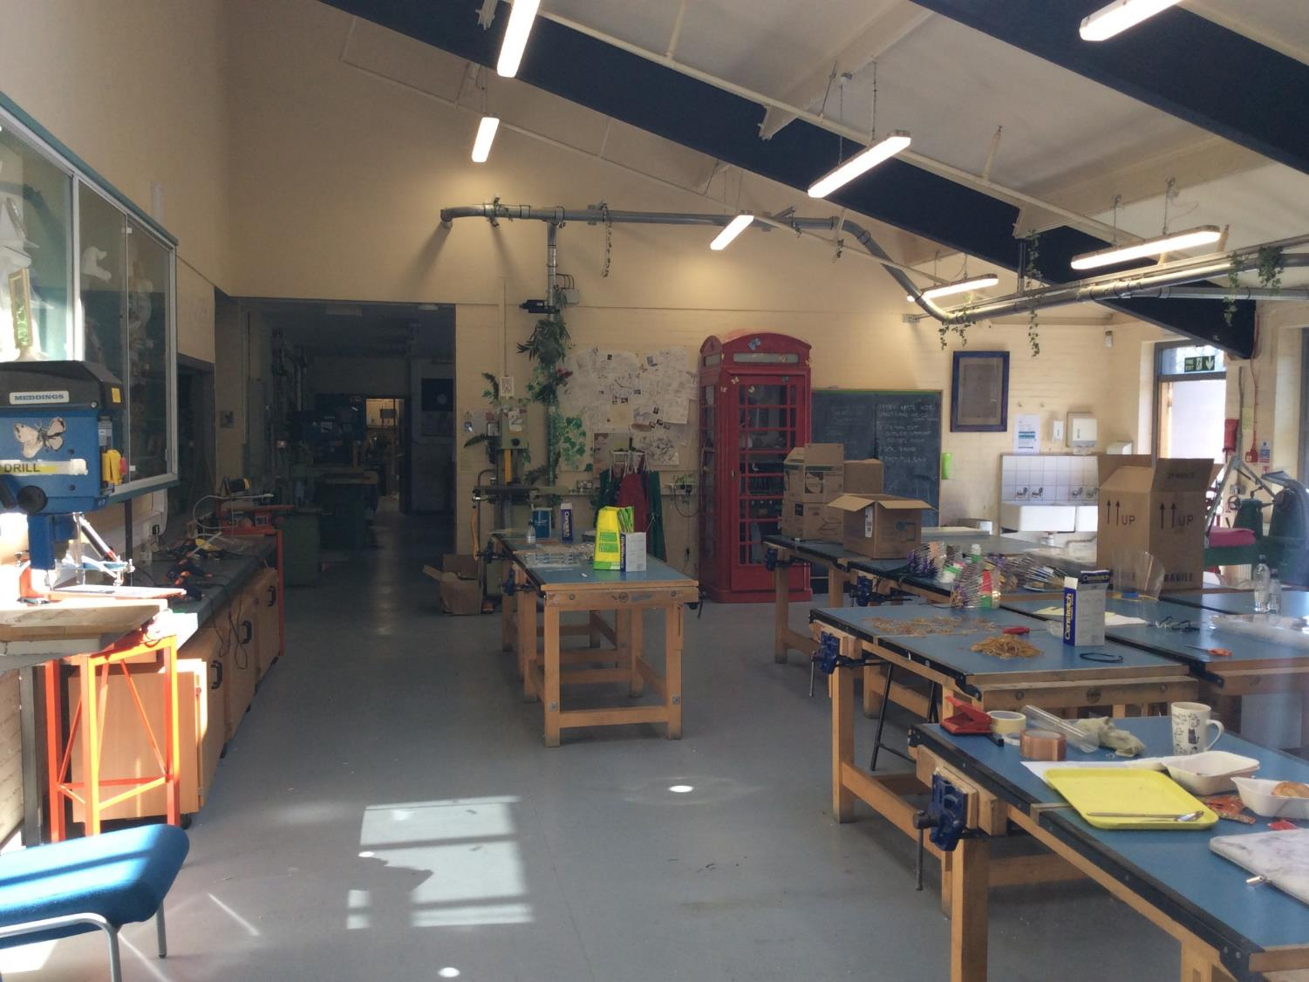
Workshop 1

Slide 47
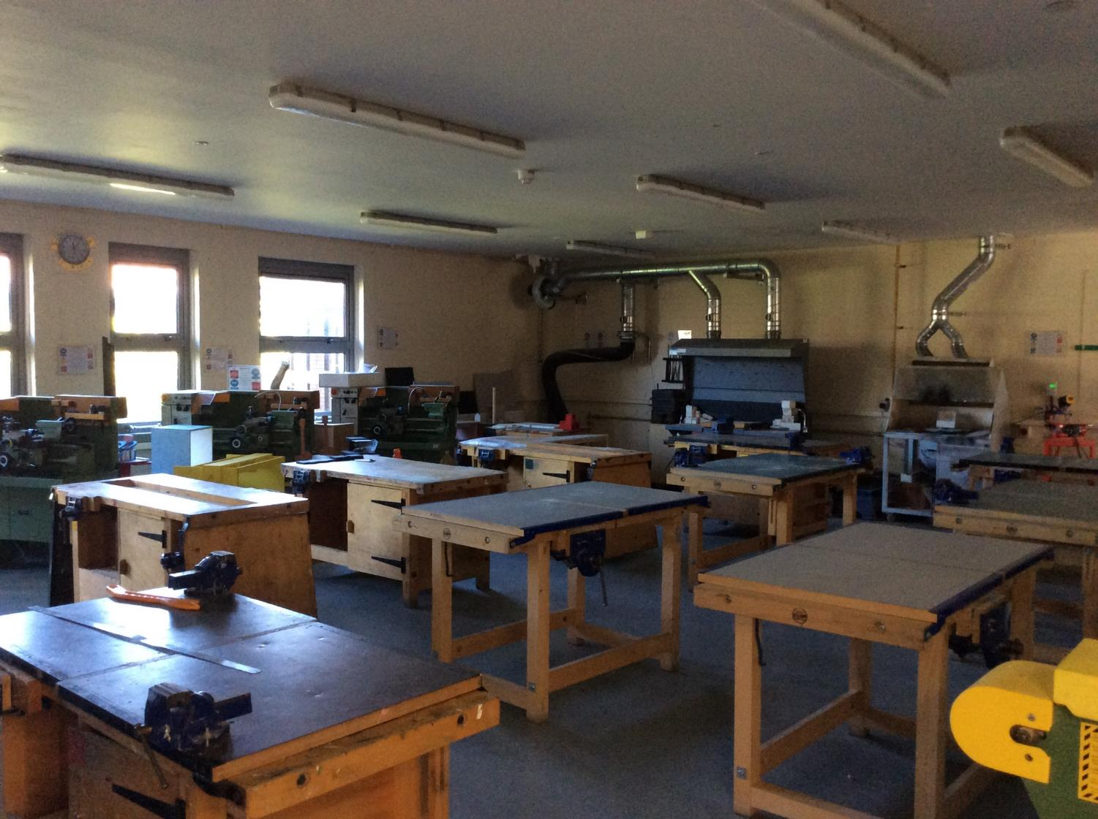
Workshop 2

Slide 48
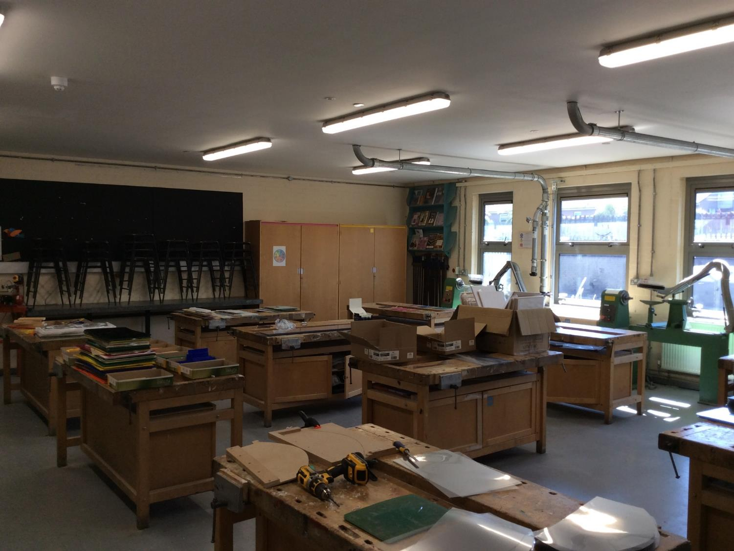
Workshop 3

Slide 49
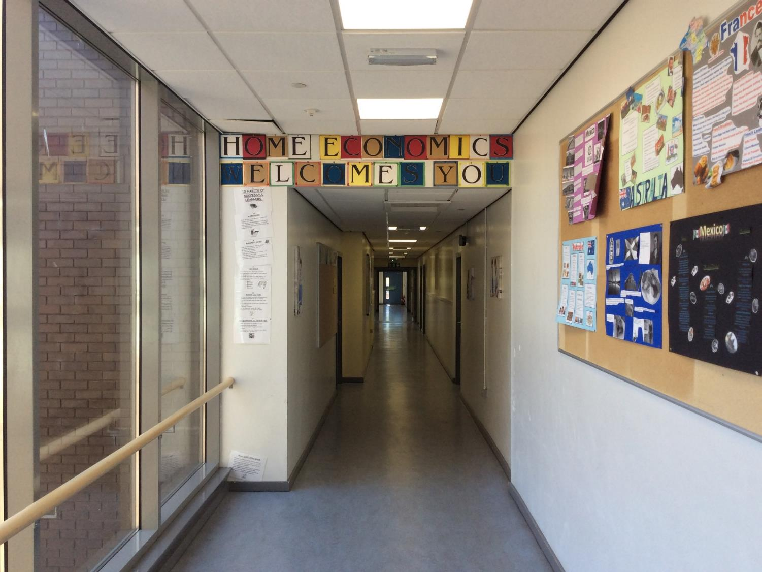
HE Entrance

Slide 50
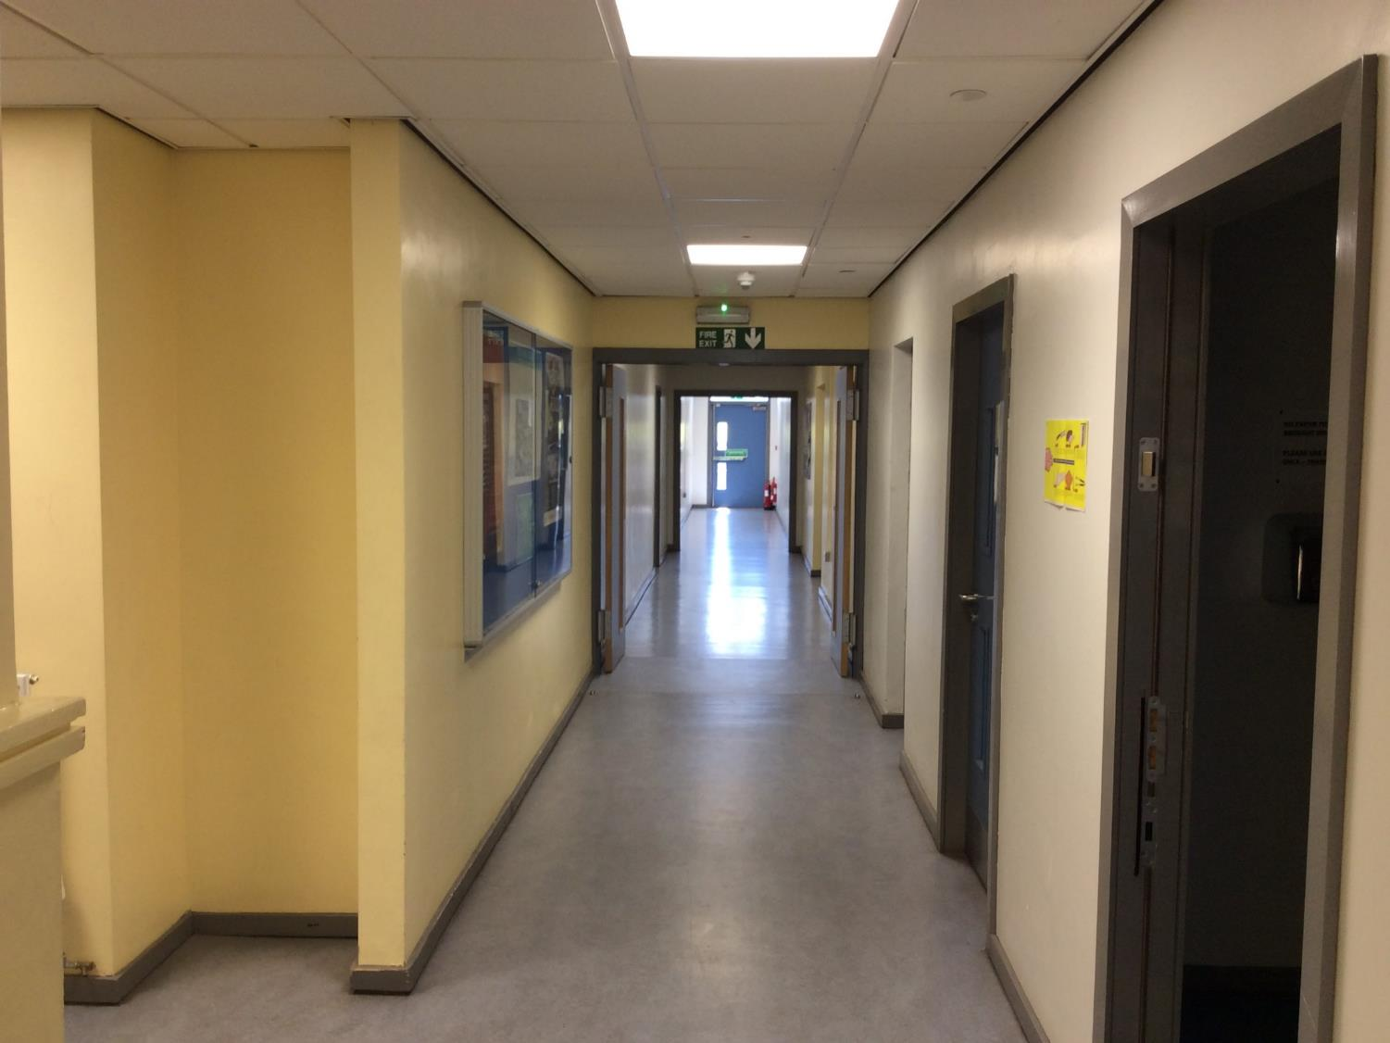
HE Corner
See inside!

Slide 51
LW Room

Slide 52
HE End
Home Economics classroom

Slide 53
iAspire
i-Aspire room

Slide 54
Stairs 1 Up

Slide 55
Stairs 1 Down

Slide 56
Stairs 2 Up

Slide 57
Stairs 2 Down

Slide 58
LT Pool corner

Slide 59
Pool Junction

Slide 60
Pool

Slide 61
Gym Junction

Slide 62
Small Gym

Slide 63
Langs Corner

Slide 64
Langs/Business

Slide 65
Langs 1
Languages Staffroom
Languages Classroom

Slide 66
Langs 2
Languages Classroom
Languages Classroom

Slide 67
Langs/Socs
RMPS Classroom
Languages Classroom
Languages Classroom

Slide 68
Socs
RMPS Classroom
Geography Classroom
History Classroom

Slide 69
Socs corner
History Classroom

Slide 70
Elaine’s corner
Geography Classroom

Slide 71
Socs/Science

Slide 72
Lower Walkway Socs

Slide 73
Science Base Area
Science Labs
Science Labs

Slide 74
Science 1
Science Labs
Science Labs

Slide 75
Science 2
Science Lab

Slide 76
Lower Walkway Science

Slide 77
Science 3
Science Lab

Slide 78
Business from Science
Business Classrooms
Business Classrooms

Slide 79
Mandarin from Business
Mandarin classroom

Slide 80
Business Corner

Slide 81
Lower Walkway Business

Slide 82
Games Hall Gym Entrance

Slide 83
Games Hall Gym side

Slide 84
Games Hall PE side

Slide 85
Games Hall corridor from Gym
PE Changing rooms

Slide 86
Games Hall entrance from Music

Slide 87
Games Hall corridor from Music
PE Changing rooms

Slide 88
Music/PE
Music classroom

Slide 89
Dance Studio area

Slide 90
Dance Studio

Slide 91
Music 1
Music practice rooms
Music classrooms

Slide 92
Music top
Music Department

Slide 93
Music Corner
Music staffroom

Slide 94
LT Door

Slide 95
LT
Lecture Theatre

