Slide 1
Grace Darling
Has anyone heard of Grace Darling before?

Slide 2
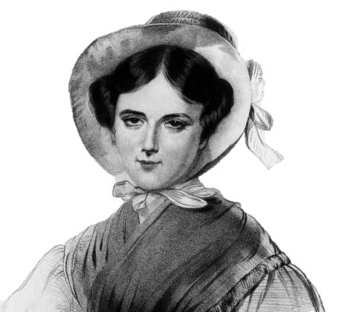
Early Life:
Grace Horsley Darling was born on 24th November 1815.
She was born in Bamburgh, Northumberland in England.
She lived with her parents, 8 brothers & sister.
Grace’s father was a lighthouse keeper.
Her and her family moved to Longstone Lighthouse in 1926.
Notes:
Video link attached to image. Video is of Grace Darling discussing her story.

Slide 3
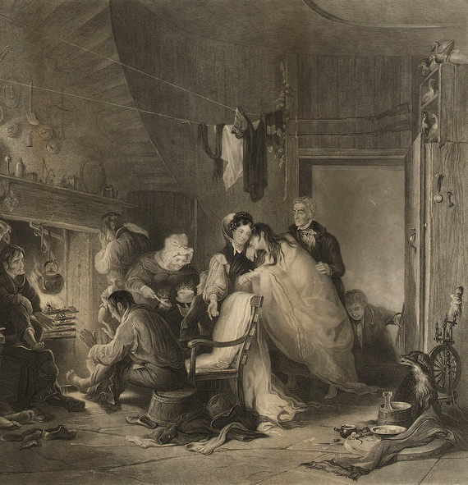
Life in the Lighthouse:
Grace’s father was called William Darling.
He taught Grace & her sibling to read and write.
She never went to a school.
Grace always had a great interest in the sea.
Grace & her sisters also learnt how to spin, knit, sew & cook.

Slide 4
Love of the Sea:
1829 - only Grace & her younger brother still lived at home.
Grace helped her father to look after the lighthouse.
She wasn’t allowed to help row the coble.
This was considered a “man’s job”.
Coble - flat-bottomed fishing boat.

Slide 5
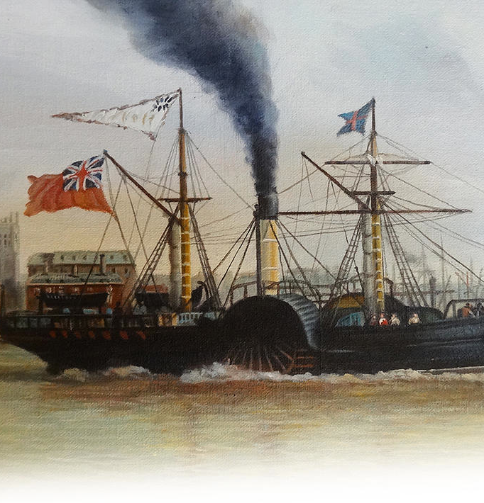
SS Forfarshire:
5th September 1838 - SS Forfarshire left Hull for Dundee.
During the evening the ship started to leak.
The engine stopped shortly after.
6th September - a storm hit and the ship hit a rock.
It was shipwrecked 3/4 mile from Grace’s lighthouse.
Grace’s father decided to help the men.

Slide 6
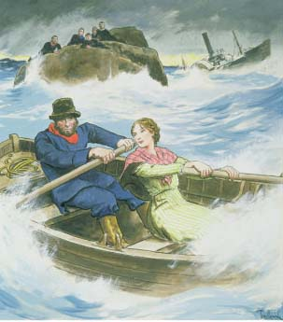
The Rescue:
Grace’s brothers were away from home.
7th September - Grace & her father rowed a coble to the shipwreck.
They wanted to rescue the survivors.
The survivors were clinging to the rocks.
In total, they found 9 survivors.

Slide 7
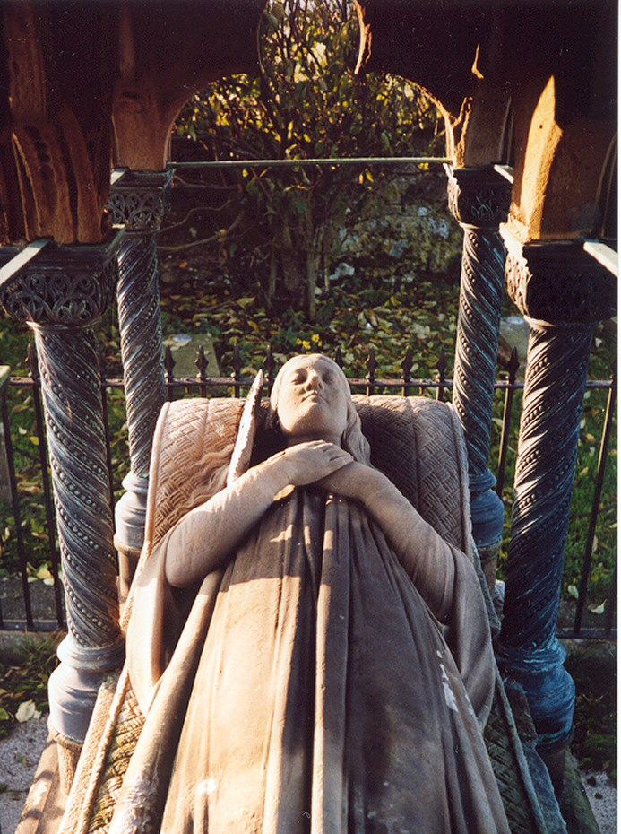
After the Storm:
Grace helped look after the survivors for 3 days until the storm stopped.
Her actions made her famous in England.
She received a personal letter & £50 from queen Victoria.
Got lots of fan-mail too.
20th October 1842 - Grace became very ill and died.
A monument was built to her in St Aidan’s Churchyard, Bamburgh.

Slide 8
Grace Darling - Timeline:
1815 - Grace Darling was born and lived in the Trinity House in the Farne Islands.
1826 - 15th of February the Darling family moved to their newly built Longstone Lighthouse.
1834 - First launching of the 150 ton steamship, Forfarshire at Dundee.
1838 - Forfarshire crashes on rocks of Farne Island, Grace saves nine survivors.
1839 - Both Grace and William were awarded specially minted Royal Humane Society Gold Medals.
1842 - Grace dies, she is only 27 .

