Slide 1
Wendy the Witch

Slide 2
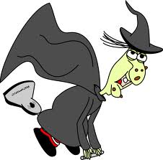
Wendy the witch has a black cloak.

Slide 3
She lives in a castle with a moat.

Slide 4
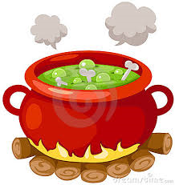
Wendy the Witch likes to boast,
that she can make the best witches brew with toast!

Slide 5
To make her brew she needs:

Slide 6
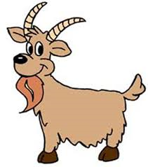
A goat from down the road.

Slide 7
A branch of an oak tree.

Slide 8
A bar of green soap.

Slide 9
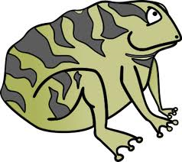
A big fat croaky toad.

Slide 10
And a big tub of shaving foam!

Slide 11
She made her brew one day, but got carried away!
The brew grew and grew and grew!

Slide 12
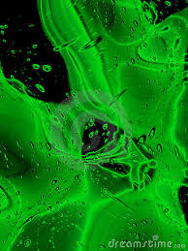
Oh no! she said with groan.
It’s turned into a river she moaned.

Slide 13
She cast a spell to make a boat.
She hopped in to stay afloat!

Slide 14
Then she waved her wand and said: diddle de doad, fix this load!

Slide 15
Without further ado, her castle was as good as new!

