Slide 1
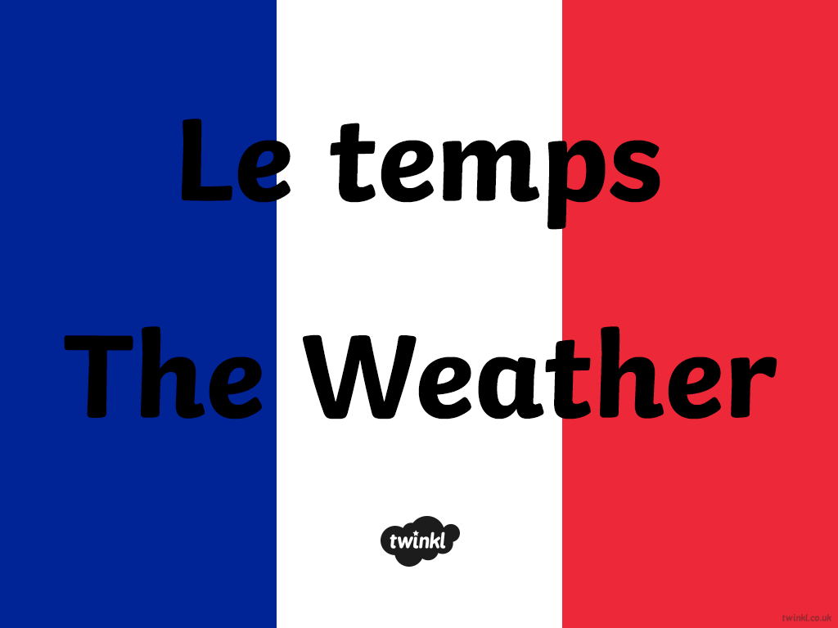

Slide 2


Il fait nuageux.
It is cloudy.

Slide 3
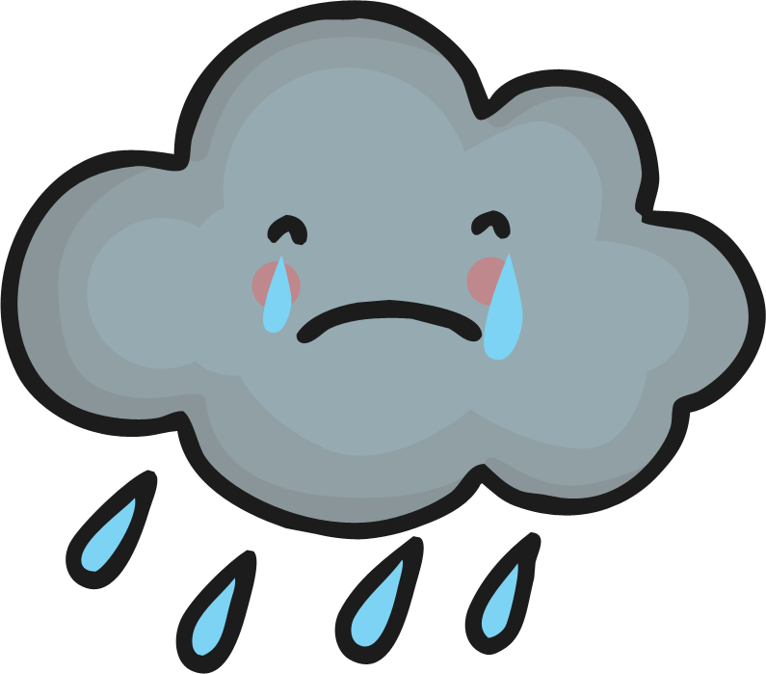
Il pleut.
It is raining.

Slide 4
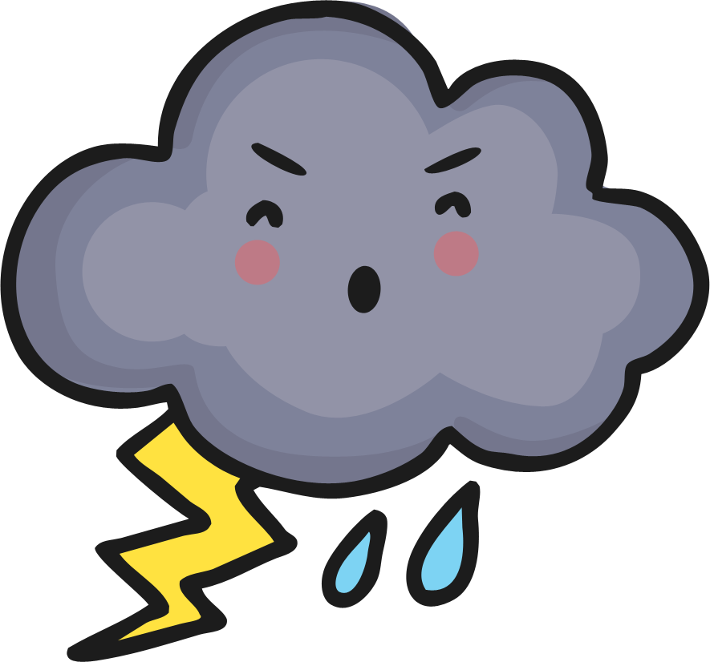
Il fait orageux.
It is stormy.

Slide 5

Il neige.
It is snowing.

Slide 6

Il fait beau.
The weather is nice.

