Slide 1
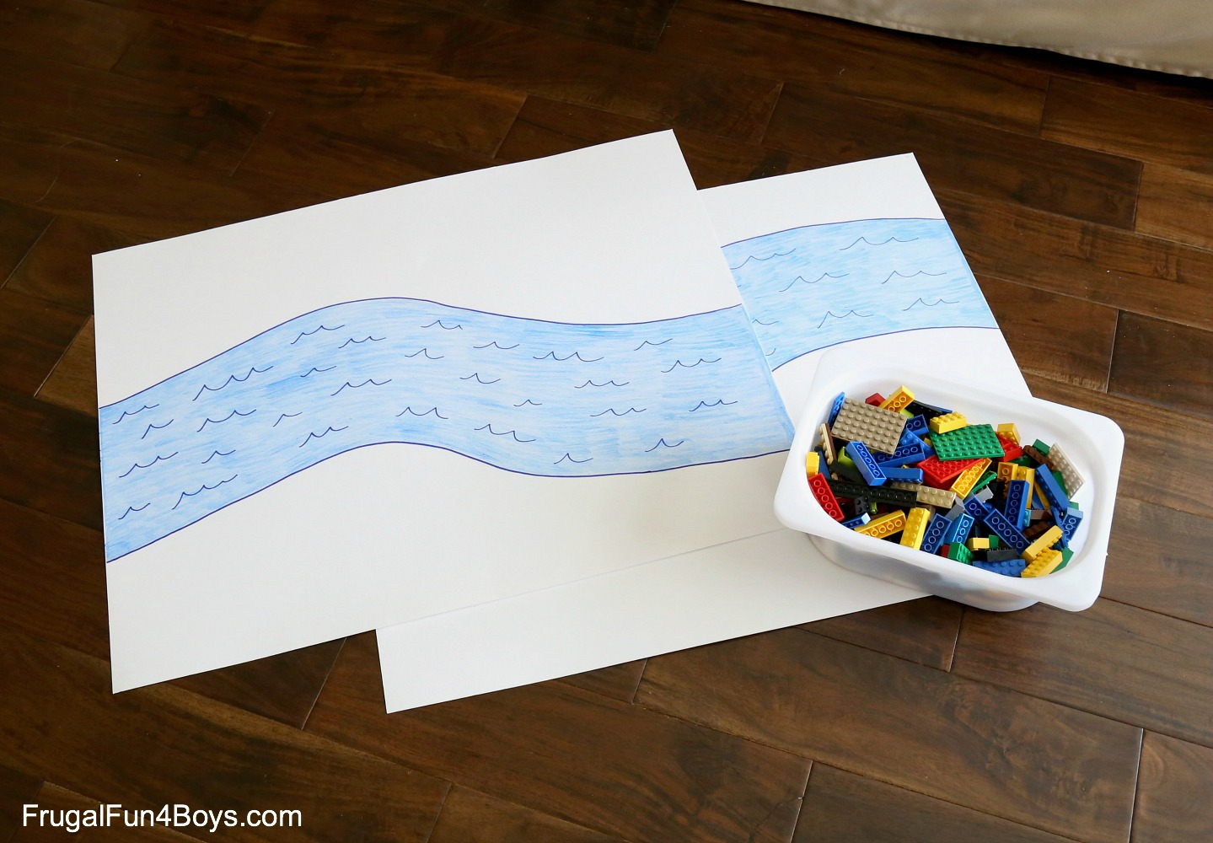
HELP!
WE HAVE AN EMERGENCY

Slide 2
WE ARE STUCK AND CAN’T GET ACROSS THE RIVER

Slide 3
WE NEED A STURDY BRIDGE TO BE BUILT

Slide 4
We challenge you to construct a sturdy LEGO® bridge that spans the width of the river.
It has to be 10 cm high.
It has to hold the weight of a lego car.

Slide 6
Things to Consider:
Think about the bridge’s span.
Do you need to reinforce something to make it stronger?
The bridge’s beam, or the horizontal part of the bridge, needs to be strong and able to hold a lot of weight.
Just one layer of LEGO® bricks won’t be very strong or hold much weight.
If you reinforce your bridge with a layer of overlapping plates, it will be much stronger.

