Slide 1
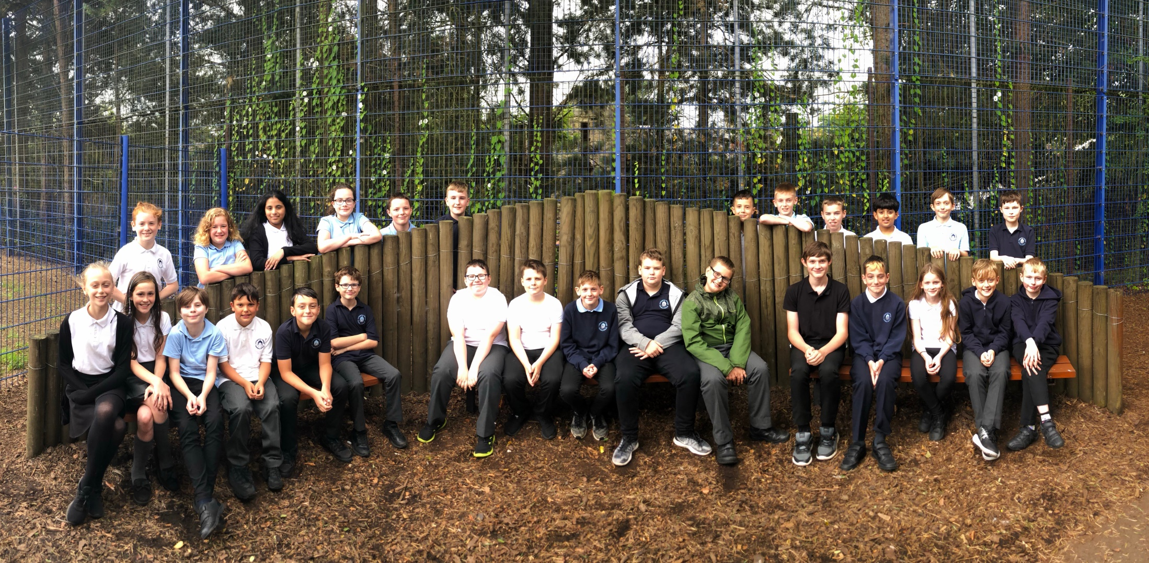
Primary 7 Miss Marnie

Slide 2
SNSAs (completed Oct/Nov 2019)
P7 children take three SNSA assessments: one in reading, one in writing and one in numeracy.
The assessments are adaptive, which means that if a child is experiencing difficulty, the questions will get easier, and if a child is doing well, the questions will become more challenging. In this way, the assessments establish children’s capacity without them having to face lots of questions that are too easy or too hard for them to answer. There is no pass or fail.
https://standardisedassessment.gov.scot/parents-and-carers/

Slide 3
Literacy/Reading
ERIC time in class daily (Everyone Reading In Class)
Reading for information, comprehension and higher order thinking questions in preparation for SNSAs
Spelling – Tasks completed in class
New grammar/writing resource – PM Writing
Drama as a stimulus for creative writing
French (Mrs Moore – ICHS)

Slide 4
Numeracy & Maths
Revision of strategies to solve + - x ÷
Fractions, decimals and percentages
Worded problems
Information and data handling

Slide 5
ICT
Glow login
E-mail access
Didbook (Pupil Profiles)
Internet safety (including social media)

Slide 6
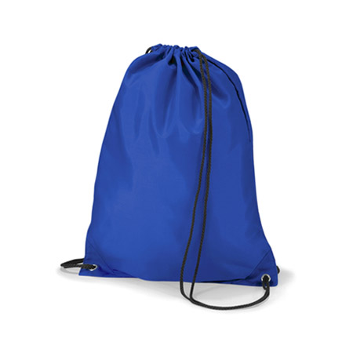
PE
Our PE days are Monday, Tuesday and Thursday.
Kits can stay in school and will be
sent home for washing at the end
of term (or before if needed!)

Slide 7
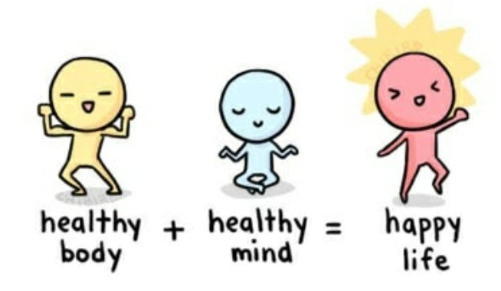
Health & Wellbeing
Resilience & Growth Mindset
UN Convention of the Rights of the Child (Class Charter, LVPS Vision, Values & Aims)
Road Safety
Netball in PE
Internet Safety

Slide 8
Wider Opportunities
ICHS Cluster school camp – Dalguise Wednesday 3rd – Friday 5th June 2020
P6/7 Show (beginning after Christmas with performances usually
around March/April)

Slide 9
P7 Responsibilities
P1 Pals
House Captains & Vice Captains
Sports Captains and Sports Committee
Reading Champions
JRSOs
Language Leader & Champions
Pupil Council
Digital Leader & Team

Slide 10
Sharing Learning
@MissMarnie2
@LiviVillagePS
Livingston Village PS Facebook page
School Blog (available on the school website)

