Slide 1
Linlithgow Bridge Primary School P5 REMOTE LEARNING WEEKLY DIARY w/c Monday 8th March 2021
TREASURE YESTERDAY
LIVE FOR TODAY
DREAM OF TOMORROW

Slide 2
ONLINE LESSONS for week commencing Monday 8th March 2021
Monday | 8th March | Check-in | 09:30
Monday | 8th March | Numeracy (Guidance for page 42 and page 45- multiplying a 2 digit by a single digit and a 3 digit by a single digit). | 11:30
Tuesday | 9th March | Comprehension Lesson – Tail to Tail | 11:00
Wednesday | 10th March | Numeracy (Guidance for page 43 and 44, multiplying a 2 digit number by a 2 digit number). | O9:30
Wednesday | 10th March | RZSS Lesson with Sandie Robb | 11:00
Thursday | 11th March | Cable-Stayed Bridges | 11:00
Friday | 12th March | Chocolate Chip Cookie – Bake Off | 11:00

Slide 3
SUGGESTED TIMETABLE FOR THIS WEEK
Monday | MEETING 09:30 Check –In and to go over the Weekly Diary | MEETING 11:30 NUMERACY -complete this work after the lesson. | Numeracy Task 1 – page 42 | Bridges Research Task
Tuesday | Numeracy Task 2 – page 45 | MEETING 11:00 COMPREHENSION – complete this work after the lesson | Comprhension – Tail to Tail | French – Kahoot Quiz
Wednesday | MEETING 09:30 NUMERACY | MEETING 11:00 Sandie Robb - RZSS | Numeracy Task 3 – page 43 | Making a Weather Vane
Thursday | Numeracy Task 4 | MEETING 11:00 Cable-Stayed Bridges | Reflection of Lockdown Task | Grammar and Punctuation
Friday | Preparation for Chocolate Cookie – Bake Off | MEETING 11:00 Baking Lesson – Chocolate Chip Cookies

Slide 4
GRAMMAR AND PUNCTUATION
PREFIXES – UNIT 16
LI – to use prefixes to give a word the opposite meaning.
Definition of prefix - letter or group of letters added to the beginning of a word to make a new word
e.g., un and dis
REMEMBER TO COMPLETE PRACTICE YOUR PUNCTUATION OR P.Y.P.
Complete this unit of work and upload it please.
Remember to underline the missing words in Getting Started and Now Try These (with a ruler).
Please upload into Assignments.

Slide 5
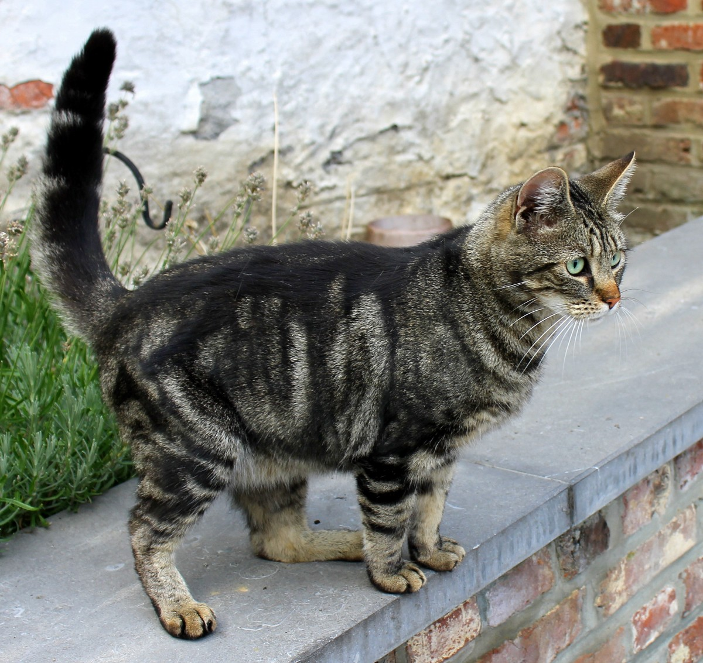
COMPREHENSION SUCCESS
Tail to Tail – page 15
LI – to observe the detail of an image and discuss this.
Please complete sections A, B and C after our lesson on Tuesday. Remember to answer the questions in sentences.
Please upload into Assignments.

Slide 6
Madame Gordon’s French Lesson
French Fun week.
Click on the picture below and do some revision with Madame Gordon, then do the KAHOOT quiz after and see how you do!
P4/5 - https://kahoot.it/challenge/07415691?challenge-id=823cef87-e65d-4588-9a27-d1f35dce8d22_1614896539605

Slide 7
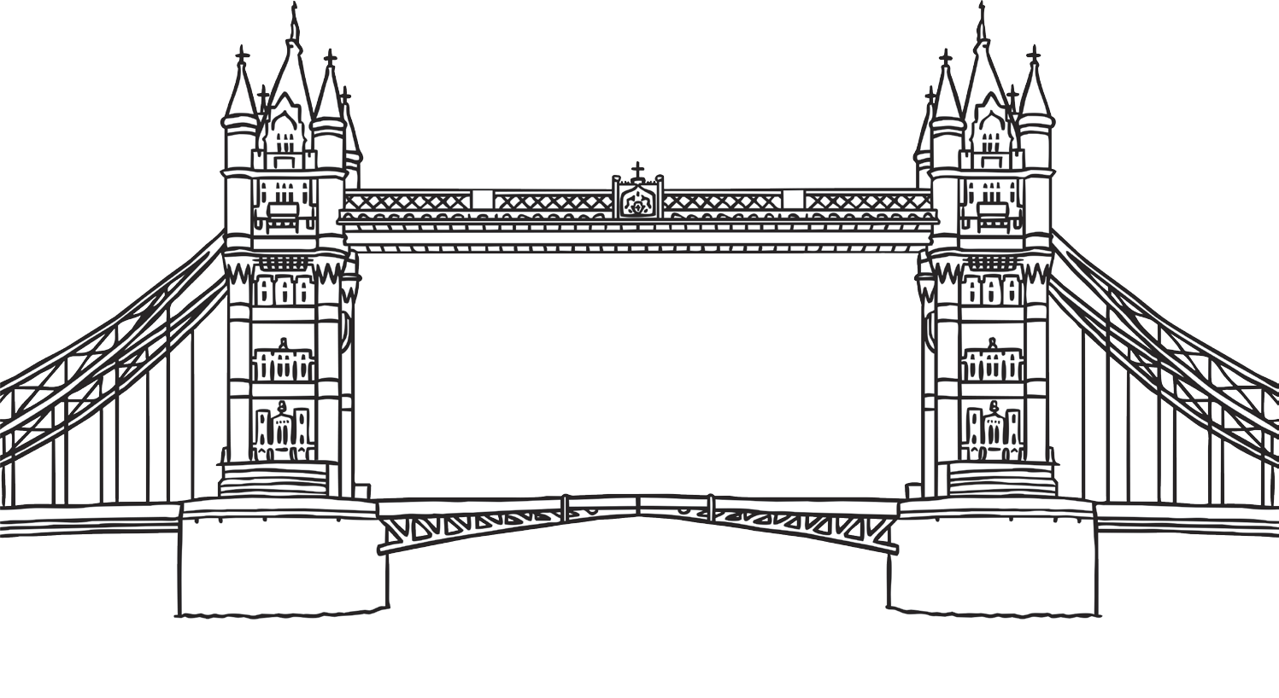
Bridges
You are going to investigate 6 bridges, you will find out where each bridge is and find some interesting facts about it. Please go to assignments to find the worksheet. You can make a poster about the bridges, you can do the work in your jotters or you can fill out the worksheet.
Please upload into Assignments.

Slide 8
Please complete all numeracy work in your numeracy jotters.

Slide 9
NUMERACY TASK 1
LI – Multiplying a 2 digit number by a single digit
Please complete page 42 of H5 textbook in your numeracy jotters.
Complete this after our numeracy lesson on Monday.
Remember to write the date and page number before starting your work.
Use the column method strategy for all your calculations!
Please go to Assignments to find your Task.
Please upload into Assignments.

Slide 10
NUMERACY TASK 2
LI – Multiplying a 3 digit number by a single digit
Please complete page 45 of H5 textbook in your numeracy jotters.
Complete this after our numeracy lesson on Wednesday.
Remember to write the date and page number before starting your work.
Use the column method strategy for all your calculations!
Please go to Assignments to find your Task.
Please upload into Assignments.

Slide 11
NUMERACY TASK 3
LI – Multiplying a 2 digit number by a 2 digit number
Please complete page 43 of H5 textbook in your numeracy jotters.
Complete this after our numeracy lesson on Monday.
Remember to write the date and page number before starting your work.
Please go to Assignments to find your Task.
Please upload into Assignments.

Slide 12
NUMERACY TASK 4
LI – Multiplying a 2 digit number by a 2 digit number
Please complete page 44 of H5 textbook in your numeracy jotters.
Complete this after our numeracy lesson on Wednesday.
Remember to write the date and page number before starting your work.
Please go to Assignments to find your Task.
Please upload into Assignments.

Slide 13
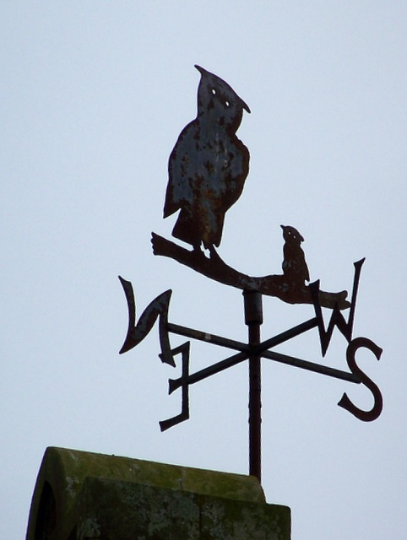
Health and Wellbeing
Watch the video below first!
https://www.youtube.com/watch?v=xganMMrfegc
Make a weather vane!
YOU WILL NEED
Empty tin/jar with a thin plastic lid (a coffee tin is ideal)
Empty biro pen casing
Skewer
Thin plastic (such as a food tray)
Gravel or pebbles
Compass
1 - Why not start by decorating your container? You could use coloured tape or paint.
2 - Cut an arrow shape out of the plastic and stick it to the skewer with tape (you could use cardboard, but it won’t be as weather proof).
3 - Fill the container with gravel/pebbles to weigh it down and avoid it blowing over.
4 - With an adult’s help, carefully make a hole in the container lid. When it’s big enough, push the biro casing through and thread the skewer through it. This enables the skewer and arrow to turn easily in the wind.
5 - Decide where to put your weathervane and use a compass (there is one on most smartphones) to mark North, East, South and West on the jar, or on the ground nearby.
6 - Use your weathervane to see which direction the wind is blowing from! Keep watching your weathervane to see how it works. Could you improve it somehow?

Slide 14
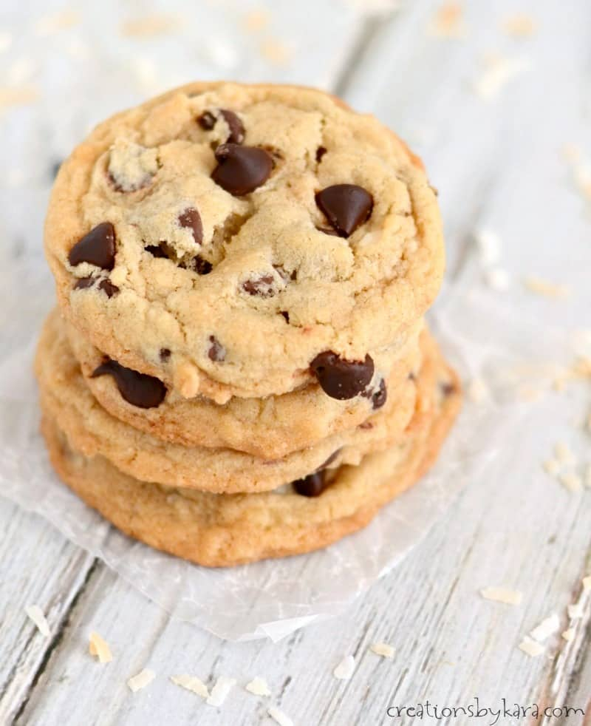
Health and Wellbeing
A Baking Lesson
Chocolate Chip Cookies
P5 Fairtrade Bake Off!
Friday 12th March 2021 @ 11:00 am
Important notes to ensure the Bake Off goes smoothly
Please don’t worry if you are unable to make the cookies at this time as you can still join the call to watch what is happening and make them at a time that suits your family.
You will need an adult to help you as you need to use an oven.
Read over and become familiar with the recipe before our lesson begins.
Make sure you have your oven heated to 180C or 160C for fan ovens before the lesson begins at 11am.
Please have your ingredients measured out and prepared prior to the lesson starting.
At 11am we will start the call, with cameras on, and together we will follow the recipe and make the cookies.
While the cookies are in the oven we can have a little chat!
Once the cookies are out of the oven we can show off our finished masterpieces, take photos to upload onto our Team.
Once the cookies are cool we can enjoy sharing them with our families!

Slide 15
Health and Wellbeing
Lockdown Reflection
Please complete the lockdown reflection sheet in Assignments and upload it. You can use the sheet and then upload or you can do your answers in your jotter.

Slide 16
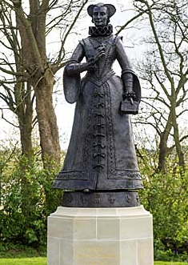
Health and Wellbeing
Another walk around Linlithgow…..
Please go to Assignments to find out what
your task is.
The due date for this task is in three weeks time.

Slide 17
PERSONAL READING It is important that you continue to read fiction as much as you can. Next week we will focus on our personal reading.
Click on this page.
Remember to fill out your passport.

Slide 18
Health and Wellbeing
Health and Wellbeing
Health and Wellbeing
Health and Wellbeing

Slide 19
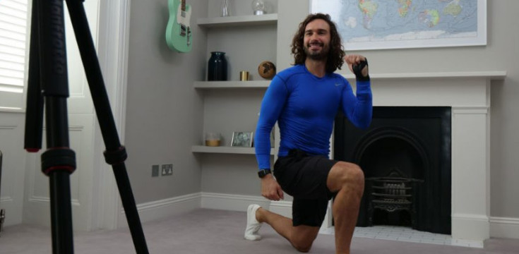
Health and Wellbeing
Joe Wicks’ PE lessons
This is a great way to start the day.
These sessions are live on YouTube on Mondays, Wednesdays and Fridays at 9am.
They are 20-minutes, half the length of last lockdown’s sessions.
They do not require any specialist equipment or large amounts of space.
ttps://www.youtube.com/channel/UCAxW1XT0iEJo0TYlRfn6rYQ

Slide 20
CORE WRITING TARGETS
These are your targets for all types of writing!
A word about spelling. When writing your first draft I would recommend that you check your spelling after you have finished your text. This will allow your story to flow. When you have finished take time to check that have used your spelling rules and strategies for all common words. You should use a dictionary for more challenging words.
Confidently and accurately use capital letters, full stops, commas, inverted commas, exclamation marks, question marks and/or apostrophes.
Use sentences of different lengths and complexity.
Use challenging vocabulary for description and openers.
Ensure sentences are grammatically accurate, nouns, verbs and tenses agree.
Accurately use paragraphs to separate ideas/events.
Proof read and edit writing accurately.
Use linked, legible handwriting to present work attractively using correct forms of layout.

