Slide 1
Linlithgow Bridge Primary School P5 REMOTE LEARNING WEEKLY DIARY w/c Monday 1st March 2021
TREASURE YESTERDAY
LIVE FOR TODAY
DREAM OF TOMORROW

Slide 2
ONLINE LESSONS for week commencing Monday 1st March 2021
Monday | 1st March | Check-in | 09:30
Monday | 1st March | Numeracy – Factors and Factor Trees | 11:00
Tuesday | 2nd March | BRIDGES | 14:00
Wednesday | 3rd March | Numeracy – Multiplying a 2 digit number by a single digit | 11:45
Thursday | 4th March | NO LESSONS
Friday | 5th March | Spelling and sharing our suspension bridge designs or artwork. | 09:30

Slide 3
SUGGESTED TIMETABLE FOR THIS WEEK
Monday | MEETING 09:30 Check –In and to go over the Weekly Diary | Bridges Task 1 | MEETING 11:00 NUMERACY - FACTORS and FACTOR TREES | Numeracy Task 1 –Factors AND Factor Trees
Tuesday | Spelling | Bridges Task 2 or 3. Watch the videos. | Numeracy Task 2 | MEETING 14:00 BRIDGES
Wednesday | Comprehension – From fireplace to flap | Bridges Task 2 or 3. | MEETING 11:45 NUMERACY | Numeracy Task 3
Thursday | Numeracy Task 4 | French | Bridges Task 2 or 3 | Personal Reading
Friday | 09:30 MEETING – SPELLING and sharing our bridge designs or artwork. | Grammar and Punctuation -Adjectives

Slide 4
SPELLING
Focus ‘c’
We have been learning about the different representations of the phoneme ‘s’. Please go to assignments to find out what your spelling tasks are for the week.
Try out the website below for some extra practice on soft ‘c’.
https://www.spellzone.com/word_lists/list-4807.htm
Please upload into Assignments

Slide 5
GRAMMAR AND PUNCTUATION
ADJECTIVES (2) – UNIT 13
LI – To use more interesting adjectives when writing.
An adjective is a describing word. It tells us more about nouns. Adjectives make our writing more interesting.
Complete this unit of work and upload it please.
Remember to underline the missing words in Getting Started and Now Try These.
Please upload into Assignments.

Slide 6
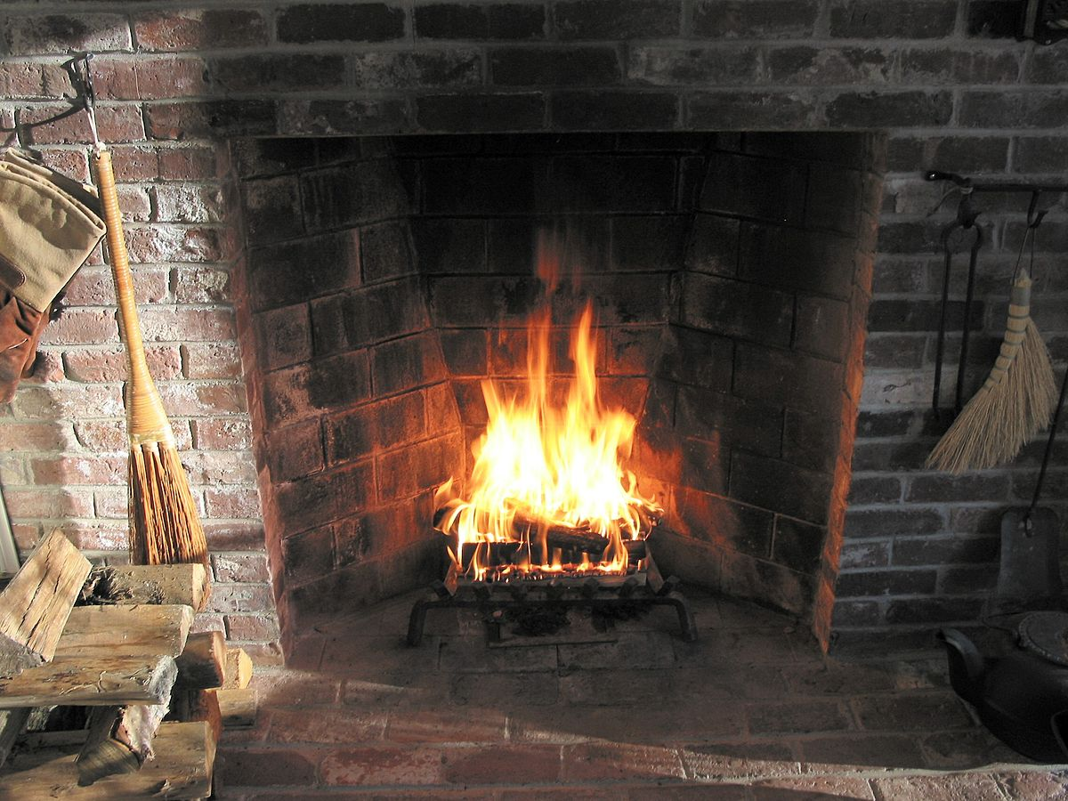
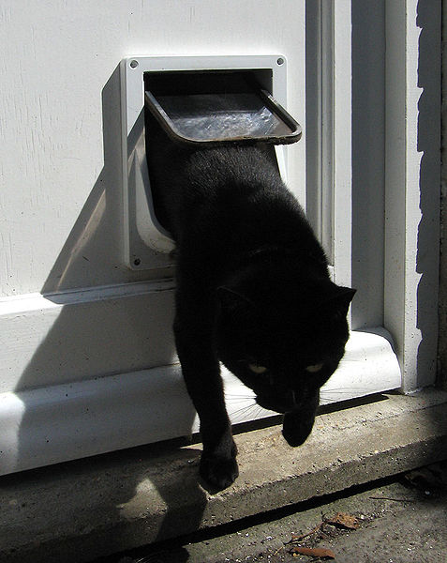
COMPREHENSION SUCCESS
From fireplace to flap – page 24
LI – to locate and retrieve information from a dictionary.
Complete section A, please write each statement fully and underline the missing word.
Complete section B and remember to write in sentences.
Complete section C – design a class flag.
Please upload into Assignments.

Slide 7
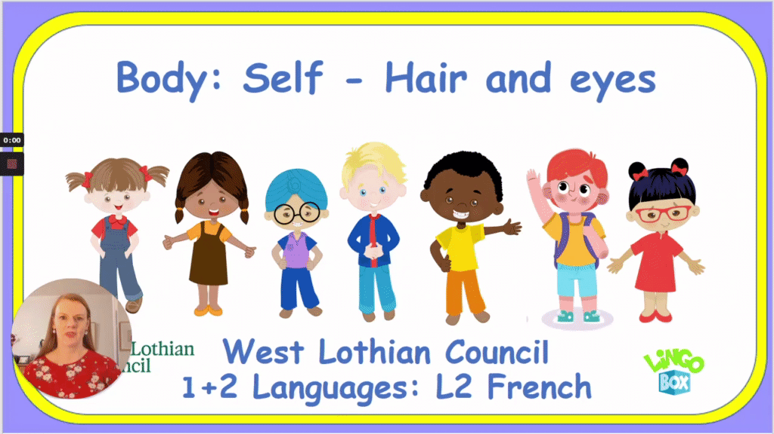
Madame Gordon’s French Lesson
Descriptions - hair and eye colour
https://www.loom.com/share/ba935f10e02a4a7d849a9d3ad706d616
Activities
Wordwall - quiz - https://wordwall.net/play/11602/673/362
Wordwall - game - balloon pop https://wordwall.net/play/6948/299/594
Mr Innes video - hair - https://video.link/w/XN6Vb
Although we do not need to uplaod anything into Assignments. Please practise writing the vocabulary you learn during Madame Gordon’s lessons. You can pause the video and practise writing and then continue. Remember to pronounce the words after Madame Gordon has spoken.

Slide 8
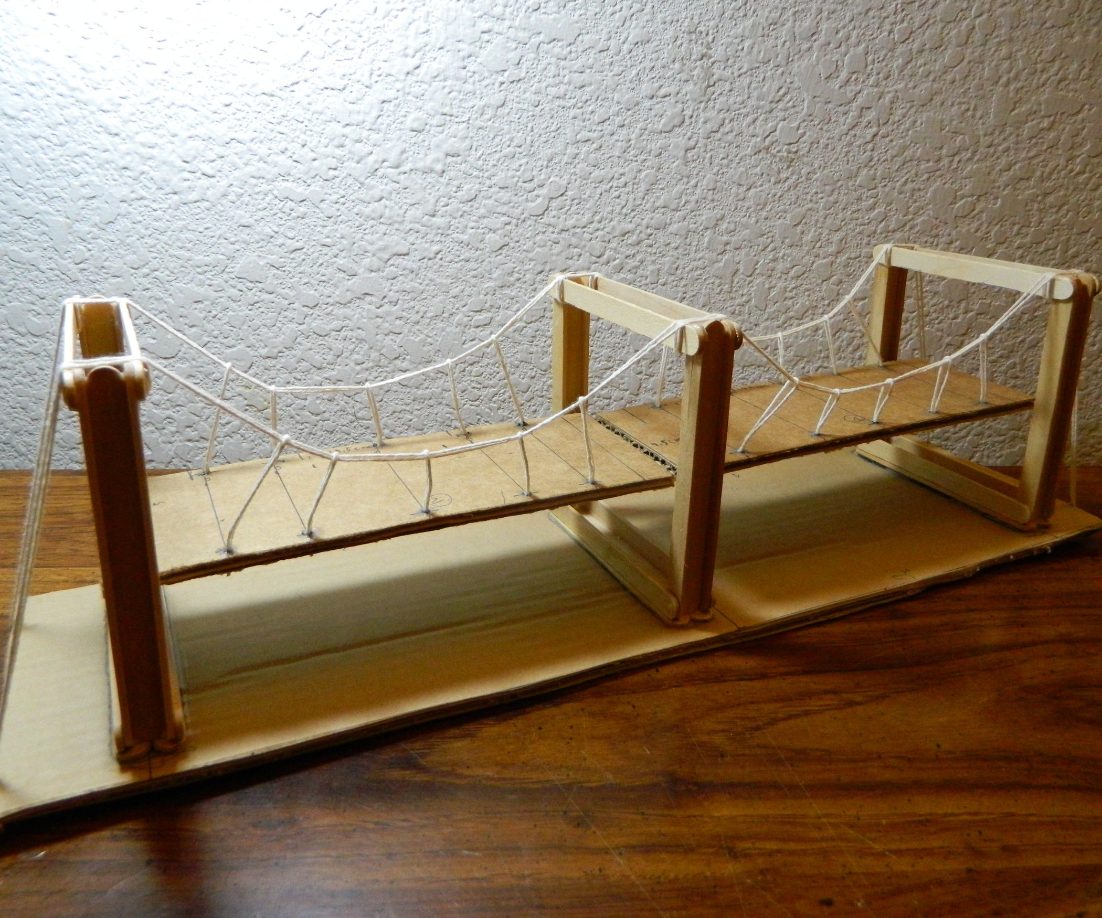
Task 1 – Suspension Bridges
This week we are learning about suspension bridges, before starting task 1 of your Bridge work watch the video below.
https://www.google.com/search?q=how+to+build+a+suspension+bridge&rlz=1C1GCEA_enGB914GB915&oq=how+to+build+a+suspension+bridge&aqs=chrome..69i57j0l9.5428j1j1&sourceid=chrome&ie=UTF-8&safe=active&ssui=on#kpvalbx=_f707YKWHHcOf1fAP9NyPkAU15
Now go to Assignments. Your worksheet asks you to read over a passage about suspension bridges. Then you have to make up 5 questions and answers based on the passage. BEFORE YOU START – make sure you understand all the words in the passage – use a dictionary to make a glossary before your start.

Slide 9
This is an extra and you do not need to upload this to assignments.
Suspension Bridges
Draw this diagram of a simple suspension bridge, remember to label it.

Slide 10
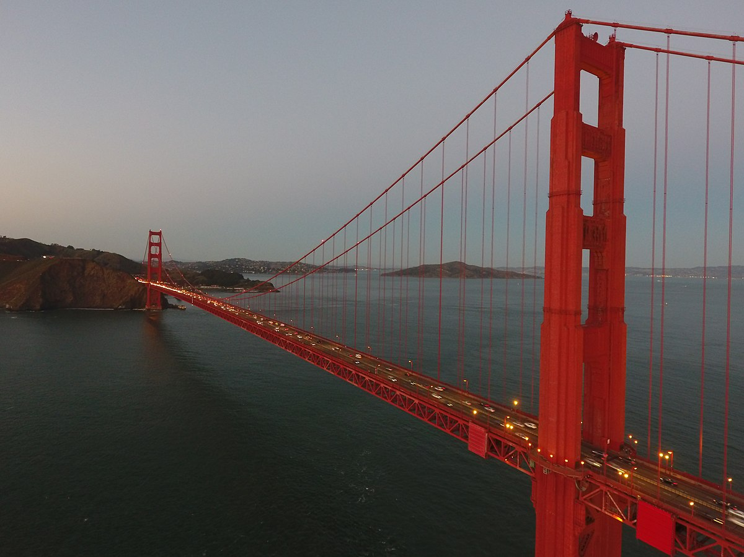
Task 2 – Suspension Bridges
We have an art task and an engineering task.
You can choose whether you want to do task 2 or 3 or BOTH!!
ART
How to draw a suspension bridge. Watch the first video and
practise drawing a simple suspension bridge.
Then watch the second, this shows you how to draw one of the most famous suspension bridges in the world – the Golden Gate
Bridge. Sketch your bridge and then colour it in using pencils, crayons or paint. Please upload your coloured Golden Gate Bridge
into Assignments.
FIRST VIDEO
https://www.youtube.com/watch?v=DZhw-AUthR0
SECOND VIDEO
https://www.youtube.com/watch?v=xAb3kcaQl8o

Slide 11
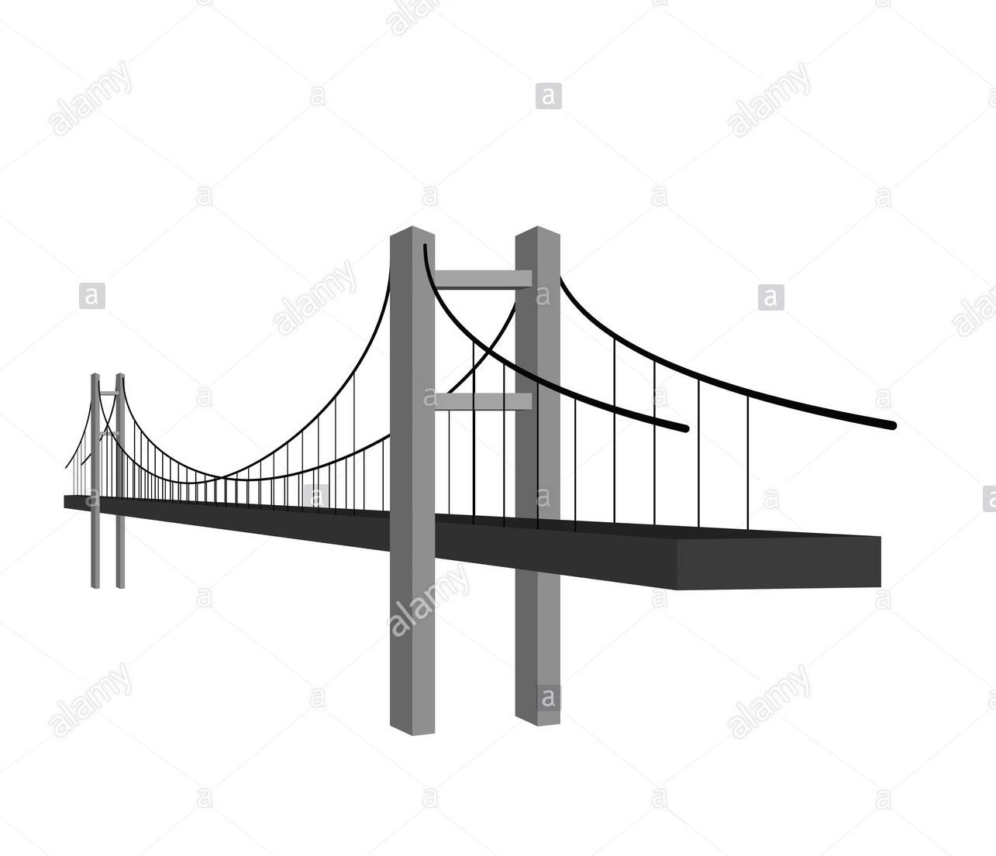
Task 3 – Suspension Bridges
(remember you can do task 3 or 2 or both)
Build your own suspension bridge.
You can look at diagrams and videos to get ideas – here are some below. You can use any materials you want and it can be any size. Please show that your bridge can hold a small tin of tuna or something of the equivalent mass. Be as creative as you like.
If you want some ideas you can watch the videos below.
https://www.instructables.com/Simple-Suspension-Bridge-Model/
https://www.youtube.com/watch?v=hsX5WiNL4xM

Slide 12
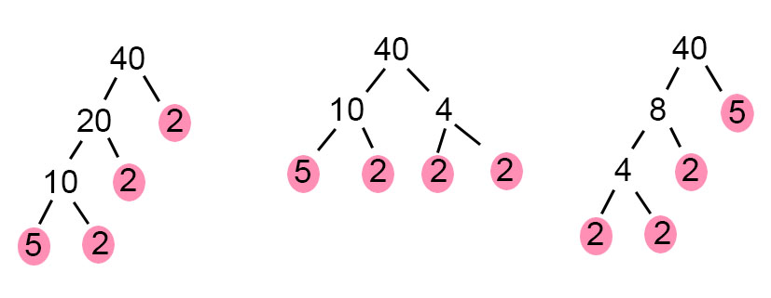
NUMERACY TASK 1
LI – Factors and Factor Trees
Please complete page 76 of H5 textbook in your numeracy jotters.
Complete the factor trees worksheet. Complete this after out numeracy lesson on Monday.
Remember to write the date and page number before starting your work.
Please go to Assignments to find your Task.
Please upload into Assignments.

Slide 13
NUMERACY TASK 2
400 x 300 = 1200
LI – Mulitplication Tables - facts
LI – multiplying a two digit multiple of 10 by a three digit multiple of 100
Please complete page 38 and then page 37 of your H5 textbook in your numeracy jotters.
Remember to write the date and page number before starting your work.
Please go to Assignments to find your Task.

Slide 14
NUMERACY – TASK 3
LI – finding the product of numbers
Please complete page 39 of H5 textbook in your numeracy jotters.
Remember to write the date and page number before starting your work.
I have included a ‘Missing numbers multiplication facts worksheet’ – this is something you can do for extra practice – you do not need to upload this, we all need to go over our tables regularly!
EXTENSION WORK (optional) – page 40
Please go to Assignments to find your Task
.

Slide 15
NUMERACY – TASK 4
LI – multiplying a 2 digit number by 6,7,8,9
45 x 7 =
40 x 7 = 280 or The column method
5 x 7 = 35
280 + 35 =315
Please complete page 41 of H5 textbook in your numeracy jotters.
Complete this after our numeracy lesson on Wednesday.
Remember to write the date and page number before starting your work.
Please go to Assignments to find your Task.

Slide 16
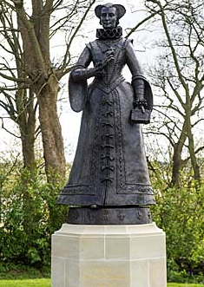
Health and Wellbeing
Another walk around Linlithgow…..
Please go to Assignments to find out what
your task is.
The due date for this task is in three weeks time.

Slide 17
PERSONAL READING It is important that you continue to read fiction as much as you can. Next week we will focus on our personal reading.
Click on this page.
Remember to fill out your passport.

Slide 18
Health and Wellbeing
Health and Wellbeing
Health and Wellbeing
Health and Wellbeing

Slide 19
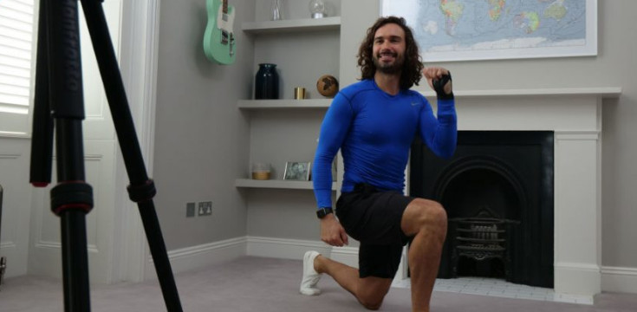
Health and Wellbeing
Joe Wicks’ PE lessons
This is a great way to start the day.
These sessions are live on YouTube on Mondays, Wednesdays and Fridays at 9am.
They are 20-minutes, half the length of last lockdown’s sessions.
They do not require any specialist equipment or large amounts of space.
ttps://www.youtube.com/channel/UCAxW1XT0iEJo0TYlRfn6rYQ

Slide 20
CORE WRITING TARGETS
These are your targets for all types of writing!
A word about spelling. When writing your first draft I would recommend that you check your spelling after you have finished your text. This will allow your story to flow. When you have finished take time to check that have used your spelling rules and strategies for all common words. You should use a dictionary for more challenging words.
Confidently and accurately use capital letters, full stops, commas, inverted commas, exclamation marks, question marks and/or apostrophes.
Use sentences of different lengths and complexity.
Use challenging vocabulary for description and openers.
Ensure sentences are grammatically accurate, nouns, verbs and tenses agree.
Accurately use paragraphs to separate ideas/events.
Proof read and edit writing accurately.
Use linked, legible handwriting to present work attractively using correct forms of layout.

