Slide 1
Linlithgow Bridge Primary School P5 REMOTE LEARNING WEEKLY DIARY w/c Monday 20th February 2021
TREASURE YESTERDAY
LIVE FOR TODAY
DREAM OF TOMORROW

Slide 2
ONLINE LESSONS for week commencing 8th February 2021
Monday | 22nd February | Check-in | 09:30
Monday | 22nd February | Numeracy | 11:00
Tuesday | 23rd February | NO LESSONS
Wednesday | 24th February | China’s endangered species PART 2 (Lesson delivered by Sandie Robb of RZSS) | 10:00
Wednesday | 24th February | Numeracy | 11:45
Thursday | 25th February | HWB – Personal Hygiene and Achievments (please bring your questionnaire and be prepared to tell us of your achievements). | 11.00
Friday | 26th February | Bridges’ Task (be prepared to discuss how you made your bridge). | 11:00

Slide 3
SUGGESTED TIMETABLE FOR THIS WEEK
Monday | MEETING 09:30 Check –In and to go over the Weekly Diary | Spelling | MEETING 11:00 NUMERACY - FACTORS | Numeracy Task 1 -Factors | Bridges Task – Make your plan.
Tuesday | Grammar and Punctuation - Pronouns | Numeracy Task 2 Multiples | HWB – Task 1 ACHIEVING | Bridges’ Task | Bridges’ Task
Wednesday | HWB – Task 2 School Meal Survey | MEETING 10:00 China’s endangered species – Part 2 (by Sandie Robb of RZSS) | MEETING 11:45 NUMERACY – PRIME NUMBERS | Numeracy Task 3 | Bridges’ Task
Thursday | HWB – Task 3 Personal Hygiene Questionnaire | Numeracy Task 4 Prime Numbers | MEETING 11:00 HWB Make sure you have your questionnaire with you and be prepared to talk about your achievements. | French | Bridges’ Task
Friday | Bridges’ Task – Make sure you have written down how you made your bridge – before our meeting. | Catch-up | MEETING 11:00 Bridges’ Task Catch-up

Slide 4
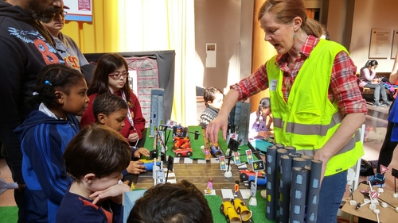
Health and Wellbeing – Task 1
Please go to Assignments. In attachments you will find a SWAY.
This SWAY focusses on one of our Wellbeing Indicators – ACHIEVING. Please read through the sway and we will discuss this on Thursday morning when we celebrate our Achievements.

Slide 5
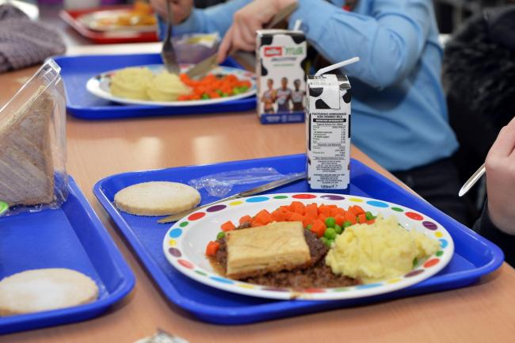
Health and Wellbeing – Task 2
Mrs Webster has asked me to include this in our diary – could you all fill this out please.
Facilities Management - School Meal Survey 2020/21 - Primary Schools
Online Survey: Facilities Management - School Meal Survey 2020/21 - Primary Schools
www.surveyhero.com
Click on the link above.

Slide 6
Health and Wellbeing – Task 3
Please complete the questionnaire in Assignments before our lesson on Thursday.

Slide 7
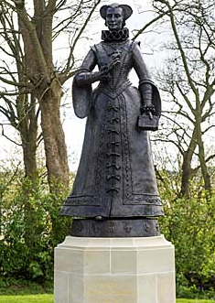
Health and Wellbeing – Task 4
Another walk around Linlithgow…..
Please go to Assignments to find out what
your task is.
The due date for this task is in three weeks time.

Slide 8
SPELLING
Focus ‘ss’
We will learn about the five different representations of the phoneme ‘s’. Please go to assignments
to find out what your spelling tasks are for the week. Please do not complete any spelling work before
our lesson.
..\SPELLING\Syllables ss.docx
..\SPELLING\Phonemes ss.docx
Please upload into Assignments

Slide 9
GRAMMAR AND PUNCTUATION
PRONOUNS – UNIT 11
LI – To be able to identify a pronoun.
To replace a noun with a pronoun and vice versa.
Complete this unit of work and upload it please. Remember to underline the missing words in Getting Started and Now Try These.
A PRONOUN IS A WORD THAT TAKES THE PLACE OF A NOUN.
Please upload into Assignments.

Slide 10
Madame Gordon’s French Lesson on CLOTHES
Please watch and listen to the lesson – click below and then watch the other videos.
https://www.loom.com/share/20f1f7d3edcc4887b3b17ad7c9c77d4f
WORDWALL GAMES – CLICK ON THE LINKS BELOW
https://wordwall.net/play/649/928/5748
https://wordwall.net/play/568/030/1050
Please go to Assignment to see what your task is.

Slide 11
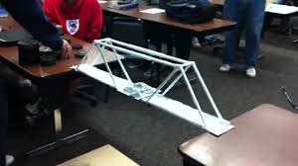
BRIDGES
Week 2 – Beam Bridge
Please go to Assignments to find out what
your task is for this week.
At our Friday meeting we will share how we
completed our task.

Slide 12
Online Lesson – Wednesday 24th February at 10:00
China’s Endangered Species- Part 2
The lesson will be on Teams at 10 o’clock on Wednesday 10th February. I will send you the link.

Slide 13
NUMERACY TASK 1
FACTORS
LEARNING INTENTION
To find the factors of a number.
To understand the difference between a multiple and a factor.
Differentiated Worksheets. Please complete after our Numeracy Lesson on Monday morning.
Please go to Assignments to find your Task.
Please upload into Assignments.

Slide 14
NUMERACY TASK 2
FINDING THE LOWEST COMMON MULTIPLE
LI – I can find a multiple of a number and the lowest common multiple (l.c.m.) of a set of numbers.
Please go to Assignments to find your Task.

Slide 15
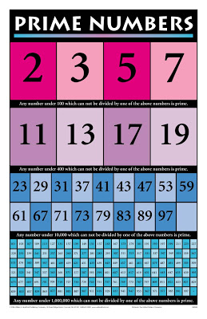
NUMERACY – TASK 3
PRIME NUMBERS
A prime number is a number greater than 1, that cannot be divided evenly by any number, other than itself or 1.
For example: 17 is a prime number because you cannot divide it (without a remainder) by any number except 17 or 1:
17 ÷ 17 = 1
17 ÷ 1 = 17
Differentiated Worksheets. Please complete after our Numeracy Lesson on Wednesday morning.
Please go to Assignments to find your Task
.

Slide 16
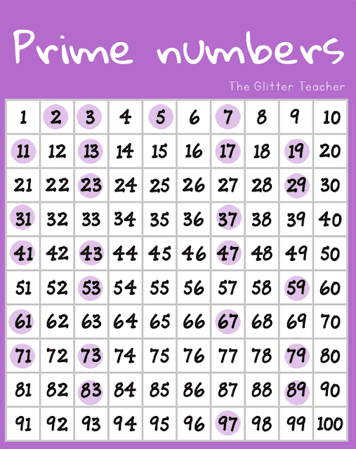
NUMERACY – TASK 4
PRIME NUMBERS – PROBLEM SOLVING
Please go to Assignments to find your Task.

Slide 17
Health and Wellbeing
Health and Wellbeing
Health and Wellbeing
Health and Wellbeing

Slide 18
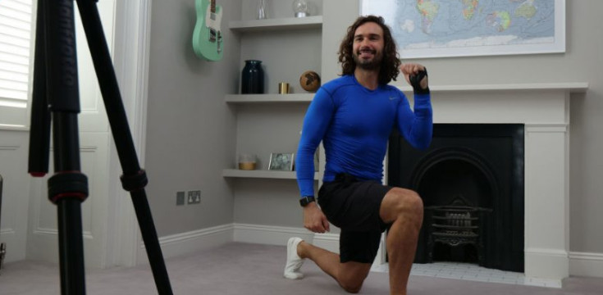
Health and Wellbeing
Joe Wicks’ PE lessons
This is a great way to start the day.
These sessions are live on YouTube on Mondays, Wednesdays and Fridays at 9am.
They are 20-minutes, half the length of last lockdown’s sessions.
They do not require any specialist equipment or large amounts of space.
ttps://www.youtube.com/channel/UCAxW1XT0iEJo0TYlRfn6rYQ

Slide 19
CORE WRITING TARGETS
These are your targets for all types of writing!
A word about spelling. When writing your first draft I would recommend that you check your spelling after you have finished your text. This will allow your story to flow. When you have finished take time to check that have used your spelling rules and strategies for all common words. You should use a dictionary for more challenging words.
Confidently and accurately use capital letters, full stops, commas, inverted commas, exclamation marks, question marks and/or apostrophes.
Use sentences of different lengths and complexity.
Use challenging vocabulary for description and openers.
Ensure sentences are grammatically accurate, nouns, verbs and tenses agree.
Accurately use paragraphs to separate ideas/events.
Proof read and edit writing accurately.
Use linked, legible handwriting to present work attractively using correct forms of layout.

Slide 20
FIRST MINISTER’S READING CHALLENGE
Click on this page.
Remember to fill out your passport.

