Slide 1
Linlithgow Bridge Primary School P5 REMOTE LEARNING WEEKLY DIARY 18th and 19th February 2021
TREASURE YESTERDAY
LIVE FOR TODAY
DREAM OF TOMORROW

Slide 2
ONLINE LESSONS for 18 and 19th February 2021
Thursday | 18th February | BRIDGES | 09:45
Friday | 19th February | NUMERACY - Factors | 09:30

Slide 3
SUGGESTED TIMETABLE FOR THIS WEEK
Thursday | 09:30 Check –in BRIDGES LESSON | Numeracy Task 1 | BRIDGES Assignment Task 1 | HWB Task 1 My positive Affirmations Journal
Friday | 09:30 NUMERACY LESSON | Numeracy Task 2 Multiples

Slide 4
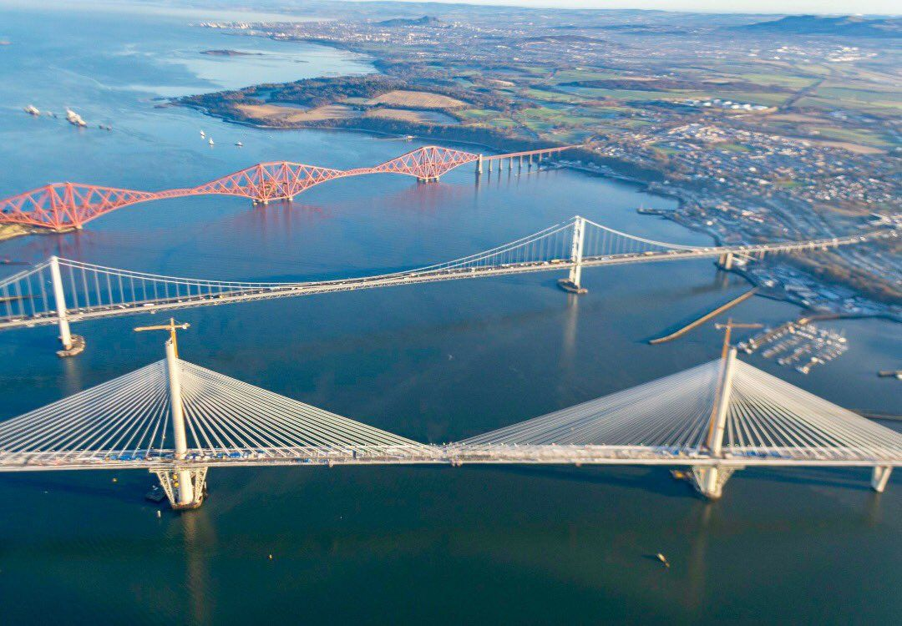
Thursday 18th February 2021
The Launch of our new BRIDGES TOPIC

Slide 5
NUMERACY
NUMBER PROPERTIES – PATTERNS
Numeracy Task 1
LI – to learn about number sequence and describe the rule of a sequence.
Please go to Assignments and choose a worksheet to complete in your jotter.
I have included mild, medium and extra challenge number patterns’ worksheets.
Please upload into Assignments.

Slide 6
Online Lesson – Friday 19th February 2021 at 09:30
NUMERACY
NUMBER PROPERTIES – FACTORS
Numeracy Task 2
Complete this page after our lesson on Friday morning.
H5 page 76 – complete this work in your numeracy jotter after our lesson.
Please upload into Assignments.

Slide 7
Health and Wellbeing
Please go to Assignments and download the Journal. Please complete pages 4,5 and 6..
Please upload into Assignments.

Slide 8
Health and Wellbeing
Health and Wellbeing
Health and Wellbeing
Health and Wellbeing

Slide 9
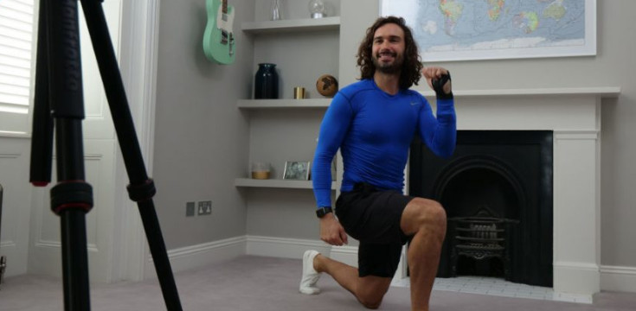
Health and Wellbeing
Joe Wicks’ PE lessons
This is a great way to start the day.
These sessions are live on YouTube on Mondays, Wednesdays and Fridays at 9am.
They are 20-minutes, half the length of last lockdown’s sessions.
They do not require any specialist equipment or large amounts of space.
ttps://www.youtube.com/channel/UCAxW1XT0iEJo0TYlRfn6rYQ

