Slide 1
Linlithgow Bridge Primary School P5 REMOTE LEARNING WEEKLY DIARY w/c 8th February 2021
TREASURE YESTERDAY
LIVE FOR TODAY
DREAM OF TOMORROW

Slide 2
ONLINE LESSONS for week commencing 8th February 2021
Monday | 8th February | Check-in | 09:30
Monday | 8th February | Spelling | 11:00
Tuesday | 9th February | Numeracy | 11:00
Wednesday | 10th February | China’s endangered species (by Sandie Robb of RZSS) | 10:00
Wednesday | 10th February | Numeracy | 11:45
Thursday | 11th February | French - click on the SWAY in your Weekly Diary. | 09:30
Friday | 12th February | Comprehension | 09:45

Slide 3
Online Lessons – Monday 8th February 2021 at 11:00
SPELLING
Focus ‘S’
We will learn about the five different representations of the phoneme ‘s’. Please go to assignments
to find out what your spelling tasks are for the week. Please do not complete any spelling work before
our lesson.
Please upload into Assignments

Slide 4
GRAMMAR AND PUNCTUATION
DIRECT SPEECH
page 42 – Unit 19
LI – to be able to use speech marks/inverted commas when writing texts.
Success Criteria
Speech marks will be correctly formed e.g., “What is your dog’s name?” asked Chloe.
There must always be a full stop, comma, question mark or exclamation mark after what has been said, then you close your speech with the marks.
Please upload into Assignments.

Slide 5
Comprehension Success 2
Big Jim
Page 42
Learning Intentions
I can listen, respond and react to texts discussing author’s craft, structures, vocabulary used and meaning conveyed
I can suggest alternative words which mean the same as those in the text.
I can summarise the main points from a text.
Please complete Section A and B before our Comprehension Lesson on Friday.
Please upload into Assignments

Slide 6
WRITING
Read over the story A Lion in the Meadow again.
Task – Plan a story that you would like to come true. Please go to Assignments and look at the guidance document.
Please upload into Assignments
I can: Develop characters through their actions, feelings and dialogue. Use interesting and descriptive language to describe the setting and convey the atmosphere. Use a variety of interesting openers to engage the reader

Slide 7
CORE WRITING TARGETS
These are your targets for all types of writing!
A word about spelling. When writing your first draft I would recommend that you check your spelling after you have finished your text. This will allow your story to flow. When you have finished take time to check that have used your spelling rules and strategies for all common words. You should use a dictionary for more challenging words.
Confidently and accurately use capital letters, full stops, commas, inverted commas, exclamation marks, question marks and/or apostrophes.
Use sentences of different lengths and complexity.
Use challenging vocabulary for description and openers.
Ensure sentences are grammatically accurate, nouns, verbs and tenses agree.
Accurately use paragraphs to separate ideas/events.
Proof read and edit writing accurately.
Use linked, legible handwriting to present work attractively using correct forms of layout.

Slide 8
FRENCH
https://sway.office.com/b0XFk8Vq5ISPr1Eh?ref=Link
Please watch this lesson on Thursday morning at 09:30,
then in Posts, write down one thing you learned
from Madame Gordon’s lesson.

Slide 9
FIRST MINISTER’S READING CHALLENGE
Click on this page.
Remember to fill out your passport.

Slide 10
Online Lesson – Wednesday 10th February at 10:00
Wednesday 10th Feb 10am
China’s Endangered Species
The lesson will be on Teams at 10 o’clock on Wednesday 10th February. I will send you the link.

Slide 11
Online Lesson – Tuesday 9th February 2021 at 11:00
NUMERACY
NUMBER PROPERTIES – SEQUENCES
Numeracy Task 1- H5 page 74
LI – to learn about number sequence and describe the rule of a sequence.
Please complete this page after our lesson on Tuesday.
Please upload into Assignments.

Slide 12
NUMERACY
NUMBER PROPERTIES – SEQUENCES
Numeracy Task 2
LI – Obtaining the rule for finding a number in a given number pattern
Please go to Assignments to find out what your task is.
Please upload into Assignments.

Slide 13
Online Lesson – Wednesday 10th February 2021 at 11:45
NUMERACY
MULTIPLES
Numeracy Task 3 - H5 page 75
LI – Finding multiples of a number and the lowest common multiple (lcm) of a set of numbers.
Please complete this page after our lesson on Wednesday.
Please upload into Assignments.

Slide 14
NUMERACY
MULTIPLES
Numeracy Task 4
Please go to Assignments to find out what your task is.
LI – Finding multiples of a number and the lowest common multiple (lcm) of a set of numbers.
Please upload into Assignments.

Slide 15
Health and Wellbeing
Please go to Assignments and read
over the Personal Hygiene PP.
Take notes to prepare for a discussion we will have next week.

Slide 16
Health and Wellbeing
Please go to Assignments and download the Journal. Please complete pages 2 and 3.

Slide 17
SUGGESTED TIMETABLE FOR THIS WEEK
Monday | MEETING 09:30 Check –In and to go over the Weekly Diary | Times Tables Revision– online games | MEETING 11:00 Spelling Lesson - S | Spelling Task
Tuesday | Grammar and Punctuation – Speech Marks | MEETING 11:00 Numeracy Lesson - SEQUENCES | Numeracy Task 1 Sequences H5 page 74 | HWB My Positive Affirmations Journal – pages 2 and 3
Wednesday | Numeracy Task 2 Sequences | MEETING 10:00 China’s endangered species (by Sandie Robb of RZSS) | MEETING 11:45 Numeracy Lesson - MULTIPLES | Comprehension – The lion in the Meadow – Sections A and B
Thursday | French Lesson with Madame Gordon, click on the SWAY in Weekly Diary 09:30 – Café | Numeracy Task 3 Multiples | WRTIING Task – Frist Draft | HWB Look over the Hygeine PP and take notes. We will have a meeting about this next week.
Friday | MEETING 09:45 Comprehension – to mark your answers to A and B. | Numeracy Task 4 Multiples | Writing – self correct – Second Draft

Slide 18
Health and Wellbeing
If you didn’t manage to watch Mrs Clarke’s SWAY last week, please take the time to do so. It is full of wonderful advice on how to look after our mental health.
://sway.office.com/dOfG2btWMlAZgcxv?ref=Link&loc=play

Slide 19
Health and Wellbeing
Health and Wellbeing
Health and Wellbeing
Health and Wellbeing

Slide 20
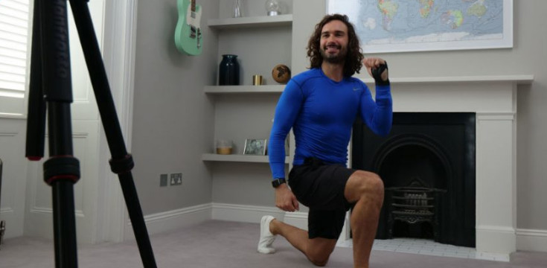
Health and Wellbeing
Joe Wicks’ PE lessons
This is a great way to start the day.
These sessions are live on YouTube on Mondays, Wednesdays and Fridays at 9am.
They are 20-minutes, half the length of last lockdown’s sessions.
They do not require any specialist equipment or large amounts of space.
ttps://www.youtube.com/channel/UCAxW1XT0iEJo0TYlRfn6rYQ

Slide 21
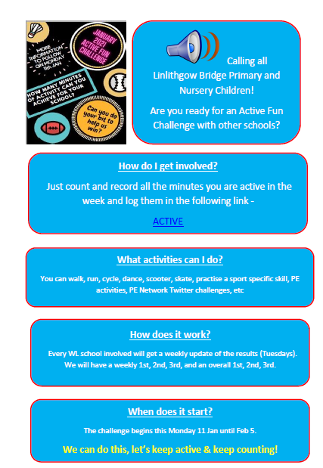
Health and Wellbeing
P.E.
Click on the document and then on the work ACTIVE within the document.

Slide 22
Daily Brain Warmer
Follow this link to find daily brain warmers from 18 Jan to 22 Jan.
https://www.senhub.co.uk/daily-brain-warmers/

