Slide 1
Linlithgow Bridge Primary School P5 REMOTE LEARNING WEEKLY DIARY w/c 18th January 2021
TREASURE YESTERDAY
LIVE FOR TODAY
DREAM OF TOMORROW

Slide 2
ONLINE LESSONS for week commencing 18th January 2021 Monday 18th January Writing Lesson – Persuasive 10:45 Tuesday 19th January Numeracy Lesson -Volume 10:45 Wednesday 20th January Comprehension Lesson 10:45 Thursday 21st January Numeracy Lesson - Area 10:45

Slide 3
Daily Brain Warmer
Follow this link to find daily brain warmers from 18 Jan to 22 Jan….
https://www.senhub.co.uk/daily-brain-warmers/

Slide 4
WRITING Online Lesson Monday 10:45 am
I can persuade using relevant supporting detail and/or evidence. (LIT 2 -29a)
I can convey information, describe events, explain processes or combine ideas in different ways. (LIT 2-28a)
Details of this task will be put in Assignments after the lesson along with the PowerPoint.
TASKS - I would like you to invent a new confectionary for Willy Wonka. You will write a description of your confectionary and then make a poster to advertise it.

Slide 5
CORE WRITING TARGETS
These are your targets for all types of writing!
A word about spelling. When writing your first draft I would recommend that you check your spelling after you have finished your text. This will allow your story to flow. When you have finished take time to check that have used your spelling rules and strategies for all common words. You should use a dictionary for more challenging words.
Confidently and accurately use capital letters, full stops, commas, inverted commas, exclamation marks, question marks and/or apostrophes.
Use sentences of different lengths and complexity.
Use challenging vocabulary for description and openers.
Ensure sentences are grammatically accurate, nouns, verbs and tenses agree.
Accurately use paragraphs to separate ideas/events.
Proof read and edit writing accurately.
Use linked, legible handwriting to present work attractively using correct forms of layout.

Slide 6
SPELLING TASK
Spelling focus will be ‘tch’.
Wordsmyth is an online children’s dictionary – you can subscribe for free.
https://www.wordsmyth.net/?level=2&ent=Dictionary
Please look in ‘Assignments’ for your Spelling Task for this week.

Slide 7
COMPREHENSION Online Lesson Wednesday 10.45am
Comprehension Success 2, page 50, Christopher Columbus
Please complete sections A and B before the lesson this Wednesday. We will discuss how to do section C in the lesson and you can complete this after the lesson.
Top tips :
Read the passage once
Look at the ‘unfamiliar words’ on the next slide
Read the questions once
Read the passage again
Answer the questions (remember to do this in sentences)

Slide 8
/Comprehension continued
Chrisopher Columbus Unfamiliar Words or phrases
‘c.’ - is short for ‘circa’. It is a Latin word meaning 'around, about, roughly, approximately – it is frequently abbreviated. So when you see ‘c.’ you know it means ‘about’ or ‘roughly.’
The Atlantic Ocean is a body of salt water covering approximately one-fifth of Earth's surface and separating the continents of Europe and Africa to the east from those of North and South America to the west.
The West Indies -is a group of islands that stretches from near the U.S. state of Florida to the northern coast of South America. The islands separate the Caribbean Sea from the rest of the Atlantic Ocean. People also call this area the Caribbean.
The East Indies - is the world’s largest island group. It is sometimes known as the Malay Archipelago (string of islands). This group of islands consists of more than 17,000 islands. The word 'Indies' is derived from the Indus River which clearly indicates that these island nations had an Indian cultural influence.

Slide 9
GRAMMAR AND PUNCTUATION
Grammar and Punctuation Text Book – Pupil Book 2 – page 16 – Unit 7 - NOUNS
In your large literacy jotter - please complete unit –7 NOUNS
Remember to:
Write the date and then underneath Unit 1 – Parts of Speech (remember to underline your date with a ruler and heading with a ruler).
Underline the missing words when you fill in the gaps in the sentences.
LI – to change a verb to agree with its subject
SC – Create sentences where the subject changes from a plural to a singular ensuring that the verb agrees with the new subject.

Slide 10
FIRST MINISTER’S READING CHALLENGE

Slide 11
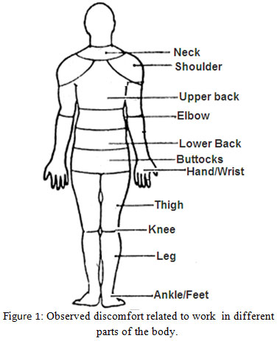
FRENCH
Here is Madame Gordon’s French Lesson.
This week’s focus – The Body
https://drive.google.com/file/d/1T3KK9zjy0k2eiZs70FjQRfGJxI6KfFjB/view?usp=sharing

Slide 12
NUMERACY TASKS
All four numeracy tasks should be uploaded into
Assignments.

Slide 13
Numeracy Task 1
REVISION of Mass/Weight
Please go to Assignments

Slide 14
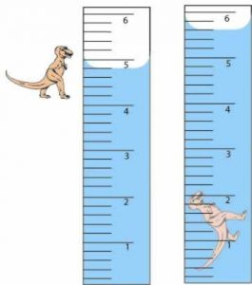
Numeracy Task 2 - Online Numeracy Lesson – Tuesday 10:45 am WHAT IS VOLUME? H5 pages 89 and 90 You can complete these pages after the lesson.

Slide 15
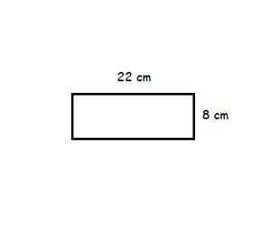
Numeracy Task 4 - Online Numeracy Lesson – Thursday 10:45 am AREA H5 page 93 You can complete this page after the lesson.

Slide 16
Numeracy Task 3
More work on Volume
Please go to Assignments

Slide 17
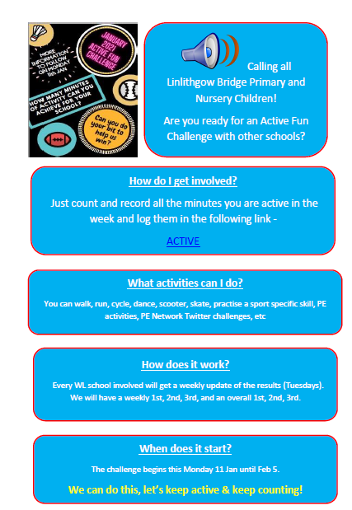
Health and Wellbeing
Task 1 - P.E.
Click on the document and then on the work ACTIVE within the document.

Slide 18
Health and Wellbeing
Task 2 – Sleep Diary
You will find the sleep diary in Files/January 21/SLEEP and in Assignments. You can download this and print it or have a look over it and make your own Sleep Diary.
Please upload your sleep diary into Assignments for Tuesday 26th January.

Slide 19
Health and Wellbeing
LI - By investigating food labelling systems, I can begin to understand how to use them to make healthy food choices
Tasks:
Read over the Food Label Power Point and take notes and make a Fact Sheet
Success Criteria for the Fact sheet:
Between 5 and 10 facts
Between 2-3 illustrations
A heading
Bullet points or numbers for each fact
YOU WILL FIND THE POWERPOINT IN
Class Files/Teams 21/HWB and on the school website
In P5 Blog and in Assignments.

Slide 20
Health and Wellbeing
Task 4
Please fill out the ‘Food Labelling’ worksheet and upload it into Assignments.
You can find this worksheet in Files/Teams 21/HWB

Slide 21
Something of interest …….
https://www.fischy.com/lockdownadvice
Lockdown Online Assemblies
20 – 30 minutes of songs, actions and fun for children and families at home or at school
On YouTube every Monday at 11AM www.youtube.com/fischymusic
Catch up anytime in the week or watch again!

Slide 22
Music
https://www.facebook.com/991047234270921/posts/4879488632093409/?d=n
 | Children's Musical Adventures So 2021 hasn't quite got off to start we all hoped it would! But the light is shining brightly at the end of the tunnel! We thought it was about time we gave Joe Wicks a run for his money  We are... www.facebook.com

