Slide 1
Linlithgow Bridge Primary School P5 REMOTE LEARNING WEEKLY DIARY w/c 1st February 2021
TREASURE YESTERDAY
LIVE FOR TODAY
DREAM OF TOMORROW

Slide 2
ALERT
I will be doing a short CHECK –IN meeting on Monday morning(01.02.21) at 09:45. This is to go over the Weekly Diary and to answer any questions about the week’s tasks.

Slide 3
ONLINE LESSONS for week commencing 1st February 2021 Monday 1st February Check - in 09:30 Monday 1st February HWB 11:00 Tuesday 2nd February Numeracy 11:00 Wednesday 3rd February Animal Classification 10:00 (by Sandie Robb of RZSS) Wednesday 3rd February FRENCH 11:45 Thursday 4th February Numeracy 11:00 Friday 5th February Spelling Test and Reflections Syllables 09:30 Phonemes 10:00

Slide 4
GRAMMAR AND PUNCTUATION
Grammar and Punctuation Text Book
SUBJECTS and VERBS
page 14 – Unit 6
LI – I am learning that a sentence will only make sense if it has a VERB.
I am learning that a sentence will only make sense if it has a SUBJECT.
Remember to:
Write the date and heading in your jotter and underline them with a ruler.
Underline any ‘missing words’ in a sentence, if these are your answers.
Please upload into Assignments.

Slide 5
Online Lessons – Friday 5th February 2021 SYLLABLES at 09:30 PHONEMES at 10:00
SPELLING
We have been learning about the spelling Phoneme ‘ch’.
We have learned about two representations of this phoneme - ch and tch.
This week we will learn about another representation and this is ‘t’.
Please go to Assignments to find out what your spelling tasks are for this week.
Please upload into Assignments

Slide 6
Comprehension Success 2
British and American
Pages 26 and 27 – please complete sections A, B and C and upload into Assignments.
LI – Learning about the different words countries use for the same thing.
You are asked to read an information page. Please do this slowly and carefully – just as you would read over paragraph.
Read over the information page twice before attempting the questions.
Please upload into Assignments

Slide 7
Online Lesson – Wednesday February 2021 at 11:45
FRENCH
REVISION WEEK
Here are the links to Madame Gordon’s lessons:
Please listen to these again and familiarise yourself with the phrases.
Lesson 1 - The weather
https://drive.google.com/file/d/1KWVIsVgqXXkUTmaGL4bQFNUj8Akb3vfW/view?usp=sharing
Lesson 2 – Body Parts
https://drive.google.com/file/d/1T3KK9zjy0k2eiZs70FjQRfGJxI6KfFjB/view?usp=sharing
Lesson 3 - Animals
https://www.loom.com/share/749bf13b32e74c63ac9fc8e3c61a88b1
Please find your French activity sheets in Assignments.

Slide 8
FIRST MINISTER’S READING CHALLENGE
Click on this page.
Remember to fill out your passport.

Slide 9
Online Lesson – Wednesday 3rd February 2021 at 10:00 - 10:45
Remember Sandie, the lady who delivered our ‘Beyond the Panda’ Lessons?
She has offered us some follow on lessons. The first lesson is this Wednesday and it is all about ‘Animal Classification’.
Sorting animals - Simple classification of animals by body covering, breathing and having babies. Looking at the literal translations for some Mandarin words for mammal, bird, reptile, amphibian and fish to help understanding.
Microsoft Teams meeting
Join on your computer or mobile app
Click here to join the meeting

Slide 10
NUMERACY
Numeracy Task 1 – H5 pages 30 and 31.
Addition and Subtraction beyond 100
LI – Problem solving and enquiry: Adding multiples of 100
REMEMBER:
Write out the sums and the answers (even if you can do the sums/calculations mentally).
As well as doing the above – remember to show your working in your jotter when required.
Use your preferred strategy eg., standard written method, partitioning
If the sum has a box – please draw a box in your jotter to show where your answer is
For question 3 on page 31, draw a number placement chart to help you find the winning ticket e.g.
Tth | Th | H | T | U

Slide 11
Online Lesson – Tuesday 2nd February 2021 at 11:00
NUMERACY
Numeracy Task 2 – H5 pages 32 and 33.
Addition and Subtraction beyond 1000
LI – Problem solving and enquiry: Subtracting a single digit
Addition and subtractions beyond 1000: small differences
REMEMBER:
Write out the sums and the answers (even if you can do the sums/calculations mentally).
As well as doing the above – remember to show your working in your jotter when required
Use your preferred strategy eg., standard written method, partitioning
If the sum has a box – please draw a box in your jotter to show where your answer is

Slide 12
Online Lesson – Tuesday 2nd February 2021 at 11:00
NUMERACY
Numeracy Task 3 – H5 page 35
Addition and Subtraction beyond 1000
LI – Problem solving and enquiry
REMEMBER:
Write out the sums and the answers (even if you can do the sums/calculations mentally)
As well as doing the above – remember to show your working in your jotter when required
Use your preferred strategy eg., standard written method, partitioning
If the sum has a box – please draw a box in your jotter to show where your answer is

Slide 13
NUMERACY
Numeracy Task 4
Maths Activity Book
Complete pages 4 (multiplication)
9 (measurement)
12 (time)
Please do this work in your numeracy jotter.

Slide 14
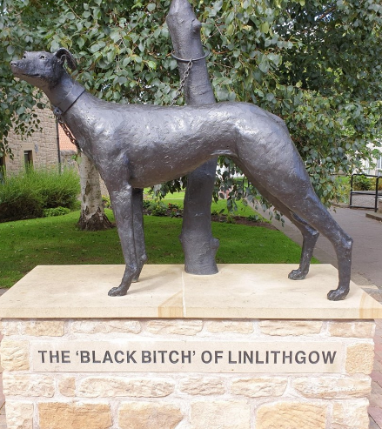
Health and Wellbeing
Outdoor Family Learning
Explore some of the street ART in Linlithgow
Please go to Assignments to find out what your task is.

Slide 15
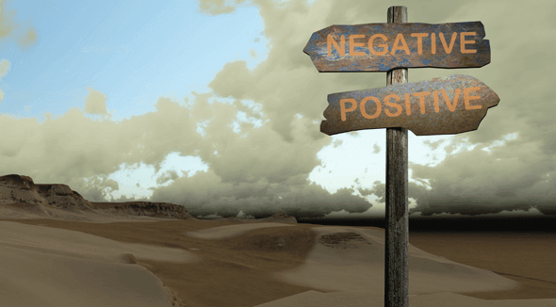
Health and Wellbeing
I know that we all experience a variety of thoughts and emotions that affect how
We feel and behave and I am learning ways of managing them. HWB 2-02a
I understand that my feelings and reactions can change depending upon what is
Happening within and around me. This helps me to understand my own and others’
behaviour. HWB 2-04a
Turning negative thoughts into positive thoughts.
This is something we need to practise.
Please go to Assignments for your TASK.

Slide 16
Online Lesson – Monday 1st February 2021 at 11:30
Health and Wellbeing
Children's Mental Health Week 1-7 January Our theme is 'Express Yourself, Get Creative'
https://sway.office.com/dOfG2btWMlAZgcxv?ref=Link&loc=play

Slide 17
Health and Wellbeing
Health and Wellbeing
Health and Wellbeing
Health and Wellbeing

Slide 18
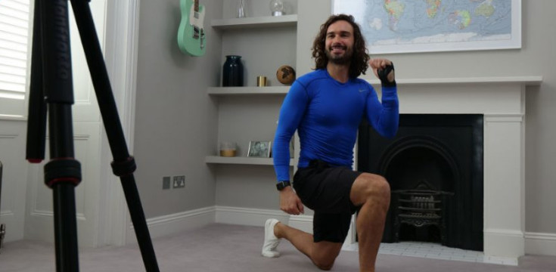
Health and Wellbeing
Joe Wicks’ PE lessons
This is a great way to start the day.
These sessions are live on YouTube on Mondays, Wednesdays and Fridays at 9am.
They are 20-minutes, half the length of last lockdown’s sessions.
They do not require any specialist equipment or large amounts of space.
ttps://www.youtube.com/channel/UCAxW1XT0iEJo0TYlRfn6rYQ

Slide 19
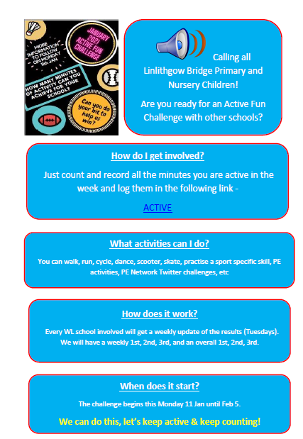
Health and Wellbeing
P.E.
Click on the document and then on the work ACTIVE within the document.

Slide 20
Daily Brain Warmer
Follow this link to find daily brain warmers from 18 Jan to 22 Jan….
https://www.senhub.co.uk/daily-brain-warmers/

Slide 21
CORE WRITING TARGETS
These are your targets for all types of writing!
A word about spelling. When writing your first draft I would recommend that you check your spelling after you have finished your text. This will allow your story to flow. When you have finished take time to check that have used your spelling rules and strategies for all common words. You should use a dictionary for more challenging words.
Confidently and accurately use capital letters, full stops, commas, inverted commas, exclamation marks, question marks and/or apostrophes.
Use sentences of different lengths and complexity.
Use challenging vocabulary for description and openers.
Ensure sentences are grammatically accurate, nouns, verbs and tenses agree.
Accurately use paragraphs to separate ideas/events.
Proof read and edit writing accurately.
Use linked, legible handwriting to present work attractively using correct forms of layout.

