Slide 1
Linlithgow Bridge Primary School P5 REMOTE LEARNING WEEKLY DIARY w/c 25TH January 2021
TREASURE YESTERDAY
LIVE FOR TODAY
DREAM OF TOMORROW

Slide 2
ALERT
I will be doing a short CHECK –IN meeting on Monday morning at 09:45. This is to go over the Weekly Diary and to answer any questions about the week’s tasks. I will be delivering a grammar lesson later on at 11:30.

Slide 3
ONLINE LESSONS for week commencing 25th January 2021 Monday 25th January Check - in 09:45 Monday 25th January Grammar 11:30 Tuesday 26th January Numeracy 11:30 Wednesday 27th January Sleep Diary/Food labelling 11.30 Wednesday 27th January Comprehension – Greedy for Gold 14:00 Thursday 28th January Numeracy 11.30 Friday 29th January Spelling Assessment and workshop 09:30

Slide 4
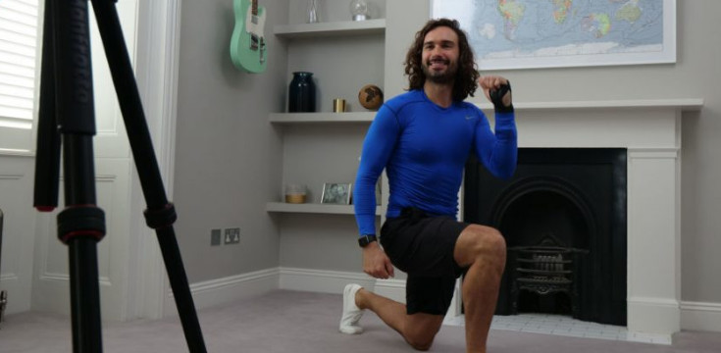
Joe Wicks’ PE lessons
I will be joining in these sessions, starting from this week. It’s a great way to start the day.
These sessions are live on YouTube on Mondays, Wednesdays and Fridays at 9am.
They are 20-minutes, half the length of last lockdown’s sessions.
They do not require any specialist equipment or large amounts of space.
ttps://www.youtube.com/channel/UCAxW1XT0iEJo0TYlRfn6rYQ

Slide 5
GRAMMAR AND PUNCTUATION
Online Lesson – Monday 25th January 2021 at 11:30
Grammar and Punctuation Text Book, page 20 – Unit 9 –VERBS (past and present tenses).
LI – write using different tenses.
SC – I can write a sentence in the present tense. I can write a sentence in the past tense.
Remember to:
Write the date and then underneath Unit 9 – Verbs (past and present)
Remember to underline your date with a ruler and heading with a ruler.
Underline the missing words when you fill in the gaps in the sentences.

Slide 6
Online Lesson – Friday 29th January 2021 at 09:30 Spelling Focus for this week will be ‘PLURALS On Friday morning we will have a spelling assessment. You will then work collaboratively in ‘break out’ rooms. You will discuss the answers you got for your spelling tasks. Please look in Assignments for your Spelling Tasks. Wordsmyth is an online children’s dictionary – you can subscribe for free. https://www.wordsmyth.net/?level=2&ent=Dictionary

Slide 7
Online Lesson – Wednesday 27th January 2021 at 14:00
Top tips :
Read the passage once
Look at the ‘unfamiliar words’ on the next slide
Read the questions once
Read the passage again
Answer the questions (remember to do this in sentences)

Slide 8
Unfamiliar Words or phrases
Europe is a continent – the country of Spain is in the continent of Europe, as is the UK.
The Americas – the combined continents of North America and South America.
The Incas - The Incas were the largest group of indigenous people in South America when the Europeans arrived. The Incan Empire lasted from 1438 until 1533. They came from Peru.
The Aztecs – The Aztecs came from Mexico. They became some of the most important and powerful people in South America. The Aztecs were known for being rather fierce and they even sacrificed humans in order to keep the gods they believed in happy! They also the people who discovered chocolate!
to mine – to dig coal or another material out of the ground
to plunder - steal goods from (a place or person), typically using force and in a time of war or civil disorder.
to raid -to enter (a place) in order to steal or take something.

Slide 9
WRITING Assignment (please upload into Assignments)
Greedy for Gold
Imagine you go back in a time machine to when the Spaniards stole the gold that belonged to the Aztecs and the Incas.
You land in the market place of an Aztec town.
You hear an Aztec and a Spaniard giving their different points of view.
The Aztec said, “It’s not fair! You Spaniards have taken all our gold!”
The Spaniard laughed, “It’s your fault. You should have made a strong army to guard all the gold.”
“We had no need for armies before you came,” groaned the Aztec.
“I don’t believe you! How did you get the gold?” shouted the Spaniard.
The argument goes on. Write down what they say next. Write at least half a page of your large blue literacy jotter for this task.

Slide 10
CORE WRITING TARGETS
These are your targets for all types of writing!
A word about spelling. When writing your first draft I would recommend that you check your spelling after you have finished your text. This will allow your story to flow. When you have finished take time to check that have used your spelling rules and strategies for all common words. You should use a dictionary for more challenging words.
Confidently and accurately use capital letters, full stops, commas, inverted commas, exclamation marks, question marks and/or apostrophes.
Use sentences of different lengths and complexity.
Use challenging vocabulary for description and openers.
Ensure sentences are grammatically accurate, nouns, verbs and tenses agree.
Accurately use paragraphs to separate ideas/events.
Proof read and edit writing accurately.
Use linked, legible handwriting to present work attractively using correct forms of layout.

Slide 11
FIRST MINISTER’S READING CHALLENGE
Click on this page.
Remember to fill out your passport.

Slide 12
FRENCH
Here is Madame Gordon’s French Lesson.
This week’s focus – Pets
https://www.loom.com/share/749bf13b32e74c63ac9fc8e3c61a88b1
Revision Lesson next week. I will be delivering a lesson on Madame Gordon’s videos next week. It will be revision of all her three videos. The links are all in the Weekly Diaries.

Slide 13
NUMERACY TASKS
Task 1 – watch the video below and complete the Area work sheets in Assignments.
To deepen your understanding of Area please click on the link below. It will take you
To a page with four videos – please watch the one called, Area of Rectangles, the presenter will tell you to do the worksheets – please ignore this as I have my own
worksheets for you.
AREA
https://whiterosemaths.com/homelearning/year-5/week-12-measurement-perimeter-area/

Slide 14
Online Lesson – Tuesday 26th January 2021 at 11:30
Numeracy Task 2
H5 Textbook page 95
Complete this page in your numeracy jotter after the lesson.

Slide 15
Numeracy Task 3
I have uploaded a Maths Activity Book into Assignments.
Please complete pages 1 -3. Complete this work in your numeracy jotter.

Slide 16
Online Lesson – Thursday 28th January 2021 at 11:30
Numeracy Task 4
H5 Textbook page 102
Complete this page in your numeracy jotter after the lesson.

Slide 17
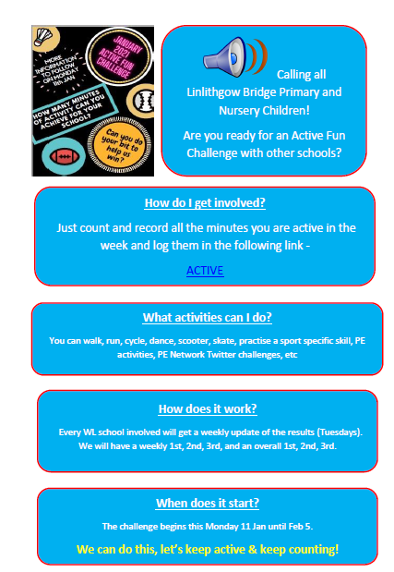
Health and Wellbeing
P.E.
And something extra……
https://twitter.com/WLPENetwork
Click on the document and then on the work ACTIVE within the document.

Slide 18
Online Lesson – Wednesday 25th January 2021 at 11:30
Health and Wellbeing
Sleep Diary
You will find the sleep diary in Files/January 21/SLEEP and in Assignments. You can download this and print it or have a look over it and make your own Sleep Diary.
Please upload your sleep diary into Assignments for Tuesday 26th January.

Slide 19
Online Lesson – Wednesday 25th January 2021 at 11:30
Health and Wellbeing
LI - By investigating food labelling systems, I can begin to understand how to use them to make healthy food choices
Tasks:
Read over the Food Label Power Point and take notes and make a Fact Sheet
Success Criteria for the Fact sheet:
Between 5 and 10 facts
Between 2-3 illustrations
A heading
Bullet points or numbers for each fact
YOU WILL FIND THE POWERPOINT IN
Class Files/Teams 21/HWB and on the school website
In P5 Blog and in Assignments.

Slide 20
Health and Wellbeing
This week we will be learning about different types of food e.g., fats and oils, proteins, carbohydrates, dairy.
You will watch a PowerPoint about the food pyramid and then you will make a poster based on the information in the PowerPoint.
You will complete the food pyramid activity sheet.
Please look in Assignments.

Slide 21
Daily Brain Warmer
Follow this link to find daily brain warmers from 18 Jan to 22 Jan….
https://www.senhub.co.uk/daily-brain-warmers/

