Slide 1
P5 Weekly Diary week commencing 11.01.21

Slide 2
Dear Parent and Carers
A Happy New Year to you and your families.
Each week this PowerPoint weekly diary will outline tasks for the week as well as the dates and times for online lessons and check-ins. At present, only numeracy and literacy tasks will have to be uploaded. Please check ‘Assignments’ in Teams to see which tasks to upload. Every week we will have an online French Lesson from Madame Gordon.
My aim is to do everything possible to help your child progress as much as they would do if they were able to attend school normally. I plan to upload a weekly diary on a Sunday to the Class Blog on our website and onto our Posts Channel on Teams. I will upload additional teaching PowerPoints when they are required.
This is a WEEKLY diary so your child can complete the work at a time of their own choosing, could I ask that all work be uploaded by the end of the day each Friday.
Please take the time to read through all of this PowerPoint – there are links to other documents and information as to where you might find documents. Most extra documents will be in Teams/Files/January 2021. An online timetable is on the next page of this PowerPoint.
I understand that everyone’s circumstances are different. Please do not hesitate to let me know if you have any worries - I am here to help you and your children and we can be as flexible as need be.
You can contact me through the Posts channel on Teams or email me directly. In the meantime, look after yourselves and I am here to support you as we find our way through our new learning challenges!
Kind Regards
Mrs Peters

Slide 3
ONLINE LESSONS for week commencing 11th January 2021 Monday 11th January – Check in and Writing Lesson – 2pm Wednesday 13th January – Comprehension – 10.30 am Thursday 14th January – Weight/Mass Lesson - Numeracy Task 4 – 11.30 am Friday 15th January – Assessment of Spelling and a ‘SLEEP’ discussion - 11 am

Slide 4
Check in and WRITING Online Lesson Monday 11th January at 2pm.
Please do not write your recount before the lesson – it is something you can work on throughout the week. The lesson will provide an opportunity to discuss ideas for your recount and for you to think about the success criteria.
Writing Task
Learning Intention – I am learning to write a recount
Task - You will write about something that happened to you during the Christmas Holidays. It could be one small event, or it could be about a whole day or what you did over a number of days.

Slide 5
CORE WRITING TARGETS
These are your targets for all types of writing!
A word about spelling. When writing your first draft I would recommend that you check your spelling after you have finished your text. This will allow your story to flow. When you have finished take time to check that have used your spelling rules and strategies for all common words. You should use a dictionary for more challenging words.
Confidently and accurately use capital letters, full stops, commas, inverted commas, exclamation marks, question marks and/or apostrophes.
Use sentences of different lengths and complexity.
Use challenging vocabulary for description and openers.
Ensure sentences are grammatically accurate, nouns, verbs and tenses agree.
Accurately use paragraphs to separate ideas/events.
Proof read and edit writing accurately.
Use linked, legible handwriting to present work attractively using correct forms of layout.

Slide 6
SPELLING TASK
Spelling focus will be ‘ch’ Phoneme.
There are three different representations of this phoneme:
ch tch t
We will learn about the ‘ch’ representation this week.
Please look in ‘Assignments’ for your Spelling Tasks for this week (just like we would do for homework).

Slide 7
COMPREHENSION Online Lesson Wednesday 10.30am
Please go to page 36 of your textbook, Comprehension Success 2
Please complete sections A and B before the lesson this Thursday – you may as an extension write your own limerick too (this is optional)!
Read the limericks on page 36 – remember to read each limerick twice., remember please answer in sentences.
On the next page are some unfamiliar words and their meanings – read over this and it will help you to answer the questions.

Slide 8
COMPREHENSION
For ‘A book of Nonsense’ - words you may be unfamiliar with:
Sparta – a very important city in ancient Greece
Dover – is a town in England (it is right on the coast) and is quite near France
clover – is a small plant which can have white or purple flowers
perceive – to become aware of something
Troy - Troy was an ancient Greek city (which was in Turkey)
partially – not completely
futile - useless; not successful

Slide 9
GRAMMAR AND PUNCTUATION
Grammar and Punctuation Text Book – Pupil Book 2
In your large literacy jotter - please complete unit 1 – Parts of Speech
Remember to:
Write the date and then underneath Unit 1 – Parts of Speech (remember to underline your date with a ruler and heading with a ruler).
Underline the missing words when you fill in the gaps in the sentences.
LI – I am learning that words can be divided into groups called parts of speech.
SC – I can identify and use nouns, adjectives and verbs in sentences.

Slide 10
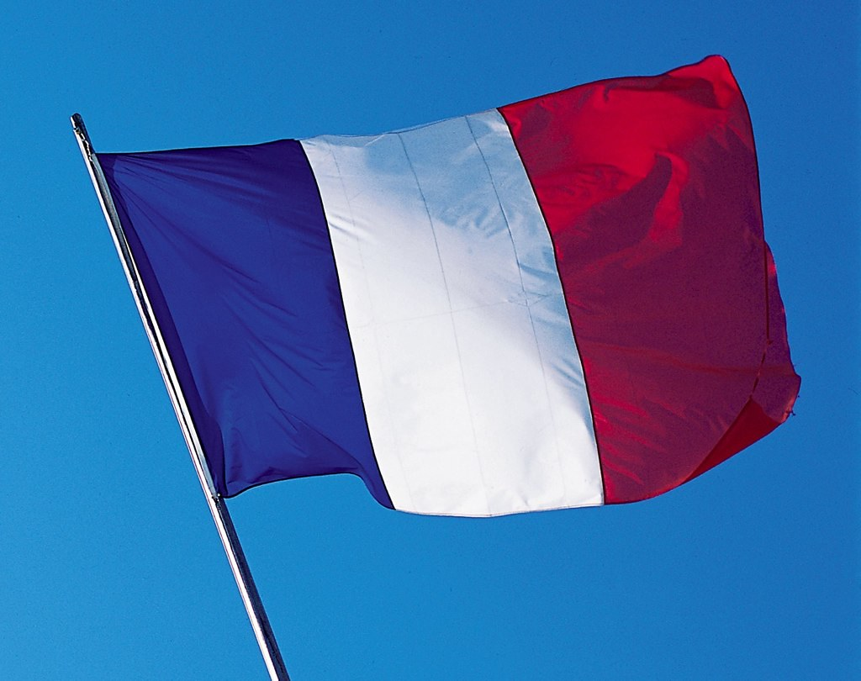
FRENCH
Every week Madame Gordon will deliver a French lesson.
This week you will be learning about the French Weather.
https://drive.google.com/file/d/1KWVIsVgqXXkUTmaGL4bQFNUj8Akb3vfW/view?usp=sharing
Follow on activity video - les saisons https://video.link/w/EXsEb

Slide 11
NUMERACY
The focus for this week is WEIGHT/MASS
Targets:
Consolidate the relationship 1kg = 1000g and ½ kg = 500g
Convert weights given as 4kg 125g to 4125g
Read scales marked in 10g, 20g, 50g and 100g division.
Estimate where on a number line e.g., 10g, 20g, 50g would be
Measuring and recording weights to the nearest 100g
Explore the relationship between ⅟10 kg and 100g kg = 4.5kg
Understand that we can use decimal notation when recording weights e.g., 4500g = 4.5kg
Understand that weight and mass are different.

Slide 12
NUMERACY Task 1
WEIGHT – page 83 warm up!
As a warm up before you start page 83 please complete the following sums in your numeracy jotter.
800 + 200 = 2. 750 + 250 = 3. 350 + 650 = 4. 500 + 500 =
5. 450 + __ = 1000 6. 260 + ___ = 1000 7. 370 + ___ = 1000
8. 560 + __ = 1000 9. 770 + __ = 1000 10. 620 + ___ = 1000

Slide 13
NUMERACY Task 1
Please complete page 83 of your Heinemann Textbook in your numeracy jotter.
Before you start answering questions.
Write the date and the page number and underline then to remind yourself write out the following underneath.
1000g = 1kg
250g = ¼ kg
500g = ½ kg
750g = ¾ kg

Slide 14
NUMERACY Task 2
Page 84 (You will need to find weighing scales in your house for the first part of this page ) and page 85.
Extension : Eilidh and Sam are going camping, but Sam’s backpack is too heavy. Eilidh’s backpack weighs 4kg 600g and Sam’s backpack weighs 6kg 300g.
How much heavier is Sam’s backpack than Aisha’s?
If Sam and Eilidh want to carry exactly the same mass, how much does Sam need to give to Eilidh? Can you explain?

Slide 15
NUMERACY Task 3
Please complete page 86 and 87 of your Heinemann text book.

Slide 16
NUMERACY TASK 4 Online Lesson - Thursday 14th January at 11.30 am
Heinemann Textbook pg 88
You may wish to complete this page before the lesson or complete it after we have gone over it on the Teams Lesson.

Slide 17
HWB This activity is a great way for you to get fresh air and build up your steps! Remember we made acute, obtuse and reflex angles with the willow. An angle less than 90° is acute. An angle between 90° and 180° is obtuse. An angle greater than 180° is reflex. You can write down what you found or take photos or make drawings. Looking forward to seeing what you find!

Slide 18
Health and Wellbeing
Our focus this week will be SLEEP
LI – I will learn just how much sleep can affect our health and happiness.
SC – I can describe what I do to help me get a better sleep.
I can create a poster indicating the order of the sleep cycle

Slide 19
Health and Wellbeing
Sleep - Second Level.ppt
Please read over this PP and learn about ‘Sleep’
Then look at tasks 1 and 2 and complete the worksheets.

Slide 20
Health and Wellbeing
SLEEP – Task 1
Please click on the document ‘Getting a Good Night’s Sleep.
You will find this in Teams/Files/January 2021/SLEEP
In your Literacy Jotter write down some of the things you already do to help you get a good night’s sleep.
One paragraph is fine however, if you wish to write more than one paragraph that is great too.

Slide 21
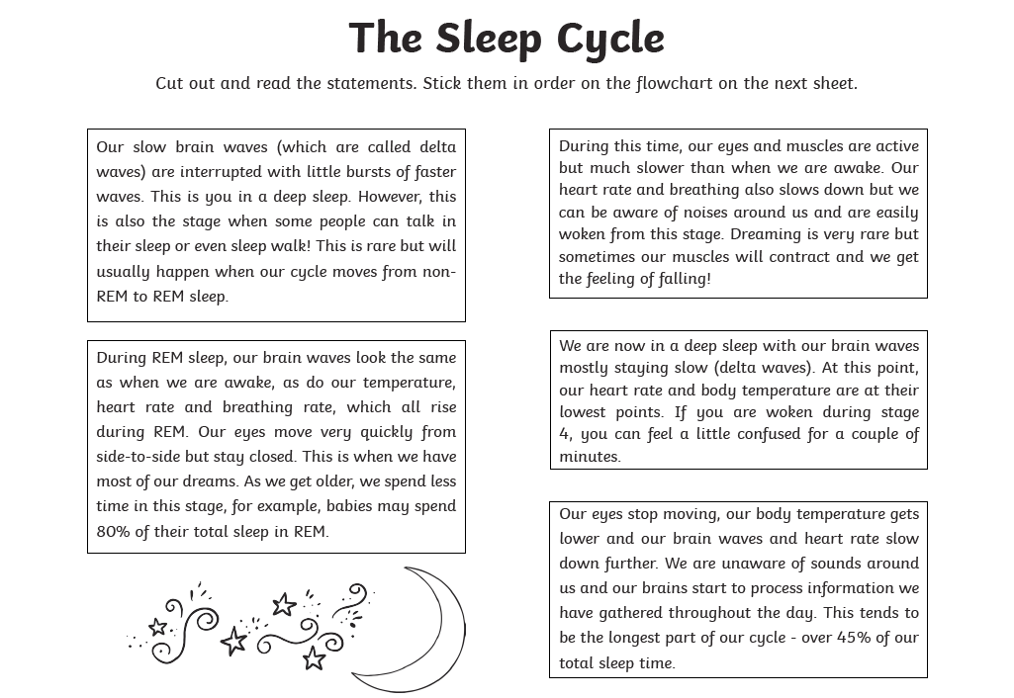
Health and Wellbeing
SLEEP – Task 3
Please click on the document ‘Sleep Cycle’.
You will find this in Teams/Files/January 2021/SLEEP
You can complete the activity by printing the document off OR if you don’t have a printer you could make your own Sleep Cycle Poster using the information in the document.
On Friday we can have a chat about what we have learned about sleep and go over the order of the sleep cycle.

Slide 22
P.E.
Please look out for PE activities from Mrs Bell. She will be posting tasks on her Team. I will let you know on POSTS when she has done this.

Slide 23
Music
https://www.facebook.com/991047234270921/posts/4879488632093409/?d=n
 | Children's Musical Adventures So 2021 hasn't quite got off to start we all hoped it would! But the light is shining brightly at the end of the tunnel! We thought it was about time we gave Joe Wicks a run for his money  We are... www.facebook.com

