Slide 1
WELCOME TO PRIMARY 5 Wednesday 12th August 2020

Slide 2
Dear Primary 5,
First of all, I would like to say a very warm welcome to all of you. I am excited to be your new teacher and I can’t wait to see you tomorrow.
We are having a different ‘first day’ back to school this year. Please read through this PowerPoint carefully as it contains information and activities for you.
Your first task is to read through the ‘Welcome Back to School’ PowerPoint on the following page. I will go over this with you on Thursday. I have then asked you to think about your ‘lockdown’ memories. There is no need to write down the answers to these questions as we will be writing these in our Lockdown Memories booklet on Thursday. Multiplication practice is next and I want you to make me a times tables poster – you choose which one! We are learning about Endangered Animals this term and I want you to write down what you know already about endangered animals, and what you would like to know about them. This information will help me to plan our activities.
I will be on Teams tomorrow, we have a new team it is called Primary 5 20-21. I look forward to chatting with you.
Remember to make sure your snack is in a plastic food bag (this will be hung up outside our classroom on your coat hooks).
See you on Thursday,
Kind Regards
Mrs Peters
Kind Regards
Mrs Peters

Slide 3
On this page is a powerpoint. I will go over this with you on you first day back.
Please click on the image above.

Slide 4
Lockdown Memories – a thinking activity!
I have made a Memories booklet for you which I will give you when you are in class tomorrow. I would like you to think about your answers to the following questions. We will have a class discussion and then you can write down your answers in your booklets. The questions are on the following page.

Slide 5
Lockdown Memories
Please have a think about your answers to these questions.
How did you feel when schools closed in March 2020?
What were some of the things you enjoyed during lockdown?
What did you miss most when you had to stay at home?
How did you keep busy during lockdown?
How did you feel about home learning?
How are you feeling about being back at school?
What will be the best things about being back at school?

Slide 6
Multiplication
I know you have been learning and practising your tables with Mrs McIndoe and Mrs Patterson.
Could you make me a poster of either the 6, 7, 8, 9 or 12 times tables. Please choose one.

Slide 7
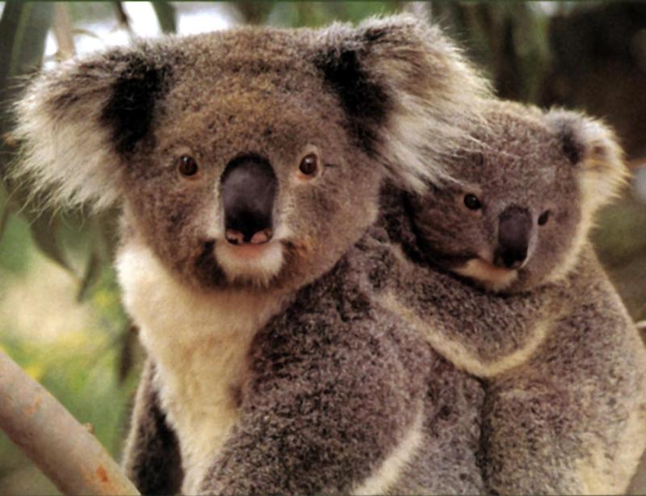
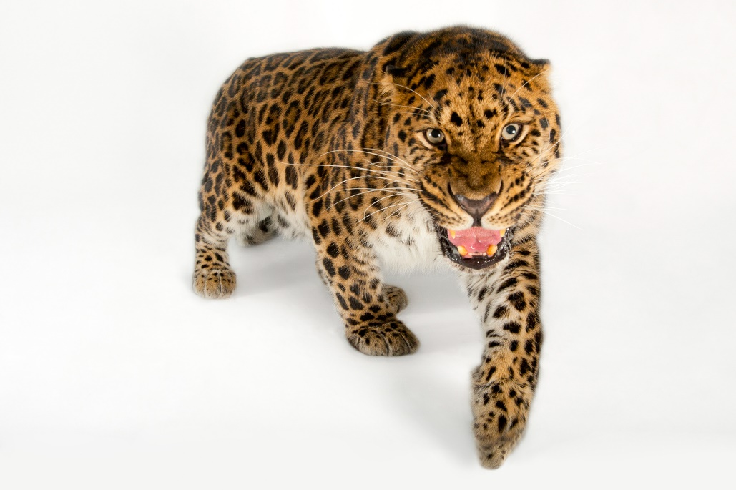
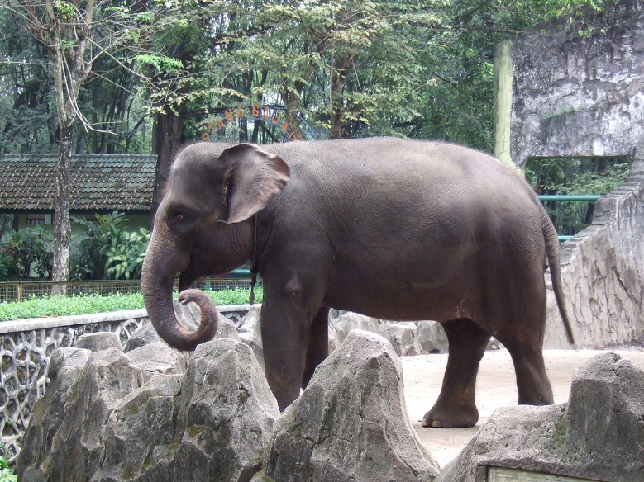
This term we will be learning about…………….
ENDANGERED ANIMALS.

Slide 8
Please write down on a piece of paper:
Everything you already know about
endangered animals
and
What you would like to know about
endangered animals

