Slide 1
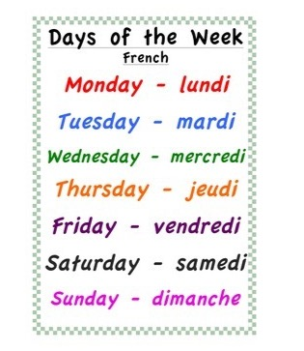
Monday 22nd June Lundi 22 Juin
Good Morning Primary 1!
Bonjour la class!
Click on the picture below to sing our Monday song.
Click on the above picture to listen to the days of the week in French.

Slide 2
Good Morning Everyone,
I cannot believe this is the last week of term, because it is, we are going to have some fun and go on an adventure together. We are going to go on a virtual trip to one of my favourite places! The clues below may help you guess the surprise.
* This place has lots of fun rides.
* This place has magical firework displays.
* This place is the home of Mickey Mouse.
Have you guessed yet?
Have you guessed it yet?

Slide 3
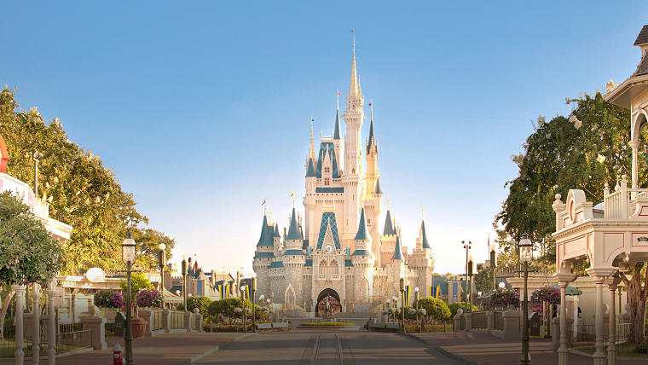
Disney Virtual Trip
Primary 1 and 2

Slide 4
Monday 22nd June

Slide 5
Art
I am learning to create an eye-catching design using
line, pattern, colour and shape.
A passport is a document issued by the government, it confirms who you are. You need a passport to travel to other countries. Ask a grown up at home to show you their passport. Can you create your own passport that you can use during our trip!
Try to include an eye-catching front cover, your name, age, address, a picture of yourself and keep lots of space for characters names! Each time you see a character this week on a ride, in a video or song, make sure to write their name in your passport! How many characters will you meet by the end of the week?
I can create a colourful and detailed front cover.
I can include my name, age, address and detailed picture.

Slide 6
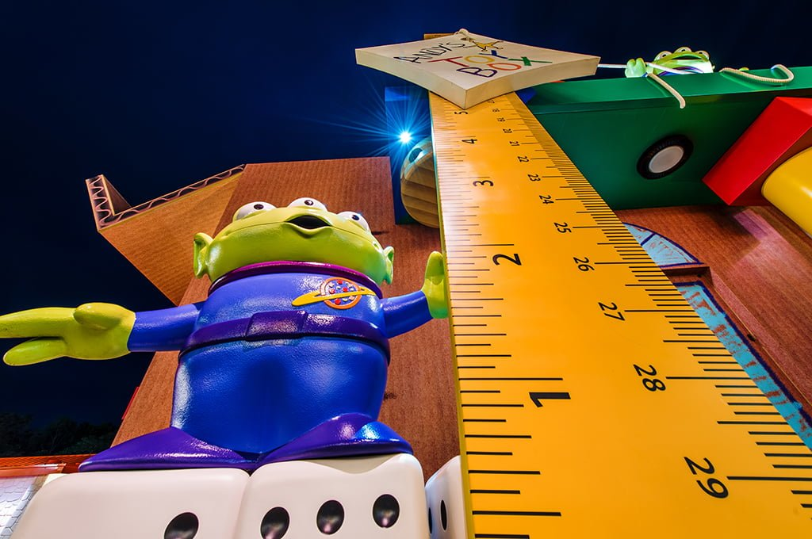
Numeracy
I am learning to measure and estimate height, using non-standard and standard units.
To go on today’s the rides you must be taller than:
6 pieces of cutlery
6 of your own shoes/socks
3 books
15 blades of grass
Estimate and then measure whether you are tall enough to ride!
Extension: If you have a measuring tape/ruler, you could measure how tall you are. Can you find 3 things that are taller and 3 things that are shorter than you. Measure the height of each thing using the ruler/measuring tape. How many centimeters is each object?
I can estimate the height of an object and measure carefully.
I can use a tape measure/ruler accurately and can compare heights.

Slide 7
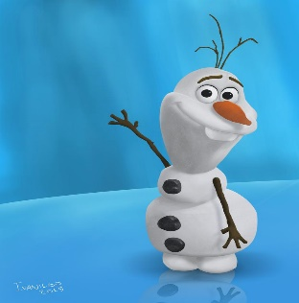
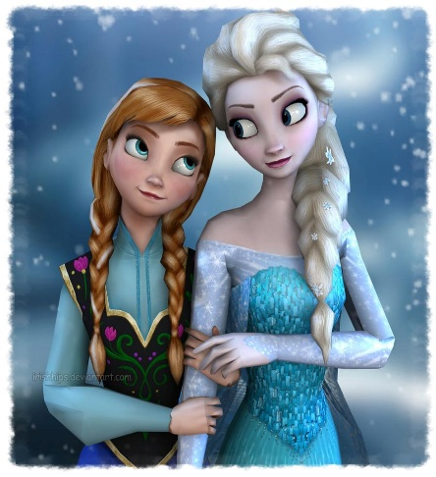
Literacy
I can generate rhyming words and use them in a
sentence or story.
Watch the Frozen ride – how many words can you think of that rhyme with snow. Record yourself saying all of the words that you can think of.
https://www.youtube.com/watch?v=J8OHP9OriMA&t=33s
Can you create your own sentences using some of the words that you have thought of. Try to write 2 sentences, remember to include capital letters and full stops.
Did you include any ‘Tricky Words’ or vowel digraphs in your sentences? If you did, circle them and count how many you used.
Extension: Write down your list and create a story using some of the rhyming words.
I can produce rhyming words and write a sentence or a story using some of these words.
I can include capital letters, full stops and spell ‘Tricky Words’ accurately in my writing.

Slide 8
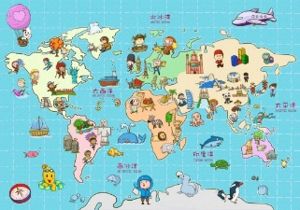
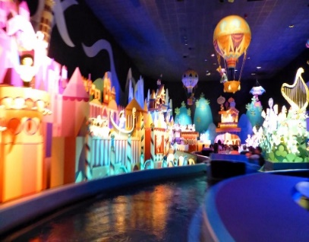
IDL
I am learning about other countries and cultures.
Task: Enjoy the ‘It’s a Small World’ ride. The ride shows many countries and places around the world.
Can you find out 3 facts about another country. You could present your facts in different ways, for e.g. in photos/drawings/text or record yourself saying what you have found out.
Extension: Can you compare Scotland with another country. You might want to think about things such as, weather, food, attractions/scenery, events and celebrations, flags or anything else you are interested in. Please present your information in a poster.
https://www.youtube.com/watch?v=I2Do309e4YU
The website below will help with information about different countries.
https://kids.nationalgeographic.com/explore/countries/
I can find out 3 facts about another country.
I can compare another country to Scotland and share my ideas in a poster.

Slide 9
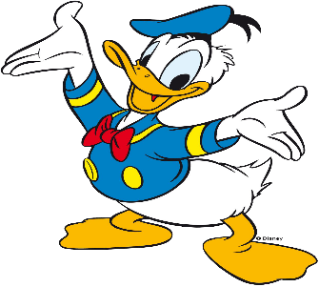
Writing
I can make an attempt to spell words correctly using my ‘sound-box’ and knowledge of letter patterns.
Take a tour of Donald Duck’s house boat. What can you see? Draw and label 5 things that you can see inside his house.
Write 2/3 sentences about how Donald Duck’s house is different to yours, for example, my windows are not circles and I do not dry my washing on my roof! How many similarities and differences do you notice?
https://www.youtube.com/watch?v=XERRGapwSVQ&t=17s
.
I can draw in detail and use my knowledge of sounds and to spell words.
I can compare my home to others and observe similarities and differences.

Slide 10
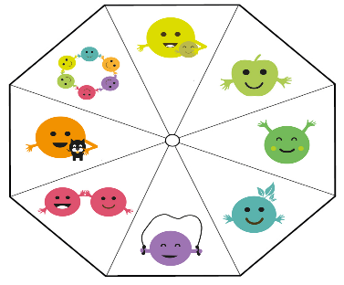
Hi Everyone,
I hoped you enjoyed the first part of our virtual trip this morning. On the following slides there are some well-being Indicator activities you could try this afternoon. It would be best if you asked a grown-up to visit the Blog/website to download the grids (the images will be clearer to see and the links will be live) and worksheets that go with the activities.
Thanks
Mrs Washington

Slide 11
Well-being Indicator Activities

Slide 12
Well-being Indicator Activities

