Slide 1
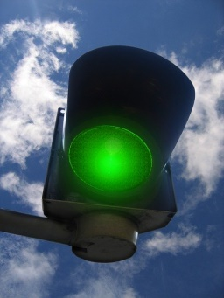
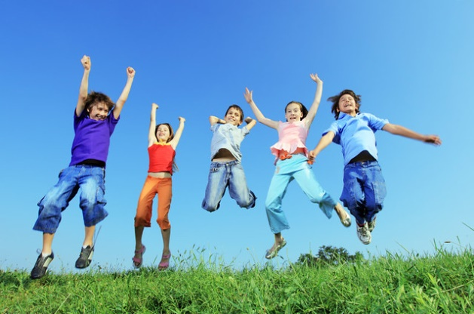
Happy Sports Day!
The green light is flashing, get going everyone. Have a fun and active day! https://youtu.be/rykYhDKt_3M

