Slide 1
Wednesday 17 June 2020
Bien? Regular? Mal?
https://www.bbc.co.uk/teach/supermovers/ks1--ks2-mfl-spanish-greetings-with-ben-shires/zfksqp3

Slide 2
Procedure Writing
To help me communicate effectively in and out of school I will write a procedure. The purpose of a procedure is to provide instructions about how to make or do something.
Say- Think, pair and share what you made for the Great Science Share, what materials you used and how you made it.
Write – Write a procedure using a title, goal, materials and steps.
Do – Read your procedure to your family. Does it make sense? Have you used your core targets?

Slide 3
Writing a Procedure
Title
Goal (What is going to be made or done?)
Materials
You will need:
Steps (How will it be made or done?)
1.
2.
3.
4.

Slide 5
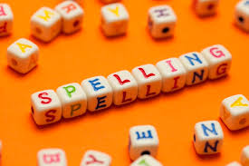
Spelling Words
fighting
drawing
cheated
melted
pointed
shouted
hoping
liking
raining
Here are your spelling words for the week. Choose 3 words each day to practise.
Remember to..
Read the word
Clap the syllables
Use your sound box to sound out the sounds.
Write out the words

Slide 6
Reading Detectives
I can read the sentences
I can find the vowel digraphs, tricky words, and words ending in ‘ing’.
I can up level the sentence to make it more interesting
I can identify the nouns and verbs.
The plane soared across the blue sky and landed safely at the airport.

Slide 7
Story Time
https://www.youtube.com/watch?v=tANJ4JtHPTw&list=PLuQ9vjXNtWESwtoHoxfx9_IiinjGsIXgL&index=13&t=0s&app=desktop

Slide 8
Maths and Numeracy
I am learning to add and subtract to 20 and beyond
To explore numbers, understand quantities, use strategies to help me work with numbers I can
Say- count forwards and backwards to and from 50 in 5s, throw and catch a ball with someone as you do it.
Make – Play Bunny Battlefront on ICT games (year 2).
Write- Complete the ‘make equal groups’ page from the blog.

Slide 9
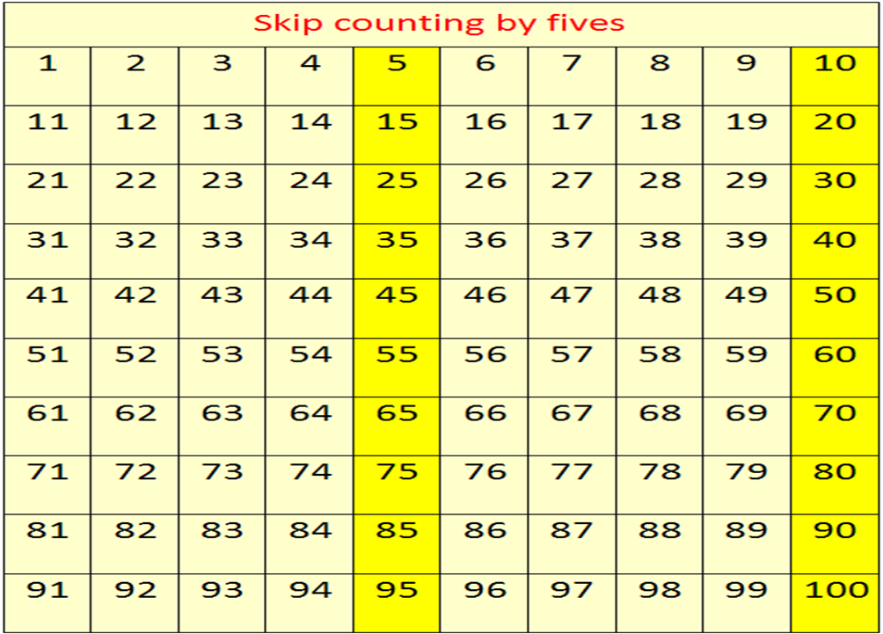
Counting in 5s
Now use the counting in 5s ppt to help you practice counting in 5s.

Slide 10
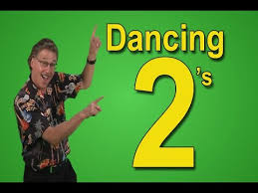
Number Songs
https://www.youtube.com/watch?v=OCxvNtrcDIs

Slide 11
Sports Day
Please have lots of fun with all the sports day activities. Don’t forget to share your photos!

