Slide 1
DIARY for the week commencing 15th June 2020

Slide 2
Dear Parents and Carers,
We are now into the last two weeks of our summer term.
Thank you to everyone who uploaded or emailed me your buddy letters – they are fantastic, I think the nursery children are very lucky to have such wonderful buddies.
We will not be following our usual weekly diary for this week because of our Marches holiday on Tuesday 16th and our Sports days on Wednesday 17th and Thursday 18th of this week. Remember to check out your PE Team on Teams and look out for instructions from Mrs Bell this week!
I will soon be passing on information to your new class teacher. Most of you upload your numeracy work to your numeracy folder and I can see where you are up to with your work. For those of you who do not upload your work – I know that most of you have done it, could you just confirm this for me on Posts or email me directly to : jane.peters@westlothian .org.uk just confirming that you have completed all the H5 pages I have asked you to do. I will need to confirm this with your new class teacher for next year. Next week we will do some numeracy revision.
I hope you have a very happy Marches week, remember to post and upload anything to do with our Marches and Space activities. I will be on Posts so you can keep in touch with me at any time. Stay safe and I will speak to you soon.
Kind Regards
Mrs Peters

Slide 3
Online Lesson this week
Monday – Sports QUIZ - (Explorers’ Group) 10.30 am
Sports QUIZ - (Adventurers’ Group) 11.15 am

Slide 4
Explorers’ Group 10.30 pm Monday
Sienna Blackwood, Sofia Brice, Katie Byrne, James Cowie, Liam Gordon, Lewis Kerr,
Boyd Mackin, Jasper Martin, Finlay Paton, Sandra Pawlowska, Ellie Perrie, Abigail Ponton,
Lyle Tavern.
Adventurers’ Group 11.15 pm Monday
Jack Horsfield, Zara Lindsay, Cristen Murray, Sophie MacDonald, Boyd Stevenson,
Gregor Stobie, Zoe Tait, Micah Theron, Ella Topping, Fraser Warnock, Jack Webster,
Logan Whytock.

Slide 5
Comprehension
There is no comprehension for this week – the comprehension task is for the following week.
Comprehension Success Textbook page 36
A book of Nonsense
Please complete A, B and C for next Wednesday (Wednesday 24th June) lesson at 10 am. During the lesson we will discus the limericks and the answers to questions A and B. For C you have to come up with your own limerick. I am hoping that some of you will want to share your limericks at the end of the lesson!

Slide 6
Numeracy for all Groups
There will be no numeracy work for this week. However, please ensure that you are up to date with all the H5 pages you have been asked to do since we have been learning from home. If you have been unable to upload your work, please send me an email confirming that you have completed all the H5 pages. You can also tell me in Posts on Teams. I need this information to pass on to your new P6 teacher.
If you have been uploading your work you do not need to email me!

Slide 7
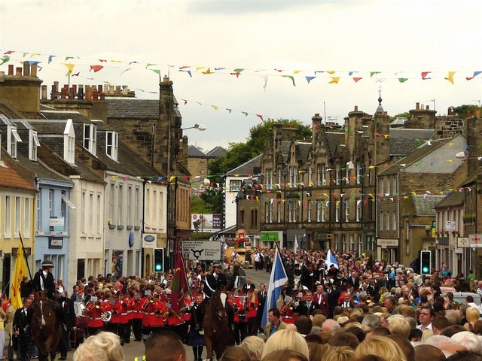
Marches STEM Challenge
There is still time to upload your photos and designs to Assignments.
All the information for this is in ASSIGNMENTS!
Could you please upload photos of your designs to Assignment or you can email them to the school office? We would like to include as many as we can in our Assembly and you can also send them to the Deacons Court to enter their competition. Details of this are included in an email or you can find them on the Linlithgow Marches and Deacons Court Facebook page.
We can't wait to see all your creative ideas!

Slide 8
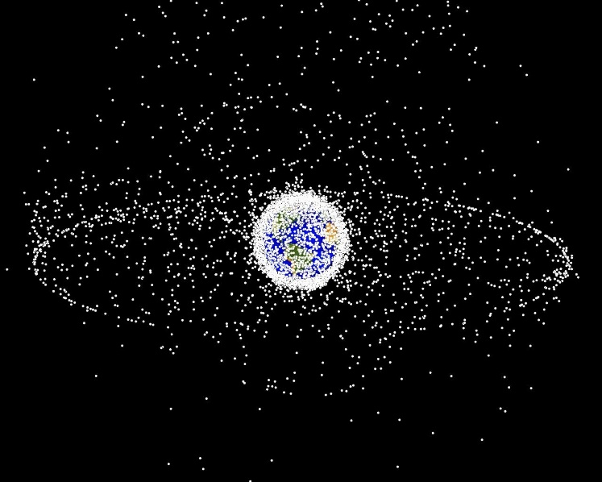
Space Activities
Share your learning! Check out Assignments for all your space tasks.
Don't forget to share what you have done!
There are lots of ways you can share:
Use Assignments
Reply to this post
Email the school office
Use Class Notebook
If you are emailing the office or using class notebook can you let me know here so I know to look for them.
We have had some fantastic efforts already and Mrs Reynolds can't wait to see what you have all done.

Slide 9
Linlithgow Bridge Sports Days
Wednesday 17th and Thursday 18th June 2020
Please check out your PE Team for
information on which Sports Days Team you are in. There are four teams, Usain Bolt, Chris Hoy, Rebecca Adlington and Lirasa Latynina.

