Slide 1
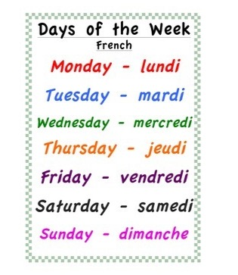
Friday 12th of June Vendredi 12 Juin
Good Morning Primary 1!
Bonjour la class! Ca Va?
Listen to the days of the week in French
Click on the above picture to listen to the days of the week in French.

Slide 2
Sounds
I can use knowledge of sounds, letters and patterns to read words.
Revision of sounds
Click on the sound button, say the sound and the word.
wh
ai
ay
sh
ch
th
ee
ea
igh
y
oa
ow
oo
ew
oi
oy
ou
ow
sound out words containing consonant digraphs sh, ch, th, wh and long vowels ai/ay, ee/ea , igh/y, oa/ow, oa/ow, oo/ew, oi/oy and ou/ow using our ‘Sound-box’.

Slide 3
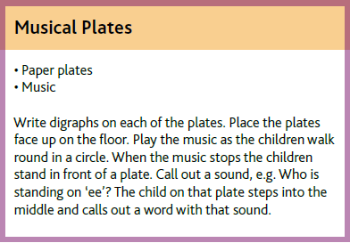
Mrs Washington’s Active Spelling Challenge
Choose one of the activities to sound out 4 of our revision words.
Or choose your own way to learn your spelling words.
Revision Words
shout owl
coin boy
look new
shy my
goal row
sheet cheap

Slide 4
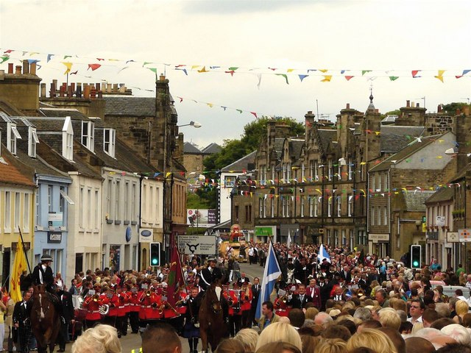
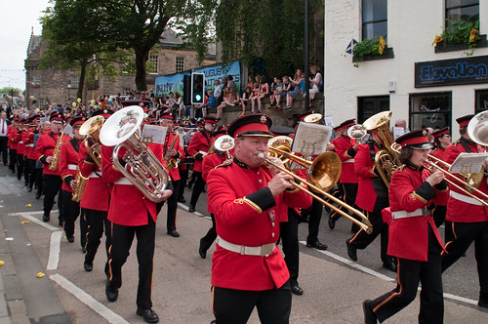
Marches Assembly
Ask a grown up to check their emails and open up this weeks assembly in SWAY.

Slide 5
HWB
To understand positive things about friendships.
Click on the picture to take you to the ‘Sesame Street’ video.
Activity – design a ‘What Makes a Special Friend’ poster. Download the worksheet from the blog/website or draw/write in your jotter.
I can identify at least 2 ways I can be a good friend.

Slide 6
Number Blocks
I can use practical materials to ‘count on and back’ to help me to understand subtraction.
Click on the picture to take you to the Number blocks episode.
Activity – can you work out the difference between the number block 7 and number block 4? Can you choose another two number blocks to work out the difference?
I can work out the difference between two numbers within 10.

Slide 7
Science
Space Week
Please see the following message from Mrs Reynolds & Mrs Patterson. In preparation for the Great Science Share on Wednesday 17th June we will be investigating Space together as a school.
Have a look at some suggested activities on the Blog.
Remember to share your learning through uploading your work and photos or email the school office: wllinlithgowbridge-ps@westlothian.org.uk

