Slide 1
Thursday 11th June
Jeudi 11 Juin
Good Morning Primary 1!
Bonjour ma Classe!
Click on the picture above to listen to the days of the week in French.
Click on the picture below to sing our Thursday song.

Slide 2
PE
PE with Cosmic Yoga
Click on the image below.

Slide 3
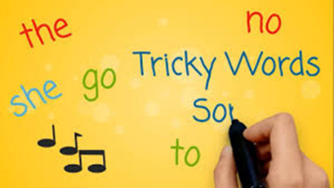
Revision Tricky Words Block 2
Click on the picture to take you to the song.
go we be her
she are they of
all some come were
said one you

Slide 4
Tricky Word/sounds Dictation
I can make an attempt to spell familiar words correctly.
owl
row
out
mouth
were
her
Are my letters formed correctly?
Are my letters in the correct order?
CHALLENGE - Write a sentence using one of the Tricky Words above.
Ask an adult to read out these tricky words.
Can you spell them correctly?

Slide 5
Sentence Dictation
I can make an attempt to spell familiar words correctly and use my ‘sound-box’ to spell other words.
It is a hot day. Joy and I are at the beach. We look for fish in the sea.
Are my letters formed correctly?
Are my letters in the correct order?
Did you remember finger spaces?
Did you remember to include a capital letter and a full stop in your sentences.
CHALLENGE – Circle all the Tricky Words in the sentences. Underline the capital letters and full stops. How many sentences can you spot?
Ask an adult to read the sentences aloud.
Can you write it independently?
Can you spell the words correctly?

Slide 6
Reading Book
I can use my knowledge of sounds, letters and patterns to read words.
Read the e-book which has been set (see Learning Journal if you are unsure) for you and self-assess using the targets below?

Slide 7
Story Time
Click on the picture below to listen to the story.

Slide 8
Number Rhyme Time
I can participate actively in songs, rhymes and stories.
Click on the picture below to sing along to a song all about the minus sign.

Slide 9
Subtraction
Click on the image below to learn about finding the difference between two numbers.

Slide 10
Subtraction Finding the Difference
I can count on and back in ones to add and subtract.
True or False?

Slide 11
Subtraction Finding the Difference
I can count on and back in ones to add and subtract.

Slide 12
Subtraction Finding the Difference
I can count on and back in ones to add and subtract.

Slide 13
Subtraction Finding the Difference
I can count on and back in ones to add and subtract.

Slide 14
Subtraction Finding the Difference
I can count on and back in ones to add and subtract.

Slide 15
Subtraction Finding the Difference
I can count on and back in ones to add and subtract.

Slide 16
Subtraction Finding the Difference
I can count on and back in ones to add and subtract.

Slide 17
Subtraction Finding the Difference
I can count on and back in ones to add and subtract.

Slide 18
Subtraction Finding the Difference
I can count on and back in ones to add and subtract.

Slide 19
Subtraction Finding the Difference
I can count on and back in ones to add and subtract.
Please download the ‘Find the Difference Sheet’ from the blog or website. Alternatively, please help your child draw some number lines in their jotter and solve the problems.

Slide 20
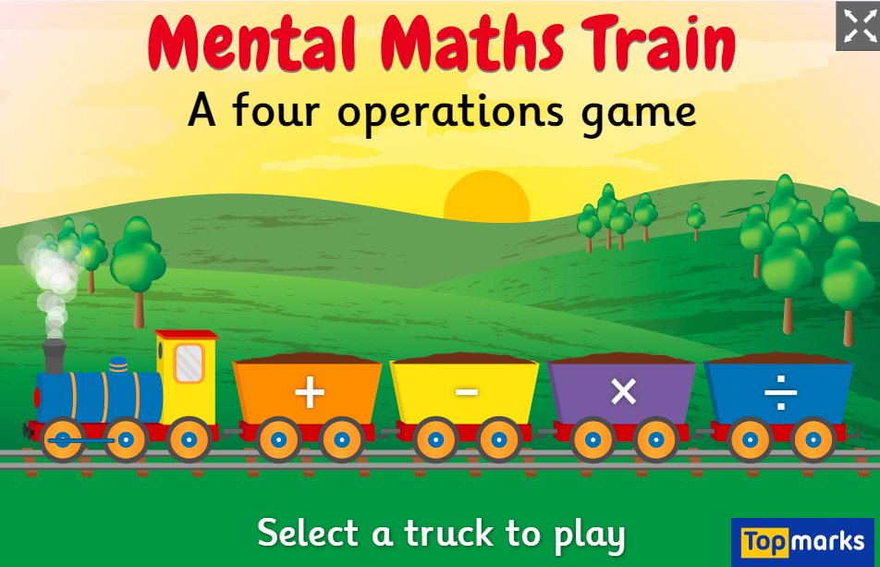
Subtraction
Click on the link and select the subtraction sign to play the game.

Slide 21
Science
Space Week
Please see the following message from Mrs Reynolds & Mrs Patterson. In preparation for the Great Science Share on Wednesday 17th June we will be investigating Space together as a school.
Have a look at some suggested activities on the Blog.
Remember to share your learning through uploading your work and photos or email the school office: wllinlithgowbridge-ps@westlothian.org.uk

Slide 22
The Marches
Marches Challenge
Join in the Marches celebrations by completing these STEM Challenges. Please find them on the P1 page of the Blog. Send your photos to the school so we can add them to our Marches Assembly!

Slide 23
The Marches
Marches Challenge
Join in the Marches celebrations by completing these STEM Challenges. Please find them on the P1 page of the Blog. Send your photos to the school so we can add them to our Marches Assembly!

