Slide 1
Wednesday 9 June 2020
Bien? Regular? Mal?
https://www.bbc.co.uk/teach/supermovers/ks1--ks2-mfl-spanish-greetings-with-ben-shires/zfksqp3

Slide 2
Report Writing
To help me communicate effectively in and out of school, I will make a Venn diagram to show the similarities and differences between how we use our beaches now and how we used them long ago.
Say- Think, pair and share the differences between the way we use beaches now compared with how we used them long ago.
Make – Make a Venn diagram to help you compare the similarities and differences.(Please find this on the blog page)
Write – Write sentences to describe what is the same and what is different. (You can write this in your jotter or there is a sheet on the blog page).
Do – Read your report to your family. Does it make sense? Have you used your core targets?

Slide 3
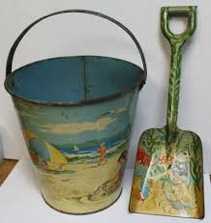
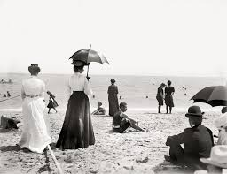
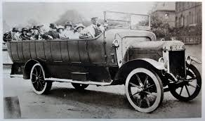
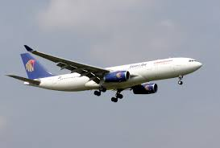
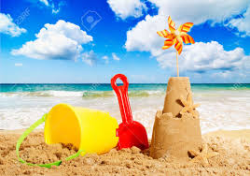
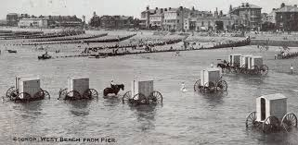
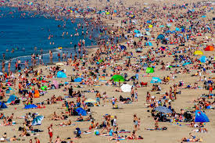
The Seaside Then and Now
Look at the photographs to remind ourselves of the seaside then and now.

Slide 5
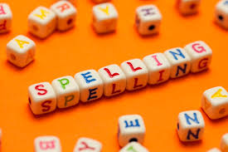
Spelling Words
filled trailed sailed saved raced stained staged trained cold told heard
Here are your spelling words for the week. Choose 3 words each day to practise.
Remember to..
Read the word
Clap the syllables
Use your sound box to sound out the sounds.
Write out the words

Slide 6
Reading Detectives
I can read the sentences
I can find the vowel digraphs, tricky words, and words ending in ‘ing’.
I can up level the sentence to make it more interesting
I can identify the nouns and verbs.
The plane soared across the blue sky and landed safely at the airport.

Slide 7
Maths and Numeracy
I am learning to add and subtract to 20 and beyond
To explore numbers, understand quantities, use strategies to help me work with numbers I can
Say- count forwards and backwards to and from 50 in 5s, throw and catch a ball with someone as you do it.
Make – Play ‘Doggy Division Dinners’ on www.ictgames.com to help you practice sharing and dividing equally.
Write- Complete the ‘make equal groups’ page from the blog.

Slide 8
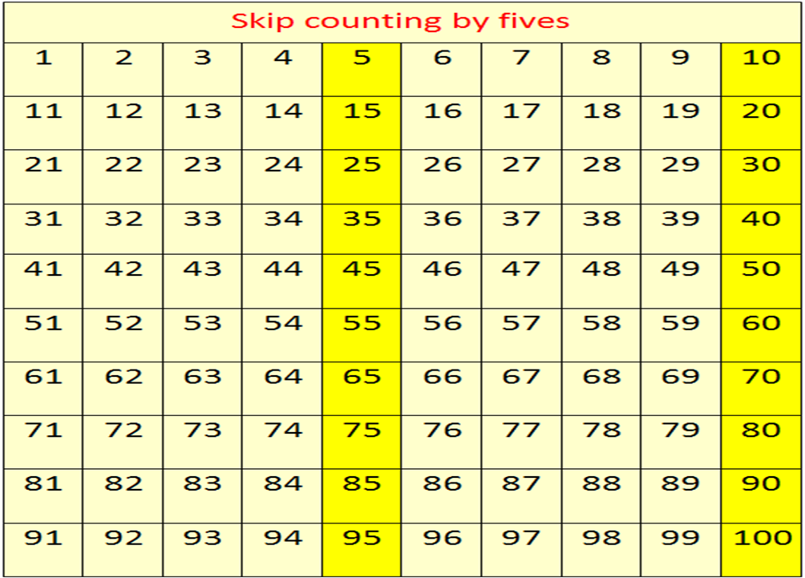
Counting in 5s
Now use the counting in 5s ppt to help you practice counting in 5s.

Slide 9
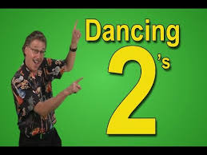
Number Songs
https://www.youtube.com/watch?v=OCxvNtrcDIs

Slide 10
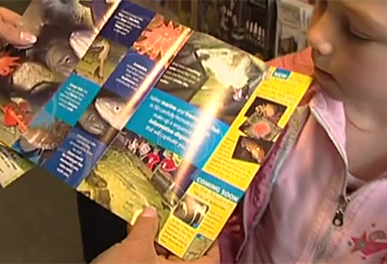
Tourism
Imagine you are a tourist and are visiting a town for the very first time. Where do you think you would visit first? We created this place in our classroom when we were learning all about Linlithgow. Have you guessed? Watch the clip below to see a family on their day out visiting a tourist information centre.
https://central.espresso.co.uk/espresso/primary_uk/subject/module/video/item1065812/grade1/module1067404/index.html

Slide 11
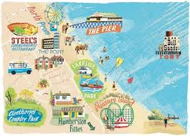
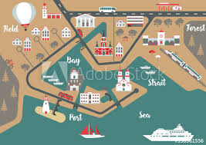
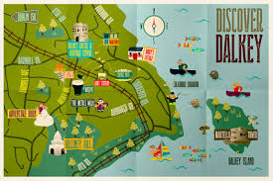
Mapping
Can you create a tourist map of your own seaside town? I have added a map to the blog page for you to use or you could make your own. What would you like to have in your seaside town?

