Slide 1
Tuesday 9th of June Mardi 9 Juin
Click on the above picture to listen to the days of the week in French.
Click on the rainbow to listen to our Tuesday song.

Slide 2
Zumba Kids
I am learning how to move my body well exploring how to manage and control it.
Click on the picture to take you to Zumba kids workout.

Slide 3
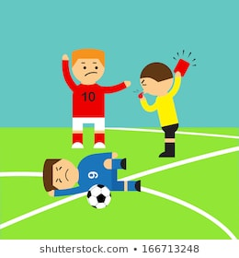
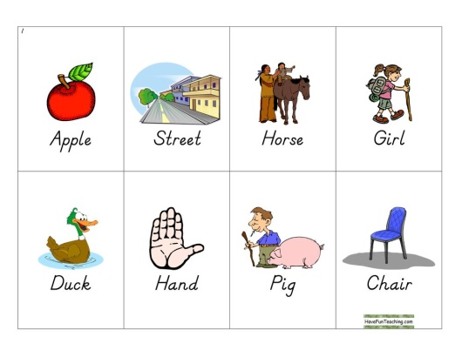
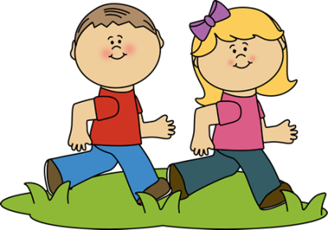
Sounds
I can use knowledge of sounds, letters and patterns to read words.
south
foul
out
noun
Click on the picture below to take you to the ‘ou’ clip.
We can sound out words containing the ‘ou’ sounds
using our ‘Sound-box’

Slide 4
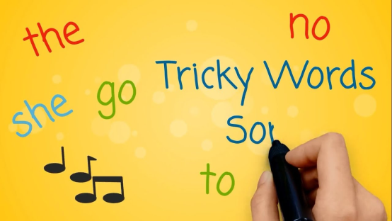
Revision Tricky Words Block 2
go we be
she are they
all some come
said one you
her of

Slide 5
New Tricky Word
were
What is the tricky part of the word?
What sounds can you hear?
Air Writing
Write the word in the air saying each sound as you form it.
Carpet Writing
Write the word on the carpet/floor saying each sound as your form it
Sentence
Put the word in a sentence.

Slide 6
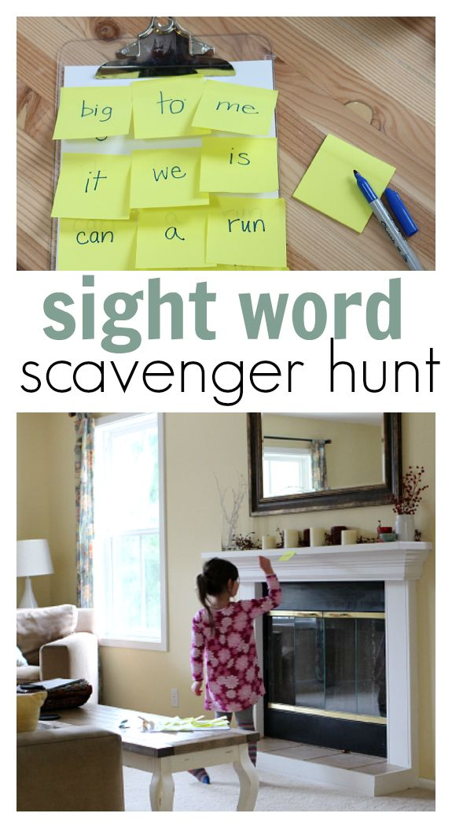
Tricky word Scavenger Hunt
Ask an adult to write out your tricky words on sticky notes and hide then around the house. Have a list of the tricky words you are looking for and go and search for them.
Have fun!

Slide 7
Sentence of the day
I can use knowledge of sounds, letters and patterns to read words.
Can you spot any tricky words?
Can you spot any words with long vowel sounds?
My dad had a new car. He took us to the fair. We had fun on the big wheel.

Slide 8
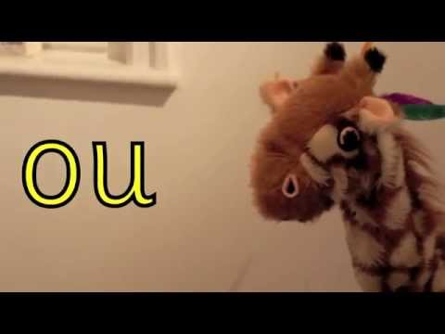
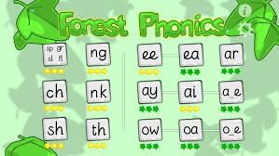
Phonics Activities
Click on the picture to watch an episode of ‘Geraldine the Giraffe’.
Activity
Spelling – draw and label a picture with 4 ou words.
ICT – Forest Phonics ‘ou’ word building.
Letter formation –
practise making the ‘ou’ sound
in the air, on the floor, in flour/salt.
‘ou’ letter formation page (home learning pack)
Click on the link below to take you to the letter formation. Follow the magic pencil to form o and u.

Slide 9
Reading Book
I can use my knowledge of sounds, letters and patterns to read words.
Read the e-book which has been set for you and self-assess using the targets below?

Slide 10
Story Time
I enjoy engaging with and listening to a story.
Click on the picture to take
you to the story.

Slide 11
Number Song Time
Click on the picture to take you to the music clip.

Slide 12
Subtraction
I can count on and back in ones to add and subtract.
Click on the link to take you to the video clip on ‘finding the difference’.

Slide 24
Finding the difference Challenge
I can count on and back in ones to add and subtract.
Use lego/building bricks to build the towers. Can you find the difference?
Can you make up your own problems?
Activity – complete the ‘finding the difference’ worksheet on the Blog/Website or write in your jotter.

Slide 25
Science
Space Week
Please see the following message from Mrs Reynolds & Mrs Patterson. In preparation for the Great Science Share on Wednesday 17th June we will be investigating Space together as a school.
Have a look at some suggested activities on the Blog.
Remember to share your learning through uploading your work and photos or email the school office: wllinlithgowbridge-ps@westlothian.org.uk

Slide 26
The Marches
Marches Challenge
Join in the Marches celebrations by completing these STEM Challenges. Please find them on the P1 page of the Blog. Send your photos to the school so we can add them to our Marches Assembly!

Slide 27
The Marches
Marches Challenge
Join in the Marches celebrations by completing these STEM Challenges. Please find them on the P1 page of the Blog. Send your photos to the school so we can add them to our Marches Assembly!

