Slide 1
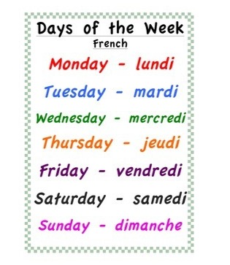
Thursday th June
Jeudi 4 Juin
Good Morning Primary 1!
Bonjour ma Classe!
Click on the picture above to listen to the days of the week in French.
Click on the picture below to sing our Thursday song.

Slide 2
P.E with
PE with Cosmic Yoga
Click on the image below.

Slide 3
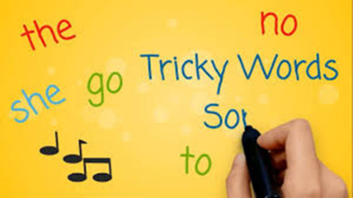
Revision Tricky Words Block 2
Click on the picture to take you to the song.
go we be her
she are they of
all some come
said one you

Slide 4
Tricky Word/sounds Dictation
I can make an attempt to spell familiar words correctly.
toy
soil
oil
want
her
of
Are my letters formed correctly?
Are my letters in the correct order?
CHALLENGE - Write a sentence using one of the Tricky Words above.
Ask an adult to read out these tricky words.
Can you spell them correctly?

Slide 5
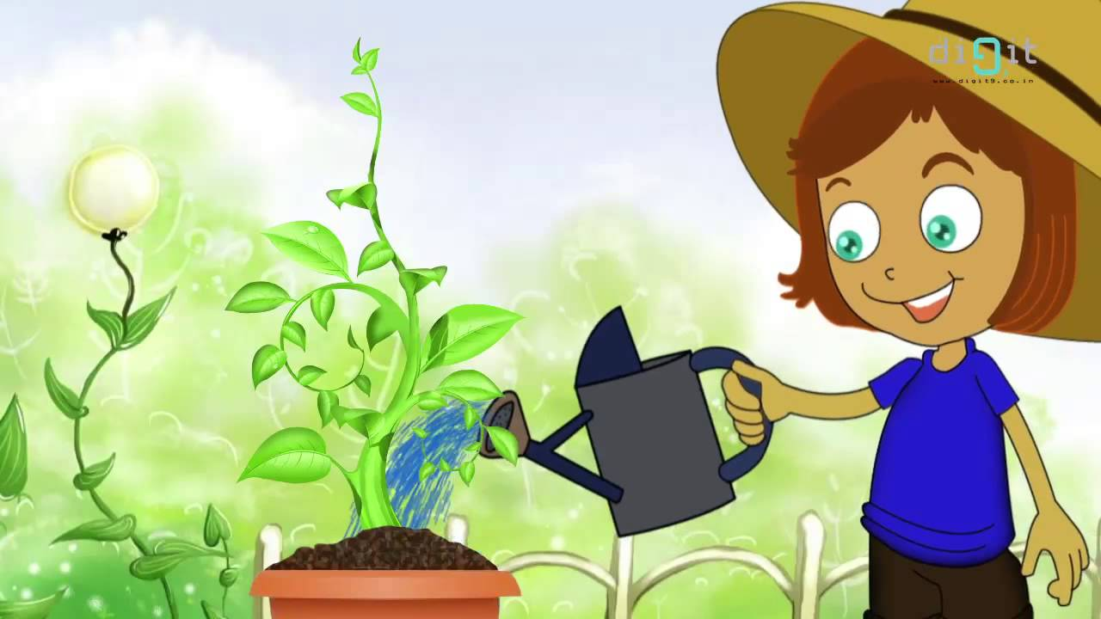
Sentence Dictation
I can make an attempt to spell familiar words correctly and use my ‘sound-box’ to spell other words.
Kim put the seed in the soil. She can put it in a deep pot.
Are my letters formed correctly?
Are my letters in the correct order?
Did you remember finger spaces?
Did you remember to include a capital letter and a full stop in your sentences.
CHALLENGE – Circle all the Tricky Words in the sentences. Underline the capital letters and full stops. How many sentences can you spot?
Ask an adult to read the sentences aloud.
Can you write it independently?
Can you spell the words correctly?

Slide 6
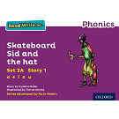
Reading Book
I can use my knowledge of sounds, letters and patterns to read words.
Read the e-book which has been set (see Learning Journal if you are unsure) for you and self-assess using the targets below?

Slide 7
Story Time
Click on the picture below to listen to the story.

Slide 8
Example -
8 + 2 = 10
Instead of saying how many dots there are, find as many ways as you can to show how you know what the total is.
Write the dots out in your jotter.
www.stevewyborney.com

Slide 9
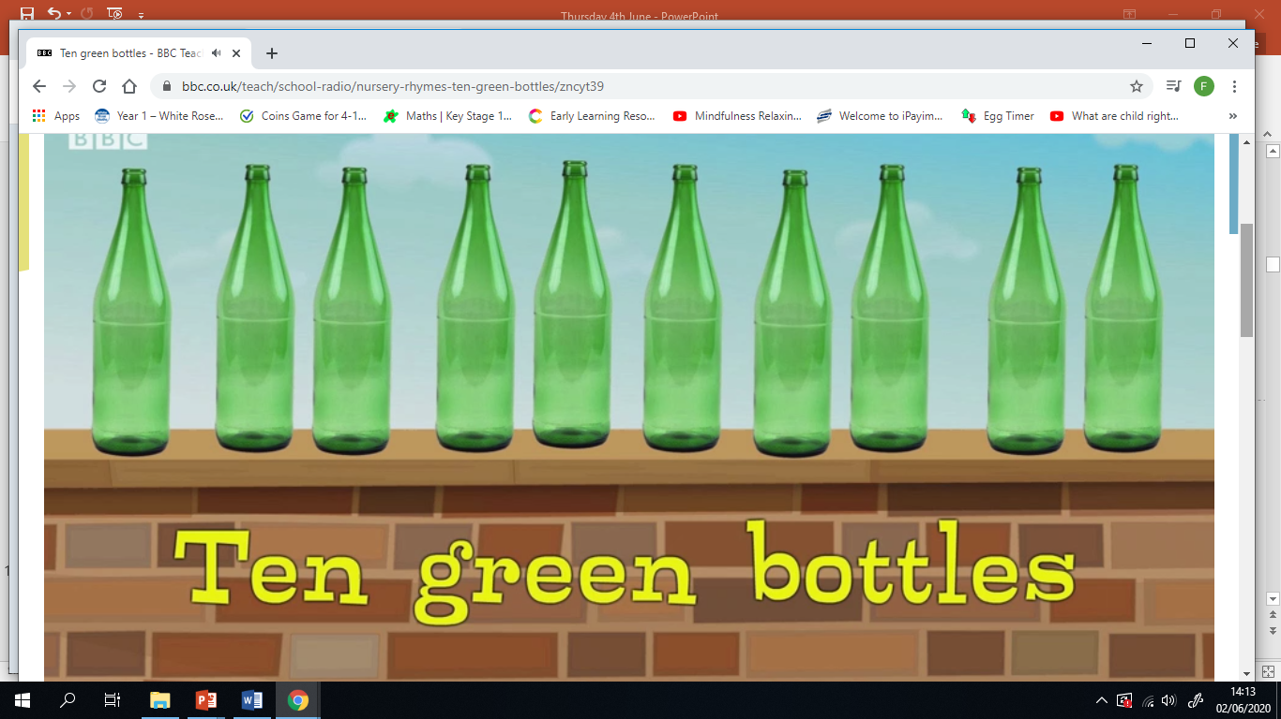
Number Rhyme Time
I can participate actively in songs, rhymes and stories.

Slide 10
Finding a Part
I can build and describe how numbers can be partitioned within 10.
Draw the part-part-whole models in your jotter and use counters, pasta shapes or Lego to work out the missing part.

Slide 11
Finding a Part
I can build and describe how numbers can be partitioned within 10.
Draw the part-part-whole models in your jotter and use counters, pasta shapes or Lego to work out the missing part.

Slide 12
Finding a Part
I can build and describe how numbers can be partitioned within 10.
Draw the part-part-whole models and sentences in your jotter and use counters, pasta shapes or Lego to work out the missing part.

Slide 13
Finding a Part
I can build and describe how numbers can be partitioned within 10.
Draw the part-part-whole models and sentences in your jotter and use counters, pasta shapes or Lego to work out the missing part.

Slide 14
Subtraction
I can build and describe how numbers can be partitioned within 10.

Slide 15
Subtraction
I can build and describe how numbers can be partitioned within 10.
Draw a picture in your jotter to match this subtraction story.

Slide 16
Subtraction
I can build and describe how numbers can be partitioned within 10.
Can you make up your own subtraction story to go with this picture?

Slide 17
Subtraction
I can build and describe how numbers can be partitioned within 10.

Slide 18
Subtraction
I can build and describe how numbers can be partitioned within 10.

Slide 19
Subtraction
I can build and describe how numbers can be partitioned within 10.

Slide 20
Fact Families
I can use my knowledge of ’Fact Families’ to help me solve addition/subtraction problems.
Click on the picture below to learn about Fact Families.

Slide 21
Fact Families
I can use my knowledge of ’Fact Families’ to help me solve addition/subtraction problems.
Fact families
A fact family is a group of calculations that are created using the same three numbers. For example, here is a fact family that uses the numbers 2 , 4 and 6.
2 + 4 = 6
4 + 2 = 6
6 - 2 = 4
6 - 4 = 2
Can you work out the fact families for 2, 3 and 5? Write them in your jotter.

Slide 22
Fact Families
I can use my knowledge of ’Fact Families’ to help me solve addition/subtraction problems.

Slide 23
Fact Families
I can use my knowledge of ’Fact Families’ to help me solve addition/subtraction problems.

Slide 24
Subtraction
Click on ‘Education City’ to log in.
Click on Subjects – Numeracy – Early *** - Activities and scroll down to ‘Lazy Lambs’.
I can split a whole into smaller parts and explain that equal parts are the same size.

Slide 25
The Snail on the Whale
Click on the picture to take you to the story.

Slide 26
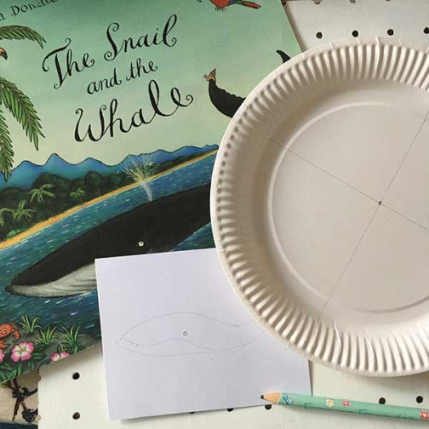
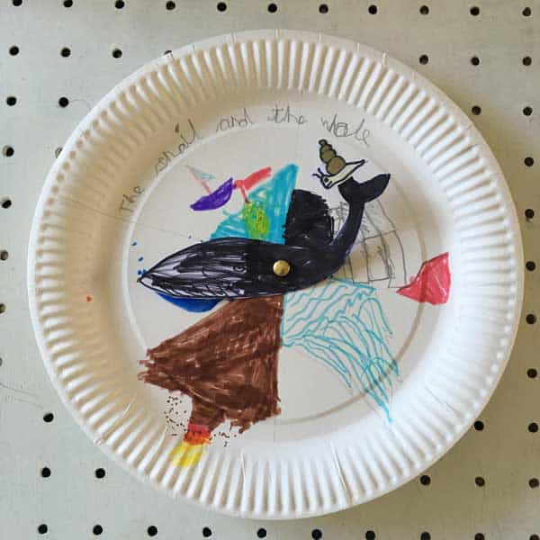
Snail and the Whale Story Wheel
Create a story wheel
What you will need:
Paper Plate
Coloured Pens
Scissors
White card
Section the plate into parts to show different settings in the story. E.g
The Snail meets the Whale
The icebergs
The volcano
The huge waves
Busy Beach
Draw the snail and the whale on a separate piece of paper/card to stick in the middle of the plate. The whale can then be moved into each section to tell the story.

Slide 27
Drama – Part 3
I can use my body, actions, voice and gestures effectively in role-play scenarios.
.
Click on the picture below to begin

