Slide 1
Wednesday 3 June 2020
Bien? Regular? Mal?
https://www.bbc.co.uk/teach/supermovers/ks1--ks2-mfl-spanish-greetings-with-ben-shires/zfksqp3

Slide 2
Good morning all,
It has been brought to my attention that you have been unable to access the Discovery Education links. This is because I haven’t given you the password –sorry!
To access, please click on the link and it will ask you to put in the username and password which is-
Pupil username: student43111
Pupil password: bridge

Slide 3
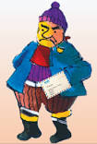
Good morning P2
I’ve been having a big long think about what we can do about all this litter that is left by people visiting our lovely beaches. Maybe they need a little reminder of what they should do and what they shouldn’t do? Can you make a poster for them so that they don’t forget to take their litter away with them? Remember posters should be bright and eye catching.
Thank you very much,
Mr Grinling

Slide 4
Make A Poster
To help me communicate effectively in and out of school, I will make a poster to share with people why it is important to keep our beaches clean and free of litter.
Say- Use the information you have learned to think, pair and share why it is important to keep our beaches clean and free of litter
Make – Make a plan of your ideas, what will be your title, where will it go? What would you like to say in your poster?
Write – Write and draw your poster, remember a poster needs a title, pictures, some written information, to be bright and eye catching so that it can be easily read.
Do – Read your poster to your family. Does it make sense? Send it to Mr Grinling so that he can display it near his beach.

Slide 5
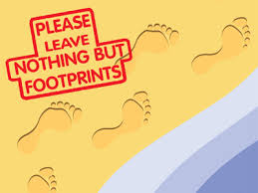
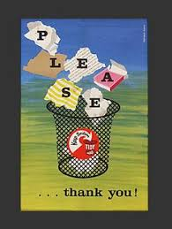
Poster Examples

Slide 7
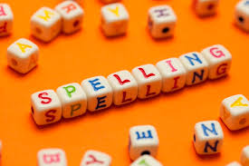
Spelling Words
hunted
shouted
wanted
started
handed
melted
heated
cleaned
complete
knew
piece
Here are your spelling words for the week. Choose 3 words each day to practise.
Remember to..
Read the word
Clap the syllables
Use your sound box to sound out the sounds.
Write out the words

Slide 8
Reading Detectives
I can read the sentences
I can find the vowel digraphs, tricky words, and words ending in ‘ing’.
I can up level the sentence to make it more interesting
I can identify the nouns and verbs.
Harry planted some yellow flowers in the garden and added water to the soil.

Slide 9
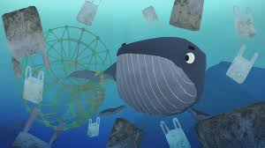
Story Time
https://www.youtube.com/watch?v=xFPoIU5iiYQ

Slide 10
Maths and Numeracy
I am learning to add and subtract to 20 and beyond
To explore numbers, understand quantities, use strategies to help me work with numbers I can
Say- count forwards and backwards to and from 50 in 5s, throw and catch a ball with someone as you do it.
Make – Play ‘Doggy Division Dinners’ on www.ictgames.com to help you practice sharing and dividing equally.
Write- Complete the ‘make equal groups sharing’ page from the blog.

Slide 11
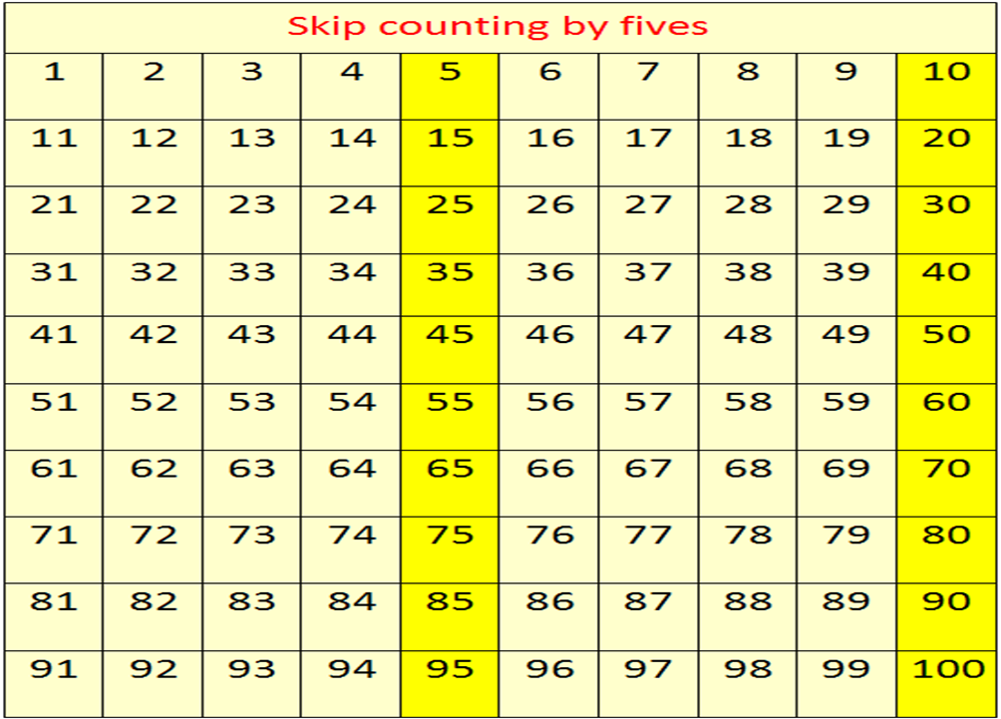
Counting in 5s
Now use the counting in 5s ppt to help you practice counting in 5s.

Slide 12
Division-sharing
Introducing the division symbol ÷
This symbol ÷ means to share between
Remember to:
take turns giving each pile one at a time
check at the end that each pile has the same amount
I can share 15 counters into 3
15÷3=5

Slide 13
Number Songs
https://www.youtube.com/watch?v=4ZPgFfo0l3k

Slide 14
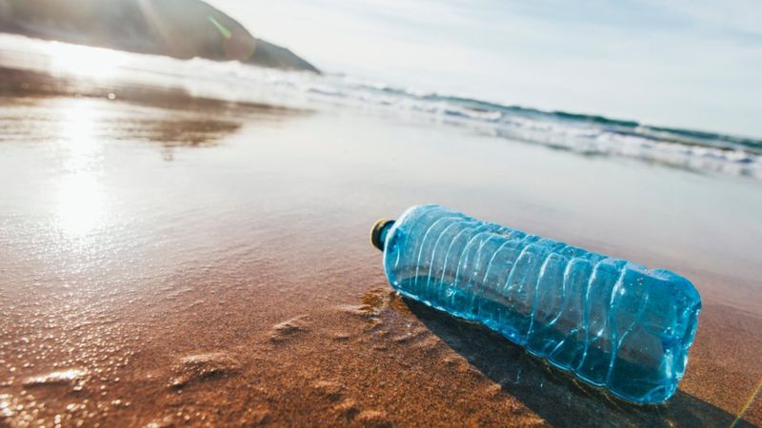
Beach pollution
https://www.bbc.co.uk/newsround/42810179
Questions to think about
What is a trash island? And what are some of the items that can be found on it?
How does plastic end up in the ocean?
What are the dangers to wildlife?
What can we do to help?

