Slide 1



Friday 29 May 2020
Bonjour P2!
Ca va bien?
Comme ci comme ca?
Ca va mal? https://www.bbc.co.uk/teach/supermovers/ks1--ks2-mfl-french-greetings-with-ben-shires/zdpdvk7

Slide 2

Assembly
Please enjoy this week’s assembly. It’s all about writing messages of hope today. (Please find the assembly in your emails, thank you).
.

Slide 3


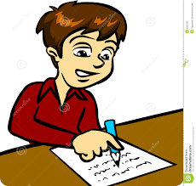
Dictation
Don’t start making sticky fudge for me because I have eaten enough.
I won’t be diving into the swimming pool because I can’t swim.
The boy was sliding down the sloping roof but he did not fall off.
Remember to –
Choose one sentence
Read the sentence aloud
Ask your child to repeat the sentence
Ask some questions to ensure understanding
Ask them to write the sentence 3 words at a time

Slide 4


Spelling Words
Time for your spelling test.
I can use my spelling strategies to help me spell my words.
wiping
gazing
biking
smiling
diving
blaring
taping
wiring
family
question
area

Slide 5


Number Talks
How many ways can you make the number 35?
Can you add, subtract and group objects?
Target Number
50

Slide 6

Friday Super Movers
https://www.bbc.co.uk/teach/supermovers/ks1-maths-length-height/zdrx92p

Slide 7
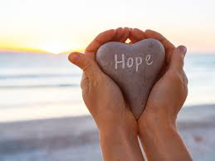

Big Talk
The saying goes, if the children can’t say it, the children can’t write it.
Every Friday (in place of ‘show and tell’) there will be a topic to talk about as a family. Please encourage your child to use interesting vocabulary, to speak in full sentences and to use eye contact. Thank you.
What do you hope for? If you were to write a message of hope to your friends, what would it say?

Slide 8

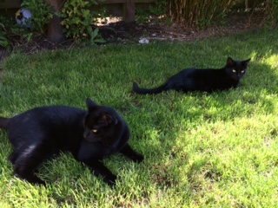
Happy Friday!
Have a lovely weekend everyone. I think it is going to be filled with sunshine!
Louis and Millie are 3 years old this
weekend so we will be having a little
party for them.

