Slide 1
Wednesday 27 May 2020
Bien? Regular? Mal?
https://www.bbc.co.uk/teach/supermovers/ks1--ks2-mfl-spanish-greetings-with-ben-shires/zfksqp3

Slide 2
Writing A Description Of Grace Darling
To help me communicate effectively in and out of school, I will-
Say- Read the information on the blog page about Grace Darling and watch the video clip (on the next page). Discuss what you have learned?
Make – Draw a detailed picture of Grace Darling and think of words to describe her.
Write – Write about Grace Darling, describe who she was and what she did. There are some writing frames on the blog page if you would like.
Do – Read your description to your family. Does it make sense?

Slide 3
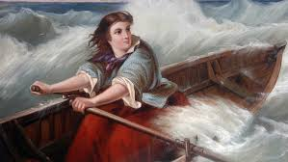
Grace Darling
https://www.youtube.com/watch?v=Yv3eS40j0N0
Can describe Grace Darling? When was she born? Where did she live? What did she do? What do you think about her?

Slide 5
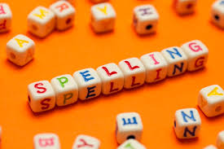
Spelling Words
baking
racing
hiding
sharing
caring
liking
biting
naming
enough
almost
mountain
Here are your spelling words for the week. Choose 3 words each day to practise.
Remember to..
Read the word
Clap the syllables
Use your sound box to sound out the sounds.
Write out the words

Slide 6
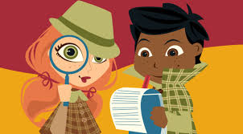
Reading Detectives
I can read the sentences
I can find the vowel digraphs, tricky words, and words ending in ‘ing’.
I can up level the sentence to make it more interesting
I can identify the nouns and verbs.
For extra reading challenge today, read the information
about Grace Darling on the blog page with a grown up
and answer some of the questions.
The teacher was wiping the whiteboard with one hand and pointing to the open door with another.

Slide 7
Story Time
https://www.youtube.com/watch?v=hlJ4wRuqsZw

Slide 8
Maths and Numeracy
I am how to multiply
To explore numbers, understand quantities, use strategies to help me work with numbers I can
Say- count forwards and backwards to and from 50 in 5s, throw and catch a ball with someone as you do it.
Make – Play ‘Array Display’ on www.ictgames.com. Press the numbers at the bottom of the screen to see the array.
Write-Look at the ‘Let’s Practise’ page on slide 11. Choose some questions to practise. Write your answers in your jotter.

Slide 9
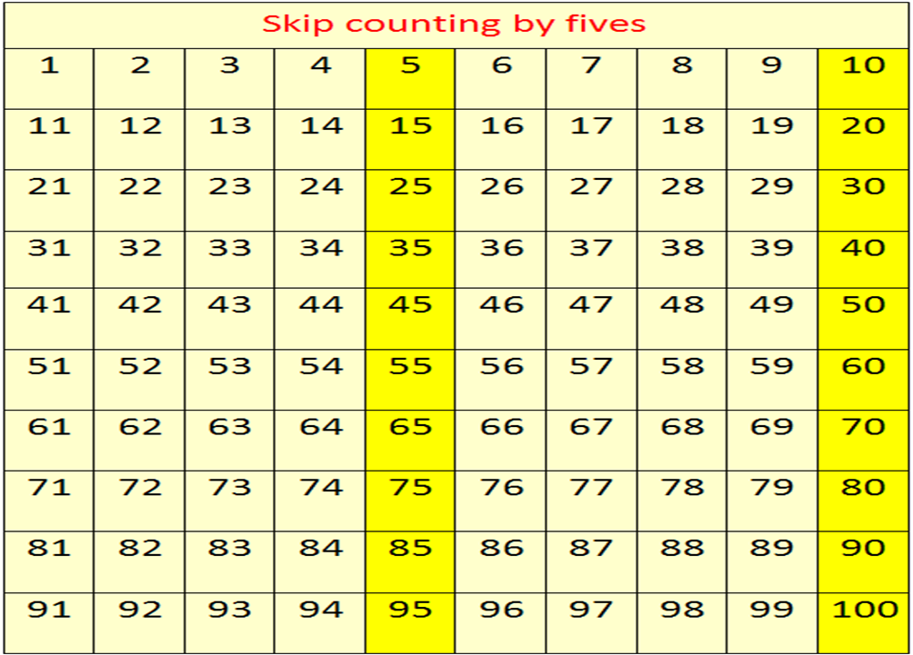
Counting in 5s
Now use the counting in 5s ppt to help you practice counting in 5s.

Slide 10
Multiplication
Introducing the multiplication symbol - X
This symbol- X means ‘groups of’ or ‘multiply’.
Remember to:
Find which number to keep adding
Find how many times to add it
+ 5 + 5
3 groups of 5
3 x 5

Slide 11
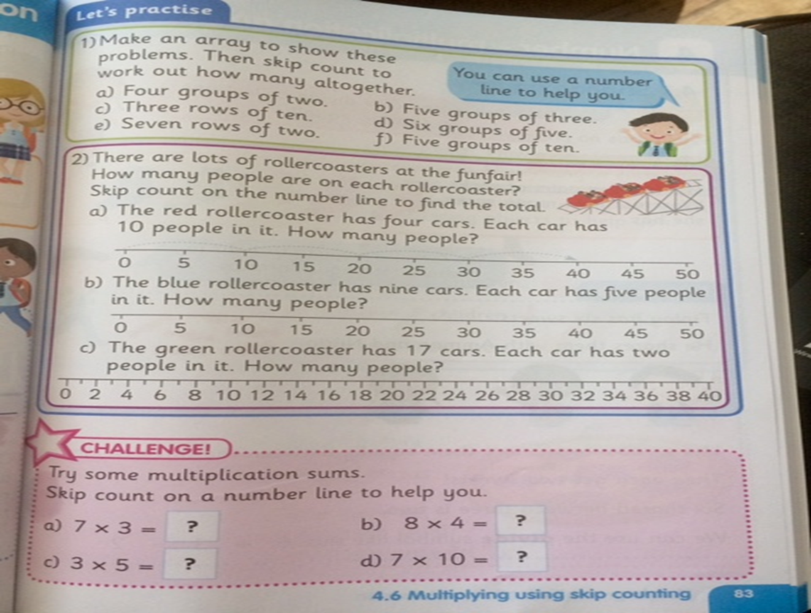
Choose some of the questions to answer and write them in your jotter.

Slide 12
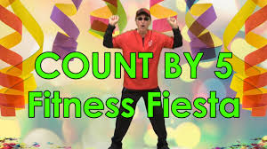
Number Songs
https://www.youtube.com/watch?v=Sh8YmvJuJ8A

