Slide 1
Tuesday 26 May 2020 Bonjour P2! Ca va bien? Comme ci comme ca? Ca va mal? https://www.bbc.co.uk/teach/supermovers/ks1--ks2-mfl-french-greetings-with-ben-shires/zdpdvk7

Slide 2
Super Sentence
I can use my spelling words and put them in a sentence.
I can use my core targets
I can use my describing bubble to help me use interesting vocabulary

Slide 4
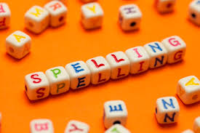
Spelling Words
wiping
gazing
biking
smiling
diving
blaring
taping
wiring
family
question
area
Here are your spelling words for the week. Choose 3 words each day to practise.
Remember to..
Read the word
Clap the syllables
Use your sound box to sound out the sounds.
Write out the words

Slide 5
Reading Detectives
I can read the sentences
I can find the vowel digraphs, tricky words, and words ending in ‘ing’.
I can ‘up level’ the sentence to make it more interesting.
I can identify which words are nouns
Derek is putting the plates out for the family meal and placing the forks on the left hand side of the plates.
Now have a go at reading the information about lighthouses on the blog page and answer the questions.

Slide 6
Story Time
Listen to the story, make predictions and look out for new vocabulary.
https://www.youtube.com/watch?v=uVDUNCCzlts

Slide 7
Maths and Numeracy
I am learning to add by skip counting
To explore numbers, understand quantities, use strategies to help me work with numbers I can
Say - Count forwards and backwards to and from 20 in 2s. Play ‘guess the number’ with your mum or dad. Use hands, hands, shoulders, shoulders, heads, heads. Say the first 3 numbers aloud then count silently.
Write- Complete the Make Arrays sheet.
Make – Draw your own arrays, remember to put them into equal rows and columns.
Do – Use the ppt on the blog to practise counting and adding in 2s.

Slide 8
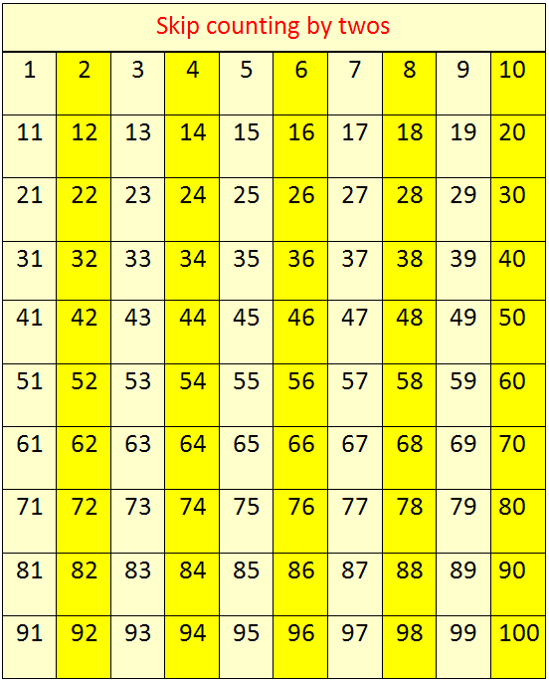
One Hundred Square
Now practise counting in 2s using PPt from last time.

Slide 9
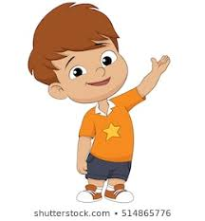
Making arrays
Timmy and Rosie are drawing arrays. Who has made a mistake? Can you explain why?
Can you explain how to fix the mistake?

Slide 10
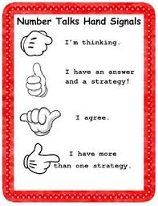
Number Talks
How many ways can you figure out how many dots?
Look at the dots for a second then shut your eyes.
How many?
What do you see?

Slide 11
Dear P2,
I hope you are well.
My lighthouse helps to keep ships and boats safe, especially during the night-time. At the top of my lighthouse is a big light which shines brightly and shows sailors where any rocks are.
However, I have a bit of a problem and I’m hoping you can help me. My lighthouse is very old and is starting to fall down. I need to build a new lighthouse but I’m not sure what it should look like. It needs to be tall and have a light at the top. Bright colours would be good too so that it can be easily seen.
Please can you help me? I need some ideas about what my new lighthouse should look like. Maybe you could make some model lighthouses for me to look at? I’ve sent you some photos of lighthouses to give you some ideas.
Thank you for your help. I look forward to seeing your lighthouse models and pictures!
Best Wishes,
Mr Grinling

Slide 12
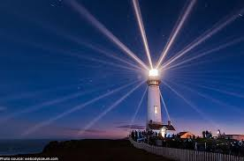
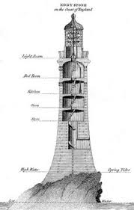
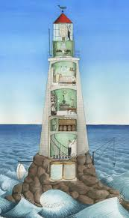
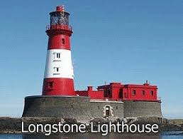
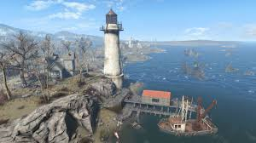
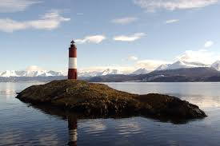
Lighthouses from Around the World
https://www.youtube.com/watch?v=QbyGznyf7BI

Slide 13
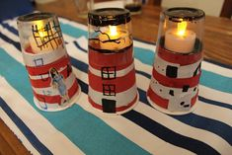
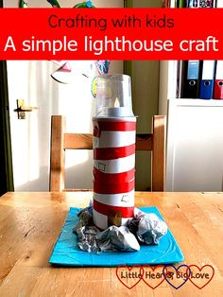
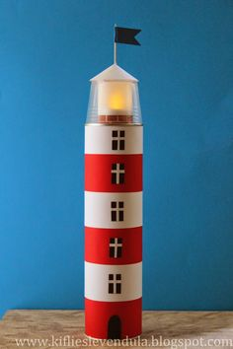
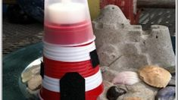
Design A Lighthouse
Can you design and build a lighthouse?
What will it look like?
What materials will you need to gather?
Draw and label your plan (there is a sheet on the blog page if you need).

