Slide 1
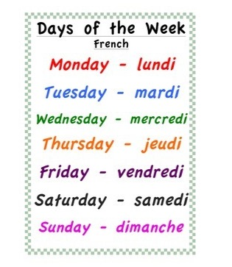
Tuesday 26th of May Mardi 26 Mai
Click on the above picture to listen to the days of the week in French.
Click on the rainbow to listen to our Tuesday song.

Slide 2
Zumba Kids
I am learning how to move my body well exploring how to manage and control it.
Click on the picture to take you to Zumba kids workout.

Slide 3
New Sound
ew
I use my knowledge of sounds, letters and patterns to read words.
Please note, this vowel digraph can make two sounds, for e.g. ‘oo’ as in chew/grew and ‘yoo as in dew/pew.
Can you think of any words that contain the ‘ew’ sound ?
Can you find this sound in any of your books at home?
Can you spot this sound on any signs when you are out on a walk?
Air Writing
Write the sound in the air, say it quietly.
Write the sound in the air, say it loudly.

Slide 4
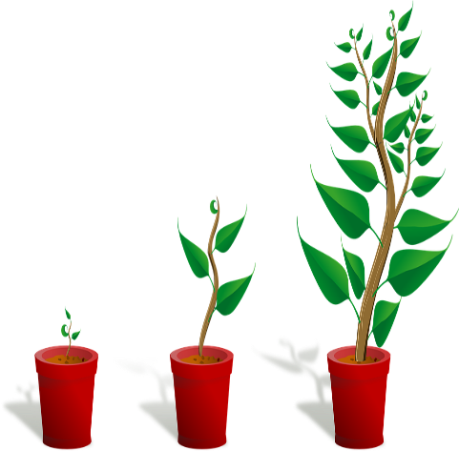
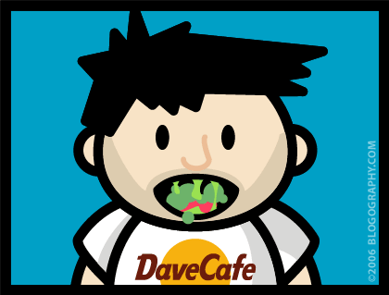
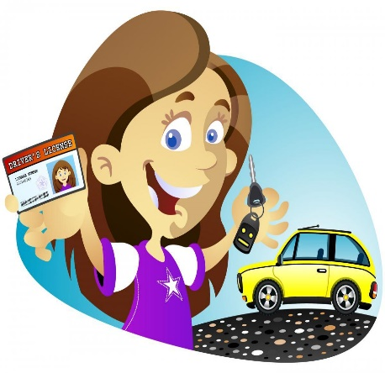
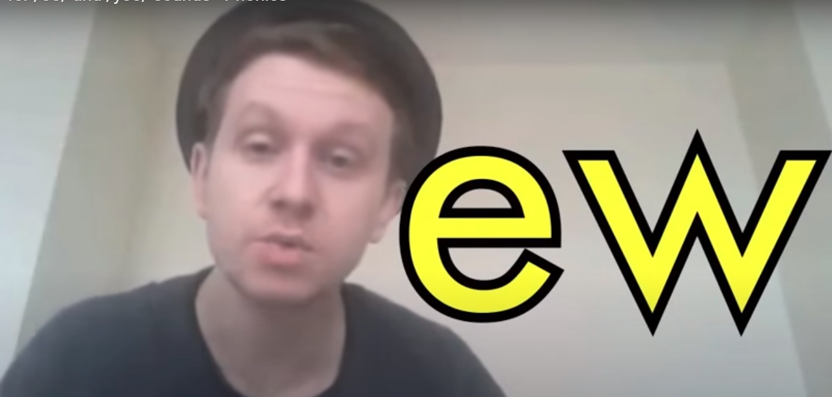
Sounds
I can use knowledge of sounds, letters and patterns to read words.
chew
new
grew
Please click on the picture below to take you to the ‘ew’ clip.
sound out words containing the ‘ew’ sounds
using our ‘Sound-box’.

Slide 5
Revison Tricky Words Block 2
go we be
she are they
all some come
said one you
her

Slide 6
New Common Word
of
What is the tricky part of the word?
What sounds can you hear?
Air Writing
Write the word in the air saying each sound as you form it.
Carpet Writing
Write the word on the carpet/floor saying each sound as your form it
Sentence
Put the word in a sentence.

Slide 7
Tricky word hopscotch
Make a hopscotch grid and label each square with a tricky word. Roll a dice and hopscotch the certain number of spaces and read the word you land on. Close your eyes and spell it out.

Slide 8
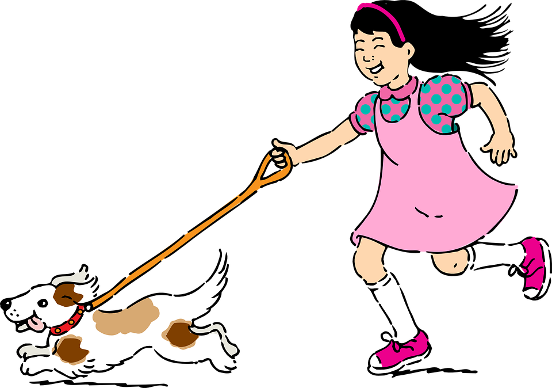
Sentence of the day
I can use knowledge of sounds, letters and patterns to read words.
Joan might show us her pet. We can feed it.
Can you spot any tricky words?
Can you spot any words with long vowel sounds?

Slide 9
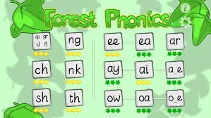
Phonics Activities
Click on the picture to watch an episode of Alphablocks.
Activity
Spelling – draw and label a picture with 4 ‘ew’ words.
ICT – Forest Phonics ‘ew’ word building.
Letter formation –
practise making the ‘ew’ sound
in the air, on the floor, in flour/salt.
‘ew’ letter formation page (home learning pack)
Click on the link below to take you to the letter formation. Follow the magic pencil to form o.

Slide 10
Reading Book
I can use my knowledge of sounds, letters and patterns to read words.
Read the e-book which has been set for you and self-assess using the targets below?

Slide 11
Story Time
I enjoy engaging with and listening to a story.
Click on the picture to take
you to the story.

Slide 12
I can use my subitising skills (recognise the amount in a group without counting) to help me estimate the number of objects in a larger group.
How many cubes are there?
As the clues appear, use the information to narrow the possibilities to a smaller set. After each clue, use estimation again to determine which of the remaining answers is the most reasonable.
Write down your first estimate. After each clue, you’ll see if your estimate is still a possibility. After each clue, if it is no longer possible write down a new estimate – and be prepared to explain why you chose it.
Steve Wyborney
www.stevewyborney.com

Slide 13
Clue #1
Clue 1
The answer is between 1 and 20.
Clue 2
The answer is smaller than 16.
Clue #2
Clue 2
The answer is bigger than 14.
Clue #3
Clue 3
The answer is bigger than 10.
Clue 4
The answer is a number between 11 and 15.
(once you have clicked on this clue, wait a few seconds).
Clue #4
1 | 2 | 3 | 4 | 5 | 6 | 7 | 8 | 9 | 10 | 11 | 12 | 13 | 14 | 15 | 16 | 17 | 18 | 19 | 20
Steve Wyborney
www.stevewyborney.com

Slide 14
After seeing the clues, you have narrowed the possibilities to a small set of numbers. Before you see the answer, select your final estimate. Write it down, and explain to someone why you chose that number.
Steve Wyborney
www.stevewyborney.com

Slide 15
14 cubes
The Reveal
Click to see the answer.
Steve Wyborney
www.stevewyborney.com

Slide 16
Number Song Time
Click on the picture to take you to the music clip.

Slide 17
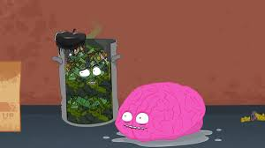
Volume and Capacity
I can estimate then measure the mass and capacity of familiar
objects using a range of non-standard units.
Download the Volume Powerpoint from the blog/website
Complete the worksheet from the blog/website. If you cannot print it out, just write it up in your jotter.
Activity
..
I can compare and describe volume and capacity using appropriate vocabulary.

Slide 18
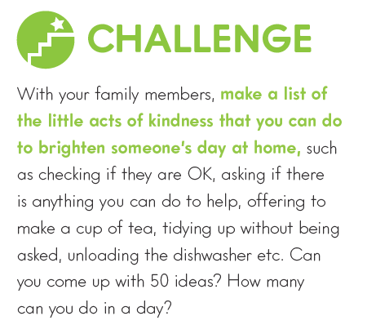
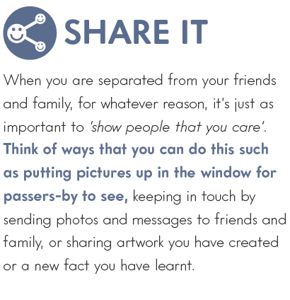
‘A Little Bit of Kindness’
Music Time
‘
Click on the ‘Out of the Ark Music’ link to hear today’s song ‘A Little Bit of Kindness’ (Wellbeing)
I enjoy singing along to music of different styles.
I can participate actively and use my voice to join in with the song.

Slide 19
Drama
I can use my body, actions, voice and gestures effectively in role-play scenarios.
Click on the picture below to begin.

