Slide 1
P5 WEEKLY DIARY
WEEK COMMENCING
Monday 25th May 2020

Slide 2
Could I please ask that no one edits (changes) anything on any page of this PowerPoint. Thank you.

Slide 3
Dear Primary 5, parents and carers,
I hope you are all well and that you had a restful weekend. Wasn’t the Reading Assembly wonderful? Mrs Clarke’s poem made me laugh out loud! It certainly inspired me to read more.
This week we are going to be using some of the booklets I gave you to take home. We will be using the Grammar and Punctuation Booklet, the Handwriting Booklet, and for most of you, the First Minister’s Reading Passport.
We are going to be doing quizzes this week and, in order for this to be manageable, I have split you into two groups, The Explorers and The Adventurers. You will see later which group you are in.
It would be great if you could have a look at ‘The Loch Ness Monster’ comprehension
text before Thursday’s lesson – please do not answer the questions till after the lesson.
For numeracy, I have copied your guidance PowerPoints onto each group’s slides – I hope this makes it easier for you.
For this week only, upload your numeracy work and your Loch Ness work. You can let me know in Posts if you have completed other work.
Thank you so much to all of you for your continued support – it is greatly appreciated.
Kind Regards
Mrs Peters

Slide 4
Online Lessons this week.
Tuesday – QUIZ - (Explorers’ Group) 1.30 pm
QUIZ - (Adventurers’ Group) 2.15 pm
Thursday - Loch Ness Monster Comprehension and Spelling Test 10 am
(We will do the spelling test at the end).

Slide 5
P5 Class Quizzes
This week we are going to have two quizzes. One for The Explorers’ Group and one for the Adventurers’ Group.
Everyone has to come to the lesson with one question and an answer. Each person will read out their question and the rest of the group will write down the answer (if they can) on a piece of paper. After everyone has asked their question, each person will read out their question again and their answer and you can mark if you got it correct or not.
Do not make your question too easy or too difficult, you could use your bridges knowledge or endangered animals knowledge or any subject at all.

Slide 6
Explorers’ Group 1.30 pm Tuesday
Sienna Blackwood, Sofia Brice, Katie Byrne, James Cowie, Liam Gordon, Lewis Kerr,
Boyd Mackin, Jasper Martin, Finlay Paton, Sandra Pawlowska, Ellie Perrie, Abigail Ponton,
Lyle Tavern.
Adventurers’ Group 2.15 pm Tuesday
Jack Horsfield, Zara Lindsay, Cristen Murray, Sophie MacDonald, Boyd Stevenson,
Gregor Stobie, Zoe Tait, Micah Theron, Ella Topping, Fraser Warnock, Jack Webster,
Logan Whytock.

Slide 7

READING GROUPS
If you have finished your book (I know not everyone has), please complete a page in your Reading Passport. You will have to say who the author is, when you started reading the book and when you finished the book. You can give it a star rating and then you need to say what you thought of the book. Don’t just say you liked it or you didn’t like it; please give reasons and explanations as to why. If you can’t find your Reading Passport, you can write this down in your jotter.
If you haven’t finished your book please aim to read at least three chapters a week.
Thank you.

Slide 8
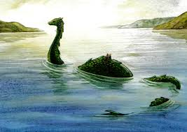
Comprehension
The Loch Ness Monster
We will go over the passage and the questions in our lesson on Thursday.
The worksheet is uploaded on our website in P5 Class Blogs.

Slide 9


French
We are going to be using a new online French Resource called Linguascope.
Our first lesson will be learning about the names of family members. We did some work on this in Term 1. Please look at the French words to remind you.
          ma soeur – my sister
          mon frère – my brother
          ma mère – my mother
          mon père – my father
          ma grand-mère – my grandmother
          mon grand-père – my grandfather
          ma cousine – my girl cousin
          mon cousin – my boy cousin
          ma tante – my aunt
          mon oncle – my uncle
          voici – here is
          moi – me
          il y a – there is/there are
          et – and
          dans ma famille – in my family
For details about this new website see the next slide.

Slide 10
French/continued
Here is the link for Linguscope https://www.linguascope.com/
This will take you to a page which says, The Language Learning Platform, click on Log In and type in the following:
Student Username : lbps
Student Password : lochcanal1
This will take you into the Student Area, now click on Elementary and then the
French flag.
Click on Famille and this will take you into a page with four options. Click on the first which is Introduction, here you will meet Clement and he introduces us to his family. He says e.g., Voici ma mere (‘voici’ means ‘here is’).
Then you go into Jeu 1 (Game 1), then Jeu 2 (Game 2) and then Jeu 3 (Game 3).
There is a worksheet which I have uploaded – this is optional.

Slide 11

LITERACY
Spelling
1. minute – (noun) a period of time equal to sixty seconds
2. natural – (adjective) not made or caused by mankind
3. naughty - (adjective) badly behaved; disobedient
4. notice - (verb) to become aware of
5. occasionally - (adverb) at infrequent or irregular intervals; now and then
6. often - (adverb) frequently, many times
7. opposite – (adjective) situated on the other; facing
8. ordinary – (adjective) with no special or distinctive features
9. possess – (verb) to own
10. position – (noun) a place where someone or something is located or has been put.
11. particular - (adjective) used to single out an individual member of a specific group or class
12. peculiar – (adjective) different from what is normal or expected; strange
Copy these words into your jotter. Write them out three times (in columns). Learn to spell these words.
Choose 5 words and write an interesting sentence about each one. Use a ruler to underline your word.
For our Thursday lesson, we will do a spelling test and I will ask you to share some of your sentences. Remember if you do spelling with Mrs McCusker you do not need to do this.

Slide 12
LITERACY
Grammar
Task 1
Use your group novel and find your favourite paragraph. Write it out in your jotter Using a pencil. Once you have written it – go over all the punctuation with a coloured pencil or pen, so it stands out.
Write down a list of all the punctuation you have found.
Task 2
GRAMMAR AND PUNCTUATION BOOK 2 (Booklet)
Please complete unit 5A Adjectives (1)
Please write question 2, the sentences in your literacy jotter (there is not a lot
of space on the page).
Complete Adjectives unit 5B Adjectives (1)
Try not to use unimaginative adjectives – check out this link for great ideas on interesting
Adjectives https://www.grammarcheck.net/boring-adjectives/

Slide 13
LITERACY
Handwriting Booklet
Please complete pages 10 – 11
‘le’ word endings
Do not worry if you can’t do joined up handwriting – just make sure that you remember to:
Write on the line,
Make tall letters tall,
Make small letters small.

Slide 14
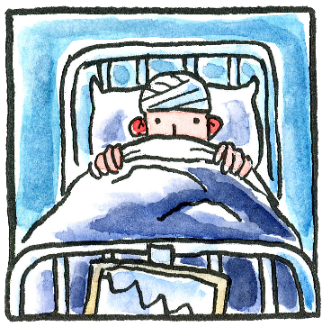
EXPRESSIVE ARTS - MUSIC
OPERA – BE PART OF A BRAND NEW OPERA CALLED ‘FEVER’
Week 3 – Don’t worry if you did not manage to visit the website last week – it is easy to catch up.
Go to www.scottishopera.org.uk/fever every Monday to find all you need to get started.

Slide 15
NUMERACY
Beetles and Butterflies
LI – I am learning to subtract two digits from three digits.
Please complete H5 pages 22, 23, 24 and 25 using the standard written method (column sums). Please refer to the Guidance PP for advice.

Slide 16
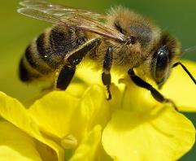
NUMERACY
H5 page 15 and 16
BEES
LI – I can add three digits plus three digits
Please look at the guidance PowerPoint.

Slide 17
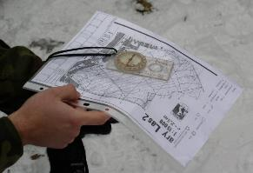
ORIENTEERING – part 3
Setting the Map
The fundamental skill of orienteering is setting the map and keeping it set. This topic introduces the concepts of setting the map and includes games and activities to practice this.
To find all the worksheets go to the school website and find P5 Class Blog or Teams/Files/P5 Resources/Orienteering.
https://www.scottish-orienteering.org/lets-get-started-orienteering/

Slide 18
Health and Wellbeing
Dr Radha (BBC Children in Need) shares her top tips on looking after your wellbeing during the current challenging times.
Coping Strategies
Find out how Dr Radha uses a toolbox of strategies to help her feel better, from listening to music to getting creative with painting.
https://www.bbcchildreninneed.co.uk/changing-lives/dr-radhas-wellbeing-tips/?utm_campaign=EY-MAY-20-1&utm_source=force24&utm_medium=email&utm_content=textlink&f24_pid=94801767-0f11-4ec2-88d1-b0ee26de848c

Slide 19
Reminders…
We understand that you may not always have access to a device so just do what you can.
If you don’t have squared paper – just use any paper you have around the house.
Remember to share links to any learning videos you think are useful.

